Slide 1

SWAG Targeted Lung Health Checks Programme

Slide 2
Purpose
To share the case for introducing the Targeted Lung Health Check Programme in Somerset, Wiltshire, Avon & Gloucestershire (SWAG).
Opportunity for you to raise questions / suggestions and concerns.
Agree next steps

Slide 3
National Targeted Lung Health Check Sites
23 CCG throughout the country.
Sites chosen based on lung cancer mortality rates.
Aim of the programme
Earlier diagnosis of lung cancer
Better treatment options
Improve survival rates
Notes:
Complete all lung health checks by March 2022 and all follow-up CT scans by March 2024.
Southampton only site in South Central/South West England.
Supports LTP Ambition By 2028
75% of all cancer diagnosed at early stage
55,000 more people living 5 years or more after their diagnosis
reduce inequalities in cancer outcomes

Slide 4
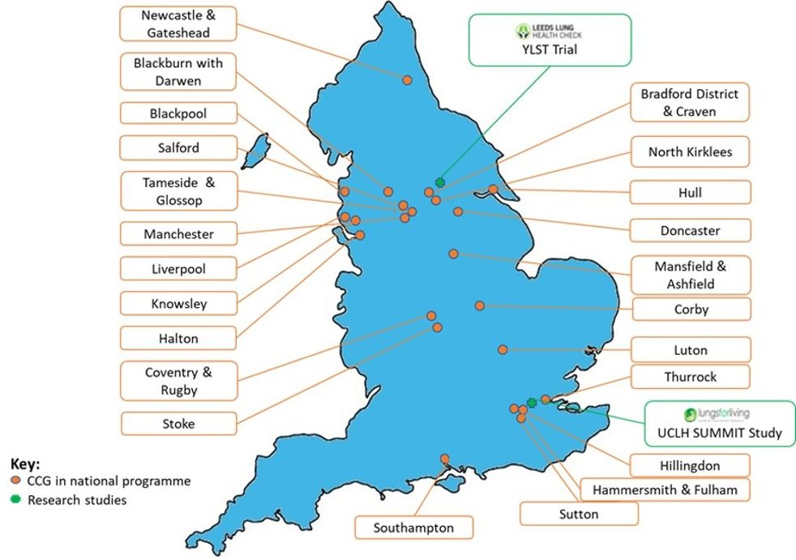
THLC Programme
Phase 1 Feb 19
  Initial 10 pilots
Phase 2 April 20
  7 screening projects onboarded into TLHC programme
Phase 3 June 15 Further 15 projects announced
  Prioritising areas with highest lung cancer mortality (top 50 CCG nationally)
  At least 1 project per cancer alliance
  Start date April 22

Slide 5
What are Lung Health Checks?
People in the selected areas who are aged 55 to 74 with a smoking history (current smoker or ex-smoker) invited to attend a lung health check by their GP.
The health check are conducted by a lung specialist nurse and involve discussion around lung cancer symptoms, a breathing test (spirometry) and smoking cessation advice (as appropriate).
The results are then used to calculate a person's individual lung cancer risk. Anyone at high risk of lung cancer is invited to have a low-dose CT scan

Slide 6
Inclusion and Exclusion Criteria
Inclusion criteria
Aged 55 to 74 years and 364 days (on date of 1st LSCT scan).
Willing and able to undergo LDCT and
PLCOM2012: a risk threshold of ≥1.51% risk of lung cancer over 6 years as the minimum threshold, and LLPv2: ≥2.5% risk of lung cancer over 5 years
Exclusion criteria
Participant does not have capacity to give consent (standard criteria for assessing capacity apply)
Full thoracic CT scan within the last 12 months or planned
Weight exceeds restrictions for scanner (>200kg)
Participant unable to lie flat; or
Poor physical fitness
Notes:
The NHS classifies individuals as eligible for lung cancer screening using two risk prediction models, PLCOm2012 and Liverpool Lung Project-v2 (LLPv2).
PLCOm2012is a logistic regression model based on U.S. data, incorporating sociodemographic and health factors, which predicts 6‐year lung cancer risk among ever‐smokers, and thus may better predict those who might benefit from screening than criteria based solely on age and smoking history.

Slide 7
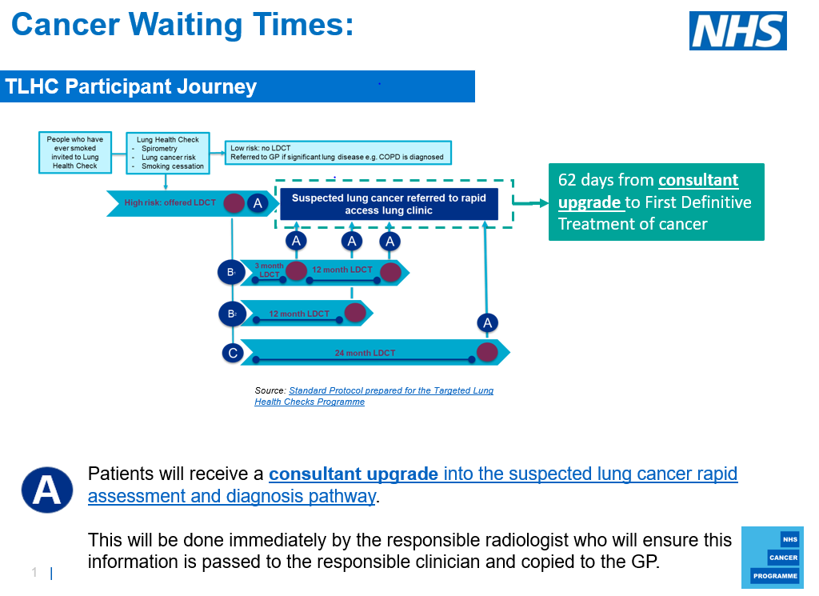
TLHC Participant Pathway
Notes:
Appropriate pathway, based on evidence and BTS (British Thoracic Guidelines) guidelines.
Patient – B Intermediate results and C no significant findings or nodules Follow up/Safety netting – monitor ATTRITION (non attendants)
But will be undermined if the right people don’t engage with it
Engagement starts with initial attendance or uptake.

Slide 8
Manchester’s Lung Health Check Pilot
“We have hard evidence now that CT scanning high-risk patients helps us to identify cancers early enough to cure them’
Dr Phil Barber, MCIP Lung Clinical Lead (2019)
https://mft.nhs.uk/app/uploads/sites/12/2019/02/lung-health-check-manchester-report_tcm9-309848.pdf
Notes:
Manchester’s Lung Health Check Pilot
Patient smokers and ex smoker invited from 14 GP practices
Lung Health Checked based in supermarket car parks (one stop shop). Following assessment by nurse high risk patients invited to have an immediate LDCT
CT scans usually reported witing 14 days. (most scans negative)
Attended for Lung Health Checks
46 lung cancer detected (42 patients)
Almost 8 out of 10 cancers were early stage and I in 10 had stage 4 advanced lung cancer.

Slide 9

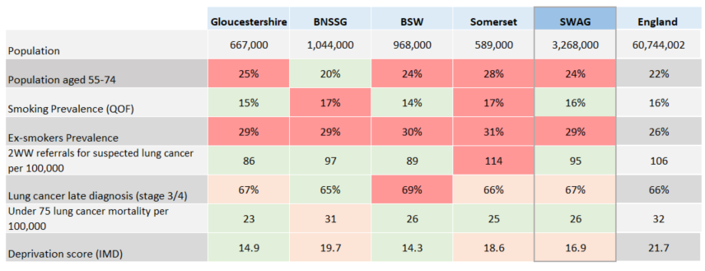

SWAG Summary
Data Sources: NHSD Patients registered at practice, PHE Fingertips, CADEAS
Notes:
SWAG has a higher proportion of the population aged 55-74 than the England average
Although the smoking prevalence overall for SWAG is lower than England, it has a significantly higher rate of ex-smokers – with all STP areas reporting significantly higher than England for ex-smokers.
Somerset has a high rate of smokers and ex-smokers and a higher rate of 2WW lung cancer referrals
SWAG overall has a similar IMD deprivation rate to the England average. BNSSG has the highest rate of deprivation within SWAG
26% of the SWAG total population are in the >20 IMD score. If Swindon is included it is 25%.

Slide 10

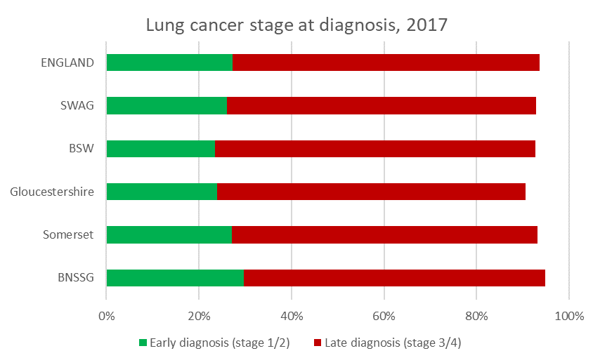
SWAG – Lung Cancer stage at diagnosis
Data source: CADEAS
Notes:
SWAG has a significantly lower early diagnosis rate and similar late diagnosis rate than England
BSW performs the worse in SWAG with both a significantly higher late diagnosis rate and a significantly lower early diagnosis rate than England

Slide 11
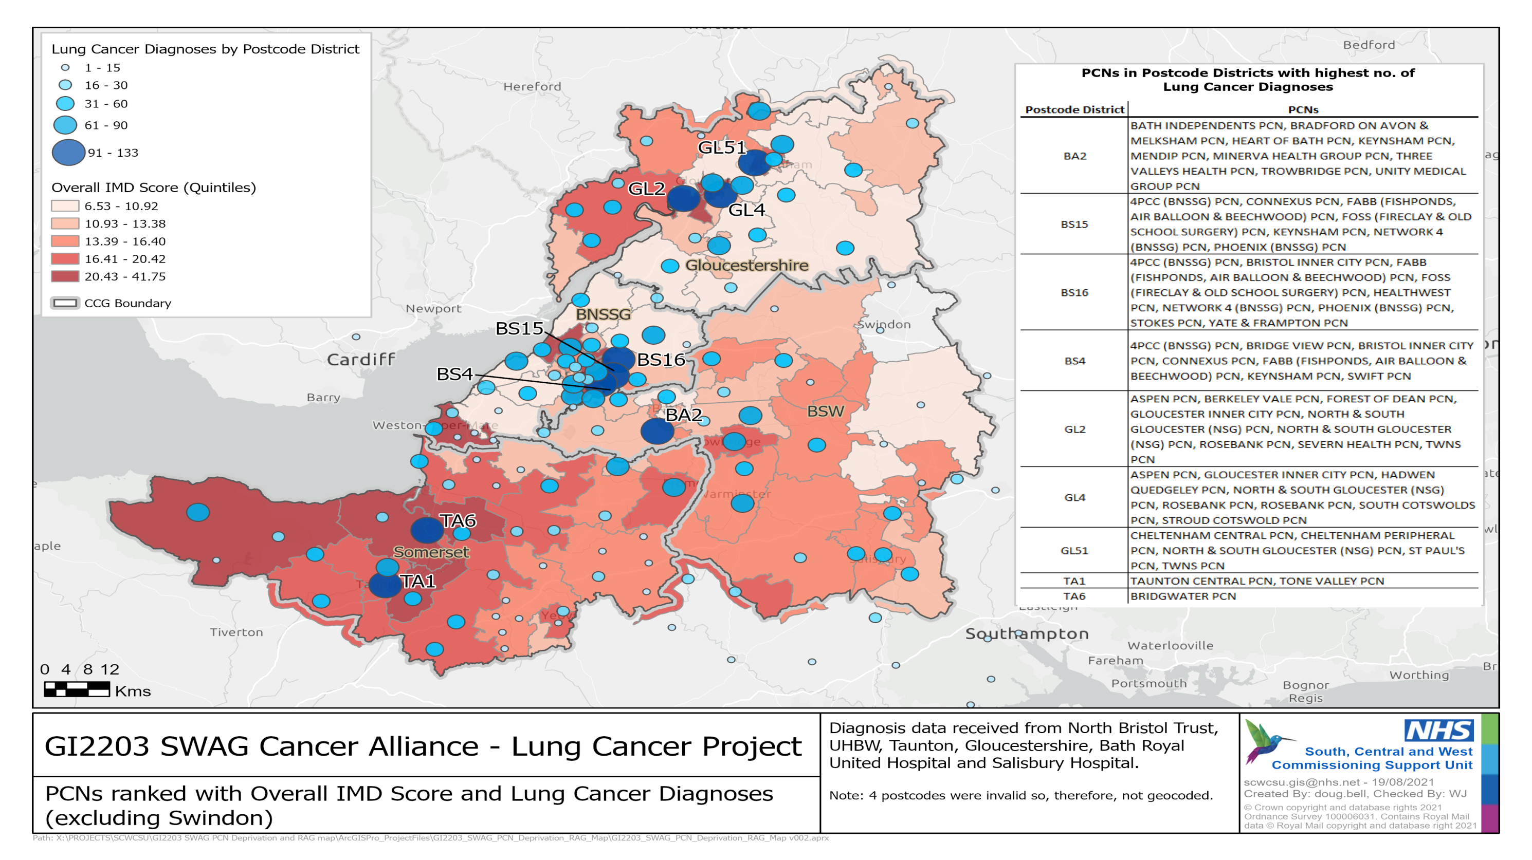

Slide 12

SWAG – population focus for checks
763,676
SWAG population aged 55-74
366,565
48% current and ex-smokers
183,283
50% LHC uptake
Notes:
Total SWAG population 3,268,000
763,676 aged 55-74
366,565 are current or ex-smokers
Assuming 50% will take up lung checks – 183,283 people could uptake the checks

Slide 14
SWAG proposal
Deliver THLC across whole of region, targeting areas with highest incidence/mortality/deprivation
  Deliver programme to communities most likely to benefit
  Tackle health inequalities across region
  Disseminate expertise across region in anticipation of national rollout
  Spread downstream work generated across MDTs/trusts
  Pilot a targeted approach to TLHC delivery

Slide 15

Planning the model - considerations
- Location selection
  What parameters
Front end
  Identification from primary care datasets
  Patient communication
  Booking system
Screening/TLHC
  Locations/logistics
  Clinical assessments
  Radiology
    Scanning
    Reporting
  Smoking cessation
  Incidental findings pathway
  Screening MDT
  Tracking and recall
Back end
  Interface with cancer MDTs for positive findings

Slide 16
SWAG TLHC Roadmap
Stage 1 Template - support Cancer Alliances to assess the feasibility of individual CCGs launching a TLHC project.
Stage 2 Key milestones (due by end of July 2021)
This stage will begin once projects are selected.
The National Team will require more specific information from the project in order for a Memorandum of Understanding to be drafted, and to determine the project funding allocation before funding is confirmed.
Stage 3 Key milestones by the end of Q2 2021.
Funding and accountability
CT capacity
ICT
Staffing and recruitment
Rollout
Engagement
Stage 4 Key milestones by Q3 2021.
Accessibility
Data/reporting
Training
Communications
Capacity
Equalities
Stage 5 Key milestones - clinical and operational readiness requirements ahead of the project going live
Are there any issues or barriers preventing the project going live?
Does the project meet the 15 Quality Assurance Standard requirements?

Slide 17
SWAG TLHC Roadmap
2021
2022
July
Aug
Sept
Oct
Nov
Dec
Jan
Feb
Mar
April
May
Apply
Respond to letter
Find out if secured funding
Engagement
13/7 NHSE
14/7 CAG
3/8 Planning Mtg
Planning
Design model
Data collection plan
Stage 1 Milestones
Demand / capacity modelling
CT service procurement
Stage 2 Milestones
ICT planning
Stage 3 Milestones by Q2 2021
Stage 4 Milestones by Q3 2021
Stage 5 Milestones
Job descriptions
Workforce
Advertise and interview
Roles in post
Communication
Launch
Patient engagement
Proposed first cohort invited

