Slide 1

Optimising the MDT Meeting
Andrew Low
Lung Cancer Lead BRI

Slide 2
BRI Set Up
30-35 cases per week
Single diagnostic and therapeutic MDT
1.5 hours – impact of other MDTs
2½ - 3 mins per case

Slide 3




Slide 4
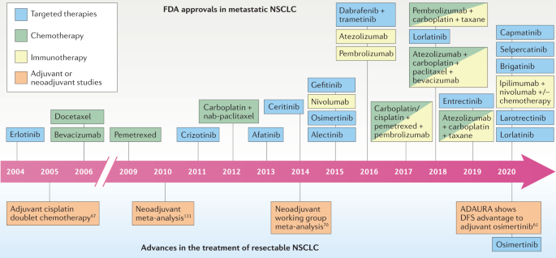

Challenges
18, 547-557 (2021)

Slide 5
Challenges
Addition of Weston MDT Jan 2017
  2 → 5 additional cases per week

Slide 6
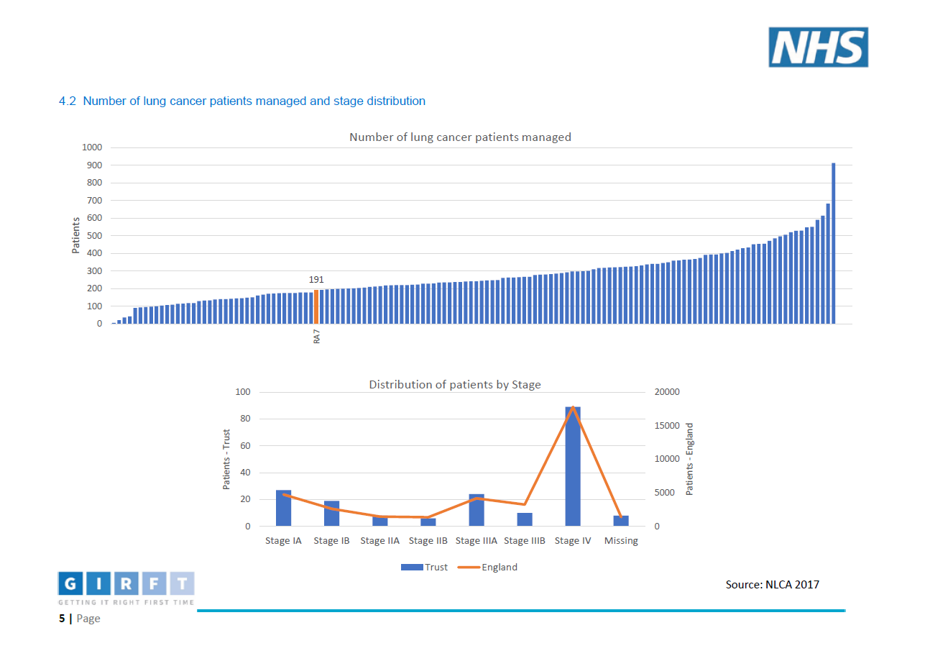
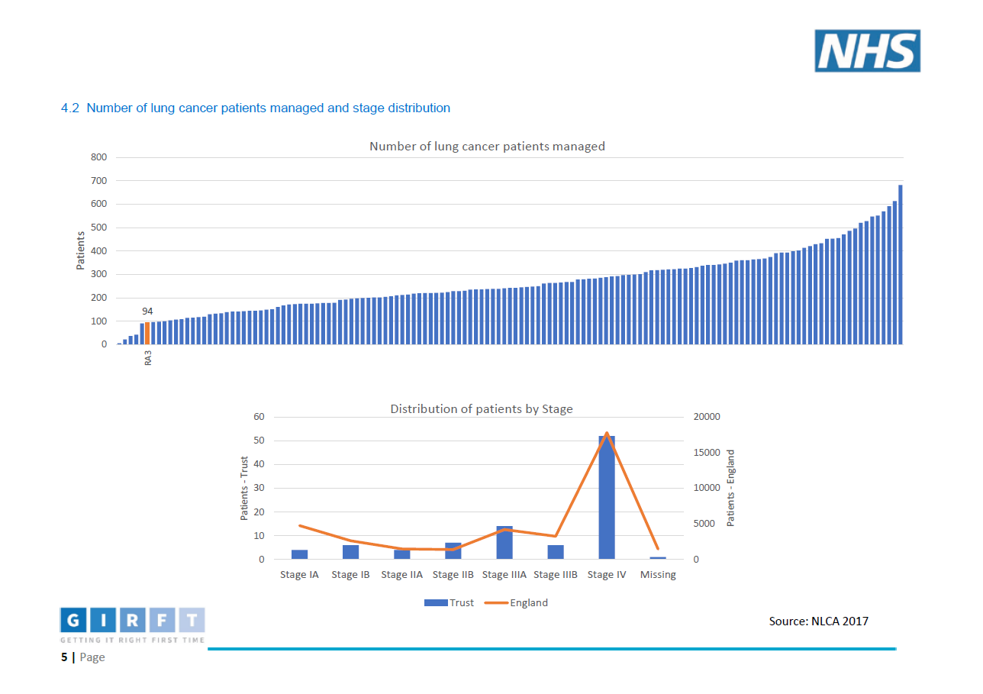
BRI + WGH Set Up

Slide 7
Challenges
Changing MDT co-ordinators

Slide 8
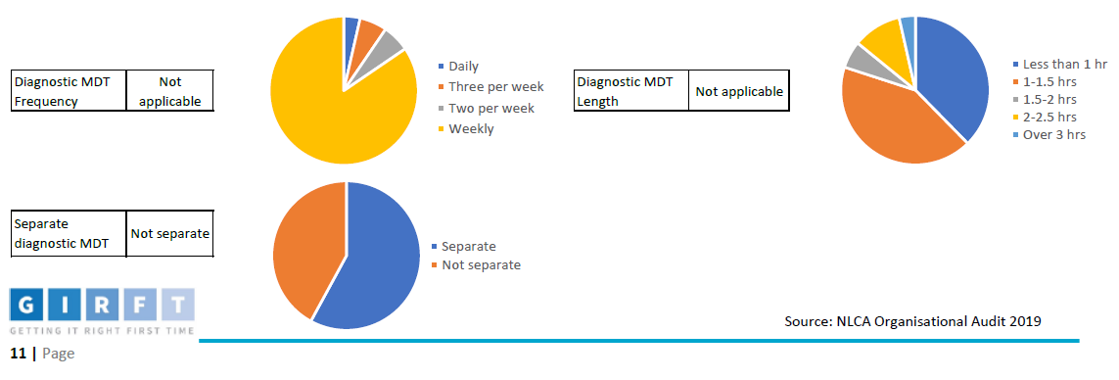
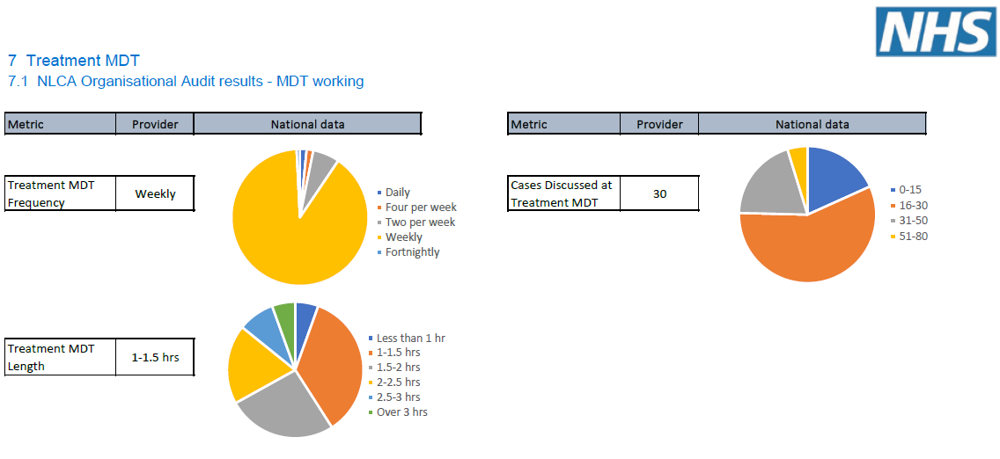
Other Centres

Slide 9
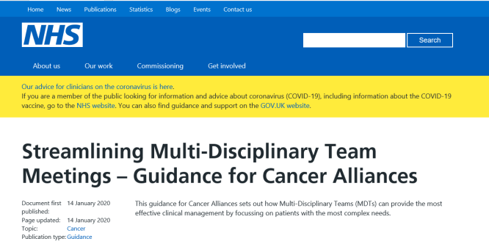
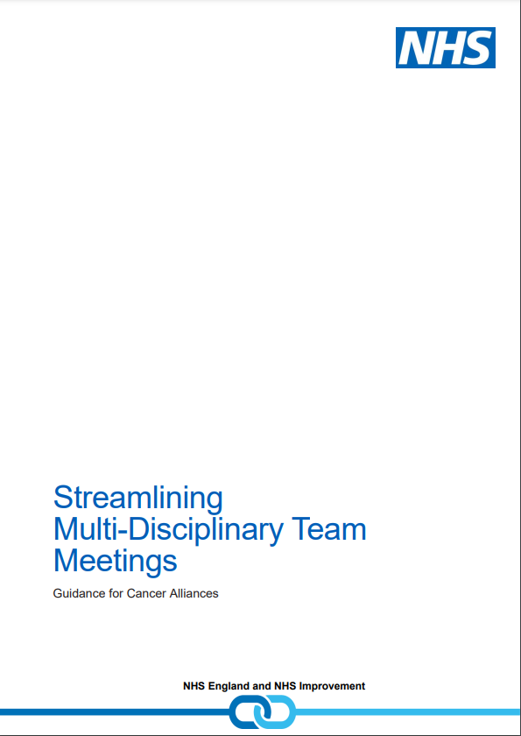
Ensuring adequate time for discussion
Streamlining
Flexibility in management of MDT
Full discussion vs Protocolised treatment (Standards of Care)
Notes:
https://www.england.nhs.uk/wp-content/uploads/2020/01/multi-disciplinary-team-streamlining-guidance.pdf
Research by Cancer Research UK 2017, 2mins or less for 50% of cases
MDT to provide oversight of cases, but maybe don’t need to discuss everythin

Slide 10
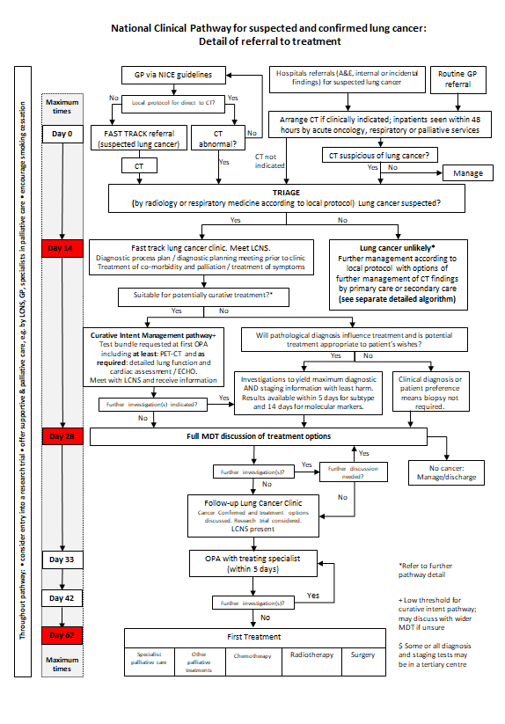
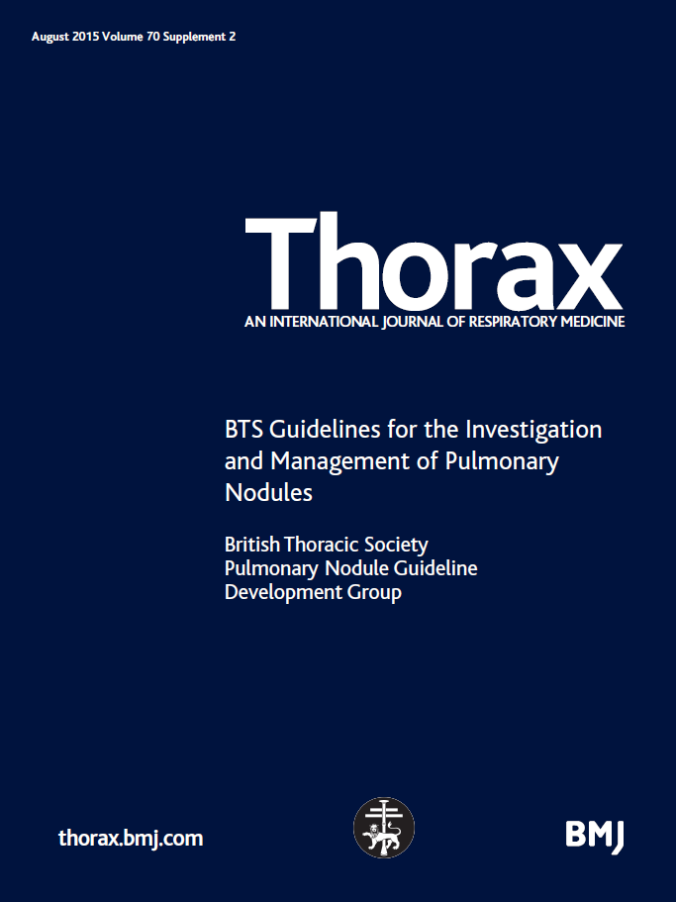
Standards of Care?

Slide 11
Changes
Dedicated MDT prep August 2016

Slide 12
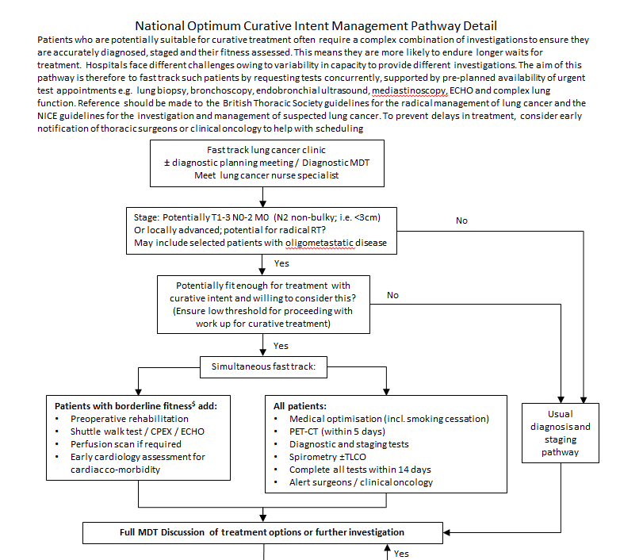
Changes
Optimal lung cancer pathway mid 2017

Slide 13
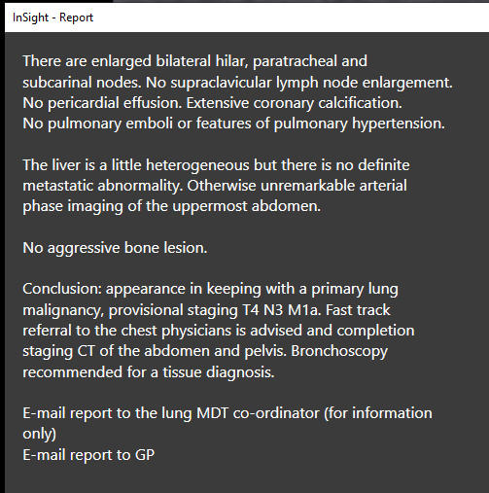
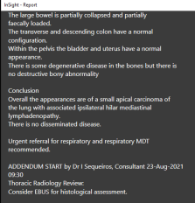
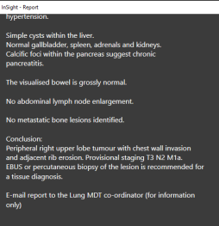
Changes
Optimal lung cancer pathway mid 2017
  Reporting Changes July 2018

Slide 14
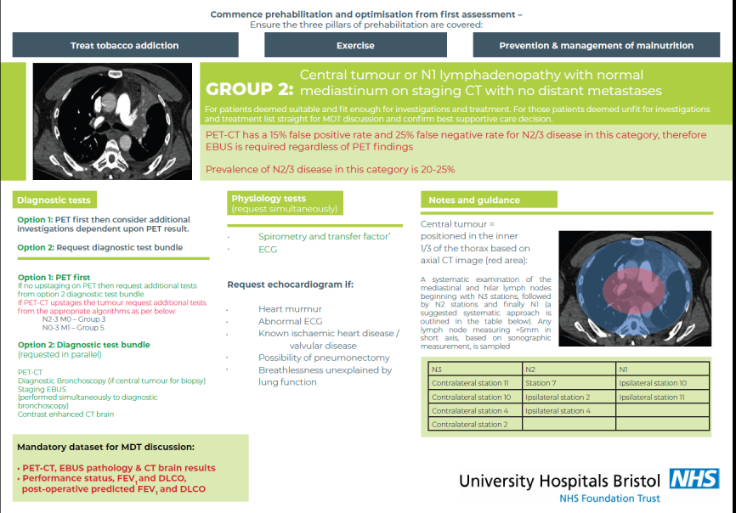
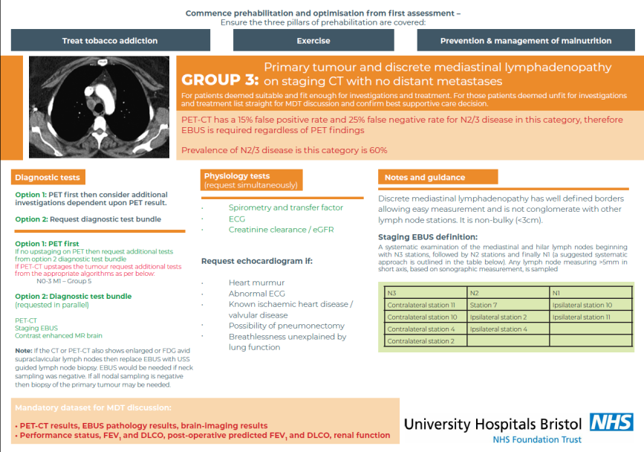
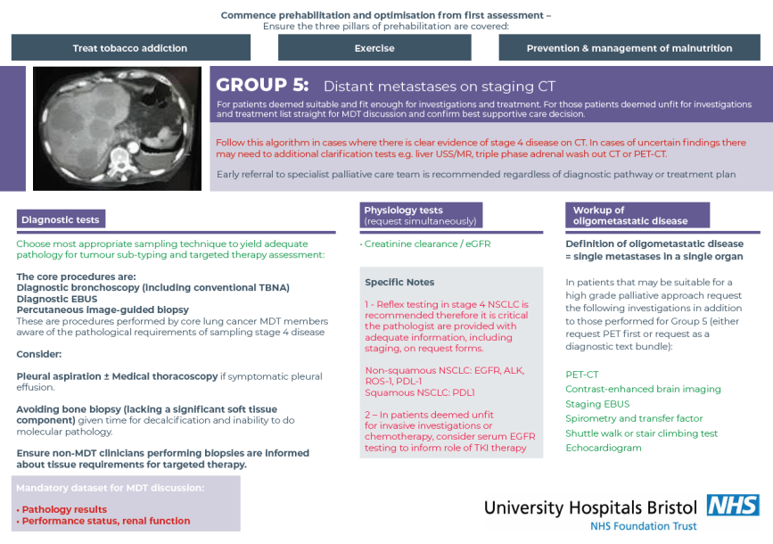
Changes
Optimal lung cancer pathway mid 2017
  Reporting Changes July 2018
  Lung Cancer Bundles August 2019

Slide 15
Changes
Weekly pathway meeting (2 days pre MDT) March 2018
Virtual nodule clinic Oct 2019

Slide 16
Average MDT Numbers (8 week rolling average)
NOLCP
Mid 2017
Bundles
7/19
Pathway Meeting 3/18
MDT prep
8/16
Inclusion of Weston
1/17
Radiology Reporting
7/18
Virtual Nodule Clinic
10/19

Slide 17
Summary
Increasing complexity of treatment and pathways
Sufficient discussion time needed
Importance of pre-MDT prep
Scope for reducing “unnecessary discussions”
  NOLCP/Diagnostic bundles
  Virtual nodule pathways

Slide 18
Questions?

