Slide 1
Navigation Bronchoscopy
Andrew Low
Lung Cancer Lead BRI

Slide 2
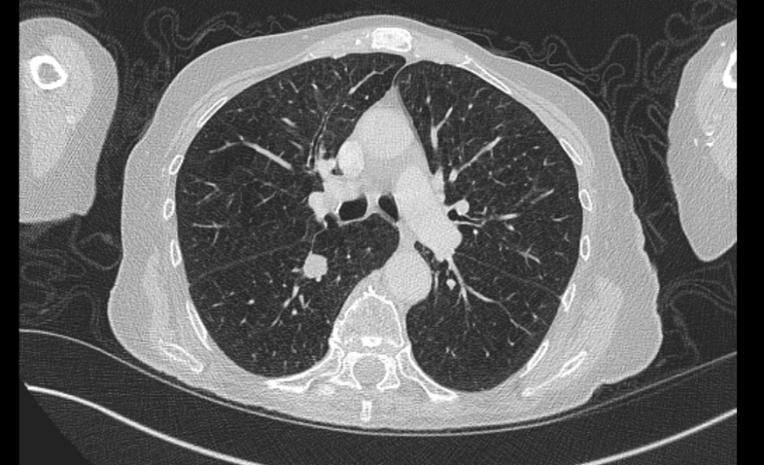
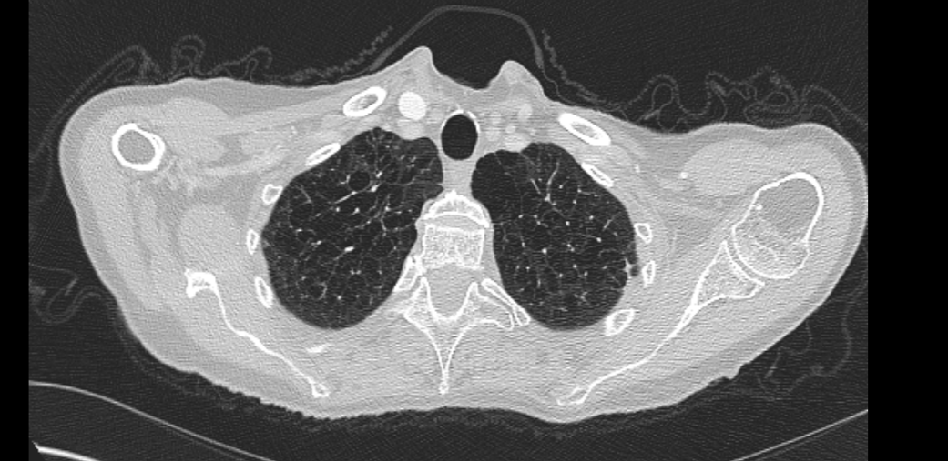
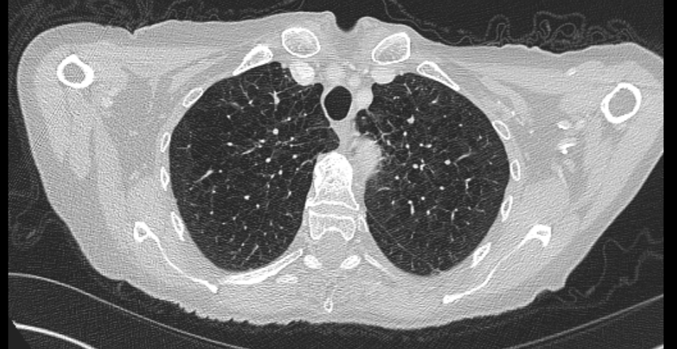
Case 1
Notes:
58M Still smoking, 27mm avid nodule SUV 23.3 FEV1 0.81 (38.9%), DLCO 2.52 (35.5%) – SABR without biopsy

Slide 3
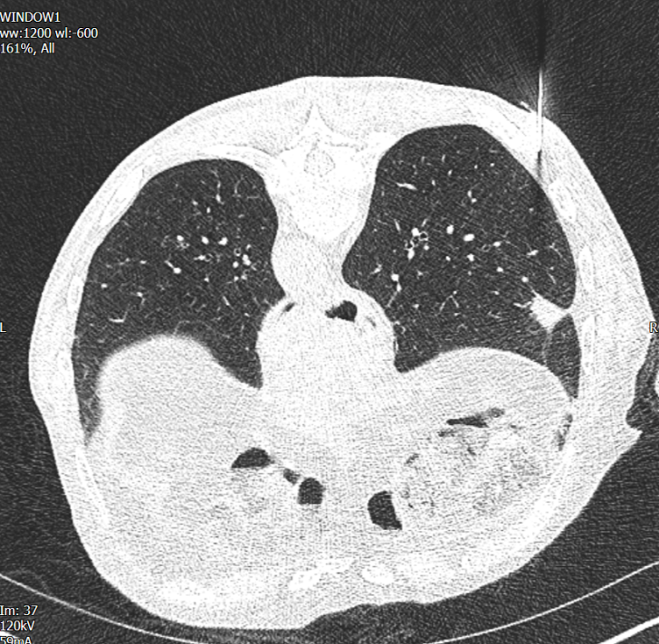
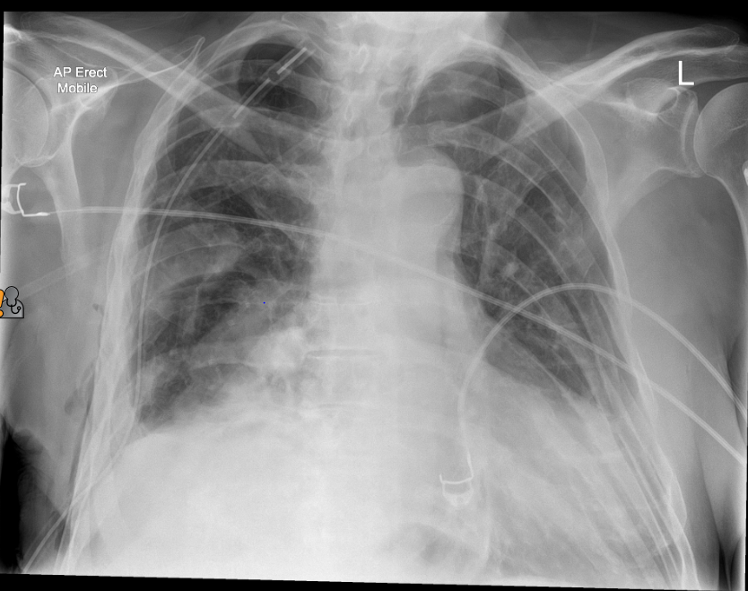
Case 2
Notes:
72 yo Man Wt loss – T1c 21mm, SUV 6.2 sustained a PTX – no histology – went for surgery – granulomatous necrotising inflammation – wedge resection

Slide 4
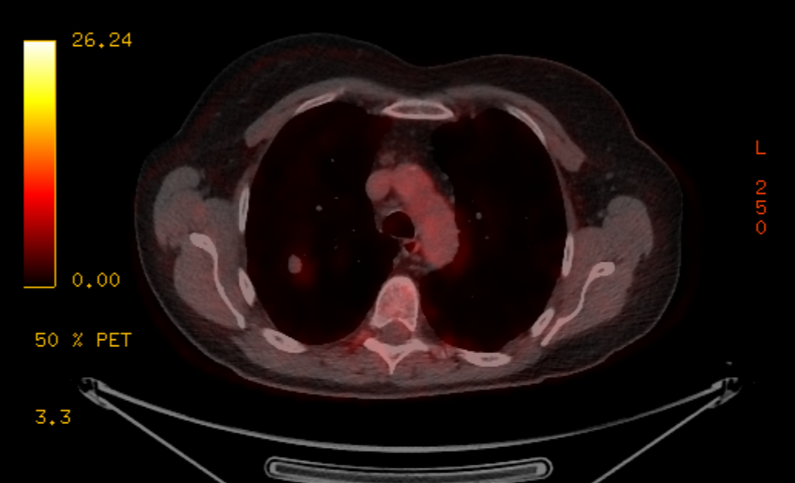
Case 3
Notes:
SUV 1.9, Herder risk 20% FEV1 1.3 (52%) 14mm T1b 61yo, still working at in the hospital as a cleaner 3 days a week, but SOB on stairss and hills – high risk VO2 max 8.0
S/B oncology – low avidity – ongoing FU

Slide 5
Case 3
Notes:
SUV 1.9, Herder risk 20% FEV1 1.3 (52%) 14mm T1b 61yo, still working at in the hospital as a cleaner 3 days a week, but SOB on stairss and hills – high risk VO2 max 8.0
S/B oncology – low avidity – ongoing FU

Slide 6
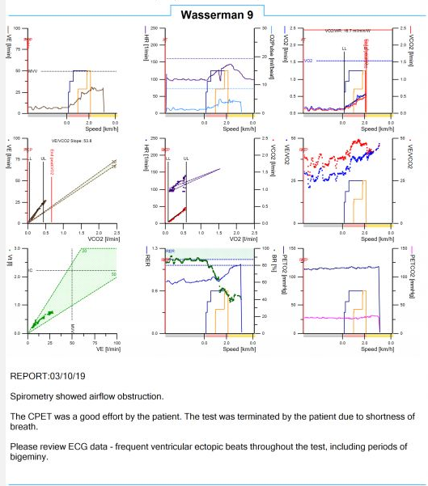
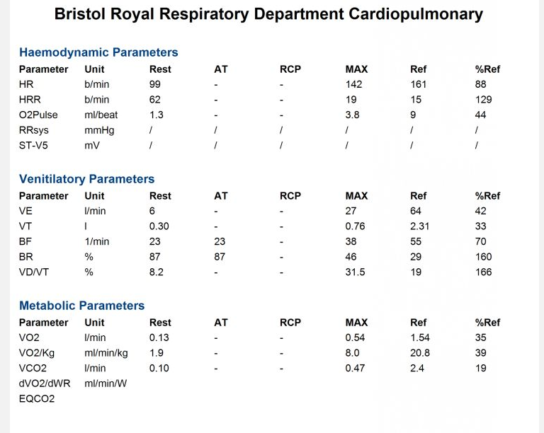
Case 3
Notes:
SUV 1.9, Herder risk 20% FEV1 1.3 (52%) 14mm T1b 61yo, still working at in the hospital as a cleaner 3 days a week, but SOB on stairss and hills – high risk VO2 max 8.0
S/B oncology – low avidity – ongoing FU

Slide 8
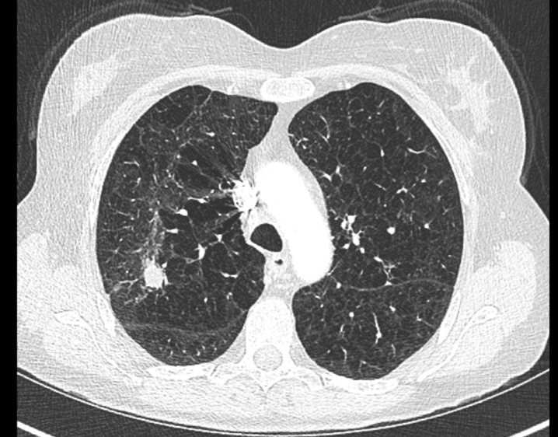
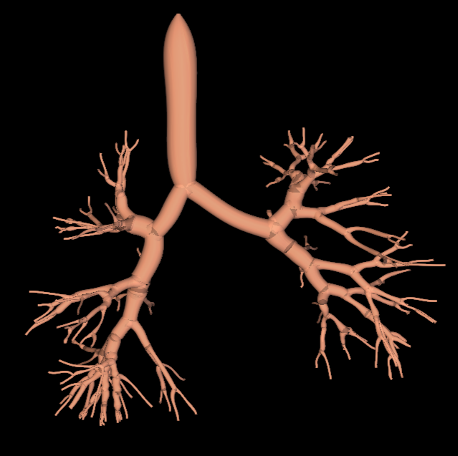
Navigation bronchoscopy
Uses CT imaging to create a 3D reconstruction

Slide 9
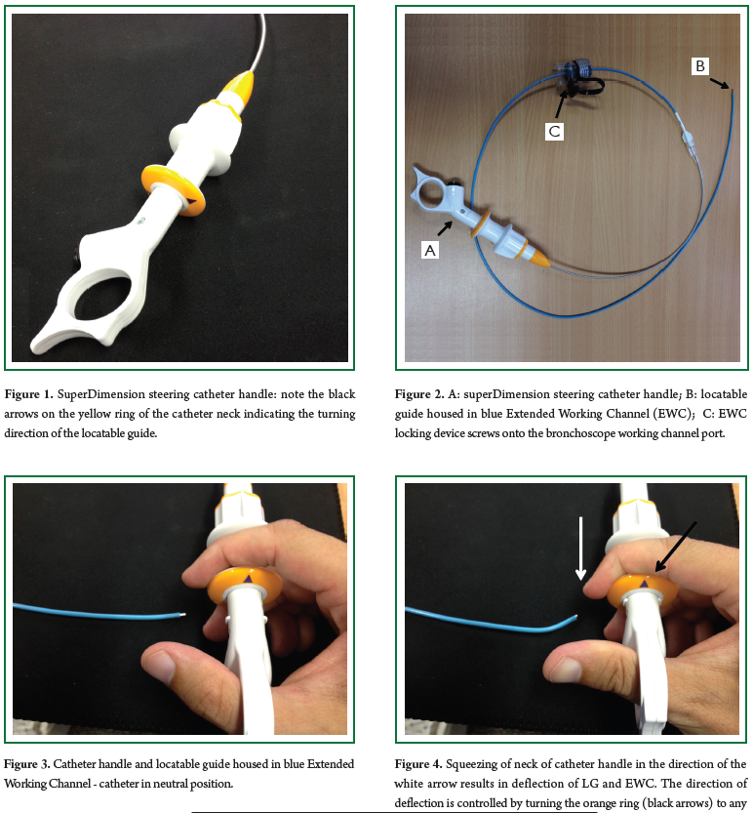
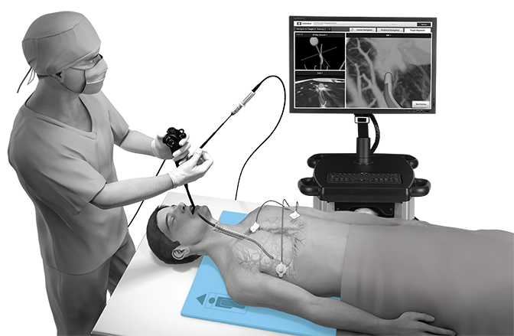
Navigation bronchoscopy
2012;4(2):173-185

Slide 10
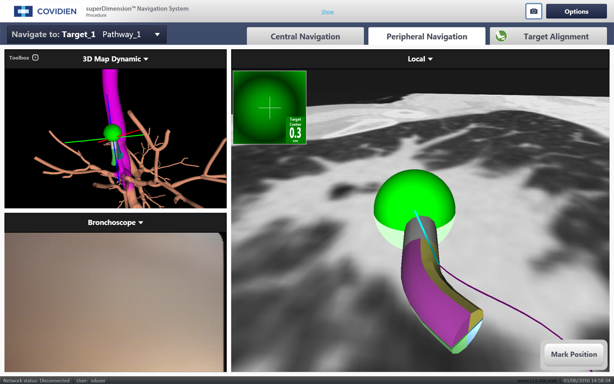
Navigation bronchoscopy

Slide 11
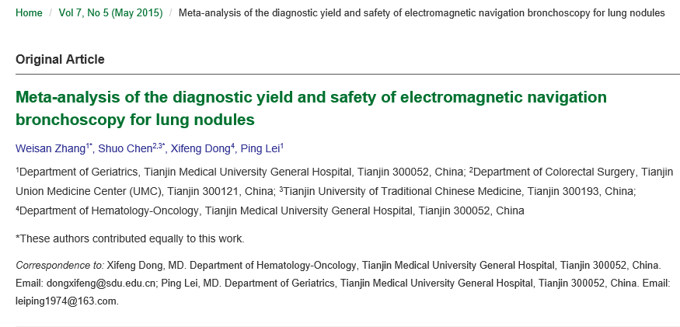
Sensitivity?
1106 pts
19 studies
Sensitivity 0.82
(0.79-0.85)
Specificity 1.00 (0.98-1.00)
Notes:
Meta-analysis of 19 studies >1000 patients – sensitivity of 82%, specificity of 100%

Slide 12
Safety?
Zhang et al 2015 - PTX rate of 5.9%
Deng et al 2018 – PTX rate of 5.2%
Towe et al 2017 – 341 patients
8.3% complication rate
PTX 27 (7.5%) – 11 needed ICD, 16 observed
2 bleeds
3 with resp failure
64 – severe COPD, 114 – moderate COPD
Notes:
Systematic Review Deng et al 2018 comparing CTGB vs ENB
1648 patients PTX rate of 5.2% in ENB vs 23% in CTGB
Towe et al – single centre US

Slide 13
Cost effectiveness?
Average cost of CT guided biopsy £1357
Nav Bronchosocpy
£1942-£2331
BMJ Open Resp Res 2020;7:e000595.
Notes:
Average cost £1357 of CTgB vs £1942-£2331 for Nav Bronch

Slide 14
Summary
Role in improving early diagnosis
Role in reducing benign resections
And presumably in reducing benign irradiation
Cost effective
Acceptable diagnostic yield and safety

Slide 17
Questions?

