Slide 1
Breast 2 week wait performance up to April 2021 South West Region

Slide 2
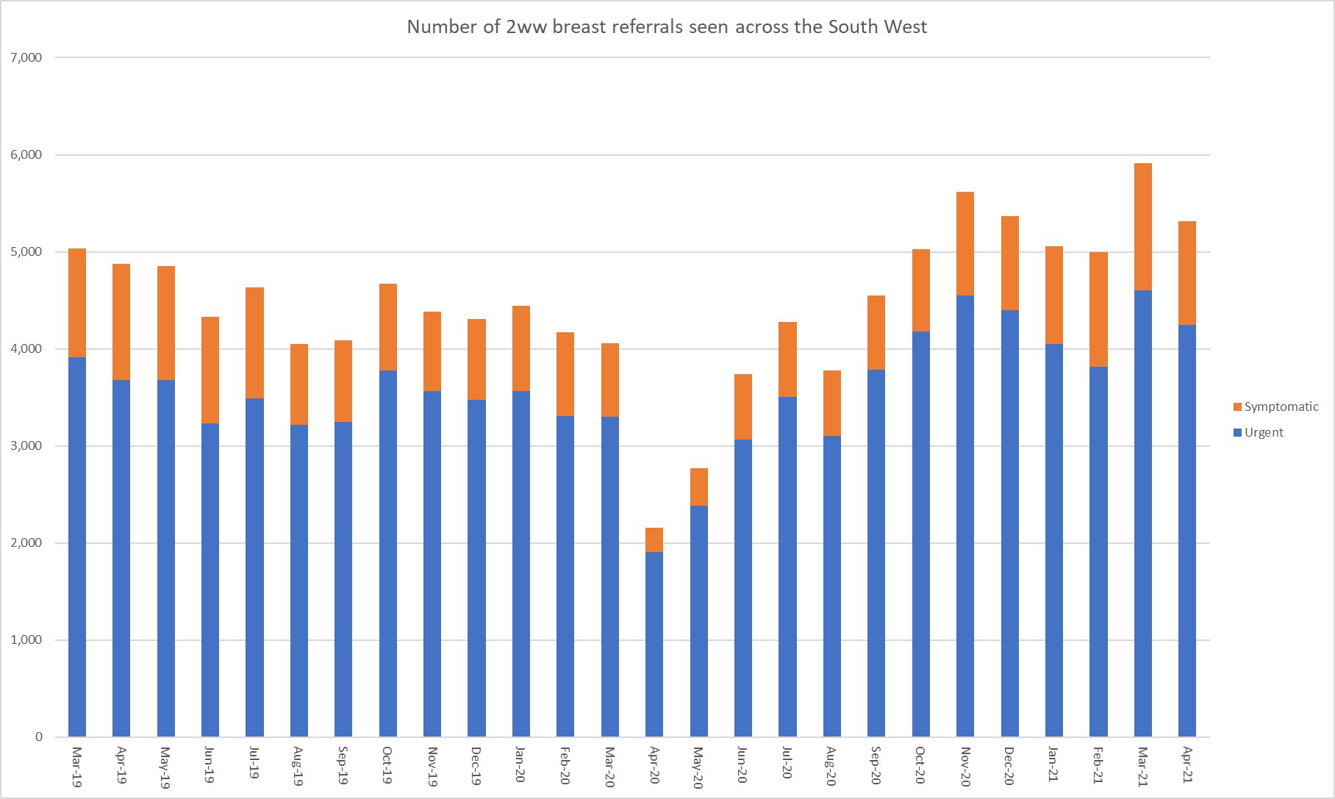
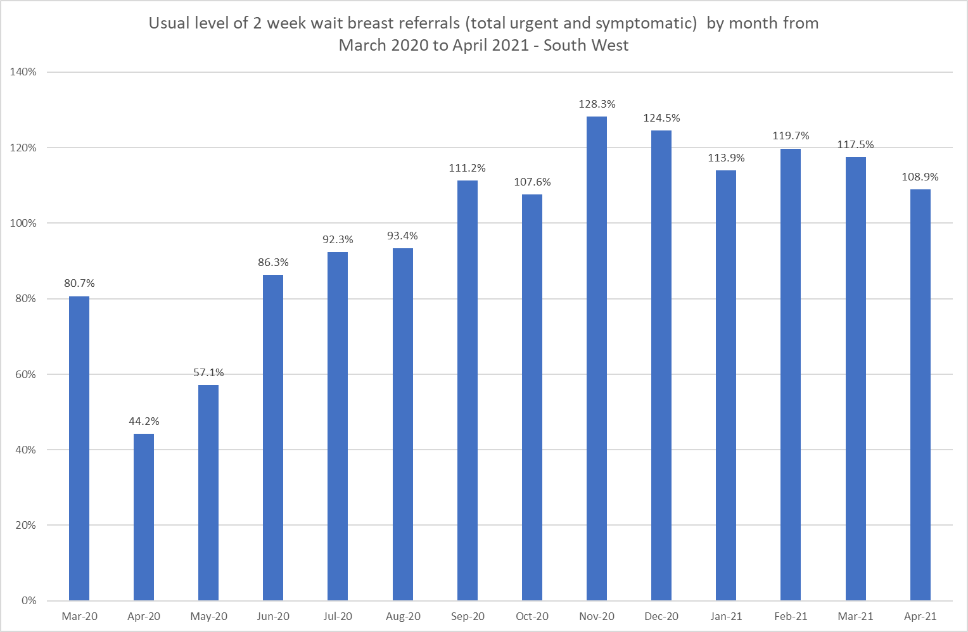
Usual level of Breast 2 week wait referrals – South West Region
Volumes of patients seen – March 2019 to April 2021
Usual levels* – March 2020 to April 2021
*Usual level, measured by comparing individual month to same month from period March 2019 to February 2020

Slide 3
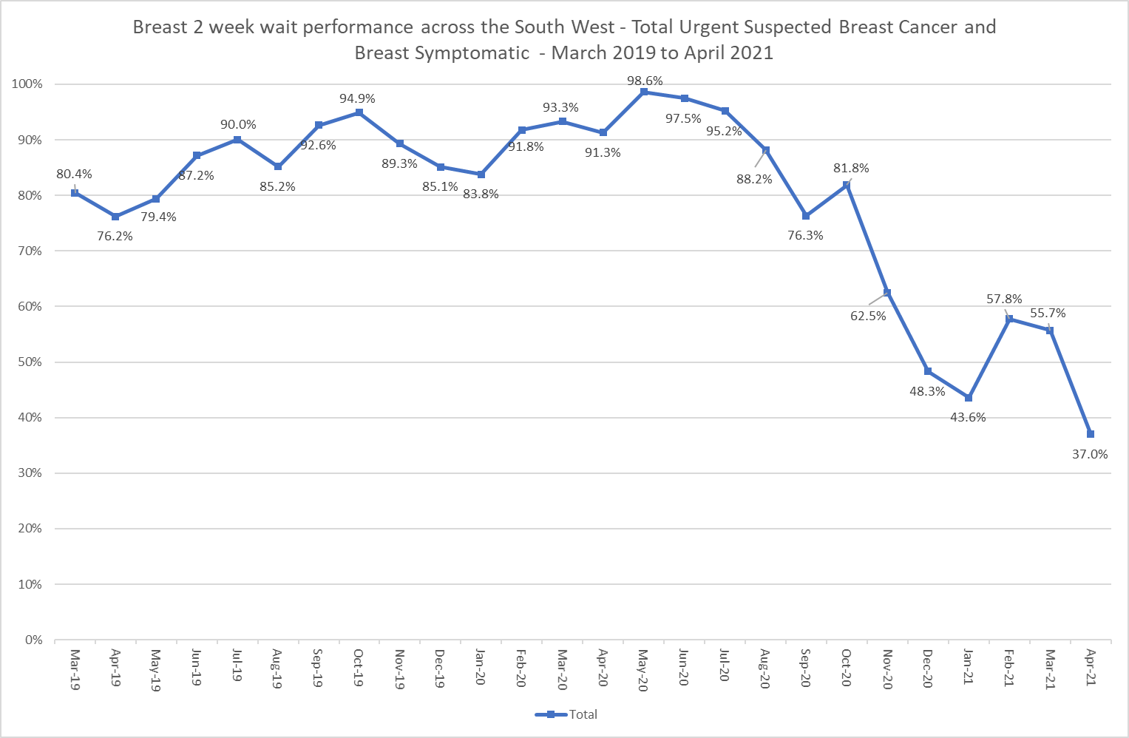
Latest National Breast Cancer Waiting Times performance – South West – 2 week wait standards
Trend March 2019 to April 2021 (Total – Urgent and Breast Symptomatic)
 | 2 week wait urgent suspected cancer |  |  | 2 week wait breast symptomatic (cancer not suspected) |  |  | Total 2ww (Breast urgent and symptomatic
 | Number of patients | Seen after day 14 | % in target | Number of patients | Seen after day 14 | % in target | Number of patients | Seen after day 14 | % in target
Mar-19 | 3,917 | 626 | 84.0% | 1,116 | 358 | 67.9% | 5,033 | 984 | 80.4%
Apr-19 | 3,676 | 718 | 80.5% | 1,203 | 444 | 63.1% | 4,879 | 1,162 | 76.2%
May-19 | 3,682 | 604 | 83.6% | 1,170 | 397 | 66.1% | 4,852 | 1,001 | 79.4%
Jun-19 | 3,235 | 359 | 88.9% | 1,094 | 195 | 82.2% | 4,329 | 554 | 87.2%
Jul-19 | 3,491 | 323 | 90.7% | 1,140 | 139 | 87.8% | 4,631 | 462 | 90.0%
Aug-19 | 3,217 | 501 | 84.4% | 832 | 99 | 88.1% | 4,049 | 600 | 85.2%
Sep-19 | 3,248 | 247 | 92.4% | 839 | 55 | 93.4% | 4,087 | 302 | 92.6%
Oct-19 | 3,775 | 202 | 94.6% | 894 | 38 | 95.7% | 4,669 | 240 | 94.9%
Nov-19 | 3,565 | 409 | 88.5% | 817 | 61 | 92.5% | 4,382 | 470 | 89.3%
Dec-19 | 3,475 | 486 | 86.0% | 832 | 154 | 81.5% | 4,307 | 640 | 85.1%
Jan-20 | 3,565 | 550 | 84.6% | 877 | 171 | 80.5% | 4,442 | 721 | 83.8%
Feb-20 | 3,308 | 274 | 91.7% | 862 | 69 | 92.0% | 4,170 | 343 | 91.8%
Mar-20 | 3,299 | 227 | 93.1% | 761 | 44 | 94.2% | 4,060 | 271 | 93.3%
Apr-20 | 1,909 | 151 | 92.1% | 246 | 36 | 85.4% | 2,155 | 187 | 91.3%
May-20 | 2,384 | 33 | 98.6% | 386 | 5 | 98.7% | 2,770 | 38 | 98.6%
Jun-20 | 3,064 | 70 | 97.7% | 672 | 25 | 96.3% | 3,736 | 95 | 97.5%
Jul-20 | 3,502 | 167 | 95.2% | 773 | 38 | 95.1% | 4,275 | 205 | 95.2%
Aug-20 | 3,100 | 380 | 87.7% | 680 | 66 | 90.3% | 3,780 | 446 | 88.2%
Sep-20 | 3,786 | 880 | 76.8% | 760 | 196 | 74.2% | 4,546 | 1,076 | 76.3%
Oct-20 | 4,182 | 773 | 81.5% | 844 | 140 | 83.4% | 5,026 | 913 | 81.8%
Nov-20 | 4,550 | 1,570 | 65.5% | 1,071 | 540 | 49.6% | 5,621 | 2,110 | 62.5%
Dec-20 | 4,395 | 2,211 | 49.7% | 969 | 562 | 42.0% | 5,364 | 2,773 | 48.3%
Jan-21 | 4,048 | 2,183 | 46.1% | 1,012 | 672 | 33.6% | 5,060 | 2,855 | 43.6%
Feb-21 | 3,817 | 1,514 | 60.3% | 1,176 | 594 | 49.5% | 4,993 | 2,108 | 57.8%
Mar-21 | 4,601 | 1,875 | 59.2% | 1,315 | 747 | 43.2% | 5,916 | 2,622 | 55.7%
Apr-21 | 4,243 | 2,573 | 39.4% | 1,070 | 774 | 27.7% | 5,313 | 3,347 | 37.0%

Slide 4
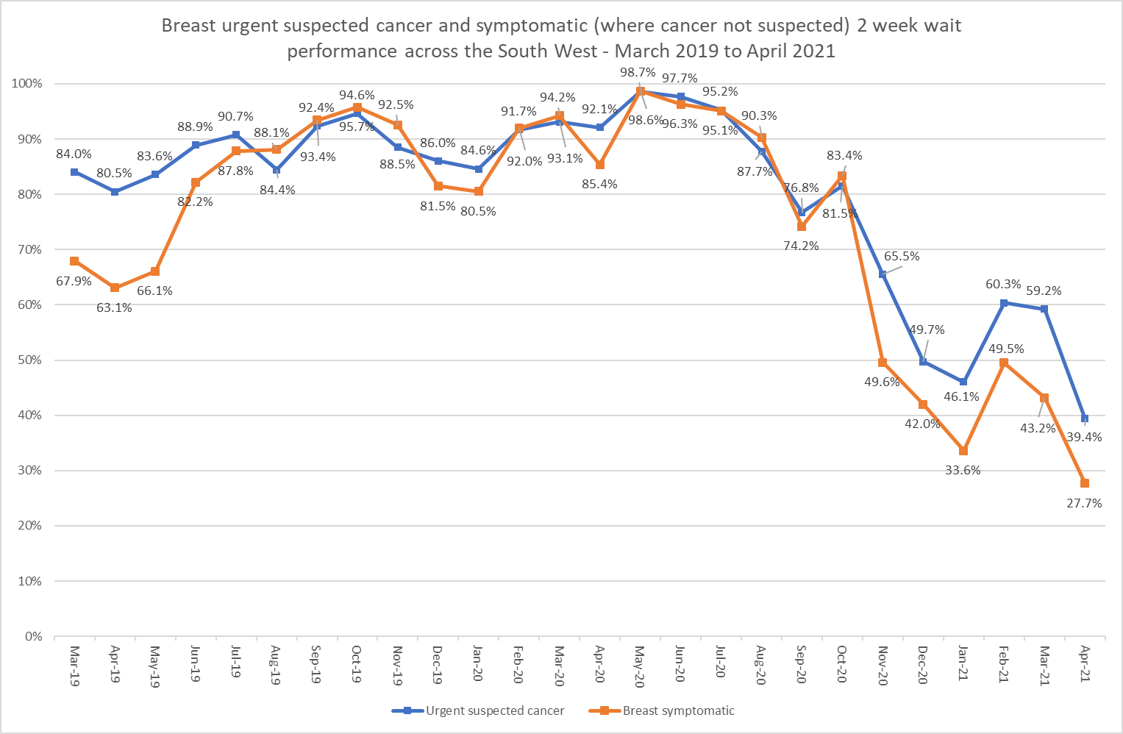
Latest National Breast Cancer Waiting Times performance – South West – 2 week wait standards
Trend March 2019 to April 2021 (Urgent and Breast Symptomatic separately)
 | 2 week wait urgent suspected cancer |  |  | 2 week wait breast symptomatic (cancer not suspected) |  |  | Total 2ww (Breast urgent and symptomatic
 | Number of patients | Seen after day 14 | % in target | Number of patients | Seen after day 14 | % in target | Number of patients | Seen after day 14 | % in target
Mar-19 | 3,917 | 626 | 84.0% | 1,116 | 358 | 67.9% | 5,033 | 984 | 80.4%
Apr-19 | 3,676 | 718 | 80.5% | 1,203 | 444 | 63.1% | 4,879 | 1,162 | 76.2%
May-19 | 3,682 | 604 | 83.6% | 1,170 | 397 | 66.1% | 4,852 | 1,001 | 79.4%
Jun-19 | 3,235 | 359 | 88.9% | 1,094 | 195 | 82.2% | 4,329 | 554 | 87.2%
Jul-19 | 3,491 | 323 | 90.7% | 1,140 | 139 | 87.8% | 4,631 | 462 | 90.0%
Aug-19 | 3,217 | 501 | 84.4% | 832 | 99 | 88.1% | 4,049 | 600 | 85.2%
Sep-19 | 3,248 | 247 | 92.4% | 839 | 55 | 93.4% | 4,087 | 302 | 92.6%
Oct-19 | 3,775 | 202 | 94.6% | 894 | 38 | 95.7% | 4,669 | 240 | 94.9%
Nov-19 | 3,565 | 409 | 88.5% | 817 | 61 | 92.5% | 4,382 | 470 | 89.3%
Dec-19 | 3,475 | 486 | 86.0% | 832 | 154 | 81.5% | 4,307 | 640 | 85.1%
Jan-20 | 3,565 | 550 | 84.6% | 877 | 171 | 80.5% | 4,442 | 721 | 83.8%
Feb-20 | 3,308 | 274 | 91.7% | 862 | 69 | 92.0% | 4,170 | 343 | 91.8%
Mar-20 | 3,299 | 227 | 93.1% | 761 | 44 | 94.2% | 4,060 | 271 | 93.3%
Apr-20 | 1,909 | 151 | 92.1% | 246 | 36 | 85.4% | 2,155 | 187 | 91.3%
May-20 | 2,384 | 33 | 98.6% | 386 | 5 | 98.7% | 2,770 | 38 | 98.6%
Jun-20 | 3,064 | 70 | 97.7% | 672 | 25 | 96.3% | 3,736 | 95 | 97.5%
Jul-20 | 3,502 | 167 | 95.2% | 773 | 38 | 95.1% | 4,275 | 205 | 95.2%
Aug-20 | 3,100 | 380 | 87.7% | 680 | 66 | 90.3% | 3,780 | 446 | 88.2%
Sep-20 | 3,786 | 880 | 76.8% | 760 | 196 | 74.2% | 4,546 | 1,076 | 76.3%
Oct-20 | 4,182 | 773 | 81.5% | 844 | 140 | 83.4% | 5,026 | 913 | 81.8%
Nov-20 | 4,550 | 1,570 | 65.5% | 1,071 | 540 | 49.6% | 5,621 | 2,110 | 62.5%
Dec-20 | 4,395 | 2,211 | 49.7% | 969 | 562 | 42.0% | 5,364 | 2,773 | 48.3%
Jan-21 | 4,048 | 2,183 | 46.1% | 1,012 | 672 | 33.6% | 5,060 | 2,855 | 43.6%
Feb-21 | 3,817 | 1,514 | 60.3% | 1,176 | 594 | 49.5% | 4,993 | 2,108 | 57.8%
Mar-21 | 4,601 | 1,875 | 59.2% | 1,315 | 747 | 43.2% | 5,916 | 2,622 | 55.7%
Apr-21 | 4,243 | 2,573 | 39.4% | 1,070 | 774 | 27.7% | 5,313 | 3,347 | 37.0%

Slide 5
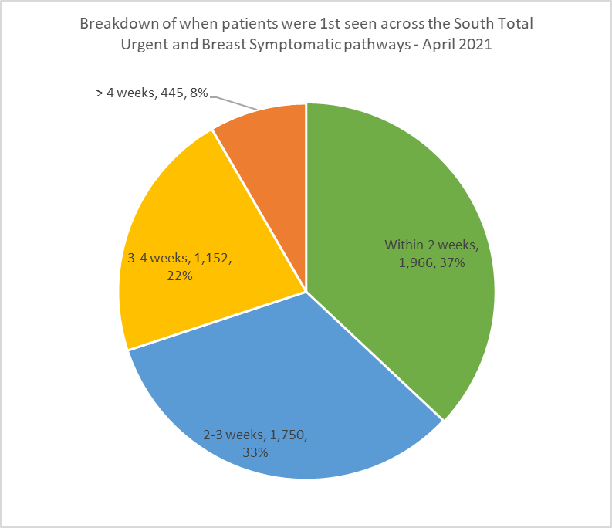
Latest National Breast Cancer Waiting Times performance – South West – 2 week wait standards
Distribution of when were 1st seen April 2021
 | Within 2 weeks |  | 2-3 weeks |  | 3-4 weeks |  | >4 weeks |  | Total
 | No | % | No | % | No | % | No | % | No
Urgent | 1,670 | 39.4% | 1,450 | 34.2% | 821 | 19.3% | 302 | 7.1% | 4,243
Breast Symptomatic | 296 | 27.7% | 300 | 28.0% | 331 | 30.9% | 143 | 13.4% | 1,070
Total | 1,966 | 37.0% | 1,750 | 32.9% | 1,152 | 21.7% | 445 | 8.4% | 5,313

Slide 6
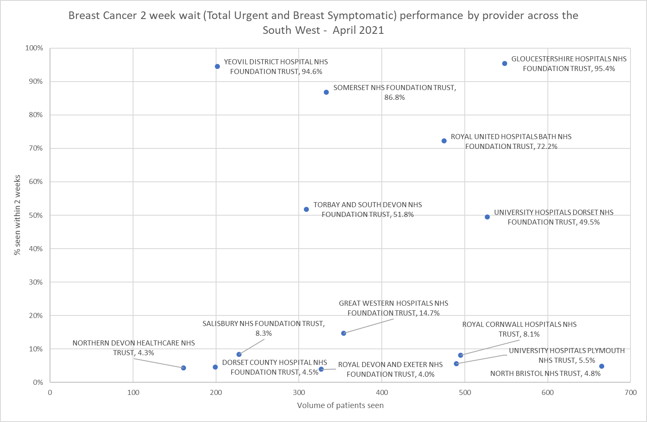
Latest National Breast Cancer Waiting Times performance across the South West – 2 week wait standards
Variation by provider – Total urgent and breast symptomatic pathways – April 2021
Trust | Urgent suspected cancer |  |  | Breast symptomatic |  |  | Total 2ww
 | Patients seen | Breaches | % in target | Patients seen | Breaches | % in target | Patients seen | Breaches | % in target
GLOUCESTERSHIRE HOSPITALS NHS FOUNDATION TRUST | 471 | 21 | 95.5% | 77 | 4 | 94.8% | 548 | 25 | 95.4%
YEOVIL DISTRICT HOSPITAL NHS FOUNDATION TRUST | 156 | 5 | 96.8% | 46 | 6 | 87.0% | 202 | 11 | 94.6%
SOMERSET NHS FOUNDATION TRUST | 317 | 41 | 87.1% | 16 | 3 | 81.3% | 333 | 44 | 86.8%
ROYAL UNITED HOSPITALS BATH NHS FOUNDATION TRUST | 368 | 108 | 70.7% | 107 | 24 | 77.6% | 475 | 132 | 72.2%
TORBAY AND SOUTH DEVON NHS FOUNDATION TRUST | 212 | 112 | 47.2% | 97 | 37 | 61.9% | 309 | 149 | 51.8%
UNIVERSITY HOSPITALS DORSET NHS FOUNDATION TRUST | 485 | 226 | 53.4% | 42 | 40 | 4.8% | 527 | 266 | 49.5%
GREAT WESTERN HOSPITALS NHS FOUNDATION TRUST | 354 | 302 | 14.7% |  |  |  | 354 | 302 | 14.7%
SALISBURY NHS FOUNDATION TRUST | 191 | 172 | 9.9% | 37 | 37 | 0.0% | 228 | 209 | 8.3%
ROYAL CORNWALL HOSPITALS NHS TRUST | 310 | 272 | 12.3% | 185 | 183 | 1.1% | 495 | 455 | 8.1%
UNIVERSITY HOSPITALS PLYMOUTH NHS TRUST | 369 | 348 | 5.7% | 121 | 115 | 5.0% | 490 | 463 | 5.5%
NORTH BRISTOL NHS TRUST | 487 | 466 | 4.3% | 178 | 167 | 6.2% | 665 | 633 | 4.8%
DORSET COUNTY HOSPITAL NHS FOUNDATION TRUST | 148 | 139 | 6.1% | 51 | 51 | 0.0% | 199 | 190 | 4.5%
NORTHERN DEVON HEALTHCARE NHS TRUST | 100 | 97 | 3.0% | 61 | 57 | 6.6% | 161 | 154 | 4.3%
ROYAL DEVON AND EXETER NHS FOUNDATION TRUST | 275 | 264 | 4.0% | 52 | 50 | 3.8% | 327 | 314 | 4.0%

Slide 7
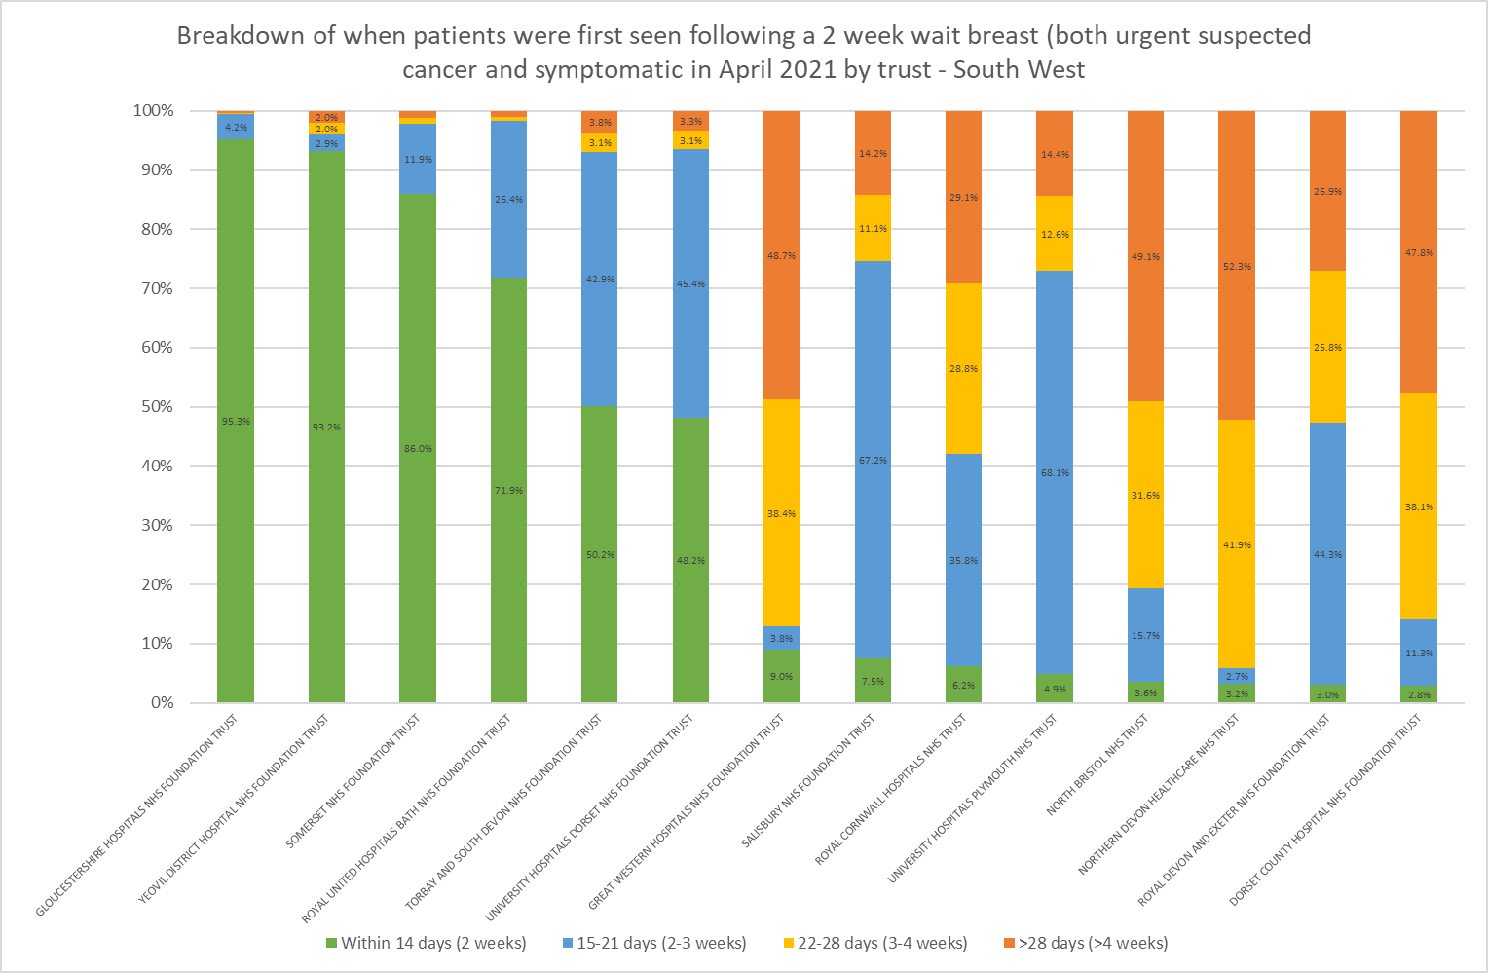
Latest National Breast Cancer Waiting Times performance across the South West 2 week wait standards
Variation by provider – Total urgent and breast symptomatic pathways – breakdown of when patients seen - April 2021
Volumes of patients
Trust | Within 2 weeks (0-14 days) | 2-3 weeks (15-21 days) | 3-4 weeks (22-28 days) | >4 weeks (>28 days) | Total
GLOUCESTERSHIRE HOSPITALS NHS FOUNDATION TRUST | 523 | 23 | 1 | 2 | 549
YEOVIL DISTRICT HOSPITAL NHS FOUNDATION TRUST | 191 | 6 | 4 | 4 | 205
SOMERSET NHS FOUNDATION TRUST | 289 | 40 | 3 | 4 | 336
ROYAL UNITED HOSPITALS BATH NHS FOUNDATION TRUST | 343 | 126 | 3 | 5 | 477
TORBAY AND SOUTH DEVON NHS FOUNDATION TRUST | 160 | 137 | 10 | 12 | 319
UNIVERSITY HOSPITALS DORSET NHS FOUNDATION TRUST | 261 | 246 | 17 | 18 | 542
GREAT WESTERN HOSPITALS NHS FOUNDATION TRUST | 52 | 22 | 221 | 280 | 575
SALISBURY NHS FOUNDATION TRUST | 19 | 170 | 28 | 36 | 253
ROYAL CORNWALL HOSPITALS NHS TRUST | 40 | 230 | 185 | 187 | 642
UNIVERSITY HOSPITALS PLYMOUTH NHS TRUST | 27 | 373 | 69 | 79 | 548
NORTH BRISTOL NHS TRUST | 32 | 141 | 283 | 440 | 896
NORTHERN DEVON HEALTHCARE NHS TRUST | 7 | 6 | 93 | 116 | 222
ROYAL DEVON AND EXETER NHS FOUNDATION TRUST | 13 | 194 | 113 | 118 | 438
DORSET COUNTY HOSPITAL NHS FOUNDATION TRUST | 9 | 36 | 122 | 153 | 320

Slide 8
Outputs from SWAG Breast Cancer Multidisciplinary Team Focus Group Friday 24th June 2021
Aim: A clinician-led and focused meeting on solutions for presentation to Region as best approaches to deal with immediate backlog and mitigate patient harm, impact on colleagues/ workforce and reputational risk. Provide support and offer guidance and advice for existing women on 2ww backlog (included many breaching) and support for GPs during the working solutions for backlog. Working in a way that is patient-centred and putting organisational barriers to one side. Acknowledging huge efforts by NBT colleagues & all teams across the regions to deliver care during the pandemic.

Slide 9
Challenges in Breast Cancer Capacity
Demand
Regional /National increase in suspected breast cancer referrals, resulting in NBT backlog and limited capacity for mutual aid from other SWAG providers
Causes:
COVID-19 Recovery
Reduction in face to face GP Consultations and referral quality
Reduction in screening with route to diagnosis diverted to symptomatic pathway
Backlog of referrals
Potential risk of late management of referrals causing psychological harm
Potential risk of late diagnoses causing physical harm
Negative impact on the patient experience (particularly harmful when at the beginning of the pathway)
Workforce
Workforce
Regional shortages, especially of imaging specialists
Retirement
Unfilled vacancies
Long term sick leave
Workload pressures / fatigue caused by local Waiting List Initiatives / postponed leave
Physical Space
Reduced capacity due to social distancing / infection control guidelines
.

Slide 10
Actions and Next Steps
Most Urgent Actions Outlined
Mutual Aid Support
Addressing Backlog of Patients
Releasing Capacity
Managing New Referrals
All centres to consider capacity to support for mutual aid (either patient numbers or specified staff resource)
Initial offers from:
Glos (consultants trained in u/s for patients <40 yrs)
Somerset – options to be explored and confirmed
RUH Bath – options to be explored and confirmed
Utilise GLANSO to support WLI
Proactively contact all patients on the waiting list - clinical expert to prioritise referrals via a triage process and to manage expectations about the current waiting times for their first appointment
Surgeons trained in ultrasound to consider availability to provide lists for patients under the age of 40 with minimal assistance from radiology
New BNSSG suspected cancer referral form to include details that indicate if the GP has a high degree or low degree of concern for publication on REMEDY by Thursday 1st July 2021
Cancer Alliance to approach Public Health England Screening Commissioners to discuss potential of screening workforce supporting symptomatic referrals
Urgent Actions
Accelerate launch of the breast pain pathway
Development of script to align the messages given to patients about expected waiting times for first appointments
Cancer Alliance to attempt to expedite purchase of an extra imaging vehicle
Further support provision of advice and guidance to support face to face examinations to PCNs
Support and facilitation for triage process:
YDH – triage for pure breast pain
Others?
Centres to review administrative duties currently undertaken by clinicians that could be delegated to ancillary staff:
review opportunities to streamline administrative workload, e.g. upskilling ancillary staff to optimise clinic throughput, such as imaging HCAs in breast clinics
2ww clinics commissioned through GLANSO or other Independent providers
The proposal for mutual aid Mega-Clinic not taken forward as general consensus was to support MA by patients being seen in other Trusts; a clinic without imaging considered a retrograde step and additional administrative burden
Opportunities for Stratified FU using different staff groups (AHPs)
Details of the GLANSO option to be shared with provider Trusts
Support and development of AI
Supporting Actions
Regional confirmation that provider Trusts participating in the provision of mutual aid will be exempt from punitive measures should cancer waiting time performance be detrimentally affected
Cancer Alliance to draft Duty of Candour statement if delays to the screening service due to supporting symptomatic services
National steer required re: Stoke / Liverpool model, to triage referrals purely on age, was ratified via an emergency governance process; not considered appropriate by CAG

