Slide 1
SWAG Lung Cancer Clinical Advisory Group
Management of Services During the COVID-19 Pandemic

Slide 2
Referrals during the Pandemic to date
Service relatively unaffected with COVID cases in first lockdown, aside from a peak in Cheltenham, attributable to Cheltenham Races
Significant reduction in suspected cancer referrals with slowest recovery post lockdown in comparison with other cancers
Reduction in routine chest x-rays
Reduction in routine other imaging/pick up of incidental findings
Increased emergency admissions/ decreased presentation of cases with early Stage disease

Slide 3
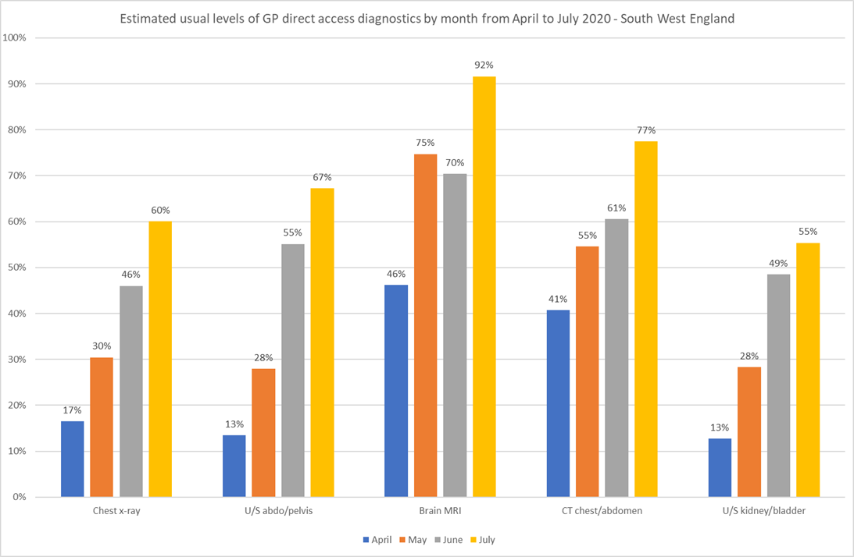

Slide 4
Primary Care / Community Communications for referral recovery
Primary Care will be encouraged to continue to refer patients in accordance with NICE Suspected Cancer Guidelines (NG12) – Webinar Provided for 40-50 GPs
Suspected Lung Cancer referral improvement campaign (led by Nicola Gowen):
‘Talking Heads’, here will be promoted on social media over the coming months
The press release is on the website here and was subsequently picked up from the Bath Echo.
Roy Castle:
Official STILL HERE video, and poem including four patient stories, online campaign pack with downloadable posters and leaflets, campaign videos and social media banners
The STILL HERE campaign will run until the end of November (lung cancer awareness month), with further activity planned including many more stories from those affected by the disease, a series of NHS videos featuring a GP, chest physician and oncologist (The NHS is STILL HERE), an update on lung health checks and sub Stoptober and cycling campaigns.
www.roycastle.org/stillhere
CRUK; Brief to GPs
Lung Cancer and COVID-19’

Slide 5
Diagnostics
Reduced CT capacity (social distancing/infection control)
Development of guidance to see where demand on radiology can be safely reduced to enable prioritisation of diagnostic CT (Guidance due to be discussed by Royal College Radiologists 24/11/2020)
Reduction in EBUS/bronchoscopy capacity
Swab/isolation/social distancing guidance & recovery capacity
Lists lost to colonoscopy
Reduced productivity due to Aerosol Generating Procedure guidance (room air change rate/PPE)
Increased number of patients with Stage II disease requiring EBUS
Latest AGP guidance: https://www.gov.uk/government/publications/wuhan-novel-coronavirus-infection-prevention-and-control/covid-19-infection-prevention-and-control-guidance-low-risk-pathway

Slide 6
Surgical Services
Surgery has continued throughout the pandemic, at initially approximately 40-50% of usual capacity, and due to increase to 60-70% when theatre space is recovered
Productivity has been reduced due to the need for full PPE and physical theatre space is limited due to adaptations made to repurpose the operation room into a critical care bed bay
A meeting is held every week to prioritise cases
Benign work has been put on hold
Although capacity is currently adequate to manage the referrals coming in, the real denominator of outlying cases is not yet known.

Slide 7
SACT / Radiotherapy Services
SACT treatment has remained standard practice throughout the pandemic to date
SABR has remained standard practice throughout the pandemic to date

Slide 8
Navigators
Provision of Navigators across SWAG:
GRH 1
NBT 0
RUH 2
SFT 1 (recently appointed)
UHBW 1 Administrator to assist CNS team
YDH 1 Radiology based Navigator

Slide 9
Innovations
Perspex screens in recovery areas
Videoconferencing
…any other ideas? Navigational Bronchoscopy Service for example?

