Slide 1
Lung Cancer Pathway Analyser
November 2020

Slide 2
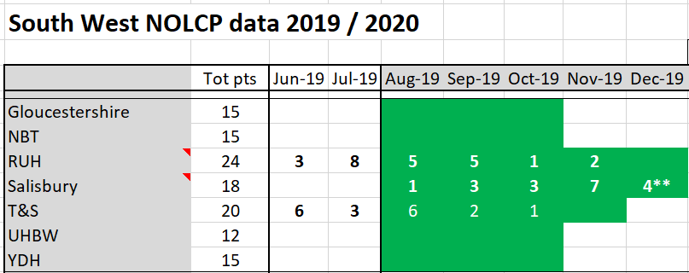
NOLCP Pathway Analyser data has been collected across the following months with a different total number of patients reported for each Trust
Notes:
YDH – has the most amount of data missing and so result reporting should bear this in mind

Slide 3
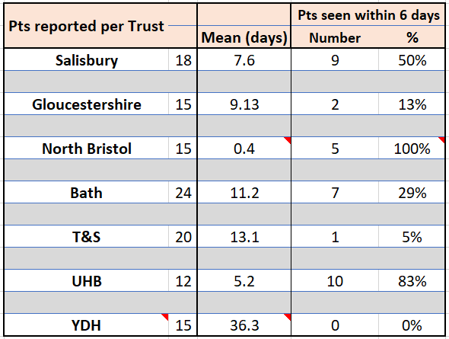
Time taken (days) from Consultation triage/2WW received/Clock start through to OPA Diagnostic plan agreed (standard is 6 days)
NBT and UHB both had average of below 6 days
YDH are outliers but had a lot of data missing
Notes:
Based on just 3 patients, only 5 out of 15 had a clock start/OPA date entry and of those only 3 OPAs were after the clock start

Slide 4
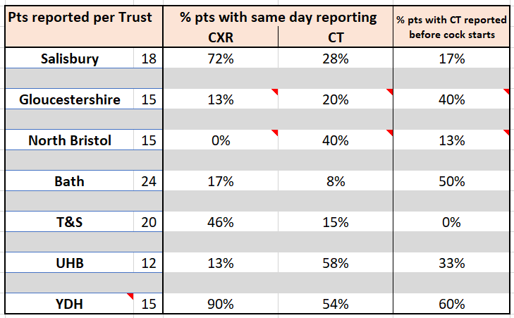
Proportion of patients with either CXR or CT reported on the same day as performed; CT reported prior to clock start
YDH and Salisbury have the highest proportion of patients with same day CXR (90%) and (72%)
UHB and YDH have the highest proportion of patients with same day CT reporting (58%) and (54%)
YDH have the highest proportion of patients with CT being reported prior to clock starting (based on 3 pts out 15)

Slide 5
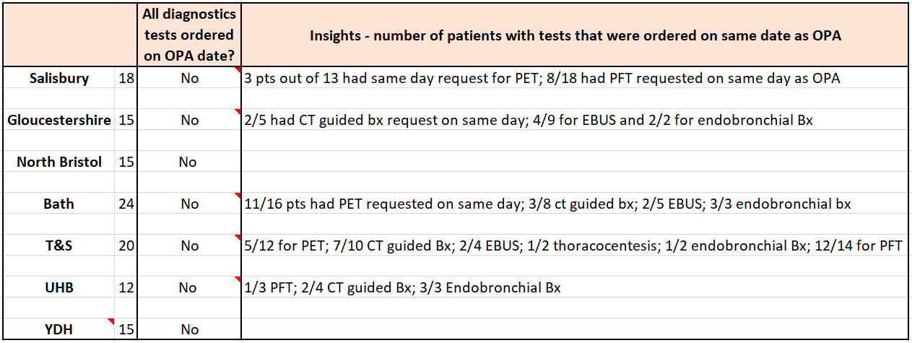
Are diagnostic tests requested on same day as the OPA?
No Hospital had all tests ordered on same day as OPA

Slide 6
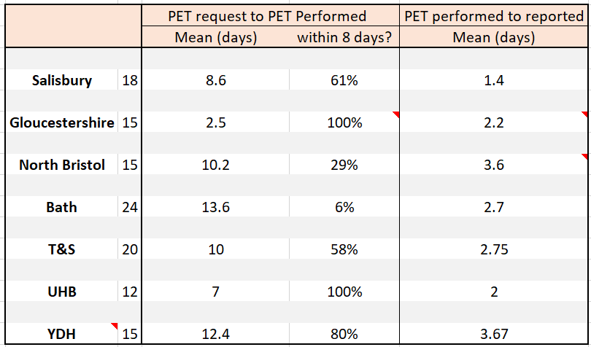
Average time per Trust from PET request to PET performed, and PET performed to PET reported
Gloucs and UHB&W were within 8 days for PET request to performed
Bath and YDH took the longest at 13.6 days and 12.4 days respectively
Salisbury were quickest to report at 1.4 days with NBT and YDH taking the longest at 3.6 days and 3.67 days respectively
Notes:
Gloucestershire - data incomplete as only 2 patients had request date complete out of 8 that had PET performed
Gloucestershire - only 5/8 patients that had a PET had their scan reported (had a date entered)
NBT – 10 had PET performed but only 8 had PET reported date

Slide 7
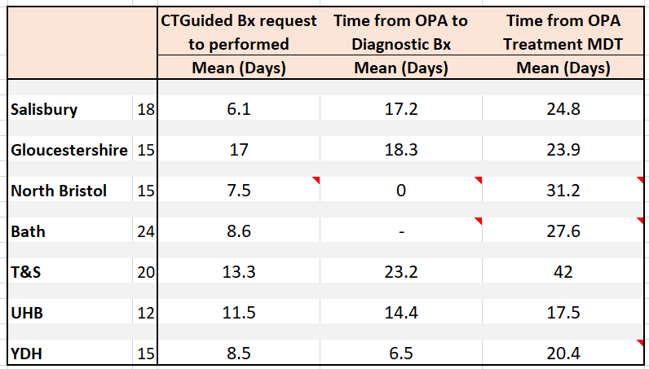
Pathway Analyser milestones and average number of days per Trust; CT guided Bx, Diagnostic Bx and Tx MDT
Salisbury and NBT were the quickest from request of CT guided Bx to performing (6.1 and 7.5 days respectively)
YDH were quickest from OPA to Diagnostic Bx at 6.5 days with T&S taking the longest (23.2 days)
UHB&W had the quickest time from OPA to Tx MDT (17.5 days). NBT had the longest average pathway (31.2 days)
Notes:
NBT data only available for 2 patients with CT guided Bx; no pts had Diagnostic Bx; only 5 out of 15 patients had date for Tx MDT recorded
RUH – 21 out of 24 pts had a Tx MDT date recorded. None had a Diagnostic Bx
YDH – only 5 pts had OPA date recorded (out of 15 patients). Only 4 of the 5 had a date recorded for Tx MDT

Slide 8
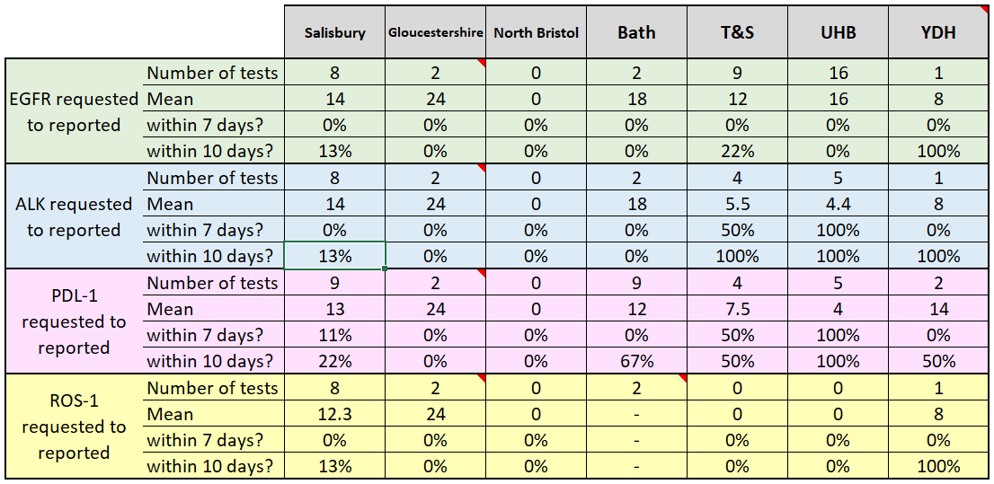
Biomarker testing requested to reported; EGFR, ALK, PDL-1, ROS-1
No hospital consistently achieved a 10 day TAT for ALL of their biomarker tests
YDH is consistently achieving good 10 TATs , but the numbers tested are low
UHB and T&S are next best performing hospitals for ALK & PDL-1
ROS-1 is the least requested test
Notes:
Gloucs – for each test, 4 patients had a request but only 2 patients were reported

