Slide 1
Lung Cancer
Clinical Advisory Group
Research Report
24/11/2020

Slide 2
Update since March 2020...
NIHR Portfolio paused due to COVID-19 pandemic
UPH Group set up on behalf of DHSC
Restart Framework - Prioritisation of studies and assessment of:
Viability
Safety
Site capacity
2nd wave guidance - protect research

Slide 3
National Restart Progress

Slide 4
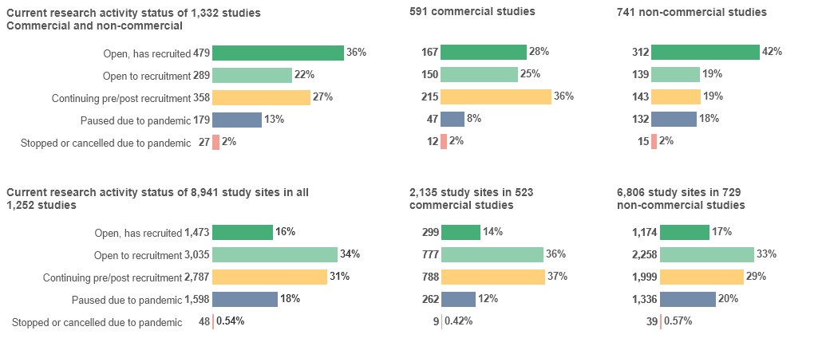
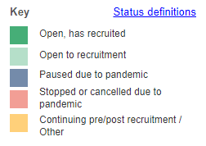
This data reflects the current national picture of restart for studies (cancer as managing specialty)
The yellow group reflects the studies which have not been affected by COVID-19, e.g a study was suspended before the pandemic and remains suspended.
Notes:
Studies managed by England, Northern Ireland and Wales that were open, suspended, or in setup at any point since 18 March are included. Responses from Scotland pending.

Slide 5
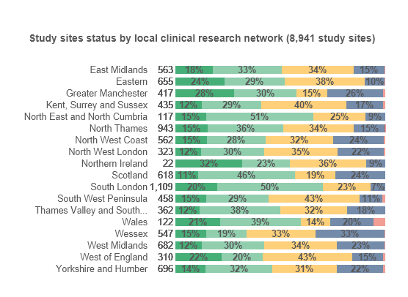
This data shows the restart progress for cancer studies by each participating LCRN
Notes:
All cancer, by CRN

Slide 6
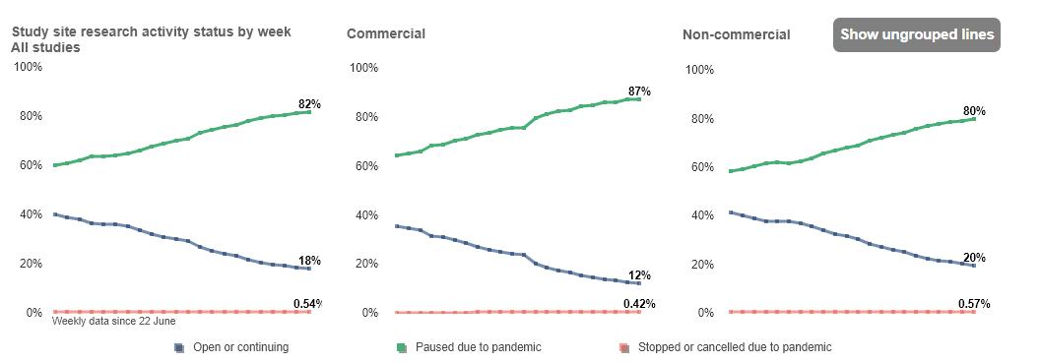
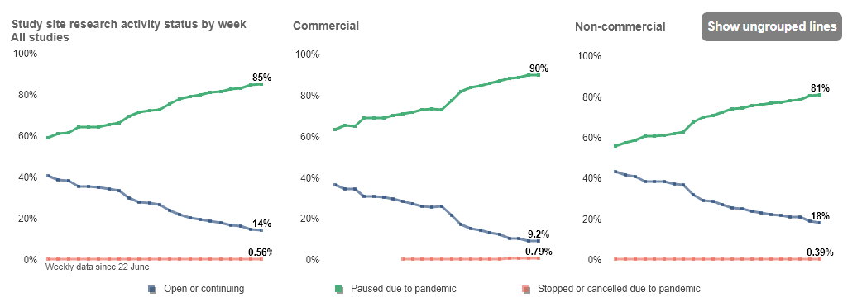
This data shows the national restart progress for cancer studies and brain cancer studies
Cancer overall
Lung cancer

Slide 7
Local Restart Progress

Slide 8
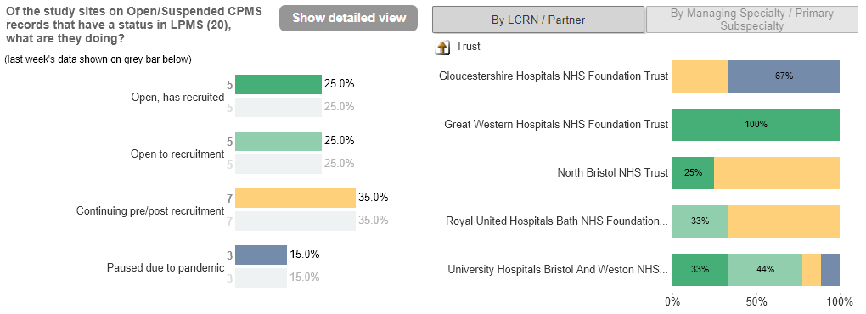
This data reflects the lung cancer studies which the West of England is participating in by sites.
Notes:
Left is showing state of the portfolio of studies WE are involved in. Total of 11 studies

Slide 9
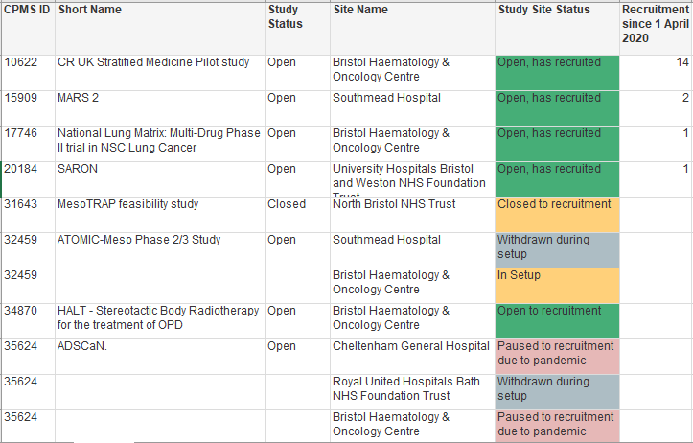
Notes:
Black is no recruitment, grey is missing data and blue is passed closure date.

Slide 10
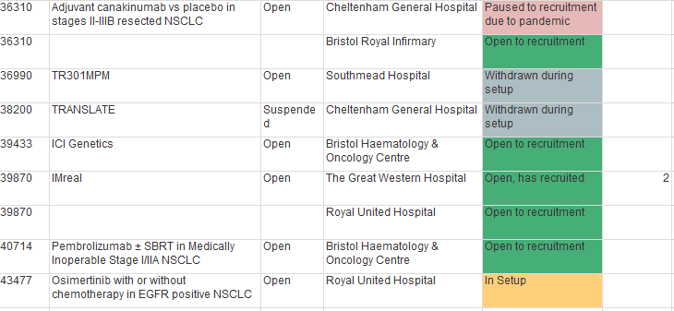

Slide 11
Useful Information

Slide 12
NIHR ODP
Open data platform. Data on performance and restart across whole CRN, including all specialty areas
NIHR Be Part of Research
See which studies are open across the country
National Cancer Research Institute Portfolio Maps
View current national portfolio of open, closed and ‘in set up’ cancer studies
Find a Clinical Research Study (ODP)
Search for a study to fit criteria. Good for horizon scanning, eligibility criteria

Slide 13
Research Delivery Manager
claire.matthews@nihr.ac.uk
Research Portfolio Facilitator
rebecca.gleeson@nihr.ac.uk
Lung Cancer Sub-specialty Lead
ashley.cox@nhs.net

