Slide 1
Swagger: sentinel lymph nodes

Slide 2
Summary
Sentinel lymph node practice across SWAGGER
Preliminary data: SWAGGER SLN Endometrial cancer
BGCS guidelines SLN
PORTEC 3

Slide 3
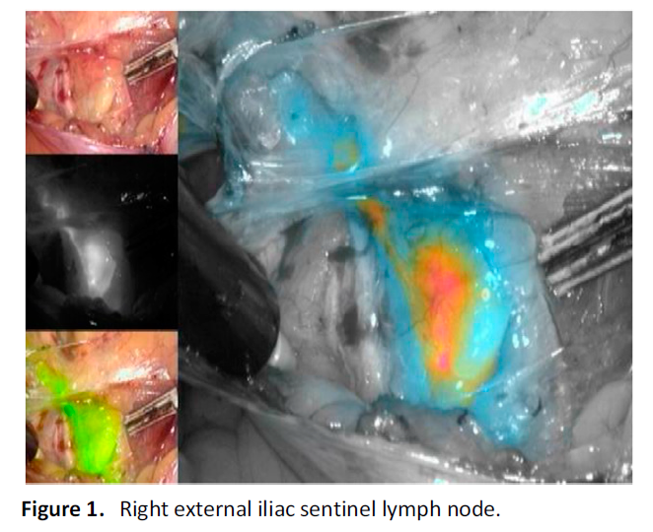
SWAGGER SLN endometrial cancer

Slide 4
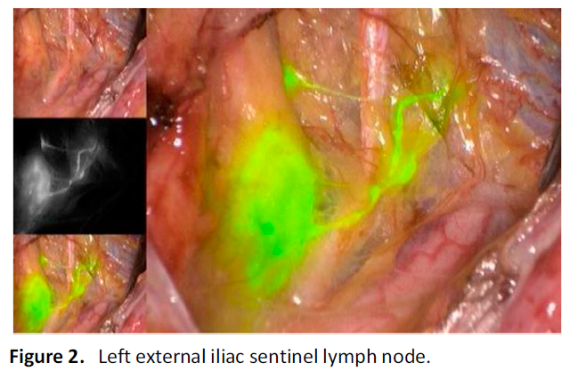

Slide 5
Exeter:
SLN for G3 endometrial cancer
72 cases – 6 recurrences, 4 deaths
Cheltenham:
No SLN
Full pelvic lymphadenectomy G3
19 cases – 12 had full pelvic lymphadenectomy
1/12 (8.3%) positive nodes – chemotherapy. Distant recurrence and died

Slide 6
Bristol:
40 cases G2 and G3
9/40 (22.5%) only unilateral SLN mapped
31/40 (77.%%) SLN mapped bilaterally
Position of SLN:
External iliac 35
Internal iliac 11
Common iliac 4
Obturator 18
Parametrial 3
14 cases G2 – 1/14 (7%) positive SLN, had chemotherapy
26 cases G3 – 1/26 (4%) positive SLN, had chemotherapy

Slide 7
Bristol 40 cases SLN G2/3 continued:
6 recurrences – 3 local, 3 distant
3 deaths

Slide 8
BGCS guidelines Sentinel nodes
Vulval Cancer:
Techniques TC99 with blue dye
Not enough evidence for ICG
Histological ultra-staging for SLN
Unifocal tumours <4cm with no suspicious lymph nodes (clinical or examination) SLN standard of care
If no SLN detected then full lymphadenectomy

Slide 9
Cervical cancer
Techniques TC99 with blue dye or ICG
Histological ultra-staging for SLN
SLN algorithms can be considered stage 1a1 with LVSI,
Stage 1a2-1b1 (tumours less than 2cm)
If no SLN detected then full lymphadenectomy

Slide 10
Int J Gynecol Cancer 2017;27: 154Y158)
pooled detection rate of 89.2% (95% CI, 86.3Y91.6)
pooled sensitivity rate of 90% (95% CI, 88Y92)
Tumours<2cm sensitivity 96-100%

Slide 11
Endometrial cancer:
Cervical injection for SLN
Techniques TC99 with blue dye or ICG
Histological ultra-staging for SLN
Can be considered in high risk endometrial cancer (clear cell, serous, grade 3 endometrioid, carcinosarcoma)
If no SLN detected then full lymphadenectomy

Slide 12
Lancet Oncol 2017; 18: 384–92. 10 centres in USA
Any grade, apparent stage 1 endometrial cancer
ICG dye used, injected into cervix
PAN 58%
293/340 (86%) successful mapping
177/340 (52%) bilateral mapping SLN

Slide 13
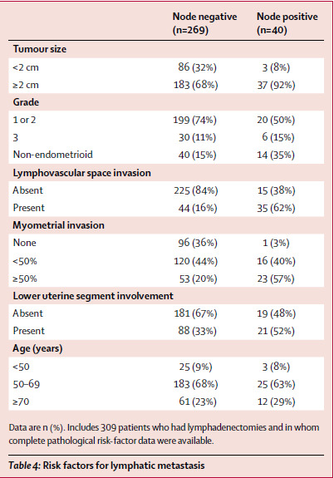

Slide 14
Results
The sensitivity was 97·2% (95% CI 85·0–100; McNemar’s p=1).
False-negative rate 3%
Negative predictive value of 99·6% (95% CI 97·9–100).
Isolated Para-aortic SLN detected 3/340 (<1%)
6 patients (17%) had positive SLN outside conventional lymphadenectomy

Slide 15
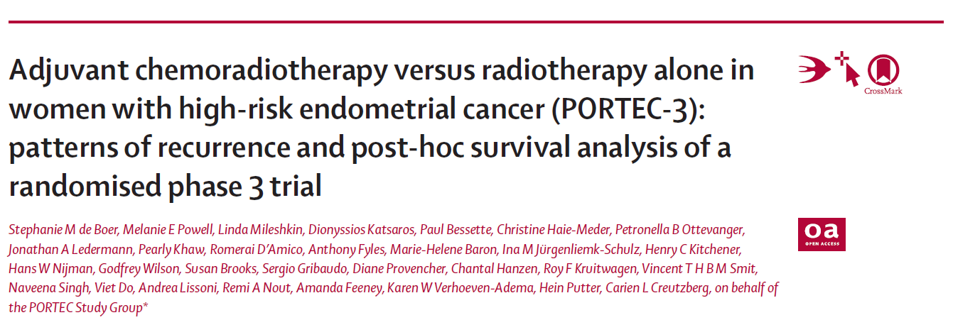
Lancet Oncol (july) 2019; 20: 1273–85
Between 2006-2013 660 women randomised
stage I endometrioid grade 3 cancer with deep myometrial invasion or lymphovascular space invasion, or both;
stage II or III disease; or
stage I–III disease with serous or clear cell histology
Receive radiotherapy alone (48·6 Gy in 1·8 Gy fractions given on 5 days per week) or
Chemoradiotherapy (two cycles of cisplatin 50 mg/m² given intravenously during radiotherapy, followed by four cycles of carboplatin AUC5 and paclitaxel 175 mg/m² given intravenously

Slide 16
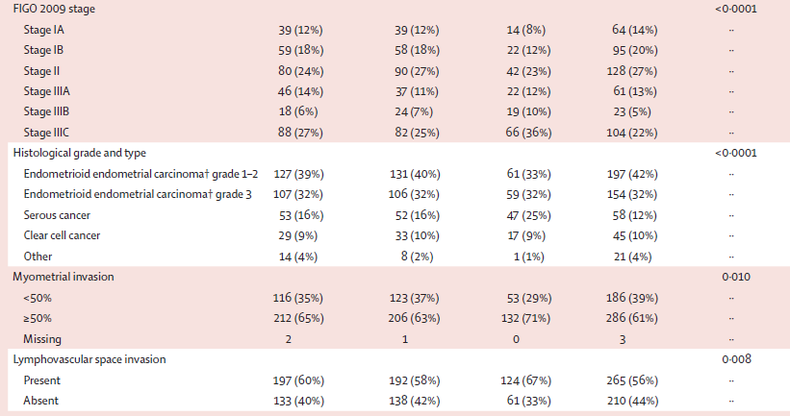

Slide 17
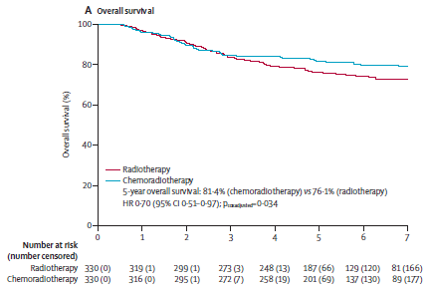
5-year overall survival was 81·4% (95% CI 77·2–85·8) with chemoradiotherapy versus 76·1% (71·6–80·9) with radiotherapy alone (adjusted hazard ratio [HR] 0·70 [95% CI 0·51–0·97], p=0·034)

Slide 18
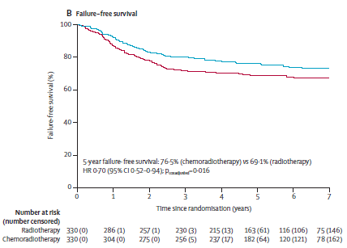
5-year failure-free survival was 76·5% (95% CI 71·5–80·7) versus 69·1% (63·8–73·8; HR 0·70 [0·52–0·94],p=0·016).

Slide 19
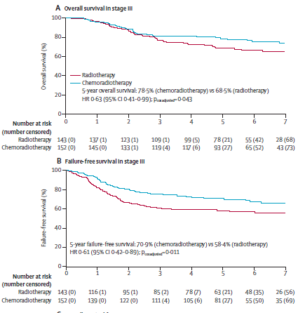
stage III endometrial cancer, 5-year overall survival was 78.5% (95% CI 72.2–85.4) with chemoradiotherapy versus 68.5% (61.2–76.7)with radiotherapy alone (HR 0・63 [95% CI 0.41–0.99]; p=0.043)

Slide 20
In women with stage I–II disease,
5-year overall survival was 83・8% (95% CI 78・4–89・5) with chemoradiotherapy
versus 82・0% (95% CI 76・5–87・7) with radiotherapy alone
HR 0・84 [95% CI 0・52–1・38]; p=0・50),
5-year failure-free survival was 81・3% (95% CI 74・7–86・3)
with chemoradiotherapy versus 77・3% (95% CI 70・5–82・7) with radiotherapy alone (HR 0・87 [95% CI 0・56–1・36]; p=0・54;

Slide 21
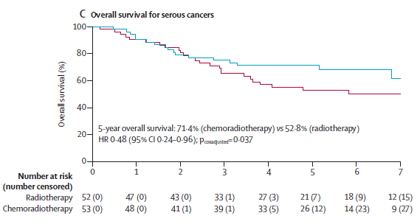
5-year overall survival was 71・4% (95% CI 60・1–84・7) with chemoradiotherapy versus 52・8% (40・6–68・6) with radiotherapy alone (HR 0・48 [95% CI 0・24–0・96]; p=0・037) 5-year failure-free survival was 59・7% (95% CI 45・1–71・6) with chemotherapy versus 47・9% (33・9–60・6) with radiotherapy alone (HR 0・42 [95% CI 0・22–0・80]; p=0・008

Slide 22
Results - recurrences
Distant metastases 78 of 330 women (5-year probability 21·4%; 95% CI 17·3–26·3) in the chemoradiotherapy group
versus 98 of 330 (5-year probability 29·1%; 24·4–34·3) in the radiotherapy-alone group (HR 0·74 [95% CI 0·55–0·99]; p=0·047).
Isolated vaginal recurrence was the first site of recurrence in one patient (0·3%; 95% CI 0·0–2·1) in both groups (HR 0·99[95% CI 0·06–15·90]; p=0·99)
isolated pelvic recurrence was the first site of recurrence in three women (0·9%[95% CI 0·3–2·8]) in the chemoradiotherapy group
versus four (0·9% [95% CI 0·3–2·8]) in the radiotherapy-alone group (HR 0·75 [95% CI 0·17–3·33]; p=0·71)

Slide 23
Result – adverse side effects
At 5 years, only one grade 4 adverse event (ileus or obstruction) was reported (in the chemoradiotherapy group).
grade 3 adverse events did not differ significantly between the two groups, occurring in 16 (8%) of 201 women in the chemoradiotherapy group versus ten (5%) of 187 in the radiotherapy-alone group (p=0·24).
grade 3 adverse event was hypertension (in four [2%] women in both groups).
grade 2 or worse adverse events were reported in 76 (38%) of 201 women in the chemoradiotherapy group versus 43 (23%) of 187 in the radiotherapy-alone group (p=0·002).
Sensory neuropathy persisted more often after chemoradiotherapy than after radiotherapy alone, with 5-year rates of grade 2 or worse neuropathy of 6% (13 of 201 women) versus 0% (0 of 187). No treatment-related deaths were reported.

