Slide 1
Complete clinical response following neoadjuvant chemoradiotherapy for rectal cancer: surgical resection versus organ preservation
Dr Jessica Jenkins
Consultant Oncologist

Slide 2
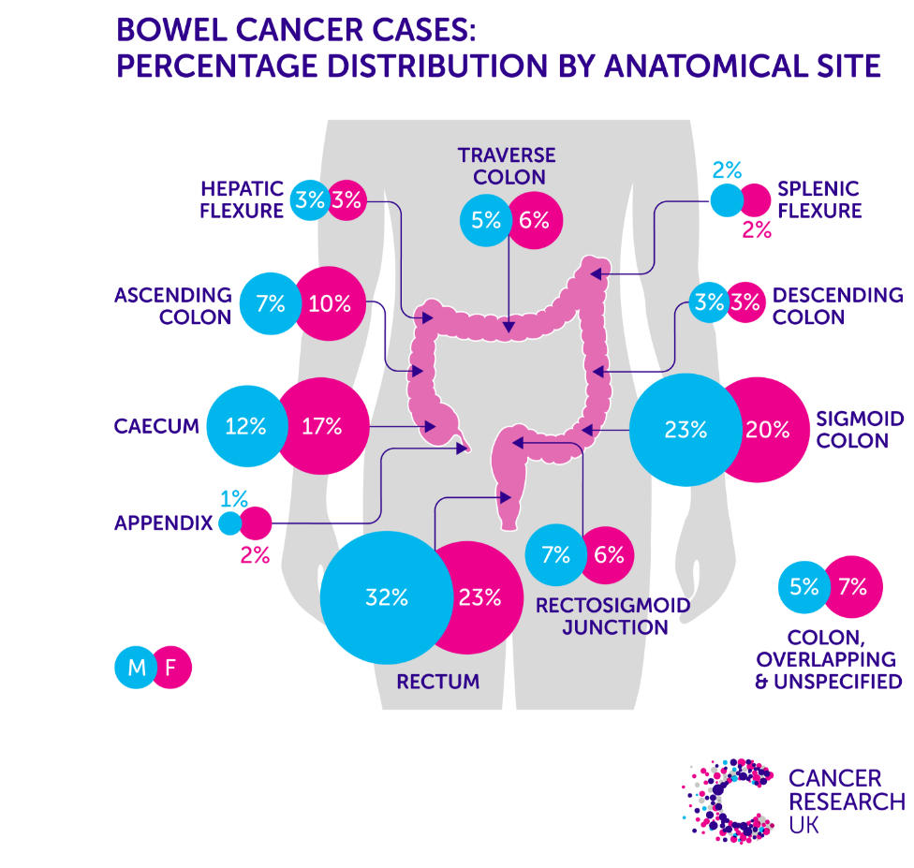
Background
The largest proportion of colorectal cancer cases occur in the rectum.
Each year in UK; over 8500 patients are diagnosed with Rectal Cancer.

Slide 3
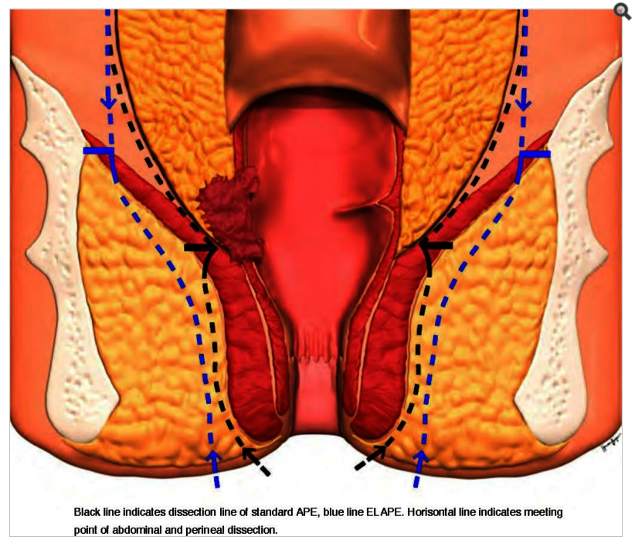
Standard of Care
Total Mesorectal Excision surgery for rectal cancer is highly effective
Surgery carries risk of morbidity, impact on quality of life and perioperative mortality of 1-2%
May require formation of permanent stoma
Neoadjuvant chemoradiotherapy for patients with high-risk non-metastatic rectal cancer improves local control

Slide 4
Outcomes of Neoadjuvant Chemoradiotherapy for Rectal Cancer
Over last decade increasing reports of excellent responses to neoadjuvant chemoradiotherapy
Complete disappearance of tumour and involve local nodes
Pathological complete response (pCR) rate up to 25%
Associated with favourable long term outcomes

Slide 5
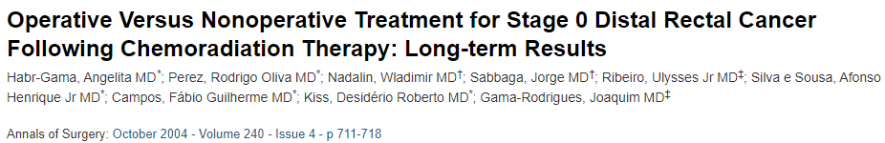
Pioneers of Watch and Wait
265 patients received neoadjuvant chemoradiotherapy for a distal rectal cancer 71 patients (26%) achieved a cCR and entered a strict surveillance programme
2/71 patients had local tumour regrowth within the rectal lumen and
3/71 patients developed systemic relapse.
5-year OS 100% and 5-year DFS 92%

Slide 6
Watch and Wait Strategy
Advantages
Non-operative approach
Organ preservation
Delay/avoid permanent stoma formation
Improved Quality of Life
Disadvantages
Risk of local regrowth
Potential for unsalvageable disease recurrence
Risk of pelvic relapse
Impact on long term oncological outcome

Slide 7
Watch and Wait Data
Multiple cohort series available in which surgery omitted after complete clinical response to neoadjuvant chemoradiotherapy
Data available is retrospective, small cohort series
Heterogenous study populations
Variable complete clinical response rates
Range of local regrowth rate 5%-60%

Slide 8
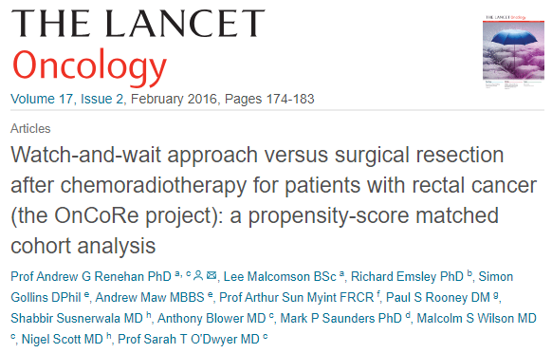
OnCoRe Project
Oncological Outcomes after Clinical Complete Response in Patients with Rectal Cancer
129 patient identified as complete clinical response
44/129 (34%) patients on Watch and Wait had local regrowth
41/44 had luminal growth only and received salvage surgery
109 patients included in the matched analysis with no difference in 3-year non-regrowth DFS or 3-Year OS between W&W and surgical group.
Better 3-year colostomy free survival in the W&W group.

Slide 9
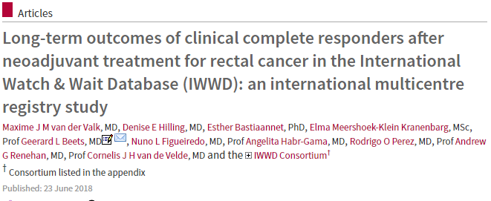
International Watch and Wait Database
Lancet June 2018
1009 patients treated with neoadjuvant treatment managed by W&W
880 were identified as having a cCR.
Median follow up time was 3.3 years
Local regrowth rate at 2 years was 25%,
87.8% patients who recurred during follow up were successfully salvaged by surgery
3-year metastatic rate 8.1% 5-year overall survival 84.7%

Slide 10
Patient Selection for Pre-Operative Therapy
Patients unfit for radical surgery
Patients who wish to avoid APE
Patients with High-Risk Low Rectal Tumours
Patient with locally advanced disease

Slide 11
Patients with Early Stage Low Tumours
Suitable for local excision or Transanal Endoscopic Micro Surgery in absence of adverse features
Should proceed without neoadjuvant therapy
Presence of high risk feature associated with local recurrence rate 20% and these patients should be offered radical surgery
Current data does not address whether neoadjuvant chemoradiotherapy aimed at organ preservation is justified or safe in patients with small distal rectal tumours.

Slide 12
Clinical Trials
Currently insufficient robust data to support Watch and Wait as standard of care approach for patients with complete clinical response after neoadjuvant therapy
Available data may aid shared decision making between clinicians and patients
Patients should be considered for appropriate Clinical Trials
STAR TREC Phase II three arm randomised feasibility trial, comparing the Standard TME surgery (control) vs Organ saving with either long course concurrent chemoradiation or short course radiotherapy
TRIGGER Magnetic Resonance mrTRG as Novel Biomarker to stratify management of good and poor responders to chemoradiotherapy.

Slide 13
Conclusion
Focus is shifting towards a more individualised approach to the management of rectal cancer
There is growing interest in organ preserving strategies in selected patients
Aim is to improve long term QOL and functional outcome without impacting on Oncological Safety
Essential to pursue further research to develop further evidence-based treatment strategies in this developing area of interest.

Slide 14
Thank You

