Slide 1
What’s new in stage III lung cancer?
Gareth Ayre
Lung SSG 27.11.18

Slide 2
What’s new
PACIFIC OS data published
NICE 2019 draft guideline –
Lung cancer: diagnosis and management
Recent BTOG lung cancer essential update

Slide 3
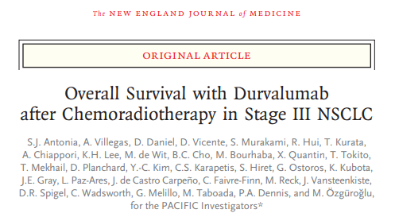
709 patients with stage 3 lung cancer (45% stage IIIB)
All received ≥2 cycles of platinum doublet chemo concurrent with 54 – 66Gy RT
Randomised 2:1 to durvalumab or placebo

Slide 4
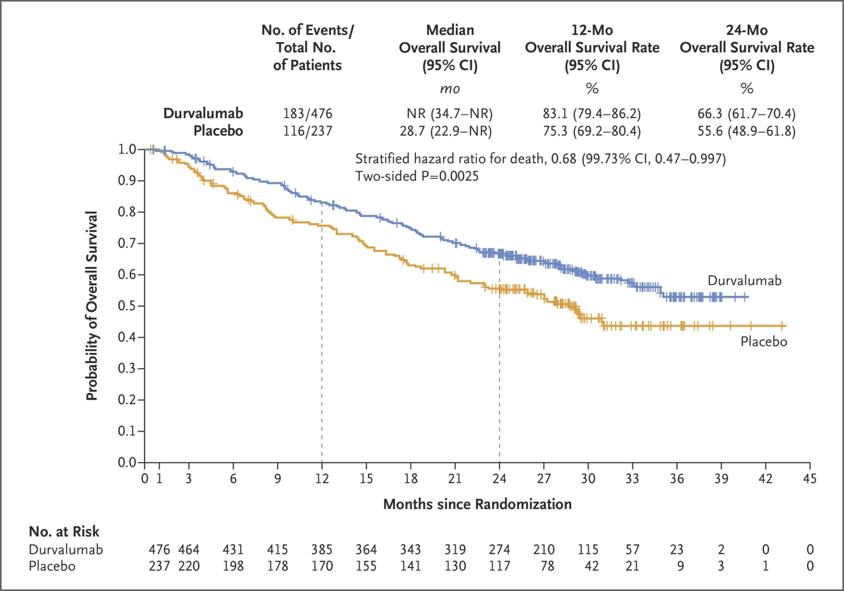
Overall survival

Slide 5
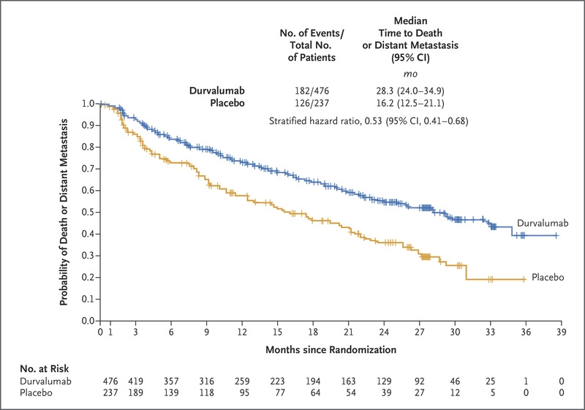
Time to death or distant metastasis

Slide 6
Lung cancer: diagnosis and management
NICE 2019 draft guideline
For people with stage IIIA–N2 NSCLC who are well enough for multimodality therapy and who can have surgery, consider chemoradiotherapy with surgery. [2019]
The available evidence showed that CRT and surgery are more effective than CRT alone in people who are well enough for surgery.
For chemo and surgery, there was no evidence that outcomes were better than for CRT, so the additional costs outweighed the benefits.
The key benefit associated with CRT and surgery is longer PFS.

Slide 7
However, there are some uncertainties in the evidence:
it was not possible to tell whether CRT alone or chemotherapy and surgery provide better survival outcomes
the evidence in favour of CRT and surgery involved indirect comparisons, and no head-to-head trials showed meaningful differences in outcomes for any of the interventions.

Slide 8
Current treatment pathways
Single station, ‘discrete’ mediastinal LN
Surgery then adjuvant chemo
Concurrent chemo-radiotherapy
Multi-station mediastinal LN
Concurrent chemo-radiotherapy if encompassable
Less fit patients
Sequential chemo-radiotherapy (?CHART)
RT alone

Slide 9
What can we all agree on
Treatment should consist of systemic therapy and local treatment
Single modality treatment is not considered optimal treatment
Concurrent CRT is considered superior to sequential
Unresectable stage III NSCLC = concurrent CRT
Adjuvant immunotherapy following concurrent CRT is now a new standard of care
T3N1 – standard of care is surgical resection and adjuvant chemotherapy in the UK

Slide 10
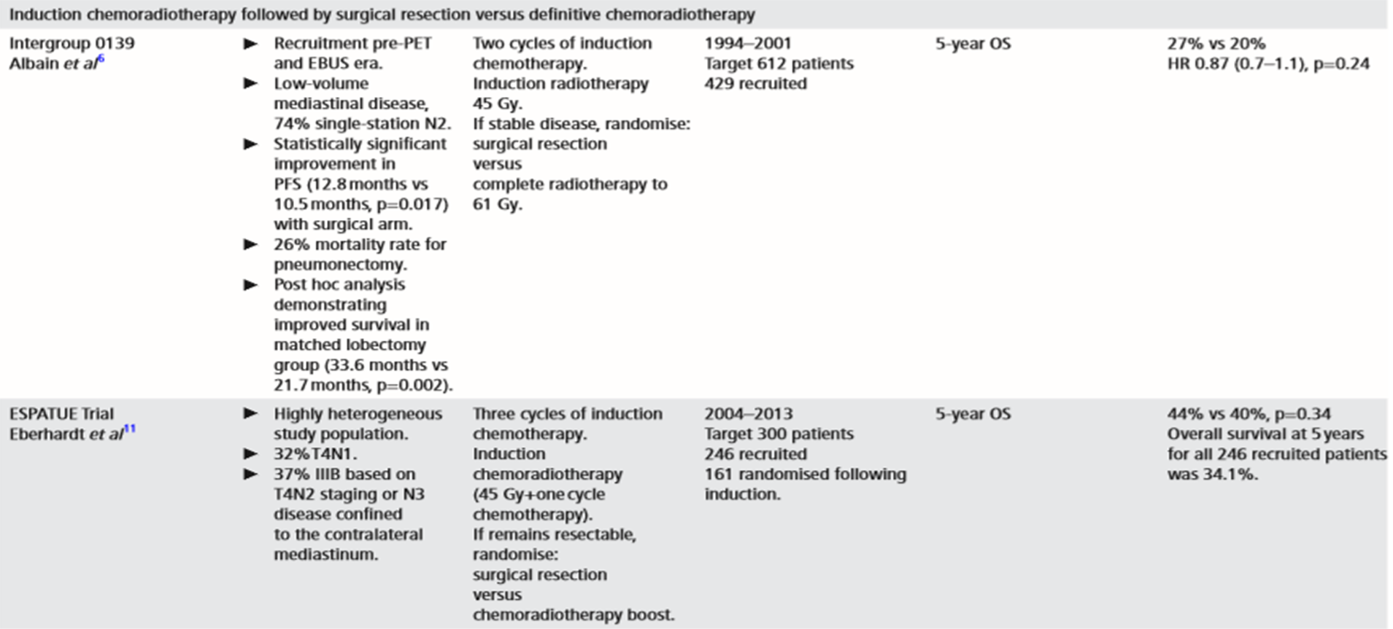
Why trimodality treatment?

Slide 11
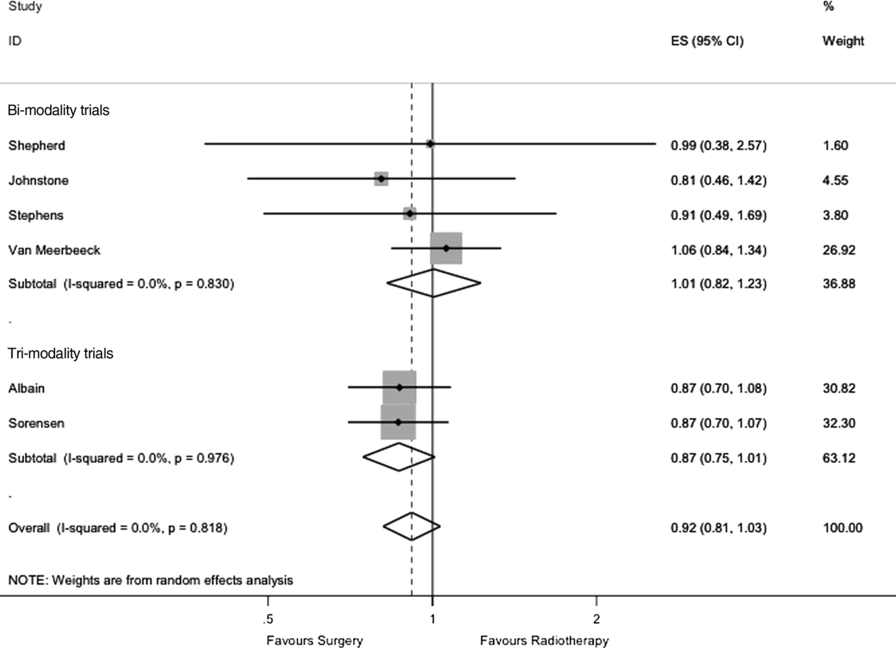
Pooled HR for death in the surgery group was 0.87 (CI 0.75 to 1.01; p=0.068)
No statistical evidence of heterogeneity (I2=0%, p=0.976).
Mcelnay et al Thorax 2016

Slide 12
Intergroup 0149: sub-group comparison
LOBECTOMY:
33.6 vs. 21.7 months (p=0.002)
PNEUMONECTOMY:
18.9 vs. 29.4 months (p=0.002)

Slide 13
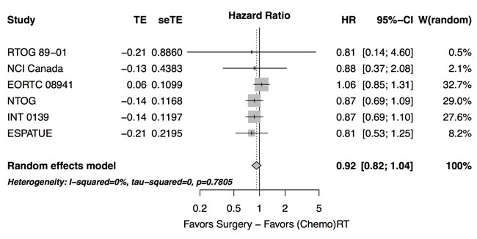
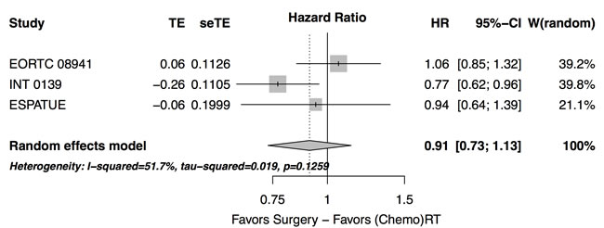
Pottgen et al. meta-analysis 2017 – including ESPATUE
Overall
survival
PFS

Slide 14
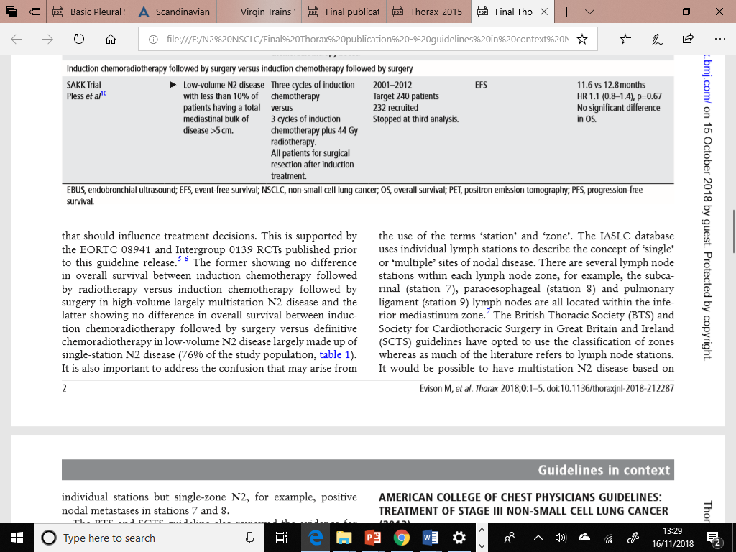
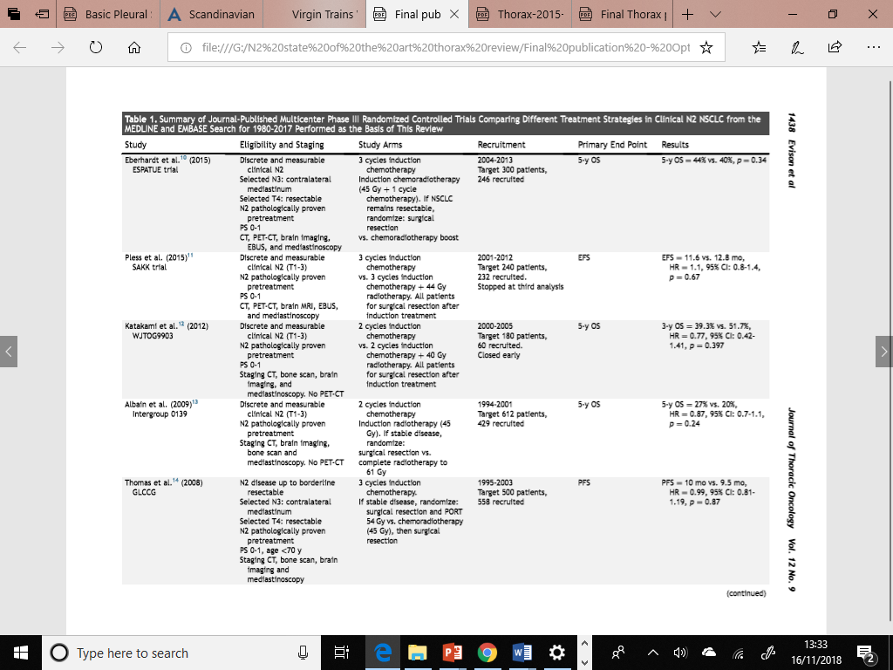
Is trimodality treatment better than bimodality treatment?

Slide 15
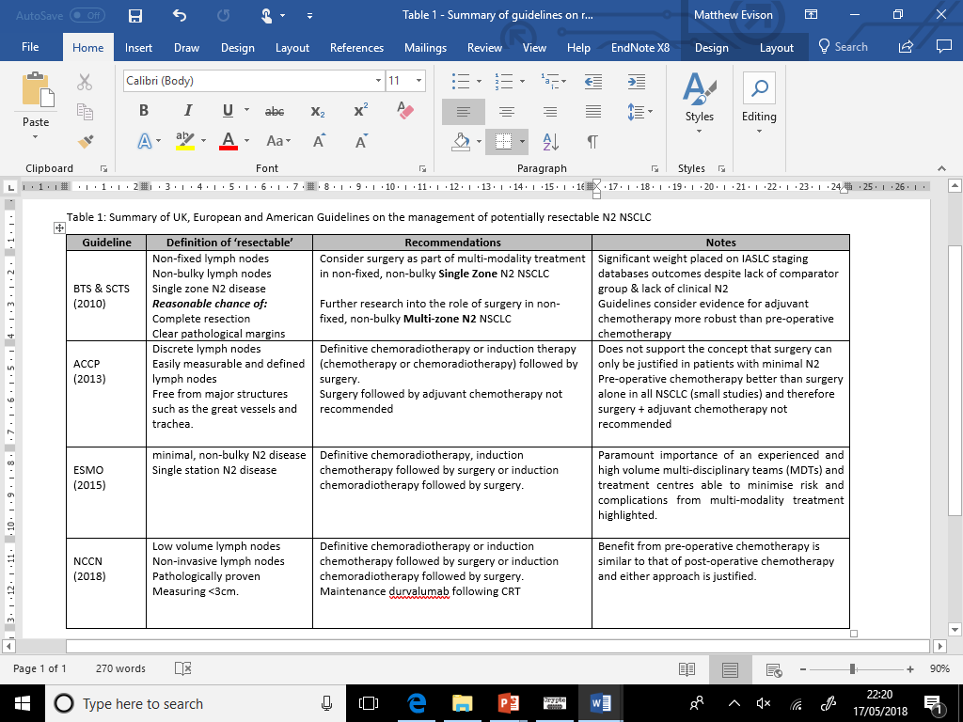

Slide 16
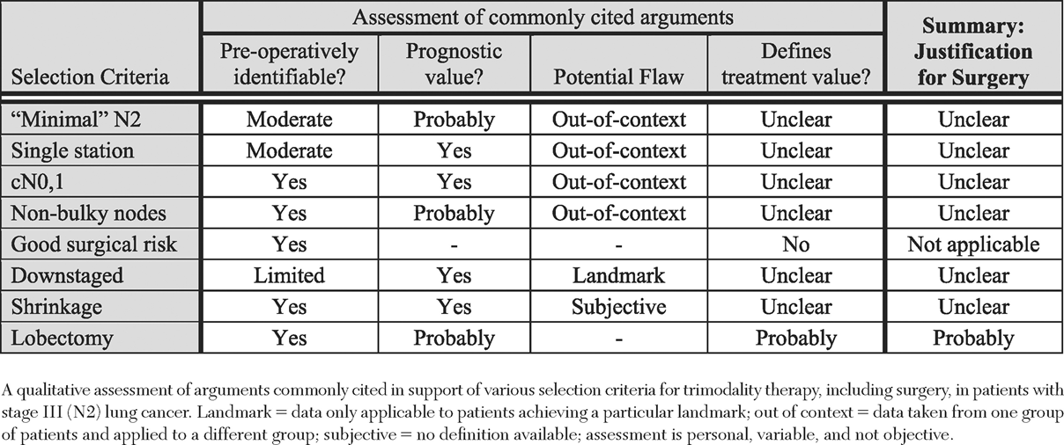
Who should get surgery?

Slide 17
Take home messages
Optimal treatment is multi-modality
Both surgical and non-surgical treatments should be offered to patients with stage 3 NSCLC
Single vs multi-station LN should not be used to select
For patients undergoing surgery, induction or adjuvant treatment are both justified although treatment completion rates are higher with induction
Patients opting for non-surgical treatment should receive concurrent CRT and adjuvant durvalumab if fit
Trimodality treatment may improve PFS ?clinically relevant

