Slide 1
Update on 100,000 Genomes Project and look ahead to Genomic Medicine Service
Chris Wragg, Lead Cancer Scientist, SWGLH
6th March 2019

Slide 2
Contents
100,000 Genomes Project
National update
Update on the future genomic medicine service

Slide 3
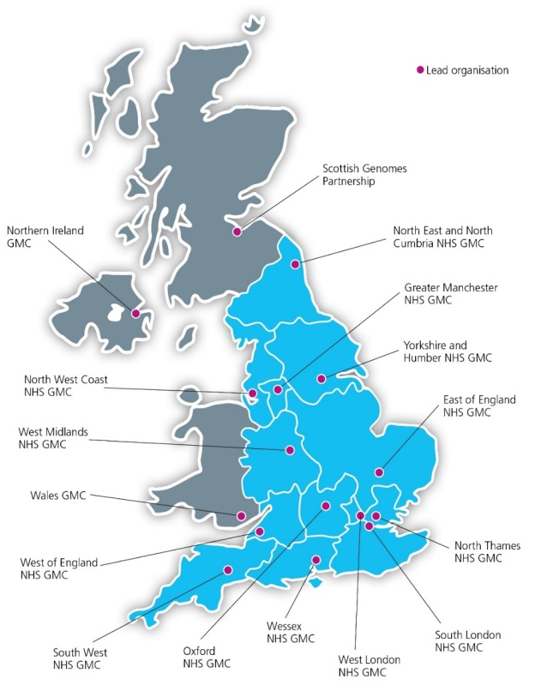
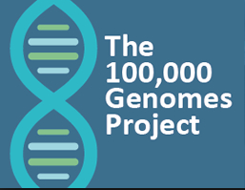
National delivery of 100,000 Genomes Project

Slide 4
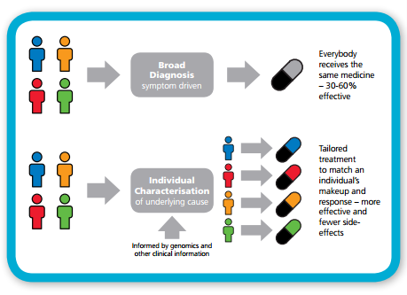
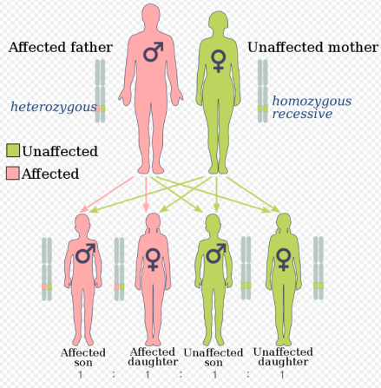
Providing actionable information for cancer patients
Format adapted from Genomics England
Prognosis
Diagnosis
Clinical Trials
Cancer Molecular Markers
Image taken from Wikipedia
Therapy selection
Image taken from NHS E
Cancer susceptibility

Slide 5
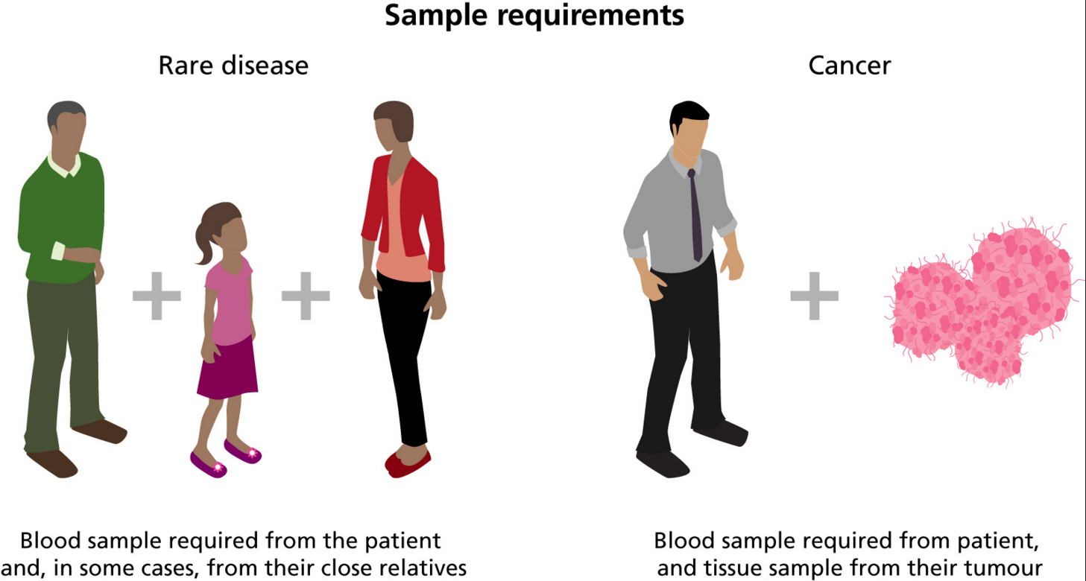
Samples required (+ supporting clinical data)

Slide 6
Simplified overview
Recruit patients, extract DNA, send DNA to Biorepository and submit clinical data
Genome sequencing by Illumina (Hinxton, Cambridge)
Bioinformatic analysis of genome sequence data
(gene panel analysis → tiered variants)
Analysis of genomic variants, GTABs where required, confirmatory testing, issue of clinical diagnostic report and communication of result to patient

Slide 7
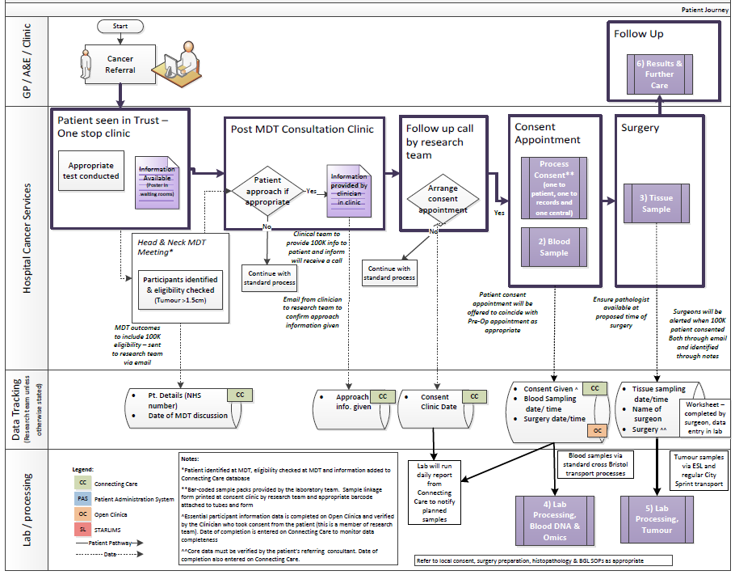
What did it mean for staff to support the 100,000 Genomes Project?
Patient
GPs
Pathology
Imaging
Surgeons
Consultants
Nursing staff
Specialists
Breast Care Nurses
Research team
Clinic management
Theatre team
MDT co-ordinators
Specimen transport team
IT experts
How do you develop a pathway? – the key is engagement at every step of the pathway…..
Blood laboratory
Tumour laboratory
Managers
Introduction to the 100,000 Genomes Project
7
Reception
Processing

Slide 8
Cancer programme
1
*
Brain
*
2
1
Haematological
2
Sarcoma
Head & Neck
1
Melanoma
3
Breast
*
1
Paediatric
2
Endometrial
2
Colorectal
2
2
Ovarian
Urological
1
Trust | group | ALL | AML | CLL | MM
UHB | Adult |  | 13 | 2
NBT | Adult |  | 1 | 4 | 11
UHB | Paed | 7
680 patients from 18 cancer pathways open across four enrollment sites
1

Slide 9
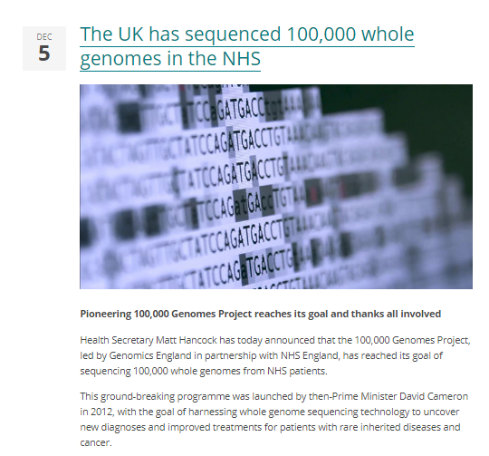
A remarkable achievement

Slide 10
GMC update
The recruitment of participants and the submission of samples to the project is now complete
Activity will need to continue throughout 2019 to finish the validation and return of results to participants, and to support continued development of the NHS genomic medicine service
In recognition of the continued role of the NHS GMCs, it is NHS England’s intention to:
extend the existing NHS GMC contracts for a further 12 months; and
complete a provider selection process to identify the future GMC infrastructure from 2020 onwards (aligned with the geographies of the seven Genomic Laboratory Hubs)
Anticipated that the extension will only be taken forward by a smaller number of existing NHS GMCs

Slide 11
GMC update
Return of results from the 100,000 Genomes Project
Patient engagement and involvement
Support introduction of the Genomic Medicine Service and whole genome sequencing (WGS)
Co-ordination and implementation of future genomics projects

Slide 12
Mainstreaming genomic medicine - Beyond 1st October 2018
Genomic Medicine Service
Genetics Laboratory Hubs:
7 nationally commissioned laboratory hubs
National Directory for all genetic & genomic testing
Genomic Laboratory Hubs
Clinical Genetics Services
Genomic Medicine Centres
Cancer Services
Genomic Medicine Centres:
Support transition from project to clinical practice
Clinical Genetics Services:
- Review of services to ensure support and equity
Cancer Services:
- Supporting 100,000 Genomes patients and future genomics pathways

Slide 13
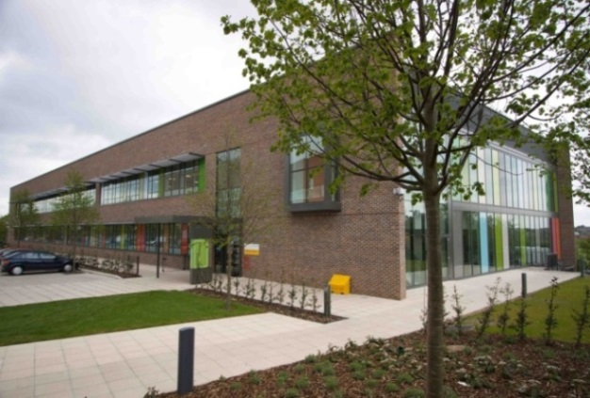
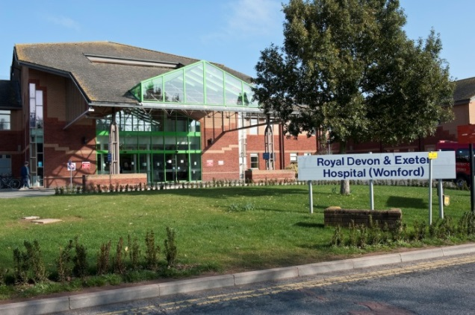
South West Genomic Laboratory Hub
Partnership
North Bristol NHS Trust
Royal Devon and Exeter NHS Foundation Trust
Core genomic tests ( all 7 GLH)
Rare disease Test Directory
Cancer Test Directory
Specialist genomic tests delivered by GLH appointed as a National Specialist Test Provider (NSTP)
17 clinical specialisms ( 2 or 4 providers)
GLH will forward samples to the designated NSTP lab
Cancer (somatic/inherited)
Cardiology
Renal
Neurology
Respiratory/Metabolic
Endocrinology

Slide 14
The National Test Directory
Technology | Est prop’n of reports
Targeted mutation testing | 20-25%
Microarray | 10-20%
WGS | 10-25%
Small panel | 10-15%
STR testing | 10-15%
WES or large panel | 2-14%
MLPA or equivalent | 5-7%
Common aneuploidy testing | 5-7%
Karyotype | 3-5%
Single gene sequencing | 3-5%
FISH; DNA repair defect testing; Methylation testing; UPD testing; X-inactivation; Identity testing; Microsatellite instability; NIPT; NIPD; PGD | each <2%
Other | 2-5%
500,000
tests per year
300
RD indications
across 14 groups
covering ~ 3000 RDs
180
cancer indications
26
Indications for WGS
22
test technologies – single gene to WGS
Defines all the genetic and genomic tests available through the NHS in England – specifying the appropriate test for each clinical indication
Requesting via central IT system (NGIS)
Developed through national & international scientific review
Updated annually - led by expert panel to keep pace with scientific advance

Slide 15
What the future holds…
Increased, more equitable access to genomic testing (centrally funded by NHS England)
On-line ordering of genomic tests from national test directory according to defined clinical eligibility criteria
New “patient choice” materials with opt-in for research
Standardised methodology across laboratories and improved reporting times
Increasing number of tests performed by genome sequencing (500,000 funded over next 5 years, aspiration of 5 million genomic tests!)

Slide 16
What the future holds…
Developing, validating and implementing a rapid whole genome sequencing in the NHS:
Building on 100K genomes sample pathways to enable rapid enrolment of appropriate patients alongside sample and clinical data
Developing IT infrastructure
Developing consent/patient choice materials
Developing robust and timely return of results pathways linking into MDTs
Expanding interim standard of care genomic testing in the SWGLH

Slide 17
Thank you!

