Slide 1
100,000 Genomes Project & Mainstreaming Genomic Medicine
Update Session
Provided by Catherine Carpenter-Clawson Programme Manager, WE GMC

Slide 2
Contents
Genetics and genomics
Introduction to 100,000 Genomes Project
Project update:
National progress
Local progress
What next? Mainstreaming Genomic Medicine

Slide 4
Genetics vs. Genomics
Genomics
Involves the entire genome, including coding (genes) and noncoding DNA
Relates to disorders with complex inheritance
Recognises complexity of gene-gene and environmental interactions
Arises from new genomic technologies
Genetics
Involves a single gene pair or chromosomal region
Relates to single gene disorders
Observes Mendelian inheritance
Arises from clinical observation
Courtesy of Genomics Education Programme

Slide 5
Genetics vs Genomics
Genetic testing = single genes or panels (Sanger sequencing)
Exome sequencing = all coding DNA (Next-Gen Sequencing)
Genomic sequencing = all coding and non-coding DNA (NGS)
Single gene
Small panel (5-10)
Larger panel (50-100)
Clinical exome
Whole exome
Whole genome
Courtesy of HEE E&T Group

Slide 6
Contents
Genetics and genomics
Introduction to 100,000 Genomes Project
Project update:
National progress
Local progress
What next? Mainstreaming Genomic Medicine

Slide 7
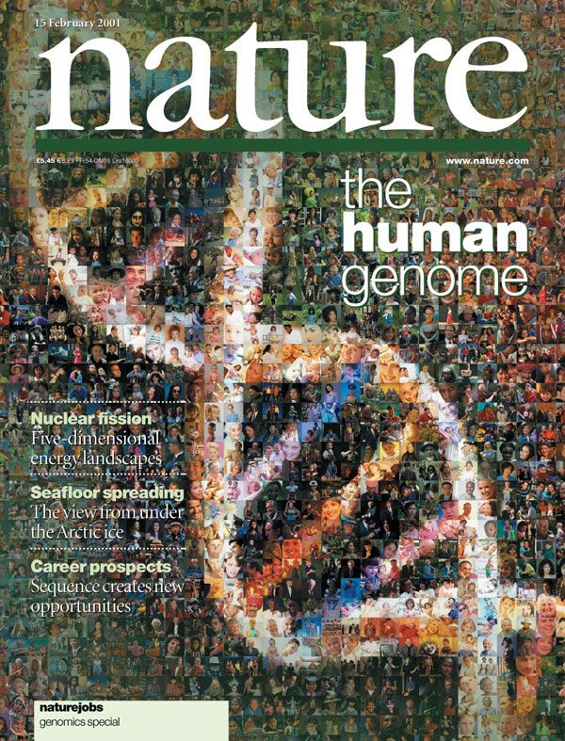
The Human Genome Project
Commenced in 1990 - completed in April 2001/2003
First genome costs $2.7 billion in total
First time the human genetic blueprint had been completely read
Enabled the discovery of genes which cause disease
Allowed genetic diagnostics to progress
Paved the way for large-scale diagnostic sequencing programmes
Courtesy of HEE E&T Group
Notes:
Reference genome created…..version 38 now causing issues!

Slide 8
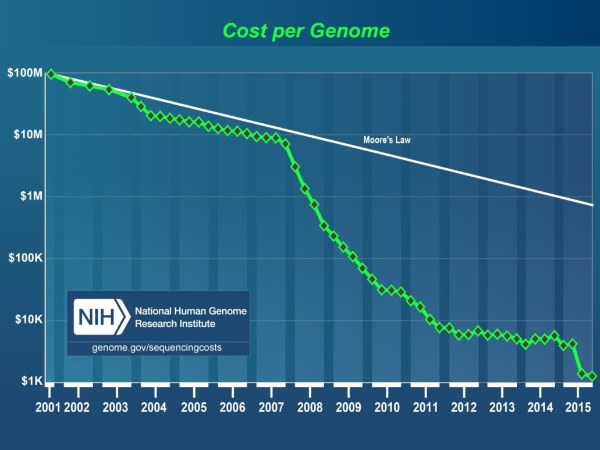
100,000 Genomes Project: How did we get here?
Human Genome Project generates reference sequence at an estimated cost of $2.7 billion
Development of new technologies drives down the cost of Whole Genome Sequencing – the $1000 genome is now a reality
Graph from NHGRI
Now potential to bring real benefits to patients, drive research and drug development, and develop personalised medicine for the NHS, in the NHS, by the NHS
Courtesy of HEE E&T Group
Notes:
The $1000 genome was talked about as the holy grail of genomics – the point at which it became possible to offer WGS at a parallel cost to standard diagnostics.
These two things made it possible, but the biggest drive for the 100K programme was the potential to bring benefits to current and future patients in the form of personalised medicine – a one size does not fit all model. Recognising that we are not identical, that tumours are not identical, some drugs work better in some than others (especially so in cancer) and that targeting therapies to individuals is a possibility – that no one alive is youer that you.

Slide 9
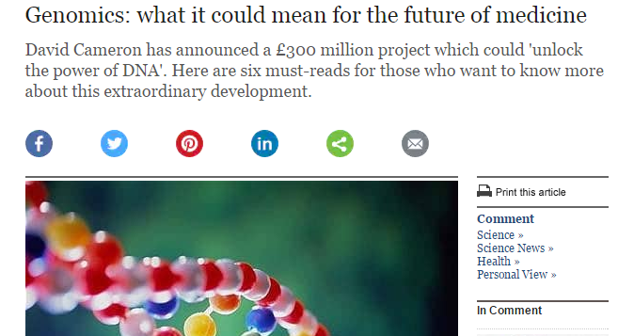
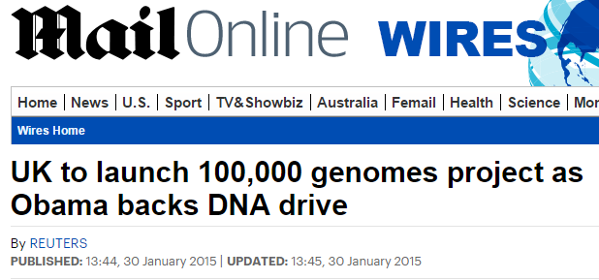
100,000 Genomes Project: Setting up
December 2012: David Cameron announces plans for the 100,000 Genomes Project as part of the Olympic legacy
July 2013: Jeremy Hunt launches Genomics England, a company established to deliver the 100,000 Genomes Project
December 2014: 11 NHS Genomic Medicine Centres are announced
December 2015: WE GMC announced as one of 2 final NHS Genomic Medicine Centres
Courtesy of HEE E&T Group

Slide 10
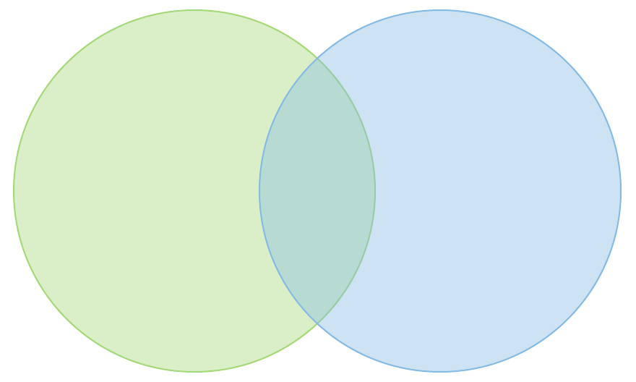
100,000 Genome Project: Objectives
NHS
Transformation
Research
Clinical
100,000 Whole Genome Sequences with linked data set by end 2018
Increased discovery of pathogenic variants leading to new treatments, devices and diagnostics
Accelerate uptake with advanced genomic medicine practice integrated into the NHS
*Mainstreaming*
Increase public understanding and support for genomic medicine
Stimulate and advance UK life sciences industry and commercial activity in genomics
Courtesy of HEE E&T Group
Notes:
Programme legacy will see:
Improving outcomes for patients and reducing variation in clinical care
High quality sample preparation and use of high throughput and novel genomic technologies
Reduction in variation of quality in laboratory processes and access to genomic testing
Richer phenotypic data linked to genetic abnormalities and markers
A robust informatics infrastructure and interoperability
Stronger link between clinical practice and applied genomics
New genomic multidisciplinary teams – bringing together many more clinical scientists and clinicians Improved clinical leadership and delivery of the clinical change model

Slide 11
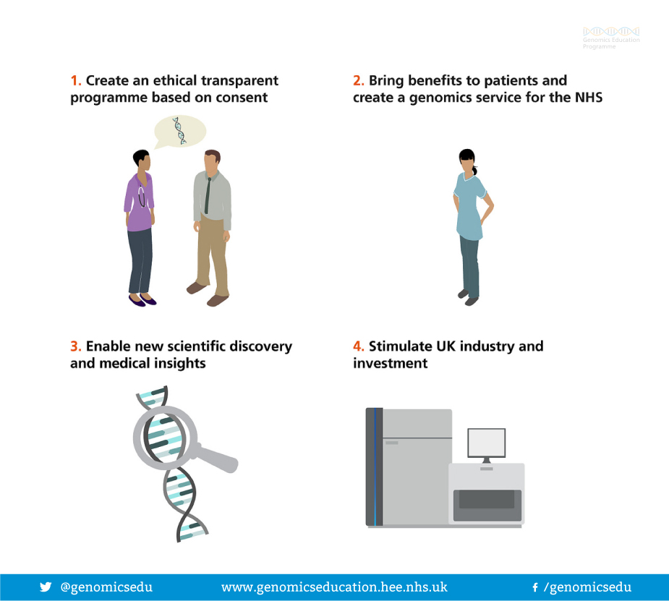
100,000 Genomes Project: Aims
Courtesy of Genomics Education Programme

Slide 12
NHS Genomic Medicine Centres
NHS Genomic Medicine Centres (NHS GMCs) : mapped against AHSN boundaries
NHS GMCs work in partnership with academia, patients and industry through the AHSNs
Notes:
Emphasis national coverage – not all providers contributing but aim was national coverage

Slide 13
What is a Genomic Medicine Centre (GMC)?
A group of NHS providers (and other key local organisations) who have come together to support delivery of the 100,000 Genomes Project
We are ordinary NHS staff seconded to work on the project and set it up alongside existing clinical practice
We are not building a big new centre or working outside of existing NHS structures

Slide 14
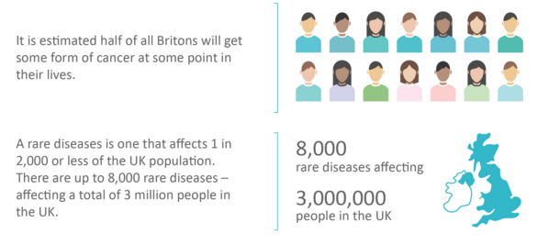
100,000 Genomes Project: who is eligible?
Cancer: 17 cancer groups with tumour size and type requirements
Rare diseases: >250 different conditions
Minimal diagnostic criteria and prior genetic testing
No causal variant identified

Slide 15
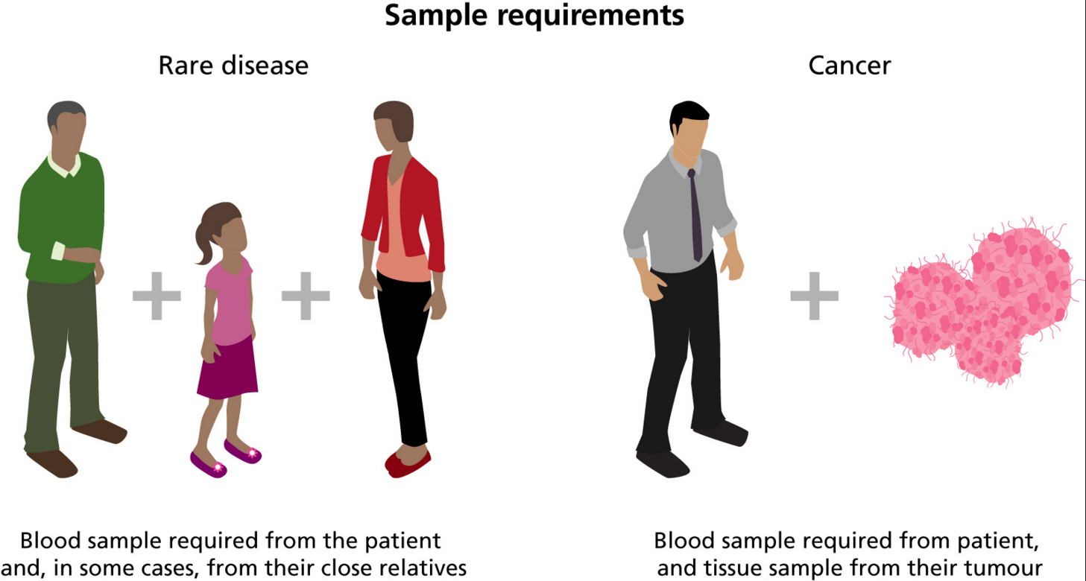
What samples are taken?

Slide 16
Cancer patients eligible under ‘Rare Disease’ – Tumour Predisposition
Tumour sample is not required - looking for underlying hereditary predisposition
Patients with familial cancers
Individuals with multiple primary tumours
(2 tumours under 50 years; 3 tumours under 60 years)
Exceptionally young diagnosis of adult onset tumour (colon cancer under 30 years)
For further information contact clinical genetic services or queries regarding 100,000 Genomes referrals ubh-tr.wegmc@nhs.net

Slide 17
Cancer genome samples
Key Considerations:
Consent
Required post diagnosis but pre-surgery
Dedicated time for discussion
Sample collection
Blood separate blood tube required
Tumour DNA damaged by formalin fixing so fresh tissue is required
Required to transport sample in appropriate timeframe/temperature
Biopsy pathway being explored
Engagement
Everyone in the pathway has to be on board…..

Slide 18
Contents
Genetics and genomics
Introduction to 100,000 Genomes Project
Project update:
National progress
Local progress
What next?

Slide 19
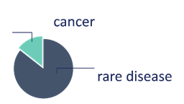
100,000 Genomes Project: National Update – December 2017
Samples
Genomes
Analysis and Reports
67,446
41,582
Reports for
3,337
Samples collected from NHS GMCs
families sent to GMCs
genomes
Equivalent to
Biopsy live and a high calibre cancer genome achieved & enrolment in cancer is growing
5,445
6,992
genomes
36,137
20-25% actionable findings
87 cancer fast track samples collected & turned around in 20 days
Scaling up
19,865
3,457 genomes
since last month
Genomes and clinical data in the Research Environment
Courtesy of NHS England
S
Notes:
As at Feb 2018 - 13,000 cancer samples processed and further 5,000 collected

Slide 20
Phase 1. Contracting & pathway mapping
Phase 2. Informatics & piloting
Phase 3. Engagement & Expansion
Phase 4. Transition & mainstreaming
First
RD consent GHNFT
28th Mar
First
RD consent
RUH 22nd June
First RD consent UHB
10th Jun
1,000 individuals enrolled 19th July
All providers operational – 4 RD & 16 cancer pathways live
First cancer consent GHNFT
11th Jan
“Go-live” of cancer & RD pathways
27th May
First cancer consent NBT
27th Jun
First
cancer consent
RUH
19th May
First cancer consent UHB
8th Nov
Designation as GMC
23rd Dec
2,000 individuals enrolled March 18
Jan 16
Jan 17
Jan 18
Launch event
26th Sep
Conference
1st Sep

Slide 21
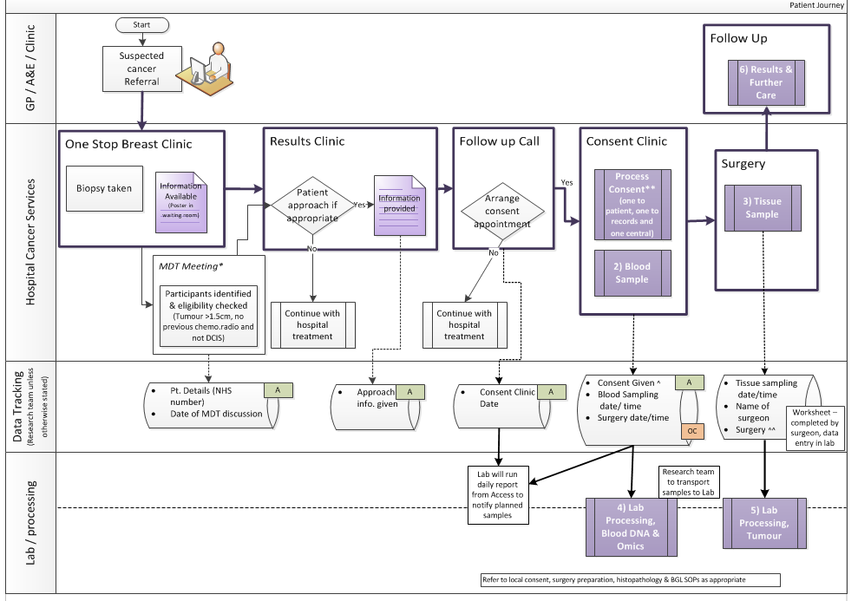
How do you develop a pathway?
Patient
Pathology
GPs
Imaging
Consultants
Surgeons
Nursing staff
Specialists
Breast Care Nurses
Research team
Theatre team
Clinic management
MDT co-ordinators
Specimen transport team
IT experts
How do you develop a pathway? – the key is engagement at every step of the pathway…..
Blood laboratory
Tumour laboratory
Managers
Reception
Processing
Notes:
Emphasis on how everyone needs to be on-board in order to get just one pathway going

Slide 22
Rare Disease – WE GMC has collected over 1,500 samples over a variety of specialties
(Date as shown taken from Open Clinica 01/02/18)
Notes:
Locally RD programme consented over 1,500 samples and includes consent to Tumour Syndrome through Clin Gen

Slide 23
Cancer samples collected
Total active samples in pipeline is 561 against target of 603
96 additional samples added to pipeline in February – continuing current consent rate will result in delivery of 95% of samples

Slide 24
100,000 Genomes Project: Cancer Local Update
As of February 2018
- 16 active pathways across WE GMC:
Pathways active across all 4 provider organisations (Head & Neck in GHNFT)
2 final pathways to consent patients
Head & Neck & Paediatric Oncology (UHBristol)
Notes:
Engagement across a variety of pathways
Question always is why these pathway and I answer we wanted to get each provider on board and as much as possible get experience across a range of pathways but number 1 clinical teams who were keen, engaged and willing to do some of the ground work themselves were a priority.

Slide 25
Contents
Genetics and genomics – Introduction to 100,000 Genomes Project
Project update:
National progress
Local progress
What next?
(So What!)

Slide 26
How do you develop a pathway?
Patient
Pathology
GPs
Imaging
Consultants
Surgeons
Nursing staff
Specialists
Breast Care Nurses
Research team
Theatre team
Clinic management
MDT co-ordinators
Specimen transport team
IT experts
How do you develop a pathway? – the key is engagement at every step of the pathway…..
Blood laboratory
Tumour laboratory
Managers
Reception
Processing
Notes:
Now turning our attention to return of results

Slide 27
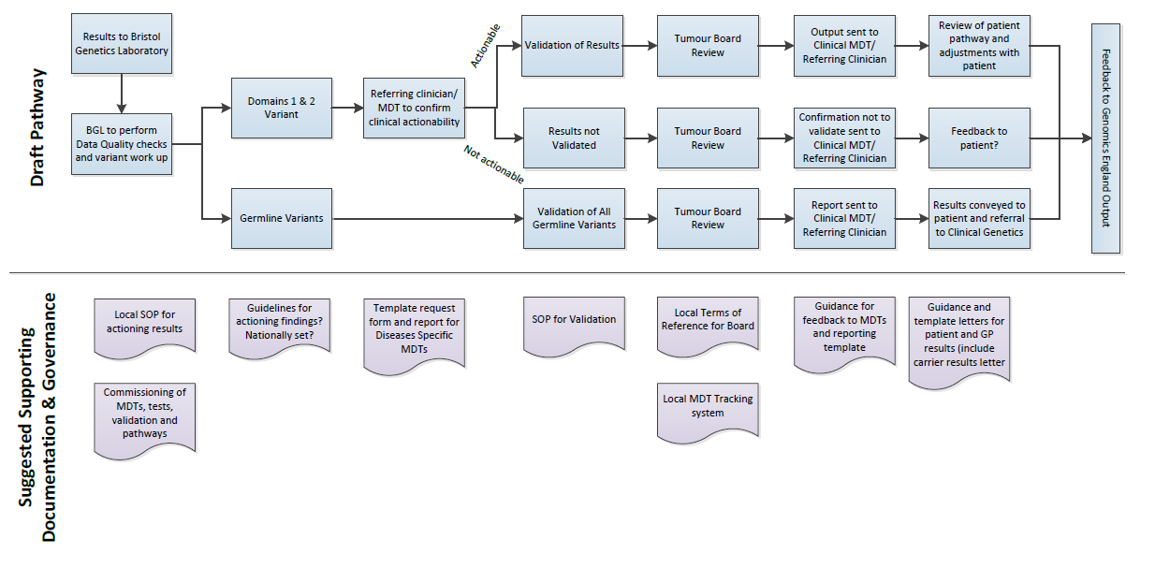
Developing the return of results pathway
WE GMC Cancer Clinical Oversight Group is starting to work through practical steps:
- Welcome comments/feedback/advice from anyone interested.
Draft for internal
discussion only
First meeting 16th February 2018 to discuss first result
Future meetings 3rd Friday of every month
Notes:
Emphasis we tried to map this at the start but this is a pilot/development project and until we get a real result it is very hypothetical.
Results come back centrally to the Bristol Genetics laboratory
Focus on defined gene panel actionable in cancer
Potential variants are highlighted
Patient clinical situation will be reviewed
Anyone who wants to be involved can be.

Slide 28
Providing actionable information for cancer patients
Courtesy of Genomics England
Early analysis found 65% of Project cancer cases have variants in actionable genes
Prognosis
Diagnosis
Clinical Trials opening up eligibility
Cancer Molecular Markers
WGS provides extra diagnostic reach (structural variants, copy no. variants etc)
Global patterns of mutation (‘signatures’) proving informative
Defining causal drivers from benign ‘passengers’ is critical
Therapy selection
Cancer susceptibility
Notes:
This is from an Genomics England presentation and will be of interest to see how our local experience compares to this:
Early analysis shows 65% of reports identify actionable genes
Tumour disposition genes also found in germline analysis
Findings have opened up eligibility for patients to enter further clinical trials

Slide 29
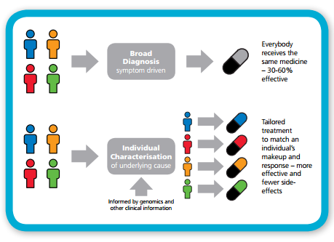
Providing personalised medicine
NHSE: Improving Outcomes through Personalised Medicine, September 2016
Notes:
Currently drugs are developed for a particular condition and there is the assumption that everyone will respond in the same manner. All patients with the same condition are given the same first line treatment however it is thought this is only effective for between 30 and 60% of patients.
Looking and the genomic and diagnostic characterisation different subtypes of patients within a condition can be identified, and a treatment can be tailored to the underlying cause.
For cancer this is an approach which is more commonly in place. Offering a genomic or molecular diagnosis - we can better understand the genetic basis and select the most appropriate treatment – improving survival chances.
It means that cancer patients can be stratified according to what is the most effective for their condition. May also mean that patients with different types of cancer may on the genomic diagnosis receive similar treatments.

Slide 30
Providing access to targeted clinical research
Notes:
Clinical trials have for a long time used mutation status to stratify cohorts – will this assist further in tailored research and entry into trials?

Slide 31
Genomics in Mainstream Healthcare
Diagnoses
Genomics
Personalised Medicine
Prognoses
Treatments
The NHS workforce needs to understand, discuss and convey this complex area to colleagues and patients
How do we support clinical teams to deliver genomic medicine in the future, training, support, piloting and education
Notes:
The introduction of genomics into mainstream healthcare is set to provide new diagnoses, prognoses and treatments, forming the foundations of personalised medicine.
The genomic revolution is critical to the personalisation of healthcare, to the prediction of disease, and the prevention of disease.

Slide 32
Mainstreaming genomic medicine - Beyond 1st October 2018
Genomic Medicine Service
Genetics Laboratory Hubs:
Reprocurement commenced Dec 17
7 nationally commissioned laboratory hubs by October 2018
National Directory for all genetic & genomic testing
Genomic Laboratory Hubs
Genomic Medicine Centres
Clinical Genetics Services
Genomic Medicine Centres:
To be reprocured/redesignated
Support transition from project to clinical practice
Clinical Genetics Services:
- Review of services to ensure support and equity
Notes:
What we know is from 1st October there will be:
Genomic Laboratory Hubs
A national directory of tests dictating which tests will be funded nationally
GMCs will exist with a transformation, governance and potential project based remit
To support this there is a review of clinical genetics services as potential impact on their work will be critical

Slide 33
How to Get Involved
Opportunities for supporting activity in the project
Get involved in recruitment– discuss possible patients with your clinical team or the GMC team
Opportunities to further your own education
Become a contact for your department / team for us to disseminate genomics information through
Tell us what you need/tell us how we can make this work together
Notes:
MENTION GeCIPS

Slide 34
Thanks and any questions
Catherine Carpenter-Clawson
Programme Manager, WE GMC
07732 561067
Catherine.Carpenter-Clawson@nbt.nhs.uk
or
Ubh-tr.wegmc@nhs.net

Slide 35
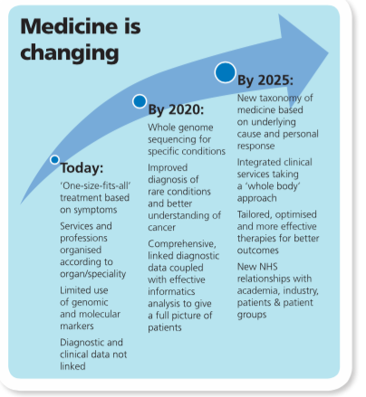

Slide 36
Structure and organisations involved in the project

Slide 38
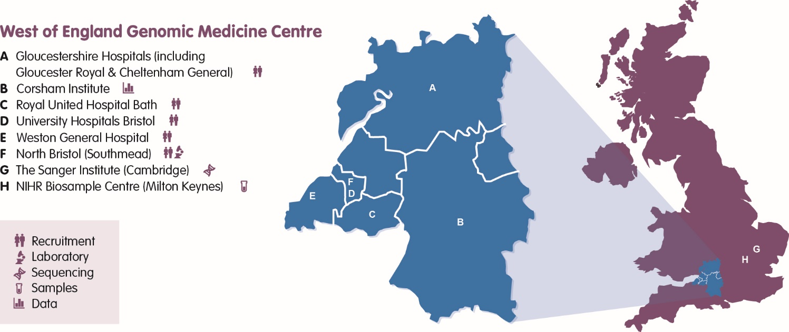
The West of England NHS GMC was designated as a centre in December 2015 and serves a population of 2.8 million. The WEGMC consortium is composed of five Trust partners:
In collaboration with:
Clinical Commissioning Groups
Health Education England South (West)
Avon and Wiltshire Mental Health Partnership NHS Trust,
West of England Clinical Research Network
West of England AHSN

Slide 39
Key Functions of the NHS GMCs
NHS GMC
Recruitment & consenting of patients across specialities
Patient & Public Involvement
Informatics systems development & capture of participant phenotypes
Sample collection, processing & logistics to defined quality standards
Post annotation validation & reporting in conjunction with MDT
Return of results to participants & clinical care according to guidelines
Transforming the NHS – improving outcomes & reducing variation
Upskilling the NHS Workforce
Partnerships & networks across geographies
Notes:
From the service specification

Slide 40
Processing the Data

Slide 41
More than just genomics
Phenotype +
DNA
Genomics
Analysis of the full DNA sequence (of which single exomes are <1%)
RNA
Transcriptomics Study of all the RNA forms in the body >30k – measures expression of genes
Proteins
Proteomics
Study of the proteins produced in the body (>100k products)
Metabolites
Metabolomics
Study of the >6500 metabolites produced by the body

Slide 42
Case Study: Jessica
100,000 Genomes Project
Early onset seizures
Developmental delay
Multiple investigations: no diagnosis
Jessica and parents recruited to 100K genomes pilot study.

Slide 43
Case study: Finding the needle
100,000 Genomes Project
677, 556 are rare
2,826 predicted to cause change in protein
67 different to her parents
1 was in a gene listed in PanelApp
6,414,934 variants in Jessica’s genome
Mutation in SLC2A1 – Glut 1 deficiency
Notes:
To begin the analysis, every genome is compared to the reference human genome sequence we use as a guide.
Jessica’s genome had 6.4 million differences, or variants, from the reference sequence. Because Jessica’s condition is rare, we knew that the variant we were looking for was rare too. So the next step in this case was to look for rare variants. Almost 700,000 were rare.
Using information from scientific studies and research papers, we then narrowed down the 700,000 variants to almost 3,000 that are predicted to cause a change in a gene product (a protein).
Jessica’s parents do not have the same condition – so the next stage was to look for differences between Jessica and her parents. Out those 3,000 variants, there were just 67 that were different between Jessica and her parents and could be the underlying cause of her condition.
Finding the right variant
We checked Jessica’s variants against a knowledge base curated by Genomics England – PanelApp. This tool has information on thousands of genes that may be linked to rare diseases, as reported by expert doctors and researchers. PanelApp is a crowdsourcing tool for the rare disease genetics community, and we are currently looking for more expert reviewers – please visit the PanelApp site for more information.

Slide 44
Case study: Altered management
100,000 Genomes Project
Some patients with Glut1 deficiency syndrome respond to a ketogenic diet.
A low-carbohydrate diet can help reduce the number of seizures by providing an alternative energy source for the brain.
Jessica has responded positively to this diet with reduced number of seizures.

