Slide 1
Treatment with Curative Intent at the BRI
SWAG Nov 19
Andy Low

Slide 2
Surgical resection rates
Audit standard 17% of all NSCLC patients
Nationally 18.4% in England
(Increase from 17.5%)

Slide 5
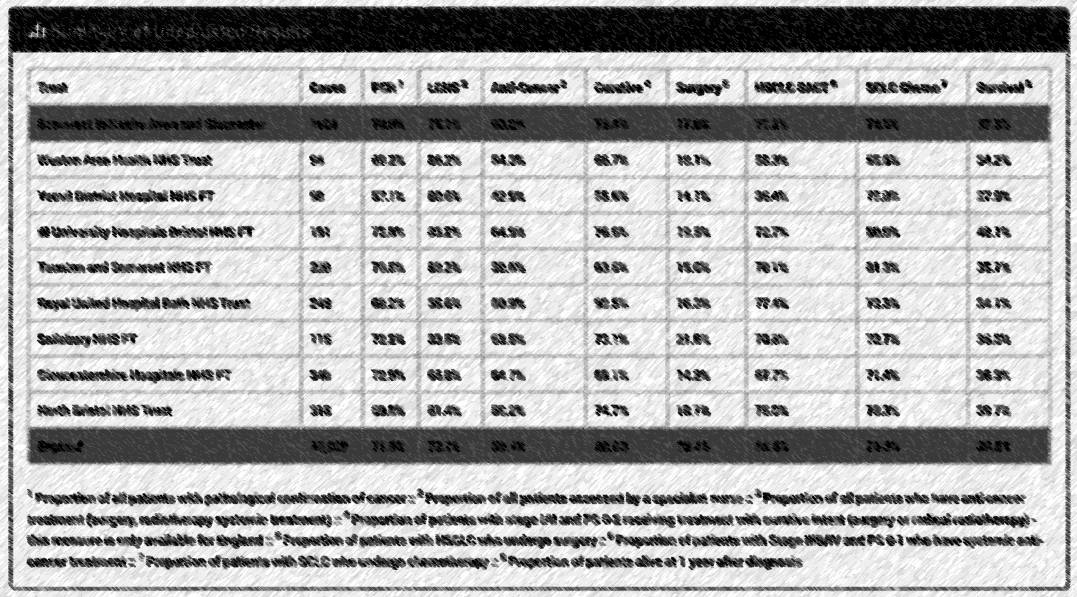
Adjusted Proportion 15.9%

Slide 6
Treatment with Curative Intent
80% standard for NCSLC I-II, PS 0-2

Slide 7
Notes:
<National average except for RUH
73.4% Regionally vs 80.8% Nationally

Slide 8
2017 data (NCLA 2018)
Total cases | No active Rx | Palliative Rx | Curative
60 | 12 (20%) | 5 (8.3%) | 43 (71.7%)
1 PS1 Complex patient – recurrent lung cancer, but also with aspergillomas – not for surgery, SABR and RFA not possible due to position
2 PS2 Very slow growing GGO – presumed adeno, not for surgery due to comorbidities and age 82 (ie unlikely to progress quick enough for it to be a problem)
3 PS2 Concurrent second malignancy – pancreatic – not for treatment of that (BSC)
4 PS2 ?Staging – bilat lesions – 1 would be amenable, but the other couldn’t be SABR’d due to position. Too frail for surgery (seen and assessed), SB oncology.
5 PS2 93 with severe ILD – couldn’t have SABR not fit for surgery
6 PS2 Not for SABR due to severe COPD on PFTs with ambulatory O2
7 PS2 88 presumed cancer – v slow growth of 2mm in 2 years with multiple comorbitidities inc breathlessness due to severe COPD, 5cm aneurysm
8 PS2 (listed as PS2-3 with very severe COPD meaning SABR not possible) FEV1 0.87 40%, TLCO 2.53 34%
9 PS1 Pt declined surgery… but not felt fit enough tor radical DXT 86, Alk pos, met the surgeons, CHART considered, but oncology advised against this and instead fiven Crizotinib (quoted 8-10% 3 yr progression free survival)
10 PS1 Couldn’t have SABR due to ILD. Surgical work up and assessment, but cancelled surgery as too high risk 6122889636
11 PS2 80 Severe dementia – had been in a care home but admitted to psych under section with deteriorating behavior – 2x synchronous primaries, no capacity
12 PS2 88 COPD deemed not for radical radiotherapy…
13 Stage IIIA not Stage IIB
14 PS1 Severe COPD with very poor lung function – did have CPEX but poor VO2 max – not for surgery. Did have induction chemo with a plan to have radical radiotherapy, but tolerated chemo poorly
15 PS2 Complex patient with concurrent head and neck cancer (small probable lung cancer), progressed slowly following treatment for head an neck Ca, unlike the patient who became weaker PS3, and with multiple other problems including nutrition, alcohol XS, poor engagement
16 PS2 Stage 3a, bilat cancers, not fit for radical radiotherapy – miscoded synchronous primaries
17 smaller lesion of patient 17

Slide 10
Clinicians Seen
Case 2 PS2 82 Very slow growing GGO – presumed adeno, not for surgery due to comorbidities and age 82 (ie unlikely to progress quick enough for it to be a problem)
Case 3 PS2 Concurrent second malignancy – pancreatic – not for treatment of that (BSC)
Case 5 PS2 93 with severe ILD – couldn’t have SABR not fit for surgery
Case 6 PS2 90 Not for SABR due to severe COPD on PFTs with ambulatory O2
Case 8 PS2 (listed as PS2-3) with very severe COPD meaning SABR not possible FEV1 0.87 40%, TLCO 2.53 34%
Case 11 PS2 80 Severe dementia – had been in a care home but admitted to psych under section with deteriorating behavior –no capacity

Slide 11
2018 data
Total Cases | No active Rx | Palliative Rx | Curative
46 | 6 (13%) | 0 | 40 (87.0%)
1 PS2 Very Severe COPD TLCO and FEV1 ~25%, ambulatory O2 – met oncology
2 PS2 Very Severe COPD FEV1 19% LTOT and NIV, met oncology
3 PS1Present for many years ?renal cell Ca met, ?new lung primary – very slow growth – advised monitoring – remained stable and later shrank
4 PS2 87 Pulmonary fibrosis. Hypoxic – O2 required TLCO 29%
5 PS1 84 Previous lung cancer – wedge 2016, slow progression of a subsolid lesion – ongoing surveillance – by a year – minimal change, but patient getting less healthy – ongoing surveillance as per patient preference
6 PS2 Very severe COPD, LTOT, FEV1 20%

Slide 13
Treatments 2018

Slide 14
Treatments 2018

Slide 15
Questions?

