Slide 1
Teledermatology in Gloucestershire
James Milne
Consultant Dermatologist

Slide 2
Advice and guidance
Started in April 2016 (96)
July 2019 (478)
All dermatology, including skin cancer
Done mainly by consultants and we have 1 hour per week in our job plan

Slide 3
Advice and guidance
Audit Jan-June 2018: 1396 A&G completed
Of the 1396 only 26% were seen in clinic within six months
8-10%, poor images, not enough info etc
Some patients have been fast tracked on 2WW with obvious MM or SCC

Slide 4
Important aspects of the service
Patient is being managed by GP, and has not been referred yet.
All practices (except 2) have a dermatoscope and picture taking facilities
These have mainly been funded by the CCG
Dermlite II pro hybrids, and Dermlite 200 hybrids
A very good GP, who is part of the PCDS, has a rolling education programme that includes basic dermoscopy and how to take good photos, both clinical and dermoscopic.

Slide 5
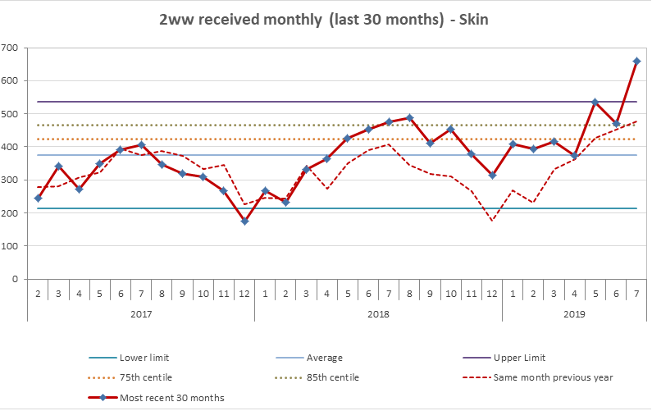

Slide 6
New RAS as a potential solution
A triage service prior to 2WW.
All potential 2WW referrals referred through this.
Turnaround within 2 days back to GP.
A 2WW clinical slot in every consultant clinic will be turned into a virtual slot to triage these.
3 options, 2WW (supaclinic), Routine/Urgent dermatology appointment, Advice only
Any doubt , poor photos, no photos – 2WW
Photos would be taken by the GP practice

Slide 7
Pitfalls
NHS England wont allow 2 week rules to be diagnosed on pictures (rules changing april 20)
Poor quality photos.
Only the lesion photographed can be assessed.
We trialled medical photography doing these and external photographers, can make mistakes – wrong mole, incorrect/poor information on the referral form, delays
May only exclude 10-20% so we will be doing a years pilot to assess whether worthwhile

