Slide 1
Service Models of Teledermatology and their impact
David de Berker
Bristol

Slide 2
With your services, please define which groups are included?
Tick as many as apply

Slide 3
How many hours a week do you practice telecare in the different parts of your job?
Number of Dermatologists
Hours per week

Slide 4
What IT platform do you use?
NHS e-referral system (eRS, formerly Choose and Book) | 33
NHS e-referral with APPS (please define in comments) | 2
Independent commercial IT platform (please define in comments) | 5
NHS.net email | 4
NHS.uk email | 1
Other (please define in comments) | 10

Slide 5
Concerning dermoscopy in images, estimate the frequency of its use in the following examples (%)

Slide 6
Who carries out the photography of the patient?

Slide 7
Estimate the percentage of those referred with pigmented lesions that you subsequently see in clinic.
N=40 respondents
Assume 100 lesions each
=1840/4000
=46% go to clinic

Slide 8
Are there agreed mechanisms in place for assessing the clinical competence of those involved in provided teledermatology services?

Slide 9
TD pathways
referral inputs
outputs
routine: non lesion
routine: lesion
2WW
urgent/on call
tertiary
Inpatient
Children
Follow ups
advice on care
decline to comment
advice to refer
triage to service
F2F appointment
telephone consultation
surgery booking

Slide 10
TD and lesions
Gloucester: mixed lesions and non-lesions – not 2WW via primary care
Leeds: 2WW via primary care
Portsmouth: non-2WW lesions via medical illustration hubs
Newport: mixed lesions (non-2WW) and rashes via MI hubs
Medway, UHBristol & Chelsea and Westminster: 2WW via MI hubs

Slide 11
TD pathways
referral inputs
outputs
routine: non lesion
routine: lesion
2WW
urgent/on call
tertiary
inpatient
advice on care
decline to comment
advice to refer
triage to service
F2F appointment
telephone consultation
surgery booking

Slide 12
Savings
GP time
Patient Time
Patient Travel
Dermatologist time
Dermatologist productivity
Waiting time for completed care/surgery/acute care
Number of appointments

Slide 13
Savings
GP time
Patient Time
Patient Travel
Dermatologist time
Dermatologist productivity
Waiting time for completed care/surgery/acute care
Number of appointments

Slide 14
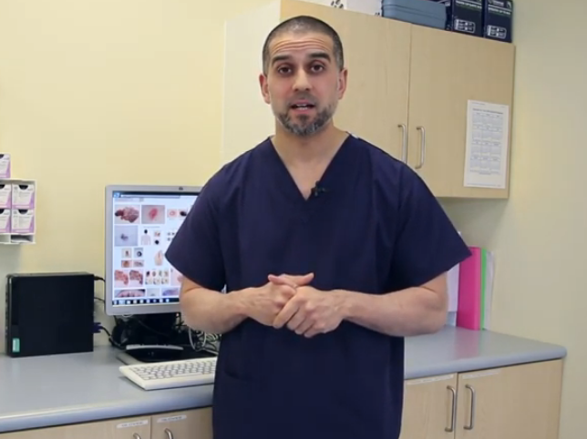
2WW referrals
All through RAS Teledermatology from June. 2018
CCG provided dermatoscopes + mobile device (iPods: 1 to 3 based on number GPs)
Consultant Connect App:
2WW locator, macro, close up images
referral through Leeds CCG template tool (DART)
GP transfers to practice admin team
Admin team upload via consultant connect to eRS
Hospital team report within 48 hours (Working days)
Reporting through third party application: WinDip
GP photo letter within 10 days or called to appointment (2WW)
Volume: 100-200 per week
10-15% come with no images and go straight to 2WW
28% (20-35% : clinician dependent) reported as benign with no consultation
72% further action: direct booking to procedures not yet undertaken
Quality control
Image quality of GP photos variable: CCG employ staff to visit problem practices and resolve
every 2-3 months consultant reporting group benchmarking
teledermatology steering group meet monthly: GPs, management, IT, bookings team, CCG members, clinicians
videos of processes and updates really beneficial for both GPs and patients.
Consultant Payment: triage payment globally 0.25PA/week and additional 2 slots in 2WW clinics
https://www.youtube.com/watch?v=XkGjlvGIhZo
https://www.youtube.com/watch?v=GyZYkwfCYX4
https://www.youtube.com/watch?v=PIuF_WC2j8Y

Slide 15
TD pathways
referral inputs
outputs
routine: non lesion
routine: lesion
2WW
urgent/on call
tertiary
inpatient
advice on care
decline to comment
advice to refer
triage to service
F2F appointment
telephone consultation
surgery booking

Slide 16
non-2WW skin cancer
Hywel Cooper
Portsmouth
Definite 2ww send 2ww
If doubt telederm: eRS A&G
Pilot of GPs didn’t work; awful photos inc. dermoscopy despite training and also they don’t have time to do properly
5 Community clinics with Medical photography
30 / clinic for photographer, 30 / session for consultant reviewing
Up scale by demand, local agreed tariff £65 a case, double pay if need upgrade still saves money for CCG
Based on e-referral so uses that framework
Photos returned to GP as pdf with advice
?2ww : upgrade 10-20%
plan is to populate op lists directly soon
WABA image storage in trust
ISSUE IS OVERUSE AND LOWER QUALITY REFERRALS OF STUFF THAT WOULD NEVER USUALLY BE SENT (FOR REASSURANCE) PLUS ANP / PARAMEDIC / PHARMACIST ACCES VIA SURGERIES WHICH MEANS ON OCCASION PRACTICALLY LAY REFERRAL – CCGs helping us with quality but ongoing issue especially in a couple of areas where GP recruitment / locums / alternate pathway care an issue
Volumes: Number 30-60 a week,
Not currently job planned but claim sessional WLI rate depending on volume (3 of us do it)
Plan to job plan with new staff involved fingers crossed

Slide 17
TD pathways
referral inputs
outputs
routine: non lesion
routine: lesion
2WW
urgent/on call
tertiary
inpatient
advice on care
decline to comment
advice to refer
triage to service
F2F appointment 2WW
telephone consultation
surgery booking

Slide 18
All non USC (2WW) lesions
Children
rashes
Caroline Mills
Royal Gwent, Newport
Medical photography outreach, 5 sites across Gwent (40 mile radius).
All non USC (2WW) lesions now go to Telederm.
Electronic referral goes straight to the Medical Illustration department and a local appointment made for patient to attend for a photograph.
populates a virtual consultant clinic on trust PAS which we report by letter dictation to patient and GP.
Volumes: 5596 patients 2018/2019
50% discharged
3-5% referred other specialty
35-40% booked to surgery directly: Mix primary and secondary care
10% 2WW
Tips - always get dermoscopy if you are going to make a decision on a lesion
Quality Control
Medical photography and studios
Double reporting on sample annually (Telederm guidance)
Work is job planned

Slide 19
TD pathways
referral inputs
outputs
routine: non lesion
routine: lesion
2WW
urgent/on call
tertiary
Inpatient
children
advice on care
decline to comment
advice to refer
triage to service
F2F appointment
telephone consultation
surgery booking

Slide 20
Medway Maritime Model
Dual service:
2WW lesion service
Dermatosis service
2WW lesion service
Dedicated nurse trained in proforma history and photography skills
E-ceptionist web-based package with archiving
3 day turnaround
Integral part of flexible service provision since 2004
Standard new patient tariff
1700-2900 referrals per year
Saul Halpern

Slide 21
Medway Maritime Model
Saul Halpern
 | 52% benign lesions discharged 39% surgical intervention (excision or biopsy) 9%F2F review needed

Slide 22
TD pathways
referral inputs
outputs
routine: non lesion
routine: lesion
2WW
urgent/on call
tertiary
Inpatient
children
advice on care
decline to comment
advice to refer
triage to service
F2F appointment
telephone consultation
surgery booking

Slide 23
David de Berker
Bristol
Rashes and non-2WW
Rego Vantage IT platform, subcontracted via hospital trust
Cost added to CCG bill per case: £58
Commenced 2011
Criteria: non-2WW, used to include children, now no children.
GP App via own mobile device streams directly to Rego
Rego downloads from EMIS and can use templates
Has inbuilt simplified proforma
Populates work list on browser log in system for Dermatologists can work remotely for this
Outcomes include direct booking to hot clinic, nurse telephone surgical pre-op and 2WW
Requires manual transfer by admin staff in Hospital to hospital systems.
3,500 per year.
Turnaround <2 days
Advice alone: 78%
Secondary care:22% (includes direct bookings 5-7%)
5 consultants reporting
rota with cross cover
monthly benchmarking and business meeting with reporters
SpR in structured training programme
GP evening case teaching monthly
annual audits
job planned: includes reporting from home

Slide 24
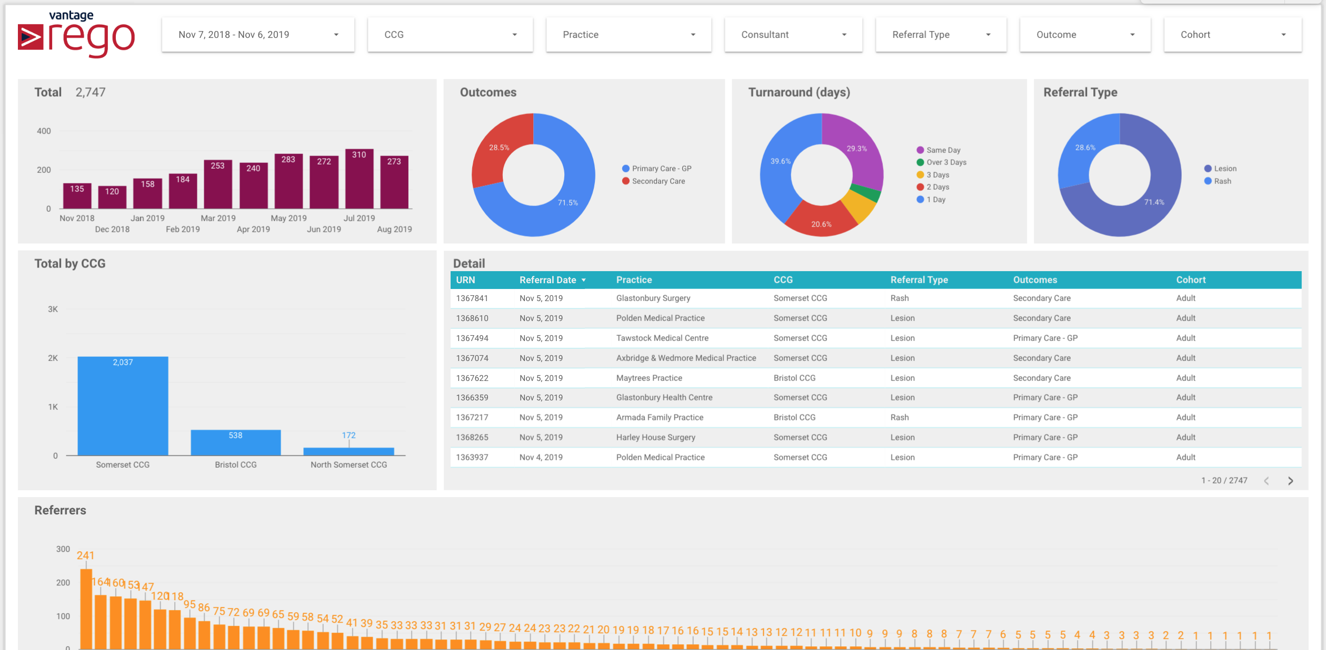

Slide 25
David de Berker
Bristol
2WW Peripheral hospital hubs
Medical illustration
Patient called beforehand to ensure verbal understanding and consent to TD 2WW
Exclusions: dementia, genitals, children
Attends hub.
Patient-filled lesion and risk factor questionnaire
Limit to 2 lesions
Written consent
Images, consent, patient questionnaire, link to medical record all uploaded to shared drive for reporting within 4 hours
Report typed by dermatologist into standardized template (Access Database)
Converted to GP and patient letter by admin within 24 hours
Team meeting within24 hours to ensure all patient pathways secure
Outcomes:
Discharged 50%
Booked direct to excision surgery via letter and nurse phone consultation: 30%
Booked direct to biopsy via letter and nurse phone consultation: 20%
Nurse fills in electronic booking form during consultation
2 Dermatologists
Intensive back room and logistic support
Short time frames
Used for geographic outlyers and peaks in 2WW activity (mid summer)
WLI rates

Slide 26
Current normal referral pathways
Conduit |  | eRS
 |  | dedicated server/other platform
 |  | NHS network non-eRS
Secondary care IN |  | admin
Secondary care OUT |  | Dermatologist | patient | Admin | GP
Acquisition | History | system download
 |  | proforma GP
 |  | letter
Upload |  | Health care professional not GP
 |  | admin

Slide 27
TD pathway: Additional processes
Acquisition | History | system download
 |  | proforma GP
 |  | proforma Patient
 |  | letter
 | Image | camera
 |  | mobile device: not phone
 |  | mobile device: phone
 | Photographer | GP
 |  | Health care professional not GP
 |  | Medical illustration
 |  | patient
 | Consent | written: electronic or photo
 |  | verbal: tick box
 |  | preconsent: phone
Upload |  | GP
 |  | Health care professional not GP
 |  | Medical illustration
 |  | admin
Conduit |  | eRS
 |  | dedicated server/other platform
 |  | NHS network non-eRS
Secondary care IN |  | admin |  | medical illustration | dermatologist
 |  | medical illustration |  | patient
 |  | dermatologist |  | dermatologist
Secondary care OUT |  | Dermatologist | GP
 |  |  | admin | GP | patient
 |  |  | GP
 |  |  | admin | Records & patient | Direct booking to services
 |  |  | patient

Slide 28
TD pathway: GP-led
Acquisition | History | system download
 |  | proforma GP
 |  | proforma Patient
 |  | letter
 | Image | camera
 |  | mobile device: not phone
 |  | mobile device: phone
 | Photographer | GP
 |  | Health care professional not GP
 |  | Medical illustration
 |  | patient
 | Consent | written: electronic or photo
 |  | verbal: tick box
 |  | preconsent: phone
Upload |  | GP
 |  | Health care professional not GP
 |  | Medical illustration
 |  | admin
Conduit |  | eRS
 |  | dedicated server/other platform
 |  | NHS network non-eRS
Secondary care IN |  | admin |  | medical illustration | dermatologist
 |  | medical illustration |  | patient
 |  | dermatologist |  | dermatologist
Secondary care OUT |  | Dermatologist | GP
 |  |  | admin | GP | patient
 |  |  | GP
 |  |  | admin | Records & patient | Direct booking to services
 |  |  | patient

Slide 29
TD pathway Provider-led
Acquisition | History | system download
 |  | proforma GP
 |  | proforma Patient
 |  | letter
 | Image | camera
 |  | mobile device: not phone
 |  | mobile device: phone
 | Photographer | GP
 |  | Health care professional not GP
 |  | Medical illustration
 |  | patient
 | Consent | written: electronic or photo
 |  | verbal: tick box
 |  | preconsent: phone
Upload |  | GP
 |  | Health care professional not GP
 |  | Medical illustration
 |  | admin
Conduit |  | eRS
 |  | dedicated server/other platform
 |  | NHS network non-eRS
Secondary care IN |  | admin |  | medical illustration | dermatologist
 |  | medical illustration |  | patient
 |  | dermatologist |  | dermatologist
Secondary care OUT |  | Dermatologist | GP
 |  |  | admin | GP | patient
 |  |  | GP
 |  |  | admin | Records & patient | Direct booking to services
 |  |  | patient

Slide 30
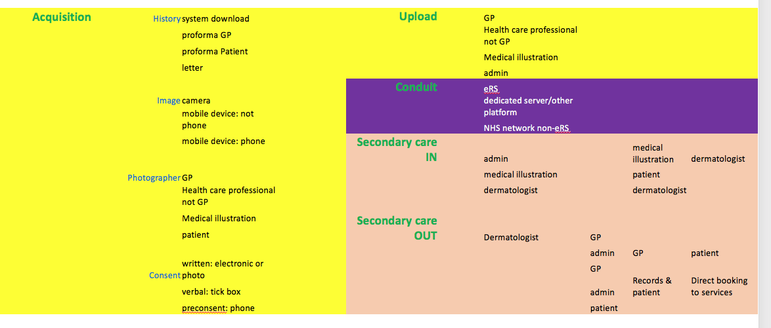
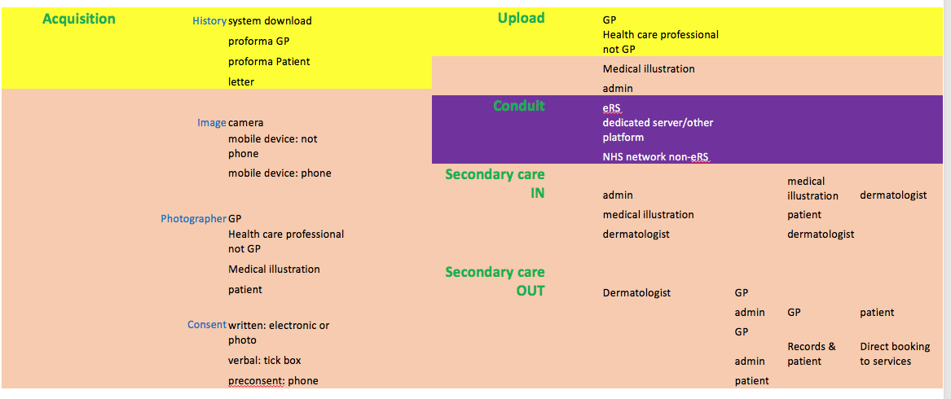
Who is going to do the extra….?
GP-led
Secondary care-led

