Slide 1
Surgical resection update
Eveline Internullo

Slide 2
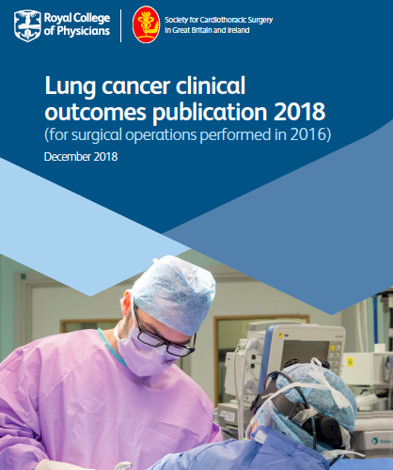
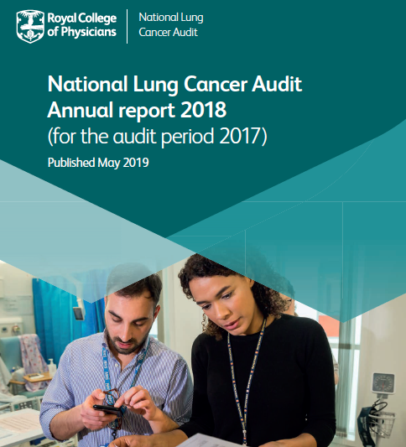

Slide 3
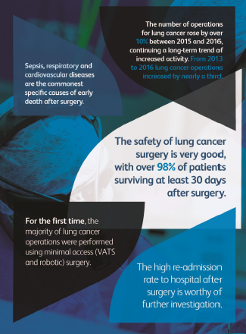

Slide 4
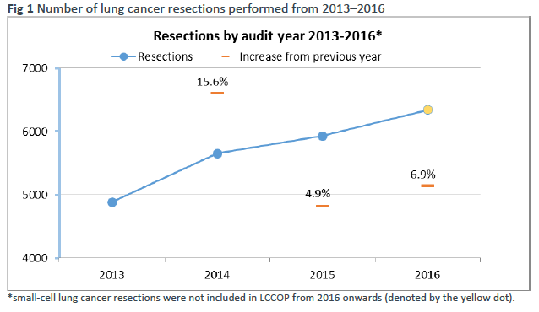
LCCOP 2018 (2016)

Slide 5
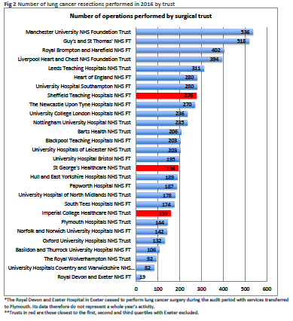
27 units
125 thoracic surgeons
Median: 203
Median per surgeon: 46
Data submitted for
LCCOP 2019 (2017)
240 lung cancer resections

Slide 6
Types of lung cancer operated in 2016 (LCCOP 2018)
93% NSCLC
Increasing number of
operations for
carcinoid tumours:
87% in 2 years

Slide 7
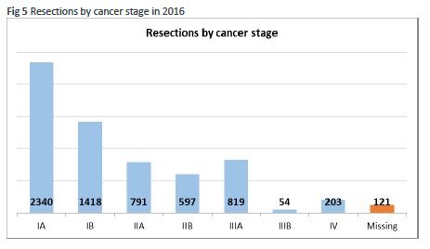
Stages of lung cancer operated in 2016 (LCCOP 2018)
81%
12.9%

Slide 8
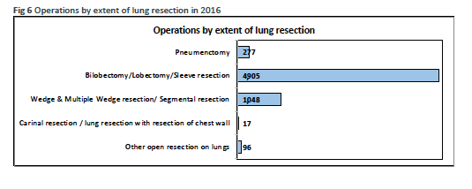
Types of procedure for lung cancer operated in 2016 (LCCOP 2018)
4%
77%
17%

Slide 9
Primary lung cancer resections by procedure performed 2015/6-2017/8
UHB

Slide 10
Procedures for primary lung cancer: proportion by VATS 2015/6-2017/8
UHB

Slide 11
Selected diagnostic procedures 2015/6-2017/8
UHB

Slide 12
Mortality for lung cancer operated in 2016 (LCCOP 2018)
Survival
England
UHBristol
30 days
98.2%
98.1%
90 days
96.5%
97%
1 year
88.7%
88.3%

Slide 13
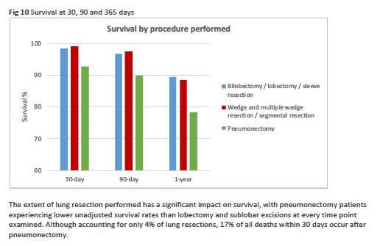
Mortality for lung cancer operated in 2016

Slide 14
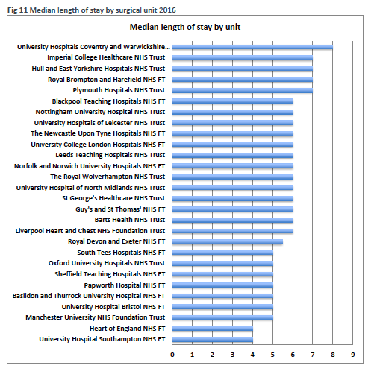

Slide 15
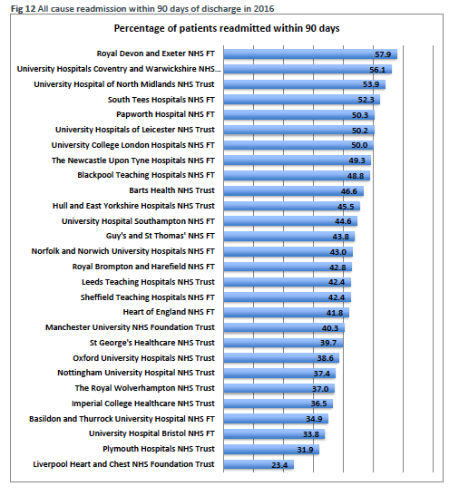

Slide 16
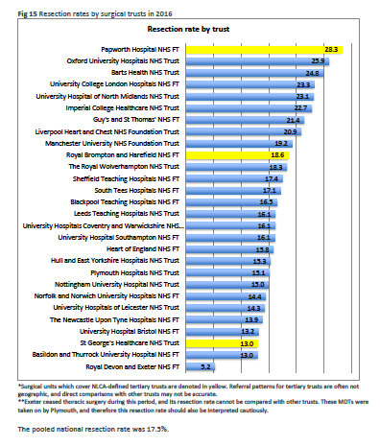

Slide 17
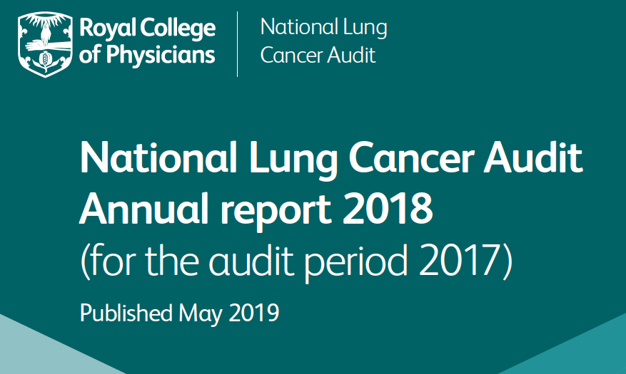

Slide 18
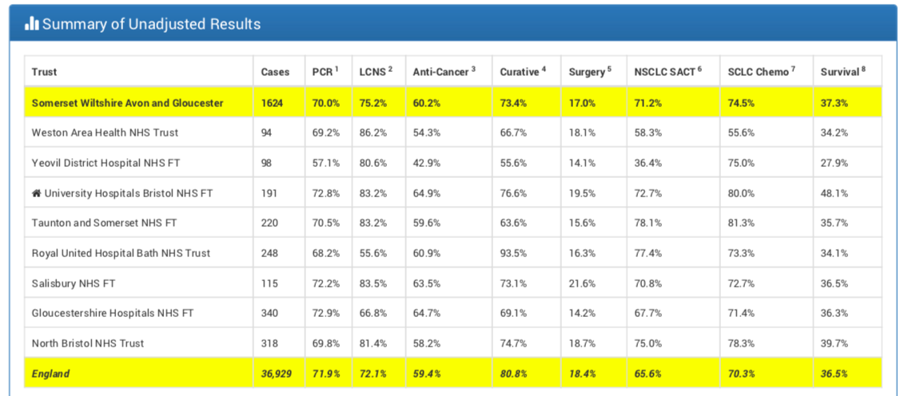
NLCA 2018 (2017)
(unadjusted)
16.6%

Slide 19
NLCA 2018 (2017) – adjusted* resection rates
 | Surgery - unadjusted | Surgery - adjusted
Alliance | 16.6% | 16.1%
Weston | 18.1% | 17.5%
Yeovil | 14.1% | 13.7%
UH Bristol | 19.5% | 15.9%
Taunton | 15.6% | 16.4%
Bath RUH | 16.3% | 17.8%
Gloucester | 14.2% | 14.7%
North Bristol | 18.7% | 16.7%
*for age, sex, stage, PS and socio-economic status

Slide 20
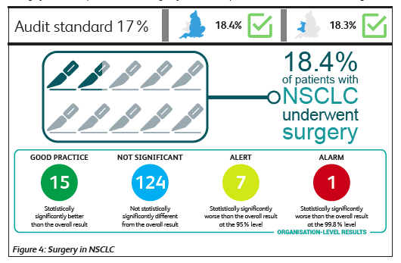

Slide 21
73.5%

Slide 22
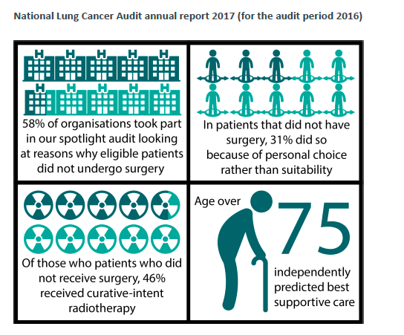

Slide 23
NLCA 2018 (2017) – adjusted* resection rates
 | Surgery - unadjusted |  | Surgery - adjusted
 | NCLA 2017 | NCLA 2018 | NCLA 2017 | NCLA 2018
Alliance | 13.2% | 16.6% | 14.9% | 16.1%
Weston | 15.2% | 18.1% | 16.8% | 17.5%
Yeovil | 15.7% | 14.1% | 14.9% | 13.7%
UH Bristol | 16% | 19.5% | 17% | 15.9%
Taunton | 11.7% | 15.6% | 12% | 16.4%
Bath RUH | 7.3% | 16.3% | 11.4% | 17.8%
Gloucester | 16.6% | 14.2% | 14.6% | 14.7%
North Bristol | 18.5% | 18.7% | 17.9% | 16.7%
*for age, sex, stage, PS and socio-economic status

Slide 24
What next?…
Telly link
Surgeons’ attendance to MDTs
Patients optimization for surgery
- smoking cessation
- COPD management
- CPET
- cardiology review
- pulmonary rehabilitation
- surgical second opinion
Pathway optimization (NOLCP)
- Minimize admin dead times (MDT to clinic appt)
- Bundles
- pooled lists
- capacity (theatres, HDU)
CCRM
PreVid
Fast Referral Forms
OPA < 7 days
One-stop clinic

