Slide 1
Looking ahead: Genomic Laboratory Hub
Rachel Butler, Head of Bristol Genetics Laboratory

Slide 2
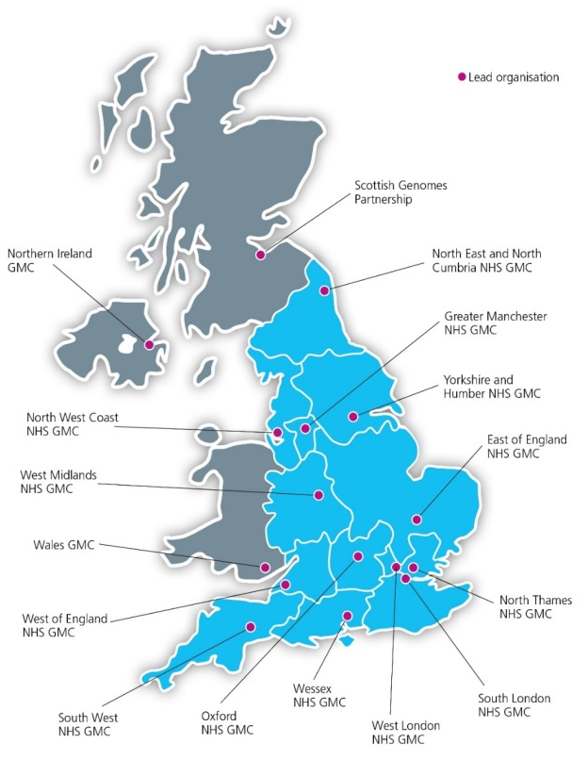
National delivery of 100,000 Genomes Project

Slide 3
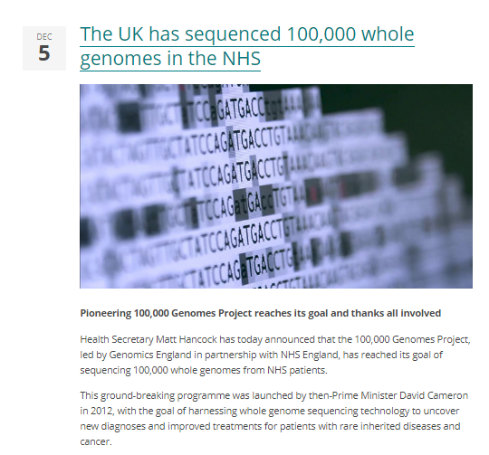
A remarkable achievement

Slide 4
GMC update
Return of results from the 100,000 Genomes Project
Patient engagement and involvement
Support introduction of the Genomic Medicine Service and whole genome sequencing (WGS)
Co-ordination and implementation of future genomics projects

Slide 5
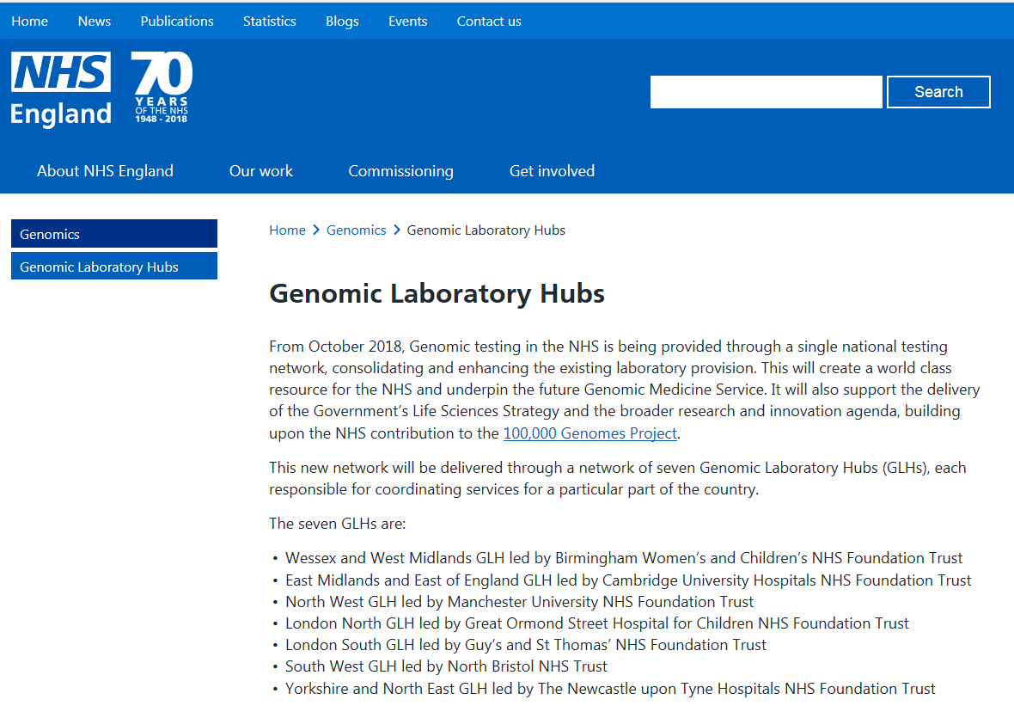
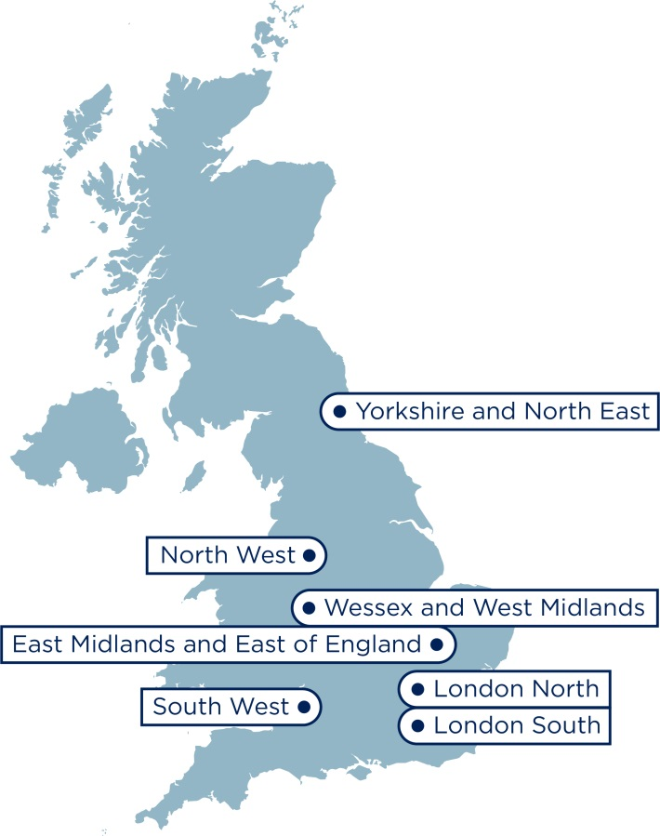
Genomic Laboratory Hubs
Notes:
Dear colleagues
As you may be aware at the Conservative Party Conference today, 2 October, the Health and Social Care Secretary Matt Hancock made reference to the Government’s plans for genomics across the UK. During his speech he referenced the development of the genomic medicine service and highlighted that mobilisation of the Genomic Laboratory Hubs is beginning. SofS also set out the Government’s ambition for 5 million genomic analyses to be performed in the UK over the next 5 years, of which the NHS will contribute 500k.
We have provided some key points about the speech this afternoon that you may want to share locally. These can be used in conjunction with the broader lines that we shared yesterday. If you do receive any queries regarding the genomics announcement or the genomic medicine service, please do not hesitate to contact NHS England press office on nhsengland.media@nhs.net<mailto:nhsengland.media@nhs.net> or 011382 50958, who can provide support.
Key points
· The Health and Social Care Secretary Matt Hancock has announced that the NHS will sequence up to 500,000 whole genomes as part of routine clinical care over the next five year period.
· Implementation of whole genome sequencing will be coordinated through the Genomic Laboratory Hubs, which from October will begin to mobilise to the new service.
· Access to whole genome sequencing will begin to be planned from October 2018 and is expected to be operational from early 2019.
· The National Genomic Test Directory 2018/19 sets that from early 2019, whole genome sequencing will be available to:
o Seriously ill children with a suspected genetic disorder, including those with cancer.
o People with 21 rare and inherited conditions.
o People with specific types of cancer which have been identified as having clear benefits to patients.
· The NHS will introduce and expand whole genome sequencing for some cancers and rare diseases, extending to other conditions as the evidence improves.
Please do not hesitate to get in touch if you have any questions or require any additional information.

Slide 6
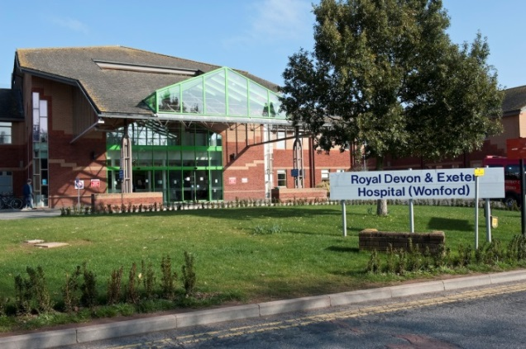
South West Genomic Laboratory Hub (SWGLH)
Partnership
North Bristol NHS Trust
Royal Devon and Exeter NHS Foundation Trust
Core genomic tests ( all 7 GLH)
Rare disease Test Directory
Cancer Test Directory
Specialist genomic tests delivered by GLH appointed as a National Specialist Test Provider (NSTP)
17 clinical specialisms ( 2 or 4 providers)
GLH will forward samples to the designated NSTP lab
Cancer (somatic/inherited)
Cardiology
Renal
Neurology
Respiratory/Metabolic
Endocrinology

Slide 7
The National Genomic Test Directory
500,000
tests per year
Technology | Est prop’n of reports
Targeted mutation testing | 20-25%
Microarray | 10-20%
WGS | 10-25%
Small panel | 10-15%
STR testing | 10-15%
WES or large panel | 2-14%
MLPA or equivalent | 5-7%
Common aneuploidy testing | 5-7%
Karyotype | 3-5%
Single gene sequencing | 3-5%
FISH; DNA repair defect testing; Methylation testing; UPD testing; X-inactivation; Identity testing; Microsatellite instability; NIPT; NIPD; PGD | each <2%
Other | 2-5%
300
RD indications
across 14 groups
covering ~ 3000 RDs
180
cancer indications
26
Indications for WGS
22
test technologies – single gene to WGS
Defines all the genetic and genomic tests available through the NHS in England – specifying the appropriate test for each clinical indication
Requesting via central IT system (NGIS)
Developed through national & international scientific review
Updated annually - led by expert panel to keep pace with scientific advance

Slide 8
The National Genomic Test Directory
https://www.england.nhs.uk/publication/national-genomic-test-directories/

Slide 9
Pharmacogenomics: DPYD analysis
Germline genetic variants in the dihydropyrimidine dehydrogenase (DPYD) gene can confer an increased risk of severe and even fatal toxicity, when patients with one or more copies of these variants are treated with the fluoropyrimidines, capecitabine or 5-Fluorouracil. The gene encodes an enzyme which plays a role in the rate-limiting catabolism step of 5-Fluorouracil metabolism and specific sequence variants are known to impact on the activity of the enzyme. If treating clinicians are aware that a patient is heterozygous or homozygous for one of these variants in many cases they will be able to adjust therapy regimes to reduce the risk of toxicity.
Gene | Nucleotide change^{i} | Protein change^{ii} | rsID | Haplotype name | Genomic coordinates (Grh38) | Allele Functional Status | Activity Score | Evidence level for functional status^{iv}
DPYD | c.1905+1G>A | N/A | rs3918290 | *2A | 1:97450058 | No function | 0 | Strong evidence supporting function
DPYD | c.1679T>G | p.I560S | rs55886062 | *13 | 1: 97515787 | No function | 0 | Strong evidence supporting function
DPYD | c.2846A>T | p.D949V | rs67376798 |  | 1:97082391 | Decreased function | 0.5 | Strong evidence supporting function
DPYD | c.1129-5923C>G c.1236G>A^{iii} | N/A, p.E412E | rs75017182, rs56038477 | HapB3 | 1:97579893 1:97573863 | Decreased function | 0.5 | Strong evidence supporting function

Slide 10
But where are we now?
Patchy (?) services for
RAS / BRAF
MSI (for Lynch and stage II ca)
meMLH1 / BRAF follow-up
Need clear pathways for reflex testing from pathology and funding

Slide 11
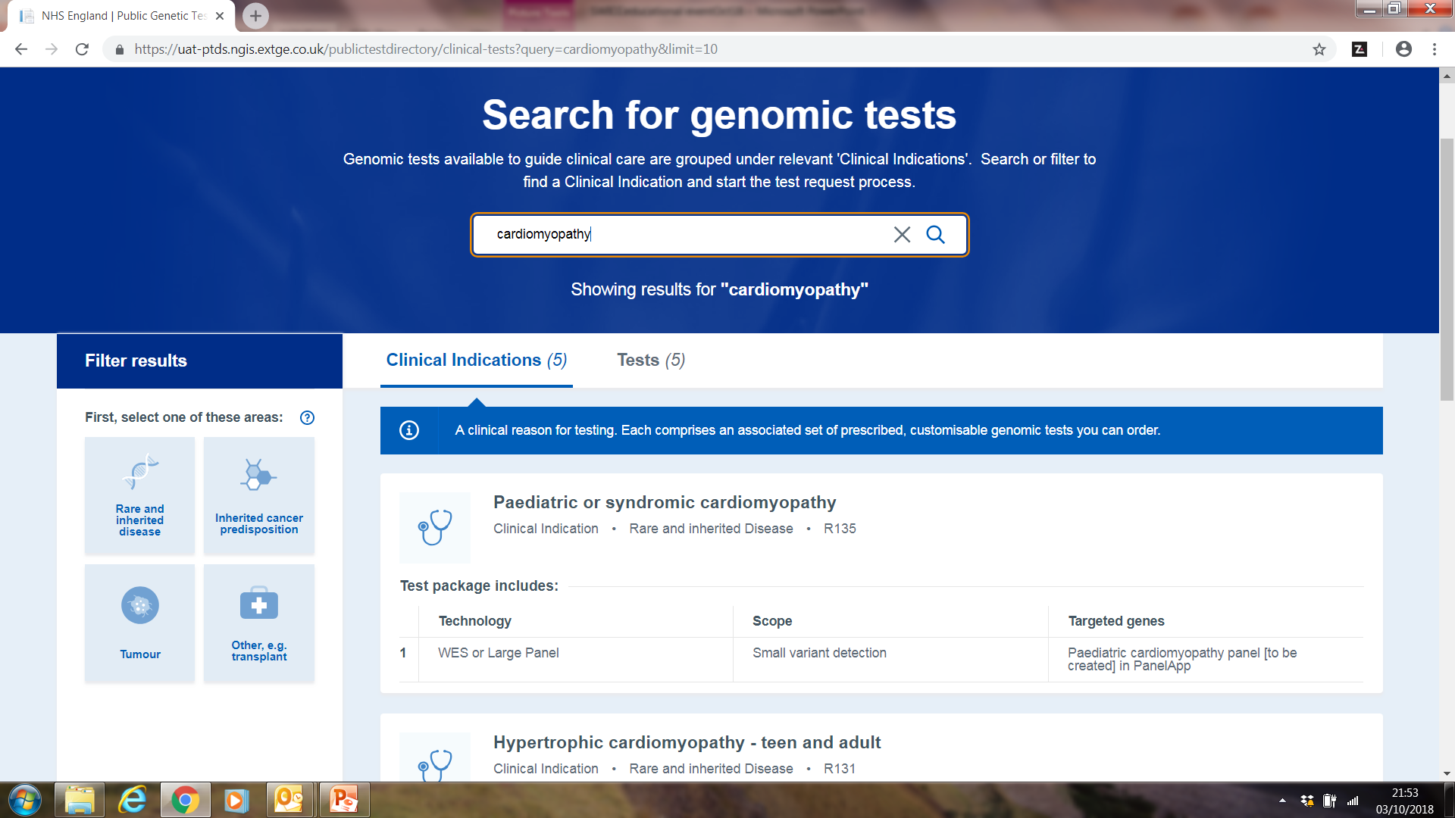
National Genomics Informatics Service (NGIS)
Notes:
One place to order genetic tests - based on Test Directory
Search for test in multiple ways – filter for your scenario and standardised criteria
- mandatory data – info on what test is available for a given condition
Handling of test is GLH responsibility from their – local or specialist lab testing
NGIS Ordering test version seen – aim is to have a version live in early 2019

Slide 12
Mainstreaming genomic medicine
Genomic Medicine Service
Genetics Laboratory Hubs:
7 nationally commissioned laboratory hubs
National Directory for all genetic & genomic testing
Genomic Laboratory Hubs
Clinical Genetics Services
Genomic Medicine Centres
Cancer Services
Genomic Medicine Centres:
Support transition from project to clinical practice
Clinical Genetics Services:
- Review of services to ensure support and equity
Cancer Services:
- Supporting 100,000 Genomes patients and future genomics pathways

Slide 13
What the future holds…
Increased, more equitable access to genomic testing (centrally funded by NHS England)
On-line ordering of genomic tests from national test directory according to defined clinical eligibility criteria
New “patient choice” materials with opt-in for research
Standardised methodology across laboratories and improved reporting times
Increasing number of tests performed by genome sequencing (500,000 funded over next 5 years, aspiration of 5 million genomic tests!)

