Slide 1
Skin cancer primary tumour (pT) staging changes from Jan 2018
All slides from RCPath website
https://www.rcpath.org/profession/publications/cancer-datasets.html

Slide 2
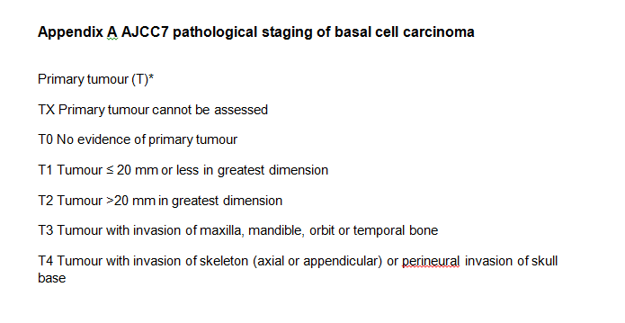

Slide 3
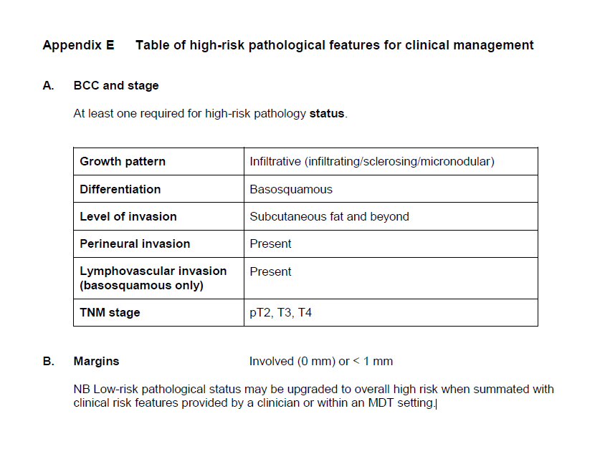
RCPath BCC dataset

Slide 5
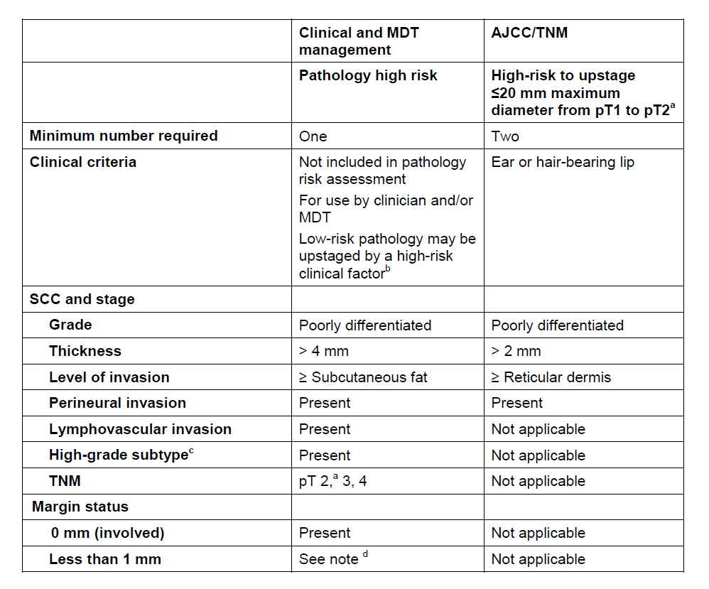
RCPath SCC dataset

Slide 6
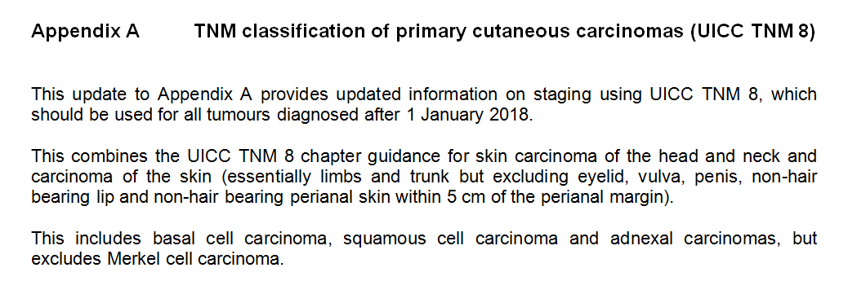
From Jan 2018…

Slide 7
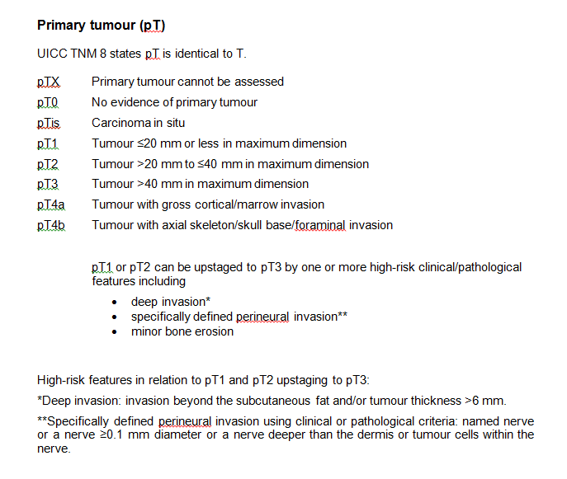
UICC TNM 8 for skin carcinoma of the head and neck and carcinoma of the skin (excluding eyelid, vulva, penis, non-hair bearing lip and non-hair bearing perianal skin within 5 cm of the perianal margin). This includes basal cell carcinoma, squamous cell carcinoma and adnexal carcinomas, but excludes Merkel cell carcinoma.

Slide 9
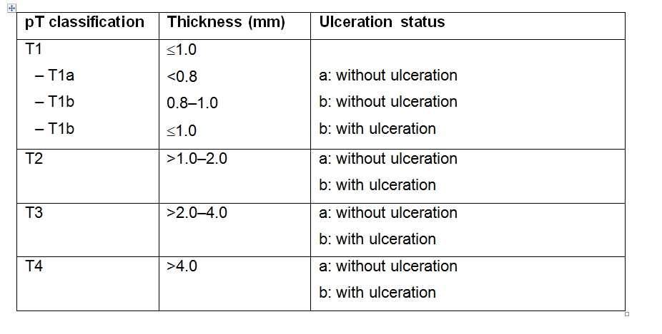
Melanoma UICC TNM8
Mitoses still recorded in dataset but no longer involved in staging 1a vs 1b

Slide 11
New college datasets in progress
Watch this space…

