Slide 1
Pilot Sarcoma Outpatient Physiotherapy Service
Jayne Masters
Lead Macmillan Rehabilitation Physiotherapist
North Bristol Trust

Slide 2
Background
May 2019 – June 2020
Proposed Pathway
Feedback
Safe
High quality
Efficient
Positive patient experiences
Risk stratified
Notes:
Feedback from Catherine
-Case study for each phase
-Use questionnaire for feedback current service
-Evaluation
-Suggestions for future
-Ideas to secure funding
Feedback from Gareth
I suspect that your input would be most valuable in 3 areas:
Identifying patients pre-op who are likely to have significant post-op physio needs. Both for pre-hab and also so we can plan in advance what their post-surgery rehab careplan will look like.
Implementing their post-op rehab prior to hospital discharge
Supervising their post-op rehab, either yourself in clinic or through liaison and handover to the patient’s local community physio team
We should also give some thought as to what information we can collect during your initial year with us to demonstrate how useful your input is to patients. This would support our application to make physio provision for sarcoma patients permanently funded
This could include recording information on functional assessments, waiting times to physio input post hospital discharge (which I hear can be long) or a patient feedback exercise.
I’m sure you’ll have your own ideas for this as well
Background
Intro to Pilot
Who am I
? Intro re Jayne
Feedback
Feedback, Questions and Suggestions welcome

Slide 3
Pathway design
Maximise Outcomes to secure long term funding
Reduced Length of stay
Reduced Readmission rates
Improved Clinical outcomes
Improved Quality Indicators
Improved use of wider system capacity
Minimise Challenges
Pilot
Limited Resources
Regional service
Notes:
Reduced Length of stay
Reduced Readmission rates
Clinical outcomes
Reduced Post op complications
Improved functional outcomes
Improved quality of life
Quality Indicators
Shorter wait time for rehabilitation Improved Patient experience
Improved use of wider system capacity
Minimise challenges
Limited to Outpatients
Clinic Space
Gym resources
Admin support
SAG will develop risk stratified pathway of post treatment management, promote physical activity and seek to improve the management of the consequences of treatment.
Enhanced recovery programme for all patients.
Current outcomes –
Length of stay
Readmission rate
Sarcoma specific –
Long term audit on wound complications

Slide 4
Proposed Sarcoma Physiotherapy Pathway
Prehabilitation
Physiotherapy support from the point of diagnosis
1
2
Specialist Outpatient Rehabilitation
Early phase 0-3 months following surgery
3
Specialist Outpatient Rehabilitation
Middle – late phase 3-12 months following surgery
Achieving rehabilitation potential and best functional outcomes
4
Late effects
Managing the consequences of treatment
Notes:
Consider for each 1-4
Referral route
Service offer
What?
Evidence
Outcomes
Case studies
1.
Pre-habilitation
Prior to or/and during Radiotherapy or/and prior to surgery
Referral – usually CNS at weekly O/P Tuesday MDT clinic
Service Offer 1 to 3 contacts either telephone or face to face assessment as clinically appropriate.
Utilising matched care approach
Evidence
Outcomes
Link with IP Physio/OT team for pre op
Case study
Is it safe?
2. Rehabilitation
Early phase
Rehabilitation during treatment
Links with inpatient Physiotherapy team, local to patient outpatient MSK Physiotherapy services and other NHS pathways
Clinicians act as expert resource
Link with exercise on referral schemes
e.g. Energise, Osteoporosis pathway,
Vocational rehabilitation
Specialist Band 7 Physiotherapy input with expertise in Musculoskeletal Physiotherapy, Pain, Cancer, body image and allodynia.
Link with nurses at Gate 24 as have O/P space Monday morning and Friday afternoon – able to therefore link with time patient is attending dressings clinic or access nurses if I have concerns e.g TE and KM
Timely re-access to Consultant or
Nurse led clinic
3.
Achieving rehabilitation potential Promoting and sustaining recovery and return to full function
4.
Managing the consequences of treatment.
Late effects

Slide 5
1
Prehabilitation
Referral route
Service offer
Outcome measures
Case study
Notes:
Proposal is:
Service opened to referrals on 30/4/19 and will run to May/June 2020 as a pilot.
Referrals will be received either in the MDT clinic, from the IP physio or via the nurse specialist.
Patients will be offered outpatient Physiotherapy at all stages of their cancer journey – to include Prehab.
Approximately 15 hours (0.4) of B7 Physiotherapy clinician time will be spent on a weekly basis providing/managing this service. This is an approximation at the current time.
This will be approximately split as
3 hours in MDT Consultant led clinic Tuesday AM.
5 hours of clinical 1:1 Physiotherapy session time offered (9-10am Tues AM before MDT clinic and 1-4pm Friday PM in plastics clinic room)
3 hours a week of service administration to include triage of referrals, telephone triage, telephone liaison with Physiotherapy colleagues, MDT liaison.
3-4 hours Currently on service development: setting up the service, staff training, liaison and setting up outcome measures.
(There is no cover for B7 A/L, study leave)
This meets the outpatient unmet needs identified in the previously submitted business case for specialist Physiotherapy input which were
Attendance at Sarcoma out-patient clinics
Pre-operative assessment/ intervention of elective sarcoma patients
Sarcoma physiotherapy out-patients
Attendance at Sarcoma MDT meetings when required
Prepare for change in NICE guidelines to reflect a requirement for patients to receive 1 week’s intensive rehabilitation
Training, education and support of tertiary services and out-patient Physiotherapy departments
No provision has been made within this pilot to increase the number of hours of inpatient physiotherapy. The business case previously submitted requested 0.8 of B6 time to cover inpatients and outpatients so this pilot will include an audit of what is needed to provide a clinically effective outpatient specialist Physiotherapy Sarcoma service.
It is expected that there will be approximately 4 new patient referrals a week on average. Patients will be offered a one hour Physiotherapy face to face outpatient Physiotherapy assessment as deemed clinically appropriate from the referral or telephone triage. Patients will then be offered a Physiotherapy rehabilitation programme dependent on their needs identified at the Physiotherapy clinical assessment, this will be a maximum of 4-6 sessions including the assessment.

Slide 6
2
Early phase rehabilitation
Referral route
Service offer
Outcome measures
Case study

Slide 7
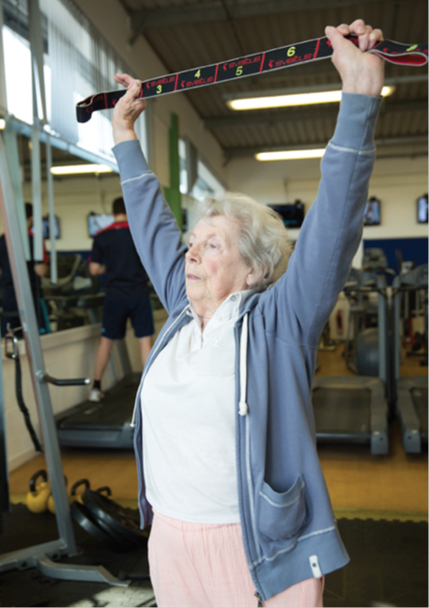
3
Middle – Late phase rehabilitation
Referral route
Service offer
Outcome measures
Case study

Slide 8
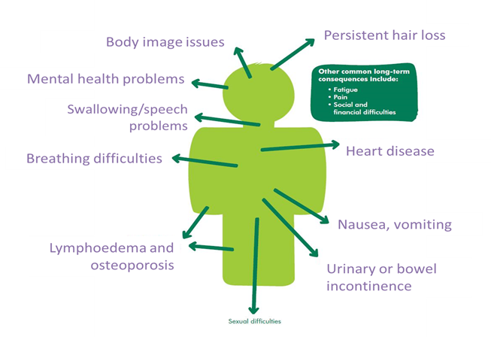
4
Late effects
Referral route
Service offer
Outcome measures
Case study
Notes:
JD – cost saving with referral to national LE service

Slide 9
Clinical Activity
7/5/19 to 14/6/19 | Pre-hab | Early post op | Late Rehabilitation | Late effects | Total activity
NPs | 6 (2 waiting) | 3 (3 waiting) | 9 | 1 | 19
F/up | 3 | 6 |  |  | 9
Tel call | 9 (4 waiting) |  |  |  | 9
Triage in MDT clinic |  |  | 3 |  | 3
Notes:
7/5/19 – 14/6/19 15 hours B7 Physiotherapist per week
5 weeks

Slide 10
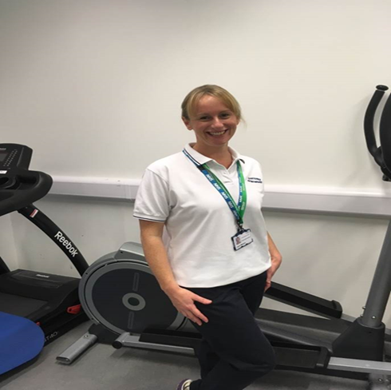
Feedback
Suggestions
Questions
How to Refer
Jayne Masters
Lead Macmillan Rehabilitation Physiotherapist
Cancerphysio@nbt.nhs.uk

