Slide 1
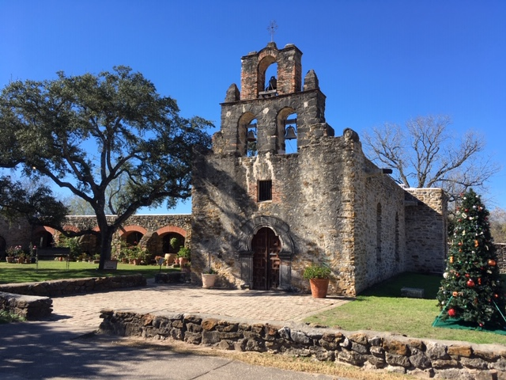
San Antonio 2019 Update
Prof Mark Beresford
RUH Bath

Slide 2
Hormone Receptor Positive disease

Slide 3
EBCTCG distant recurrence
For women with ER+ve disease who are disease-free at 5 years, recurrences occur at steady rate to year 20
Compared distant recurrence rates by period of diagnosis cohorts <2000, 2000-2004 vs >2005
Risks reduced in later cohorts
Years 5-9 recurrence risk c/w diagnosis <2000
2000-2004: HR 0.81
> 2005: HR 0.62

Slide 4
Extended adjuvant endocrine NSABP B-42
Approx 4,000 patients
Disease-free after 5 years of AI or TAM
Additional 5 years letrozole or placebo
Median follow-up 9.3 years
10 year DFS 72.1% improved to 76.1% (HR 0.84)
No difference in overall survival
No significant increase in fractures (6.4 vs 6.5%)
Note high discontinuation rate (approx 40%)
Practicalities of follow-up

Slide 5
PEARL study – metastatic ER +ve
Palbociclib + ET (exe or ful) vs Capecitabine on progression on AI
No significant difference in PFS (7.5 vs 10 months)
Palbo/ET better tolerated

Slide 6
HER2 positive

Slide 7
Margetuximab
mBC after 2 or more lines of HER2-directed therapy
New Monoclonal antibody
Binds to same epitope as trastuzumab but increased affinity
Chemo + trastuzumab vs chemo + margetuximab
Median PFS: 4.9 vs 5.8 months (p=o.033)
No significant OS advantage

Slide 8
Trastuzumab-deruxtecan
Drug antibody conjugate (topo1 inhibitor)
Phase 2 study in 184 patients post-Kadcyla
Median of 6 lines of prior treatment
ORR 61%
CR 6%
PR 55%
Median PFS: 16.4 months
Risk of interstitial lung disease (13.6%, 4 fatal)

Slide 9
Chemotherapy

Slide 10
Oral Paclitaxel
Oral vs IV paclitaxel
205mg/m2 3 days per week (with encequidar) vs 175mg/m2 iv 3-weekly
Better RR
40% vs 25%
Similar PFS, but better OS (HR 0.68)
Similar SE profile but higher neutropenia and GI symptoms with oral
Notes:
P-glycoprotein inhibitor to enable absorption

Slide 11
Radiotherapy

Slide 12
Partial Breast Radiotherapy
10 year follow-up Italian IMRT PBRT study
<25mm, WLE, margins >5mm
520 patients WBRT + boost vs PBRT (30/5)
10 year IBTR:
WBRT: 2.6%
PBRT: 3.9% (P=0.39)
High rates of ‘excellent’ clinician-rated cosmesis with PBRT

Slide 13
Surgery

Slide 14
Image-guided biopsies post-neoadjuvant chemo
4 oral presentations including RESPONDER study
Image-guided vacuum-assisted biopsies for patients with response on imaging
Went on to have surgery as usual
False negative-rate 18.7%
Differed by receptor status – worse for HR-/HER2+
If used a strict standardised protocol (>6 VABs) then false negative rate reduced to <5%

Slide 15
Genomic Profiling

Slide 16
PlasmaMATCH
Multicentre trial of ctDNA testing in patients with advanced disease
Used Guardant 360 panel of 73 genes
1,000 patients
Treatment cohorts matched to mutations
A: ESR1: extended dose fulvestrant (500mg 2-weekly)
B: HER2: neratinib + fulvestrant
C: AKT1 (ER+ve): Capivasertib + fulvestrant
D: AKT1 (ER-ve): Capivasertib
E: TNBC with no actionable mutations: Olaparib + AZD6738

Slide 17
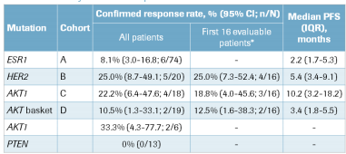
PlasmaMATCH results
Somatic mutation in 743/800 patients
Mainly p53 (44%), PIK3CA (35%), ESR1 (33%)
Approx 150 had actionable mutations and were entered into the studies:

Slide 18
