Slide 1
South West Genomic Laboratory Hub (SWGLH) Update
Laura Yarram-Smith
SWGLH Solid Tumour Laboratory Lead
06/11/2019

Slide 2
Aims of Today’s Session
What we are trying to achieve
Awareness of the infrastructure underpinning the delivery of genetic testing nationally and in the South West
Provide an understanding of the national requirement for delivering non-WGS genetic/genomic testing as defined in the national genomic testing directory (NGTD)
Understand what that means locally for adaption of current genetic/genomic test eligibility and requesting processes:
What can be tested?
What will be reported?
Turn around times
Funding models
Understanding reports and GTAB support
What this session is not about
Mapping the details of local pathways
Confirming local transport arrangements
Addressing local resourcing concerns
Notes:
WGS and the extension of non WGS pathways
∙ GMC and GLH
∙ Information on genes and potential for a pick list to support research, soc practice
∙ Turnaround time
∙ Date lines(!)
∙ Cost (!)
∙ Results – what they and what they are not (eg – looked for findings only) GTAB model – not every patient, can bring things back to the GTAB after the result is issued
∙ Education and training
TD and funding, sample, request, transport and results

Slide 3
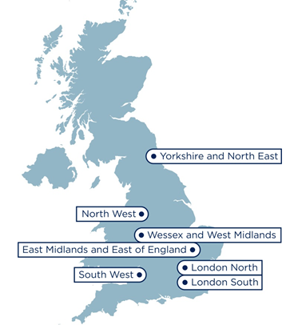
Mainstreaming genomic medicine
7 Regional Genomic Laboratory Hubs
South West Genomic Laboratory Hub region:
H
13 Hospital Sites [H]
H
H
2 Central laboratories [L]
Bristol Genetics Laboratory
Exeter Genetics Laboratory
L
H*
H
H
H
H
H
2 Clinical genetics services*
Bristol Genetics Service
SWP Genetics Service
L
H*
H
2 Genomic Medicine Centers
West of England
South West Peninsula
H
Population: >5,000,000
Span: >200 miles
GMCs: 2
H

Slide 4
Mainstreaming genomic medicine
Implementation by GLH
The development of new services as specified by the National Genomics Test Directory
Redistribution of core and specialist services both within the SW and between GLHs
Consolidation of genetic services within the SW
Genomic Laboratory Hubs
Cancer Services
Clinical Genetics Services
Genomic Medicine Centres

Slide 5
Mainstreaming genomic medicine
National Genomics Test Directory (NGTD) https://www.england.nhs.uk/publication/national-genomic-test-directories/
Defined list of funded tests allows development of regional and national diagnostic algorithms
Network guidelines
Clinical input required into gene panel content and reporting
Encompasses Whole Genome Sequencing (WGS) and non-WGS testing
Centrally funded genomic testing, accessible through the local GLH, from April 2020
Equity of access to most clinically appropriate genomic testing
Expanded range of non-WGS testing
Develop IT infrastructure
Develop transport logistics

Slide 6
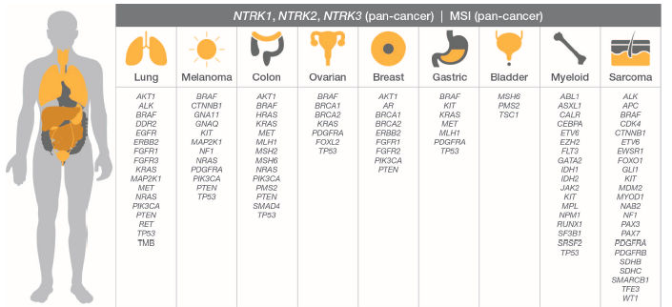
Mainstreaming genomic medicine
TruSight Oncology 500 (TSO500)
Pan-cancer NGS assay using DNA and RNA simultaneously
Targets 523 genes for SNV’s, indels & CNVs and 55 genes for fusions
Captures known and novel fusions
Includes key and emerging biomarkers
Anatomical sites include (but not limited to):

Slide 7
Sample Transport
Key
Hospitals in region
Routine transport to Bristol from north territory
Weston
Urgent transport to Bristol from north territory
Routine transport to Bristol from South territory
WGS Routine transport From South territory
Urgent transport to Bristol from South territory
Inter-site transport
Exeter
Honicknowle
Routine transport to Exeter from North territory
Urgent transport to Exeter from North territory
Routine transport to Exeter from South territory
Urgent transport to Exeter from South territory
Methods of transport
Inter-site transport/Royal mail 1st class
Royal mail 1st class
Inter-site transport/Taxi/Courier
Royal mail Special Delivery/Courier
Royal Mail (non-WGS)
Inter-site transport/Honicknowle/Royal mail 1st class
HPV transport (WGS)
Inter-site transport/Honicknowle/Courier
HPV transport/Courier

Slide 8
Test Directory - Eligibility Criteria
Group | Specialist Test Group | Clinical Indication Name | Test Code | Test Name | Technology | Further eligibility criteria | Comment
Solid Tumours (Adult) | Core | Melanoma - Adult | M7.1 | Multi-target NGS panel - small variant (BRAF, KIT, NRAS) | Panel | Primary melanomas at high risk of recurrence i.e. stage 2C / 3 / 4 (metastatic)
 |  |  | M7.2 | BRAF hotspot | Simple targeted mutation testing | Primary melanomas at high risk of recurrence i.e. stage 2C / 3 / 4 (metastatic), in rare cases where this cannot be delivered by panel testing NB will be subject to close audit | In rare cases where this cannot be delivered by panel testing NB will be subject to close audit

Slide 9
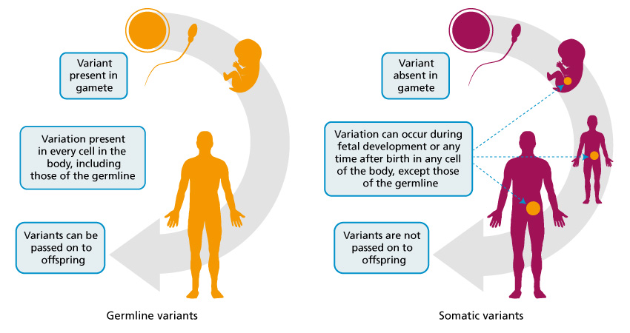
Germline/Somatic Variants
Professor Clare Turnbull of Genomics England - somatic and germline genomes in Cancer

Slide 10
The systematic application of genomic technologies has the potential to transform patient’s lives by:
matching people to the most effective medications and interventions, reducing the likelihood of an adverse drug reaction
increasing the number of people surviving cancer each year because of more accurate and early diagnosis and more effective use of therapies
There are also significant benefits for research and development that can be leveraged on behalf of the NHS, taxpayers and the wider economy.
https://www.england.nhs.uk/genomics/nhs-genomic-med-service/

Slide 11
Genomic Tumour Assessment Boards
Notes:
Is this the correct version?

Slide 12
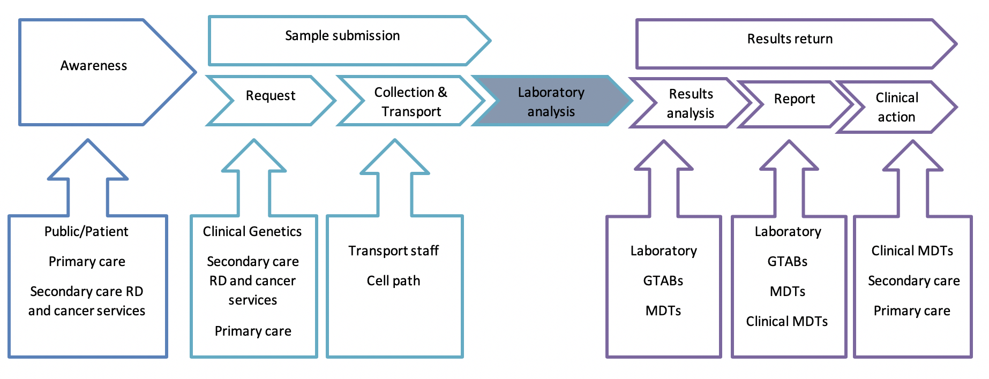
Education: Modular training matrix
Stakeholder group 1
Stakeholder group 3
Stakeholder group 2
The GLH has an E&T lead facilitating training packages to suppport localised delivery
Stakeholder mapped by training needs analysis
Multiple modalities for delivery - Face to face, Video, e-learning, existing material
Cascade training (‘Train the trainer’)

Slide 13
Regional Cancer Event 29/01/2020
Genomic Medicine Service Cancer Education Programme
Venue: Taunton Racecourse
Outcomes
Attendees will be provided with an understanding of genomic medicine applied in practice
An understanding of the relevance of genomic testing in cancer care
Evidence/case studies to illustrate clinical utility
An update on the NHS Genomic Medicine Service
An opportunity to inform the future provision of genomic testing in cancer—the design of solid tumour panel testing
An opportunity to inform the future provision of genomic testing in cancer—mechanisms to feedback relevant results to clinical teams and patients
An understanding of the role of genomic medicine from the perspective of key regional partners (Cancer Alliance, AHSN,SW Clinical Senate)
Aimed at: Professionals working in both primary and secondary care across the multi-disciplinary teams, including Clinical Nurse Specialists, oncologists, surgeons, histopathologists, radiologists and MDT co-ordinators
https://www.eventbrite.co.uk/e/genomic-medicine-service-cancer-education-programme-tickets-76421555931
Notes:
Regional Cancer Event 29/01/2020
The aim of this document is to provide an outline for a one day event with working title Genomic Medicine Service Cancer Education Programme
Purpose
The aim of this event is to provide information and educational content around the introduction of the new NHS Genomic Medicine Service and the provision of molecular genetic testing for patients with cancer in the South West Region. The event will promote discussion to support and inform the direction of the future development of genomic testing. This is a collaborative event to bring together organisations tasked with delivering improved cancer services to patients in the south west.
Format
Presentations and small group discussions aimed at a wide range of staff working in cancer services.
Audience
Professionals working in both primary and secondary care across the multi-disciplinary teams, including Clinical Nurse Specialists, oncologists, surgeons, histopathologists, radiologists and MDT co-ordinators
Outcomes
Attendees will be provided with an understanding of genomic medicine applied in practice
• An understanding of the relevance of genomic testing in cancer care
• Evidence/case studies to illustrate clinical utility
• An update on the NHS Genomic Medicine Service
• An opportunity to inform the future provision of genomic testing in cancer—the design of solid tumour panel testing
• An opportunity to inform the future provision of genomic testing in cancer—mechanisms to feedback relevant results to clinical teams and patients
• An understanding of the role of genomic medicine from the perspective of key regional partners (Cancer Alliance, AHSN,SW Clinical Senate

Slide 14
Thank you!

