Slide 1
Clinical Research Network
West of England
SWAG SSG Head and Neck Cancer Meeting
Tuesday 13th March
Research Report

Slide 2
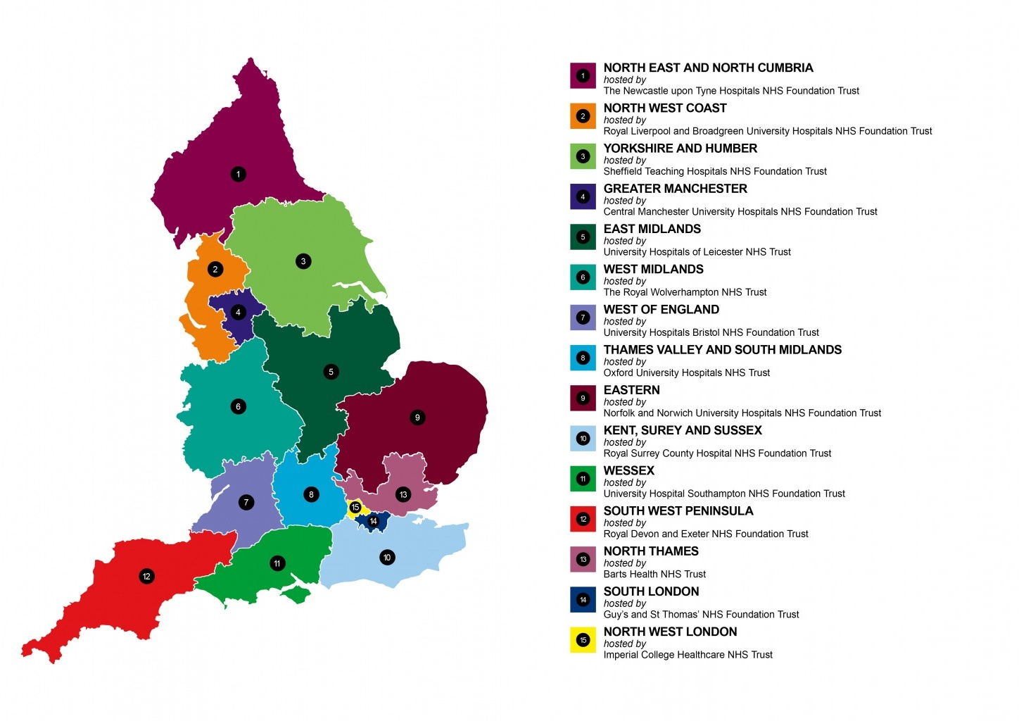
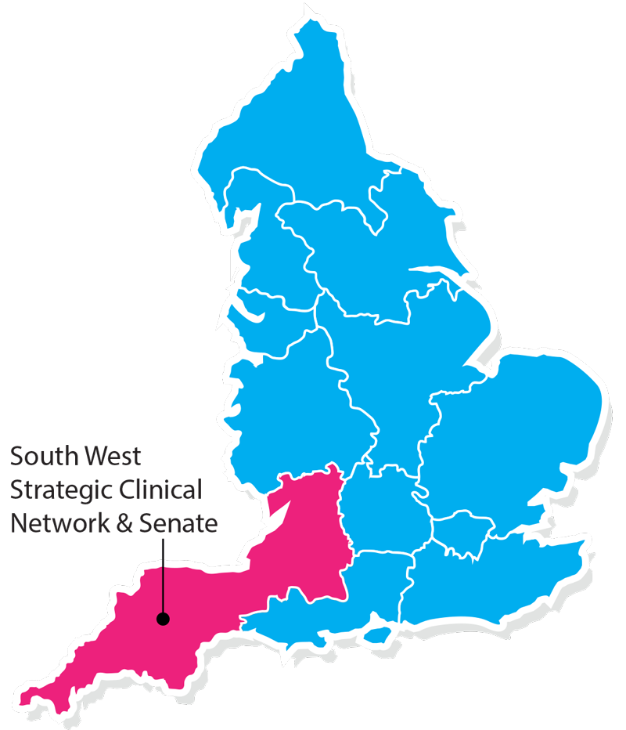
Clinical Research Network & Cancer Services
West ofEngland
SWAG - Somerset Wiltshire Avon & Gloucestershire
South West Children’s Cancer & Leukaemia
Research Network

Slide 3
NIHR CRN Objectives for cancer 2017-18
Number of LCRNs achieving on-target recruitment into at least 8 of the 13 Cancer subspecialties, where "on-target" means either improving recruitment by 10% from 2016/17 or meeting the following recruitment targets per 100,000 population served:
a) Brain & CNS: 0.2; b) Breast: 8; c) Colorectal: 3; d) Paediatrics: 3; e) Gynae: 3; f) Head & Neck: 1; g) Haematology: 7; h) Lung: 4; i) Sarcoma: 0.1; j) Skin: 0.2; k) Supportive & Palliative Care and Psychosocial Oncology & Survivorship: 3; l) Upper GI: 3; m) Urology: 8.

Slide 4
NIHR CRN High Level Objectives 2017-18
Increase number of participants into NIHR CRN portfolio studies
650,000 in England
21,905 in West of England
Increase the number of studies that deliver to time and target
Target 80%
Increase number of commercial studies delivered through network
Reduce NHS study set up times
Reduce time taken to recruit first participant

Slide 8
2016/17 Recruitment to Head and Neck as % overall Cancer Incidence

Slide 9
Open studies – Head and Neck
Portfolio ID | Project Title | Site | PI | PI email | BRAG rating | Planned end date | Recruited | Target
10876 | IoN Is ablative radio-iodine necessary for low risk differentiated thyroid cancer patients | Gloucestershire Hospitals NHS Foundation Trust | Candish, Dr Charlie | Charlie.Candish@glos.nhs.uk | -35.15% | 31/05/2018 | 7 | 12
 |  | University Hospitals Bristol NHS Foundation Trust | Beasley, Dr Matthew | matthew.beasley@uhbristol.nhs.uk | 150.59% | 18/11/2014 | 38 | 10
16203 | A randomised placebo-controlled trial of synchronous NIMorazole versus RADiotherapy alone in patients with locally advanced head and neck squamous cell carcinoma not suitable for synchronous chemotherapy or cetuximab - NIMRAD | Gloucestershire Hospitals NHS Foundation Trust | Grant, Dr Warren | warren.grant@glos.nhs.uk | 5.47% | 09/04/2018 | 4 | 4
 |  | University Hospitals Bristol NHS Foundation Trust | Booz, Dr Hoda | Hoda.Booz@UHBristol.nhs.uk | 19.74% | 01/07/2020 | 15 | 19
19934 | DARS: a phase III randomised multicentre study of dysphagia optimized intensity modulated radiotherapy (Do-IMRT) versus standard intensity modulated radiotherapy (s-IMRT) in head and neck cancer | Gloucestershire Hospitals NHS Foundation Trust | Cook, Dr Audrey | Audrey.Cook@glos.nhs.uk | 4.87% | 19/05/2018 | 7 | 8
 |  | Royal United Hospitals Bath NHS Foundation Trust | De Winton, Dr Emma | emma.dewinton@nhs.net | 105.80% | 30/11/2022 | 5 | 4
 |  | University Hospitals Bristol NHS Foundation Trust | Beasley, Dr Matthew | matthew.beasley@uhbristol.nhs.uk | -17.81% | 31/05/2018 | 8 | 12
32797 | Head & Neck 5000 Follow Up Study | Gloucestershire Hospitals NHS Foundation Trust | Hall, Mr Charles |  | -53.32% | 04/09/2018 | 0 | 10
 |  | Royal United Hospitals Bath NHS Foundation Trust | De Winton, Dr Emma | emma.dewinton@nhs.net | 30.33% | 04/09/2018 | 43 | 50
 |  | University Hospitals Bristol NHS Foundation Trust | Thomas, Prof Steven | Steve.Thomas@uhbristol.nhs.uk | 105.89% | 04/09/2018 | 156 | 90

Slide 10
Open studies – Head and Neck
Portfolio ID | Project Title | Site | PI | PI email | BRAG rating | Planned end date | Recruited | Target
18645 | A Phase II/III trial of risk-stratified, reduced intensity adjuvant treatment in patients undergoing transoral surgery for Human papillomavirus (HPV)-positive oropharyngeal cancer | Royal United Hospitals Bath NHS Foundation Trust | De Winton, Dr Emma | emma.dewinton@nhs.net | 21.03% | 20/02/2019 | 5 | 6
 |  | University Hospitals Bristol NHS Foundation Trust | Beasley, Dr Matthew | matthew.beasley@uhbristol.nhs.uk | -26.72% | 20/02/2019 | 7 | 18
9894 | Evaluation of centralisation in head and neck cancer | University Hospitals Bristol NHS Foundation Trust | Thomas, Prof Steven | Steve.Thomas@uhbristol.nhs.uk | 214.07% | 31/12/2020 | 398 | 140
18621 | CompARE Trial | University Hospitals Bristol NHS Foundation Trust | Booz, Dr Hoda | Hoda.Booz@UHBristol.nhs.uk | -1.98% | 01/04/2022 | 8 | 35
19937 | SEL-I-METRY | University Hospitals Bristol NHS Foundation Trust | Beasley, Dr Matthew | matthew.beasley@uhbristol.nhs.uk | 32.81% | 30/09/2019 | 2 | 4
20272 | Assessment of Quality of Life Tools in Medullary Thyroid Cancer (QaLM) | University Hospitals Bristol NHS Foundation Trust | Beasley, Dr Matthew | matthew.beasley@uhbristol.nhs.uk | -77.35% | 01/10/2017 | 6 | 10

Slide 11
Studies in set up
Portfolio ID | Project Title | Site
30658 | A Randomised Trial of Post Operative Radiation Therapy Following Wide Excision of Neurotropic Melanoma of the Head and Neck TROG 08.09 ANZMTG 01.09 | University Hospitals Bristol

Slide 12
Contacts
Research Delivery Manager – david.rea@nihr.ac.uk
Cancer portfolio facilitator – jessica.bartlett@nihr.ac.uk
Head and Neck research lead – steve.thomas@bristol.ac.uk

