Slide 1
SWAG SSG Haematology and Lymphoma Cancer Meeting
Clinical Research Network
West of England
Research Report
Wednesday 6th March
David Rea

Slide 2
NIHR CRN High Level Objectives 2018-19
Increase number of participants into NIHR CRN portfolio studies
650,000 in England
21,905 in West of England
Increase the number of studies that deliver to time and target
Target 80%
Increase number of commercial studies delivered through network
Reduce NHS study set up times
Reduce time taken to recruit first participant

Slide 3
Cancer specialty objective for 2018-19
Increase patient access to Cancer research studies across the breadth of the Cancer subspecialties Number of LCRNs achieving on-target recruitment into at least 8 of the 13 Cancer subspecialties, where "on-target" means either improving recruitment by 10% from 2017/18 or meeting the following recruitment targets per 100,000 population served:
a) Brain: 0.2; b) Breast: 10; c) Colorectal: 3; d); Children and Young People: 3; e) Gynae: 3; f) Head & Neck: 1.5; g) Haematology: 7; h) Lung: 4; i) Sarcoma: 0.1; j) Skin: 0.5; k) Supportive & Palliative Care and Psychosocial Oncology: 4; l) Upper GI: 3; m) Urology: 12.

Slide 4
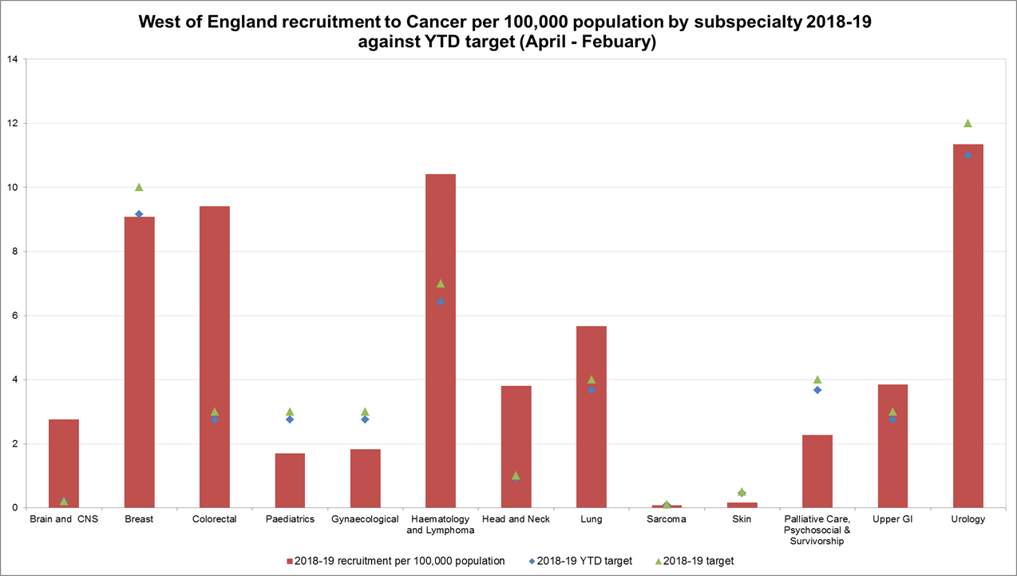
Performance regarding 2018 -19 Cancer specialty target

Slide 5
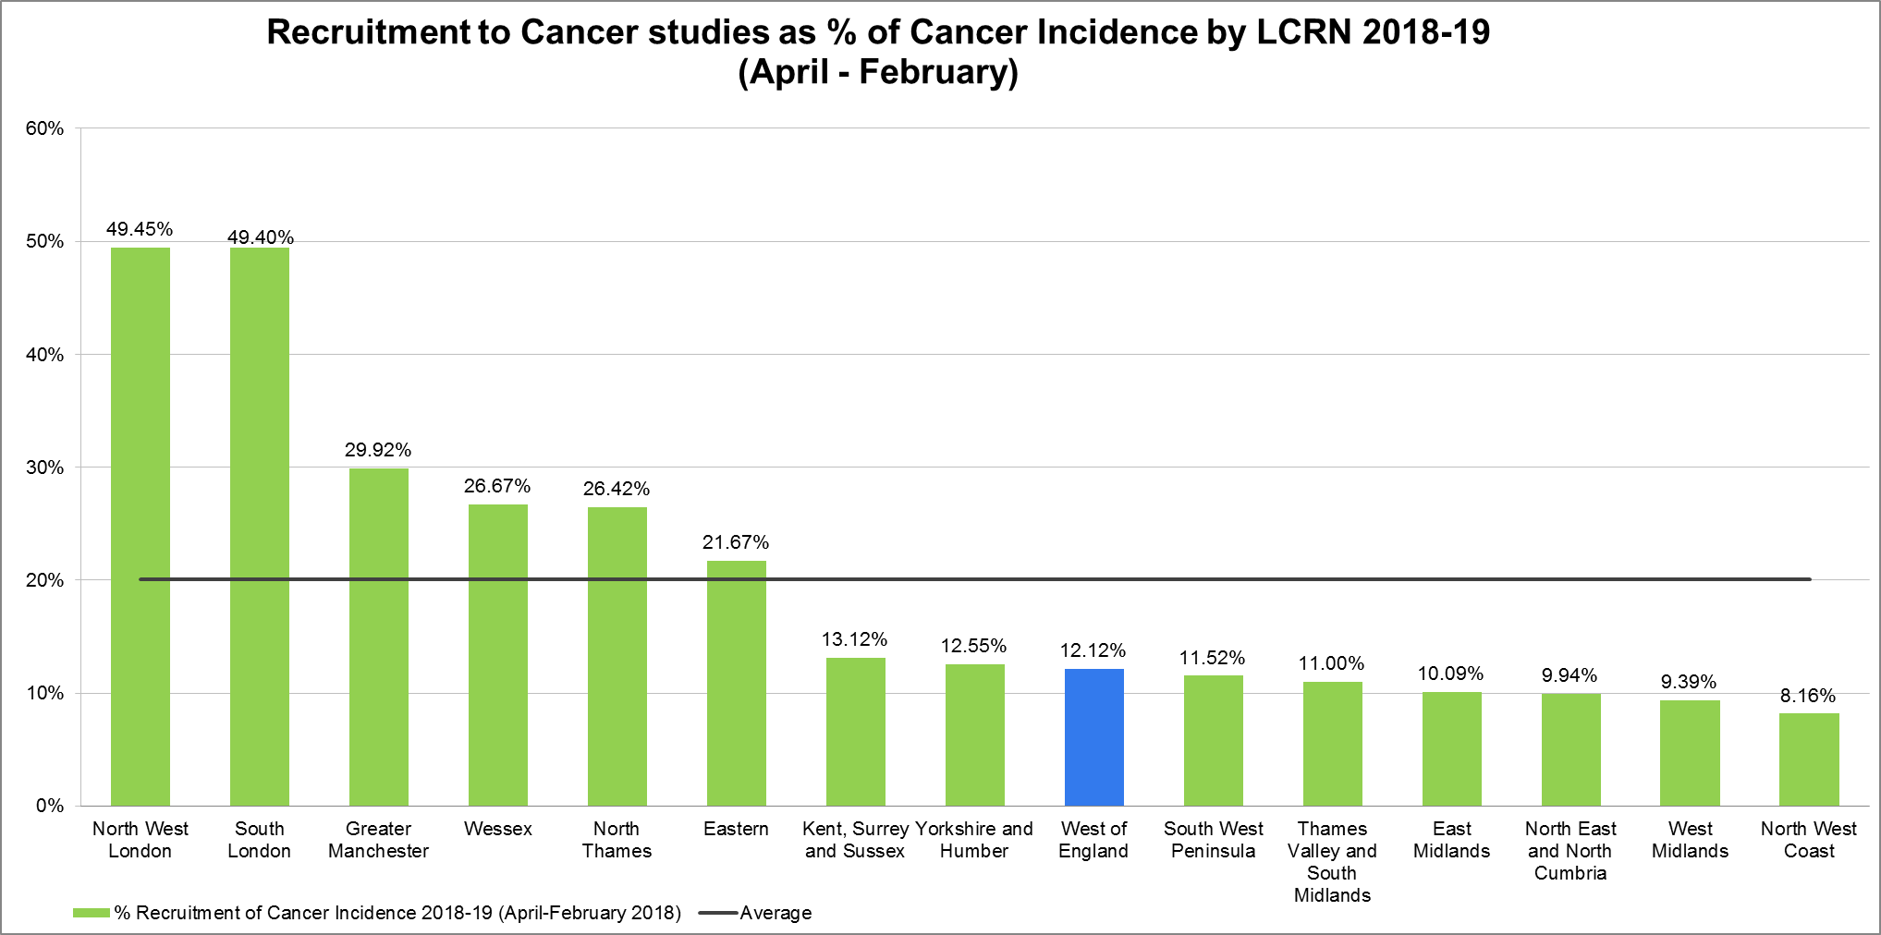
Cancer incidence

Slide 6
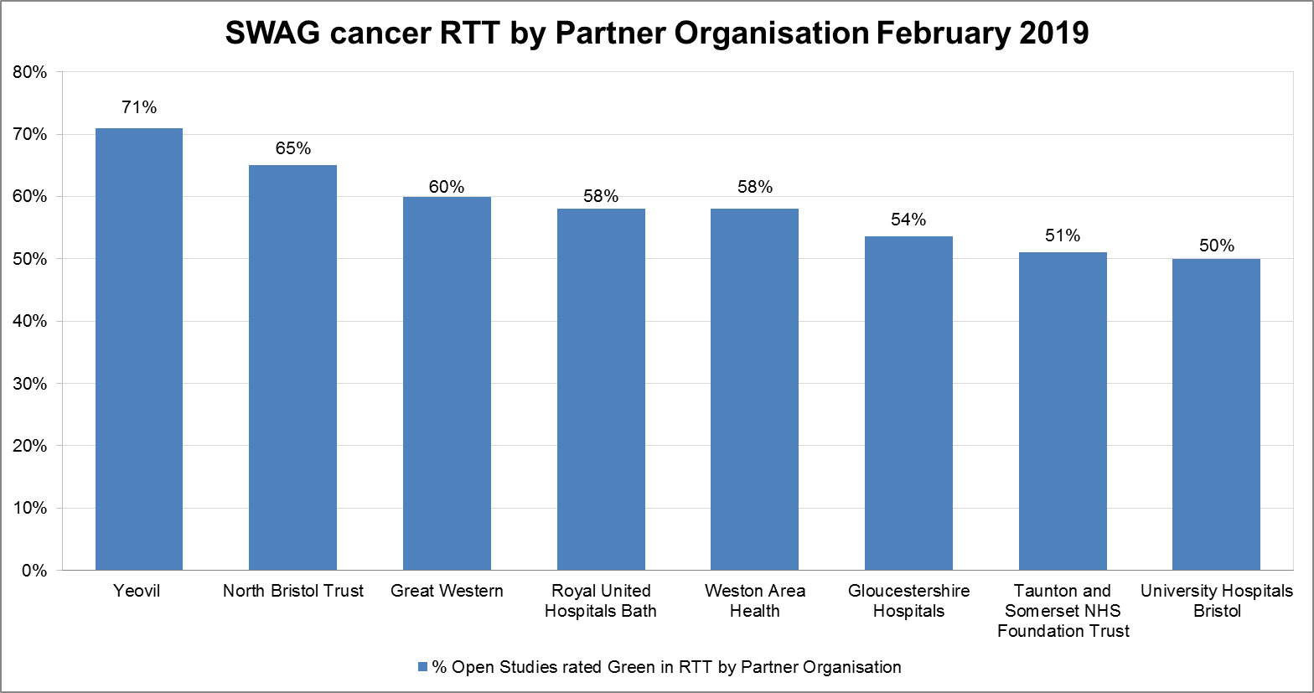
Cancer recruitment to time and target

Slide 7
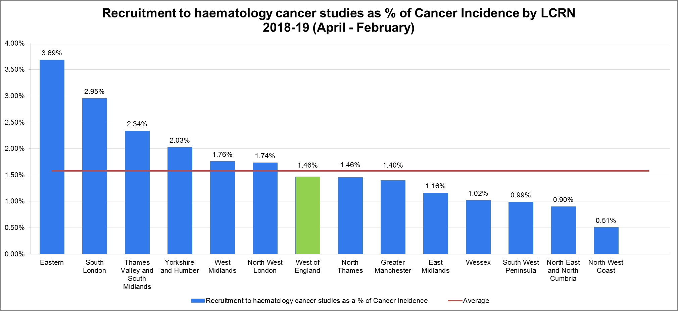
Cancer incidence: Haematology

Slide 8
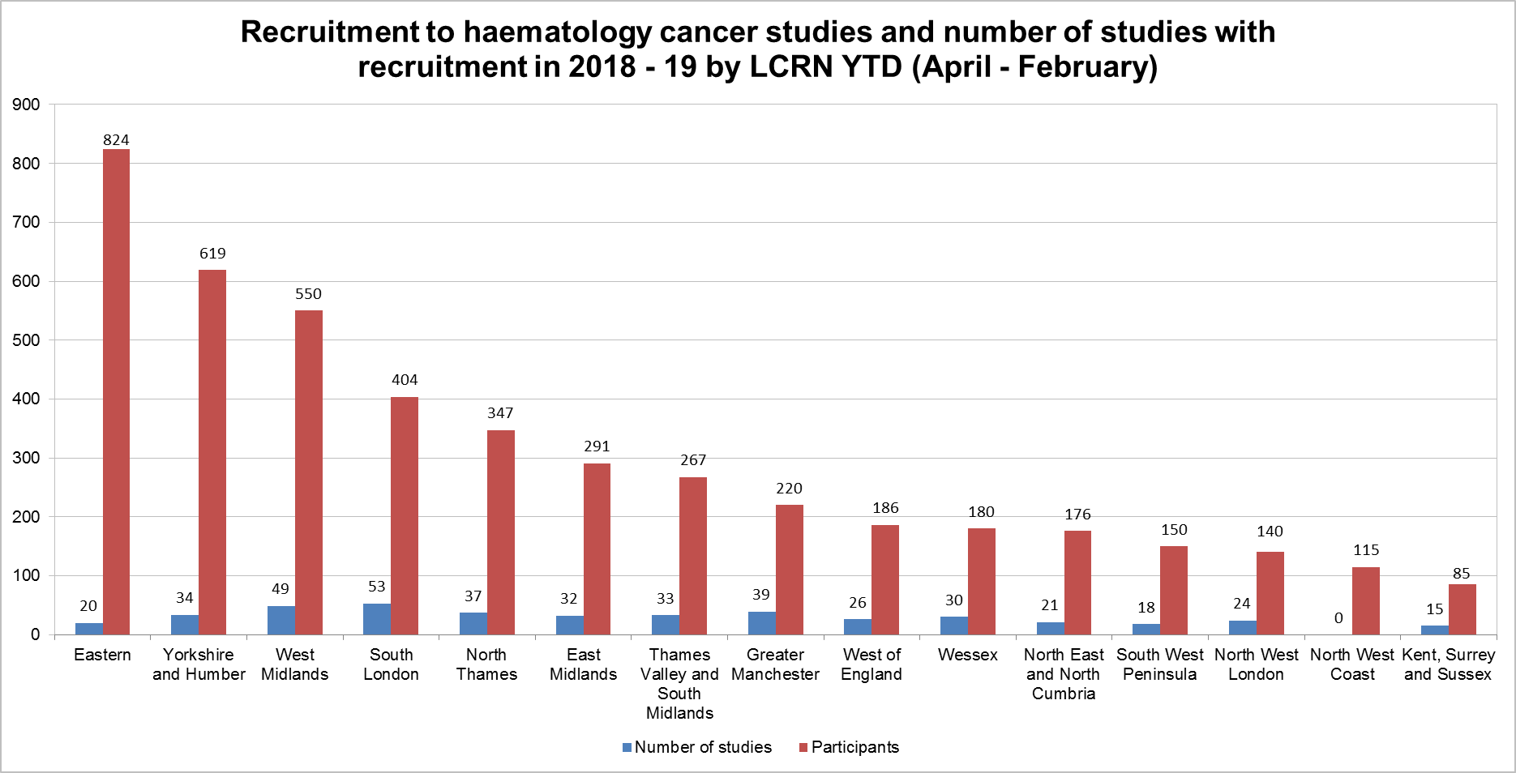
Recruitment and number of haematology cancer studies 2018-19

Slide 9
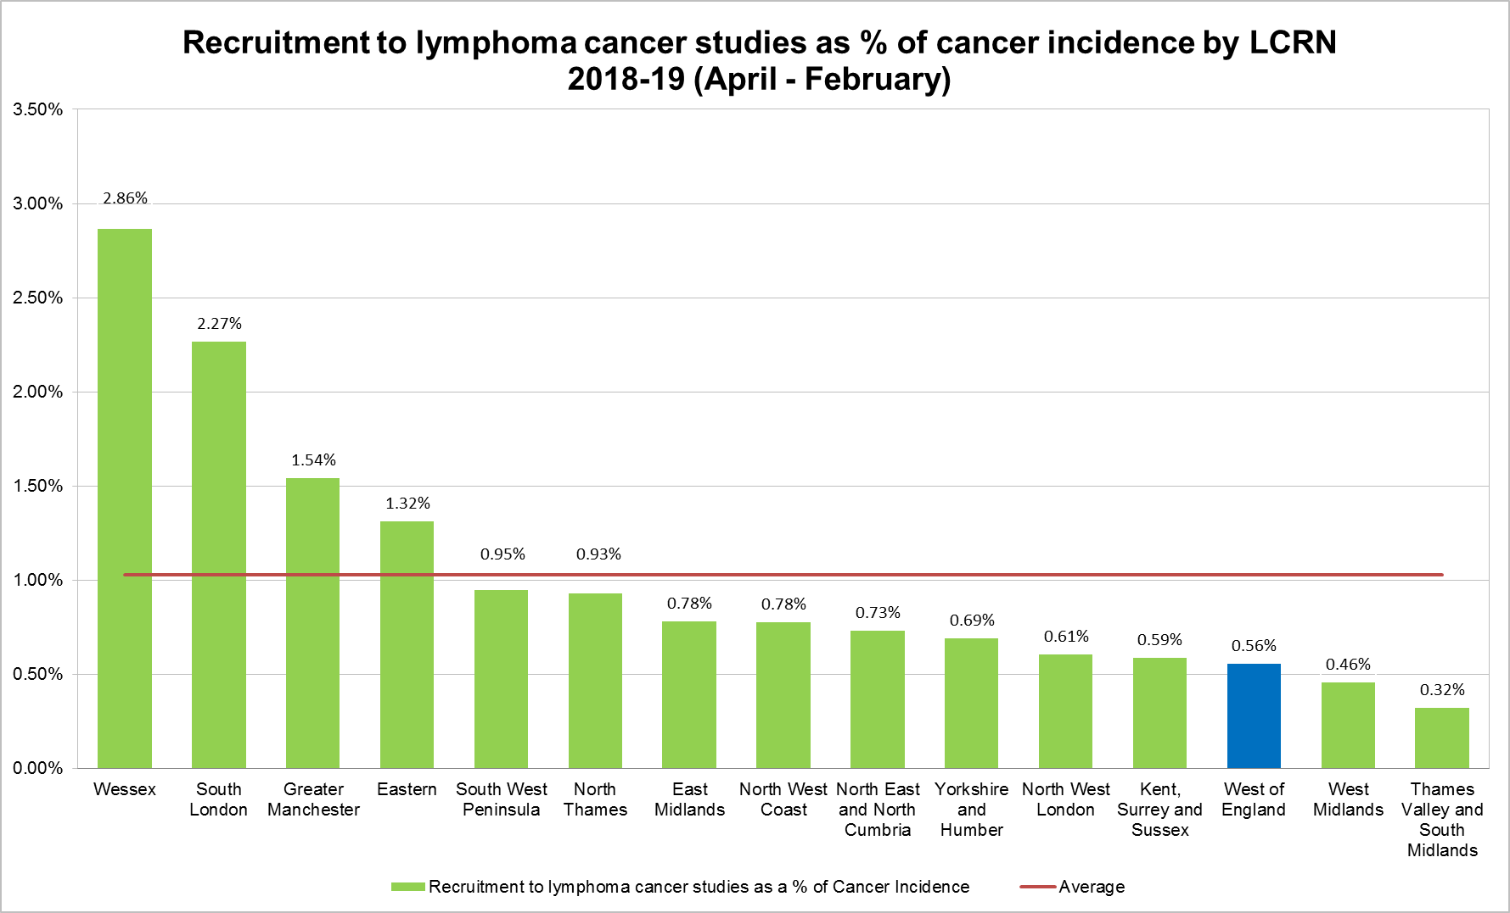
Cancer incidence: Lymphoma

Slide 10
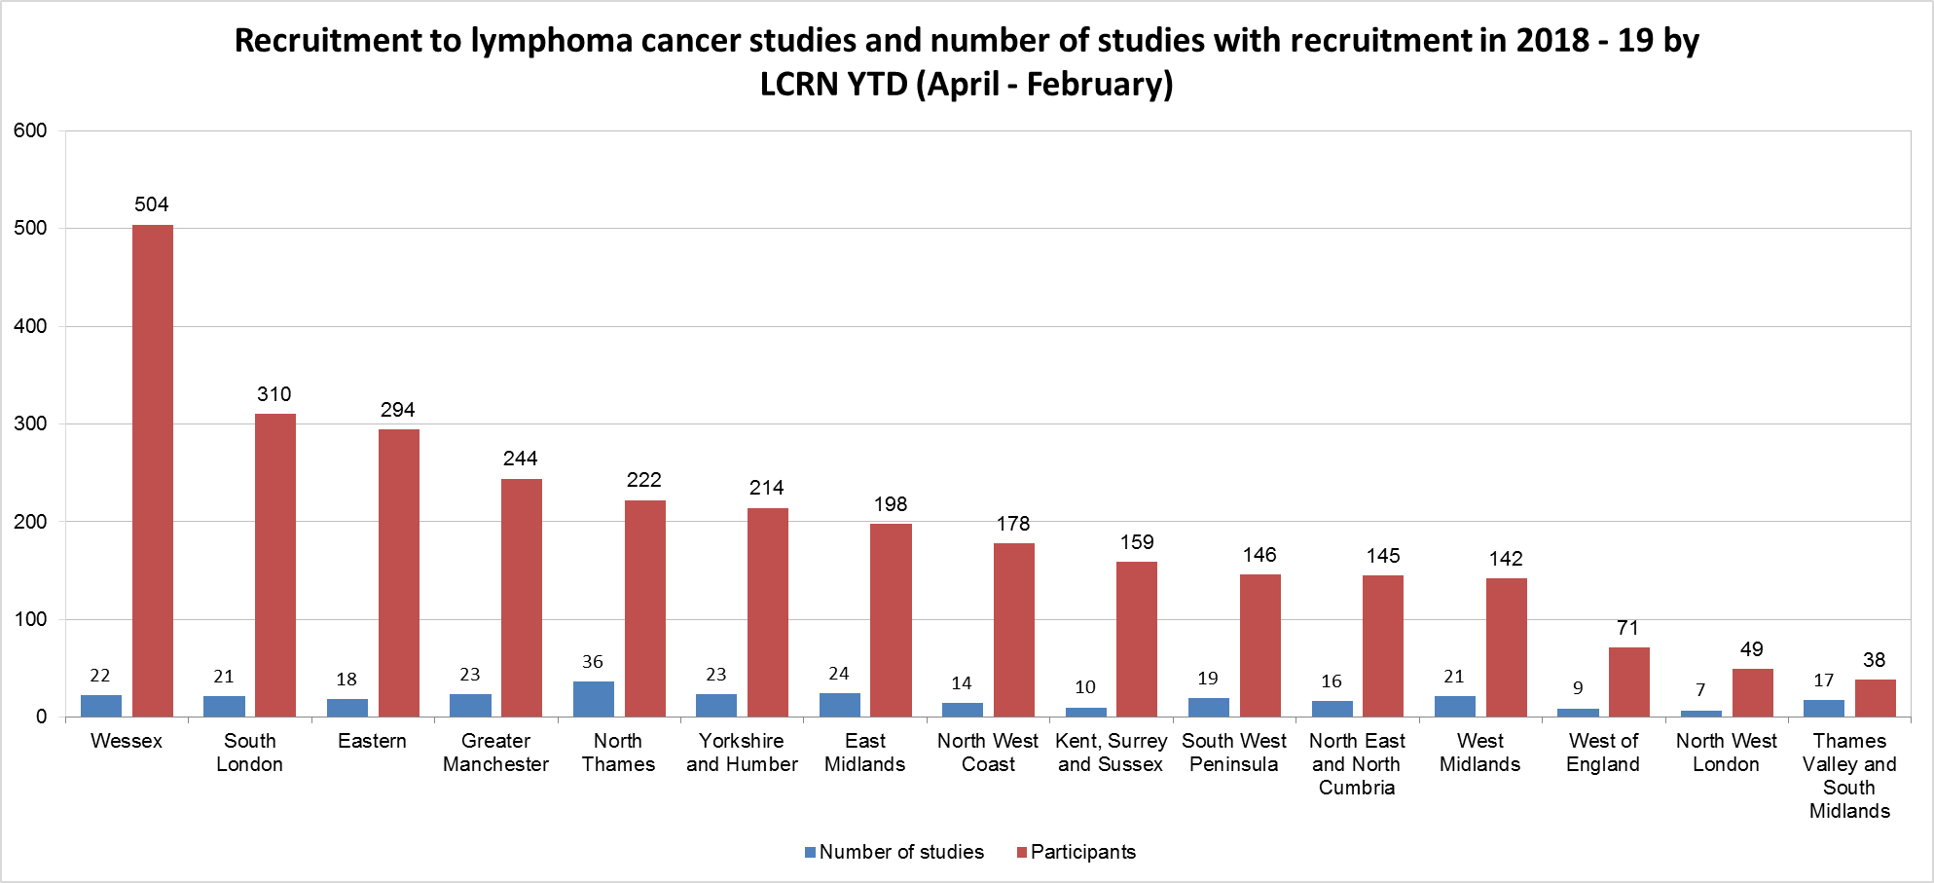
Recruitment and number of lymphoma cancer studies 2018-19

Slide 11
Useful links
https://www.crn.nihr.ac.uk/
National and local network information including training programmes templates, tools, contacts, videos etc
https://odp.nihr.ac.uk/
Open data platform. Look at performance across whole CRN including all specialty areas
http://csg.ncri.org.uk/portfolio/portfolio-maps/
View current national portfolio of open, closed and ‘in set up’ cancer studies
https://www.ukctg.nihr.ac.uk/
See where a study is open across the country
http://public-odp.nihr.ac.uk/
Search for a study to fit criteria. Good for horizon scanning, eligibility criteria

Slide 12
Contacts
Research Delivery Manager – David.Rea@nihr.ac.uk
Research portfolio facilitator – jessica.bartlett@nihr.ac.uk
Haematology and lymphoma cancer research lead – sallymoore5@nhs.net

