Slide 1
SWAG SSG Brain Cancer Meeting
Clinical Research Network
West of England
Research Report
03/04/2019
David Rea

Slide 2
NIHR CRN High Level Objectives 2018-19
Increase number of participants into NIHR CRN portfolio studies
650,000 in England
21,905 in West of England
Increase the number of studies that deliver to time and target
Target 80%
Increase number of commercial studies delivered through network
Reduce NHS study set up times
Reduce time taken to recruit first participant

Slide 3
Cancer specialty objective for 2018-19
Increase patient access to Cancer research studies across the breadth of the Cancer subspecialties Number of LCRNs achieving on-target recruitment into at least 8 of the 13 Cancer subspecialties, where "on-target" means either improving recruitment by 10% from 2017/18 or meeting the following recruitment targets per 100,000 population served:
a) Brain: 0.2; b) Breast: 10; c) Colorectal: 3; d); Children and Young People: 3; e) Gynae: 3; f) Head & Neck: 1.5; g) Haematology: 7; h) Lung: 4; i) Sarcoma: 0.1; j) Skin: 0.5; k) Supportive & Palliative Care and Psychosocial Oncology: 4; l) Upper GI: 3; m) Urology: 12.

Slide 4
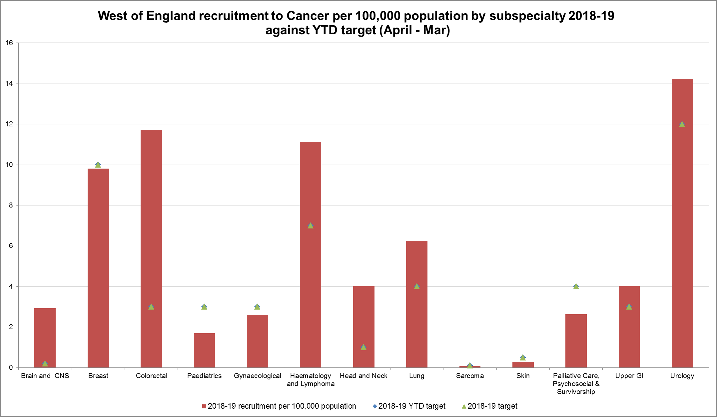
Performance regarding 2018-19 Cancer specialty target

Slide 5
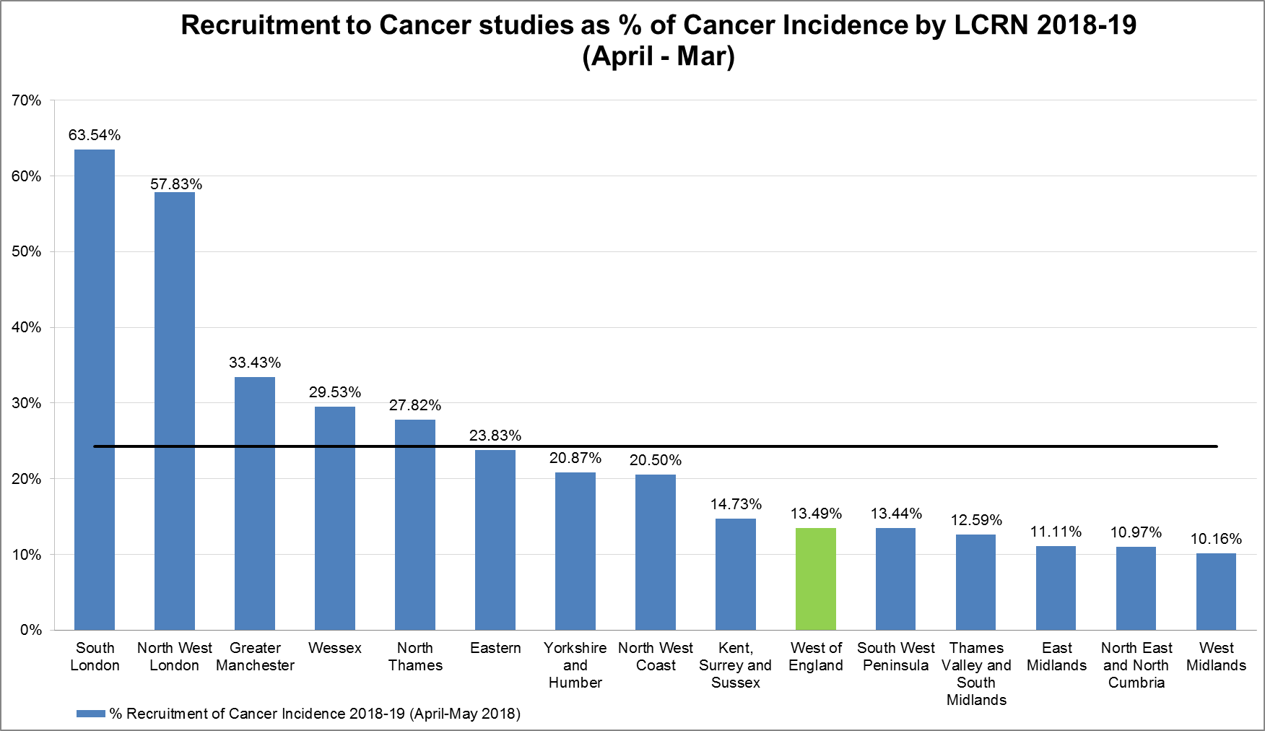
Cancer incidence

Slide 6
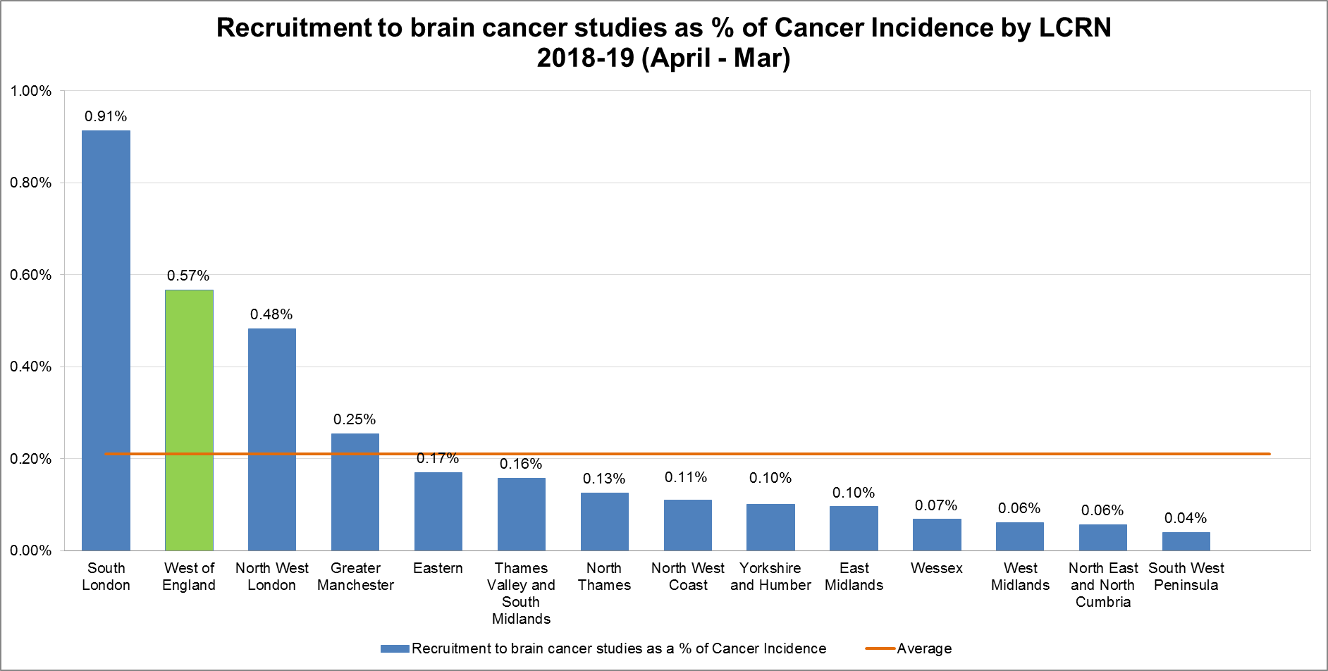
Cancer incidence: Brain

Slide 7
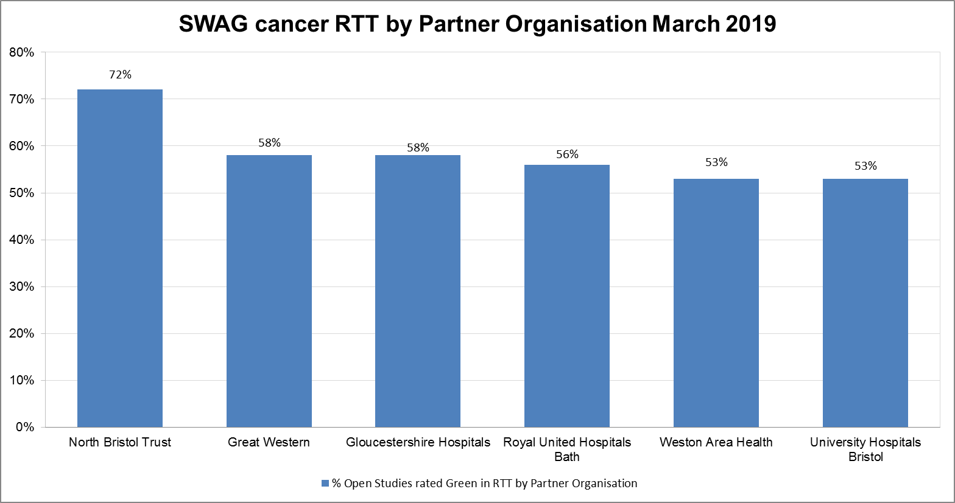
Cancer recruitment to time and target

Slide 8
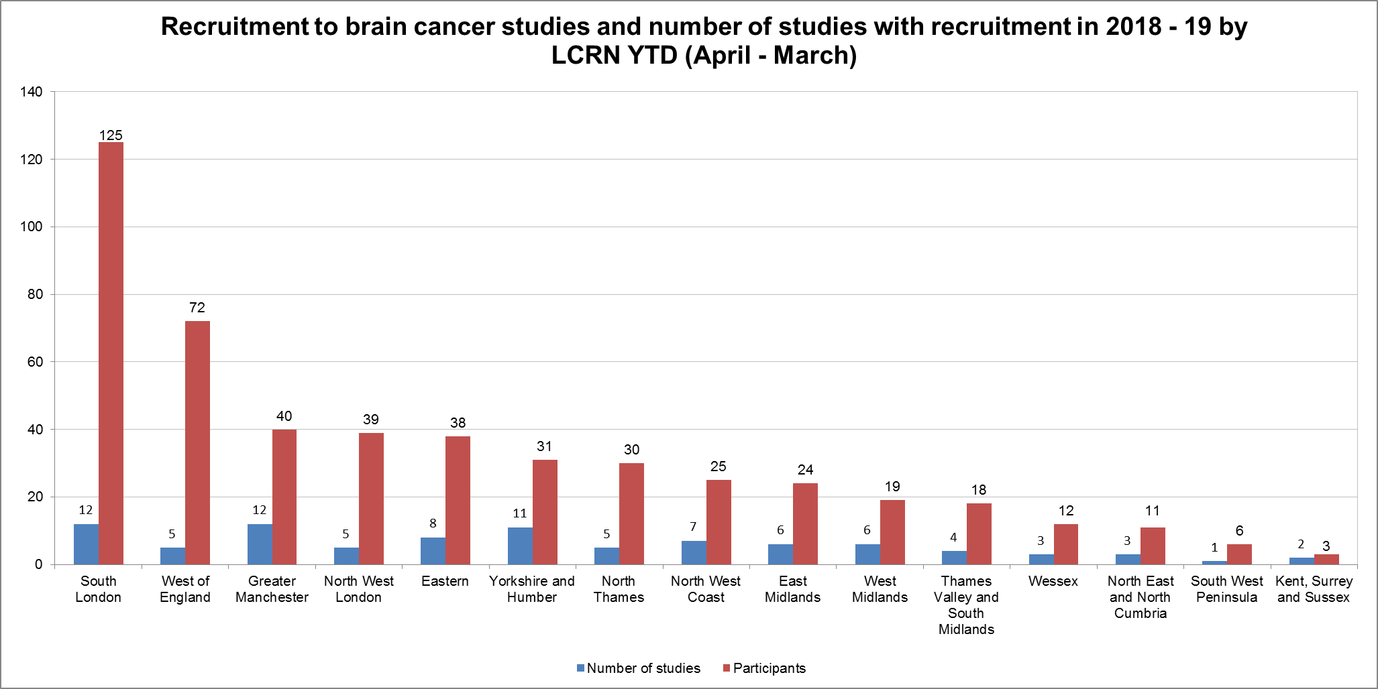
Recruitment and number of brain cancer studies 2018-19

Slide 9
Useful links
https://www.crn.nihr.ac.uk/
National and local network information including training programmes templates, tools, contacts, videos etc
https://odp.nihr.ac.uk/
Open data platform. Look at performance across whole CRN including all specialty areas
http://csg.ncri.org.uk/portfolio/portfolio-maps/
View current national portfolio of open, closed and ‘in set up’ cancer studies
https://www.ukctg.nihr.ac.uk/
See where a study is open across the country
http://public-odp.nihr.ac.uk/
Search for a study to fit criteria. Good for horizon scanning, eligibility criteria

Slide 10
Open trials
List of open trials
CPMS ID | Title | Trust | Recruited (total) | Target | Edge recruitment end date
5757 | NBT | North Bristol NHS Trust | 15 | 14 | 01/04/2015
 |  | University Hospitals Bristol NHS Foundation Trust | 51 | 100 | 01/04/2015
16948 | MOT | North Bristol NHS Trust | 94 | 15 | 20/10/2019
18137 | PARADIGM OlaPArib And RADiotherapy In newly-diagnosed GlioblastoMa: | Gloucestershire Hospitals NHS Foundation Trust | 2 | 4 | 01/04/2020
 |  | University Hospitals Bristol NHS Foundation Trust | 11 | 6 | 31/12/2018
18503 | SIOP Ependymoma II | University Hospitals Bristol NHS Foundation Trust | 2 | 3 | 28/02/2021
30967 | ROAM | University Hospitals Bristol NHS Foundation Trust | 0 | 6 | 01/03/2019
31760 | CMS Study | University Hospitals Bristol NHS Foundation Trust | 12 | 24 | 31/10/2020
31853 | VINILO | University Hospitals Bristol NHS Foundation Trust | 1 | 3 | 31/12/2019
33023 | Biomede | University Hospitals Bristol NHS Foundation Trust | 2 | 6 | 01/04/2021
33552 | PARADIGM-2 | University Hospitals Bristol NHS Foundation Trust | 5 | 6 | 01/04/2020

Slide 11
Open to new sites
Trials open to new sites
CPMS ID | Short title | Lead LCRN
43799 | Translocator Protein Expression in Transforming Gliomas | Greater Manchester
43465 | Cambridge Brain Mets Trial 1: A proofð of principle phase 1b / randomised phase 2 study of afatinib penetration into cerebral metastases for patients undergoing neurosurgical resection, both with and without prior lowð-dose, targeted radiotherapy | Eastern
43862 | SIOP Ependymoma II - An International Clinical Program for the diagnosis and treatment of children, adolescents and young adults with Ependymoma | East Midlands
43465 | NORDIC (and UK) STUDY OF THE CEREBELLAR MUTISM SYNDROME (CMS) IN CHILDREN WITH BRAIN TUMOURS OF THE POSTERIOR FOSSA | North West Coast
43982 | A dose-finding study of the safety and tolerability of intravenous reovirus (REOLYSIN©)(pelareorep) plus granulocytemacrophage colony-stimulating factor (GM-CSF) in combination with standard of care chemoradiotherapy /adjuvant chemotherapy for Glioblastoma Multiforme (GBM) | Yorkshire and Humber
43830 | Predicting sites of tumour progression in the invasive margin of glioblastomas (PRaM-GBM study) | Eastern
44287 | Biological Medicine for Diffuse Intrinsic Pontine Glioma (DIPG) Eradication (Biomede) | North Thames
44044 | Brain Imaging to predict Toxicity in Elderly patients after Radiotherapy | Kent, Surrey and Sussex

Slide 12
Contacts
Research Delivery Manager – David.Rea@nihr.ac.uk
Research portfolio facilitator – jessica.bartlett@nihr.ac.uk
Brain cancer research lead – christopher.herbert@uhbristol.nhs.uk

