Slide 1
SWAG Improving SCC pathways
Feb 2019
Dr Adam Bray
Bristol

Slide 2
Summary
New SCC staging: AJCC & UICC 8
Key determinants of TNM stages
Measuring thickness
Recent key papers:
Prognostic risks
Prophylaxis
BAD guidance 2010 (draft revision due 2019)
Increasing SCC FU demand
Audit of recurrences
Proposed risk stratification
Notes:
Union for International Cancer Control
the American Joint Committee on Cancer

Slide 4
For cutaneous lip, and all skin except penis, vulva, anus, other mucosa
Eyelid staging new – slightly different
Vermillion lip – very different, with oral cancer

Slide 6
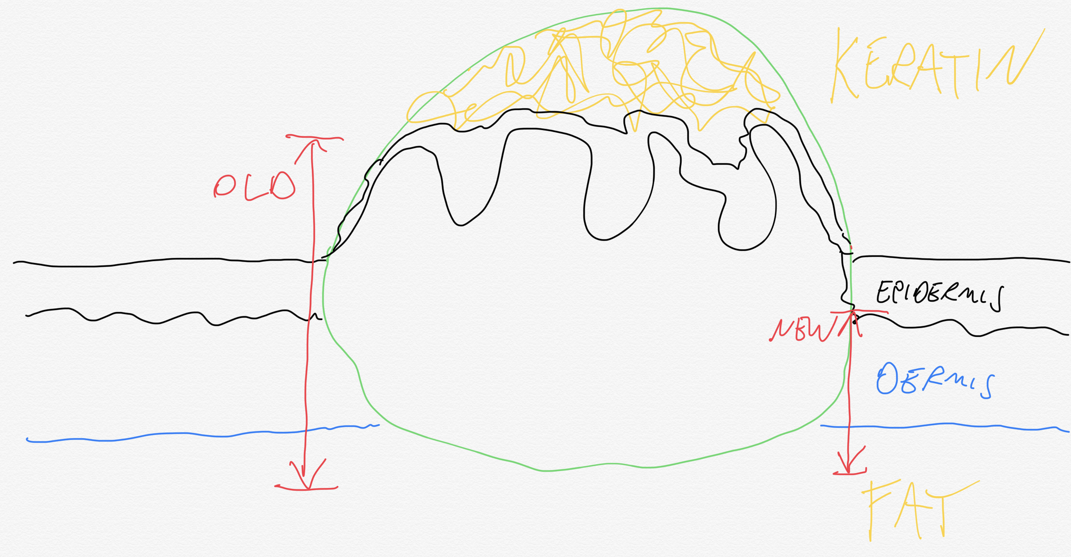
￼
￼
￼
NB Thickness: ‘ as measured from the granular layer of adjacent normal epidermis to the base of the tumour’ (AJCC7/RCPath 2014)

Slide 7
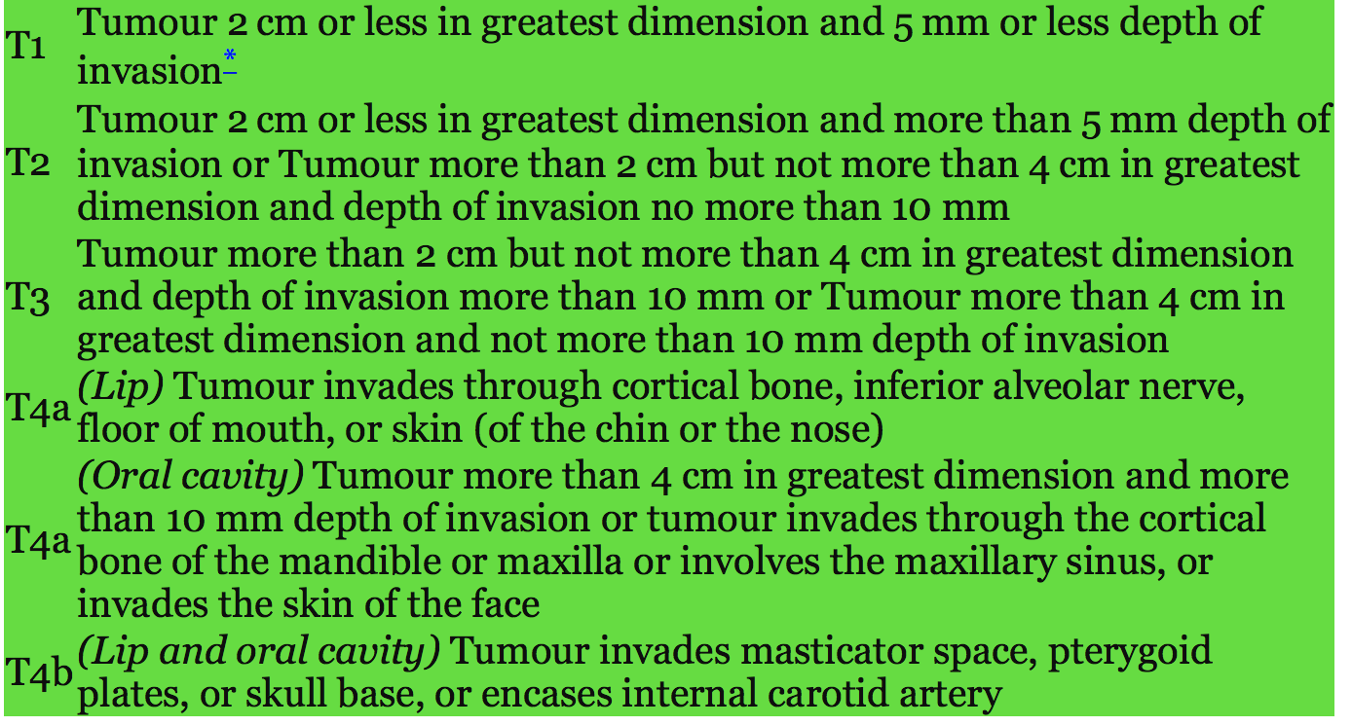
Lip vermillion/oral mucosa UICC8 – staging different
pT1 <=2cm diameter & <5mm depth of invasion
pT2 <=2cm and >5mm depth
>2cm <=4cm & <=10mm depth
pT3 >2cm <=4cm & >10mm
>4cm & <=10mm

Slide 8
pT3

Slide 9
pT4

Slide 10
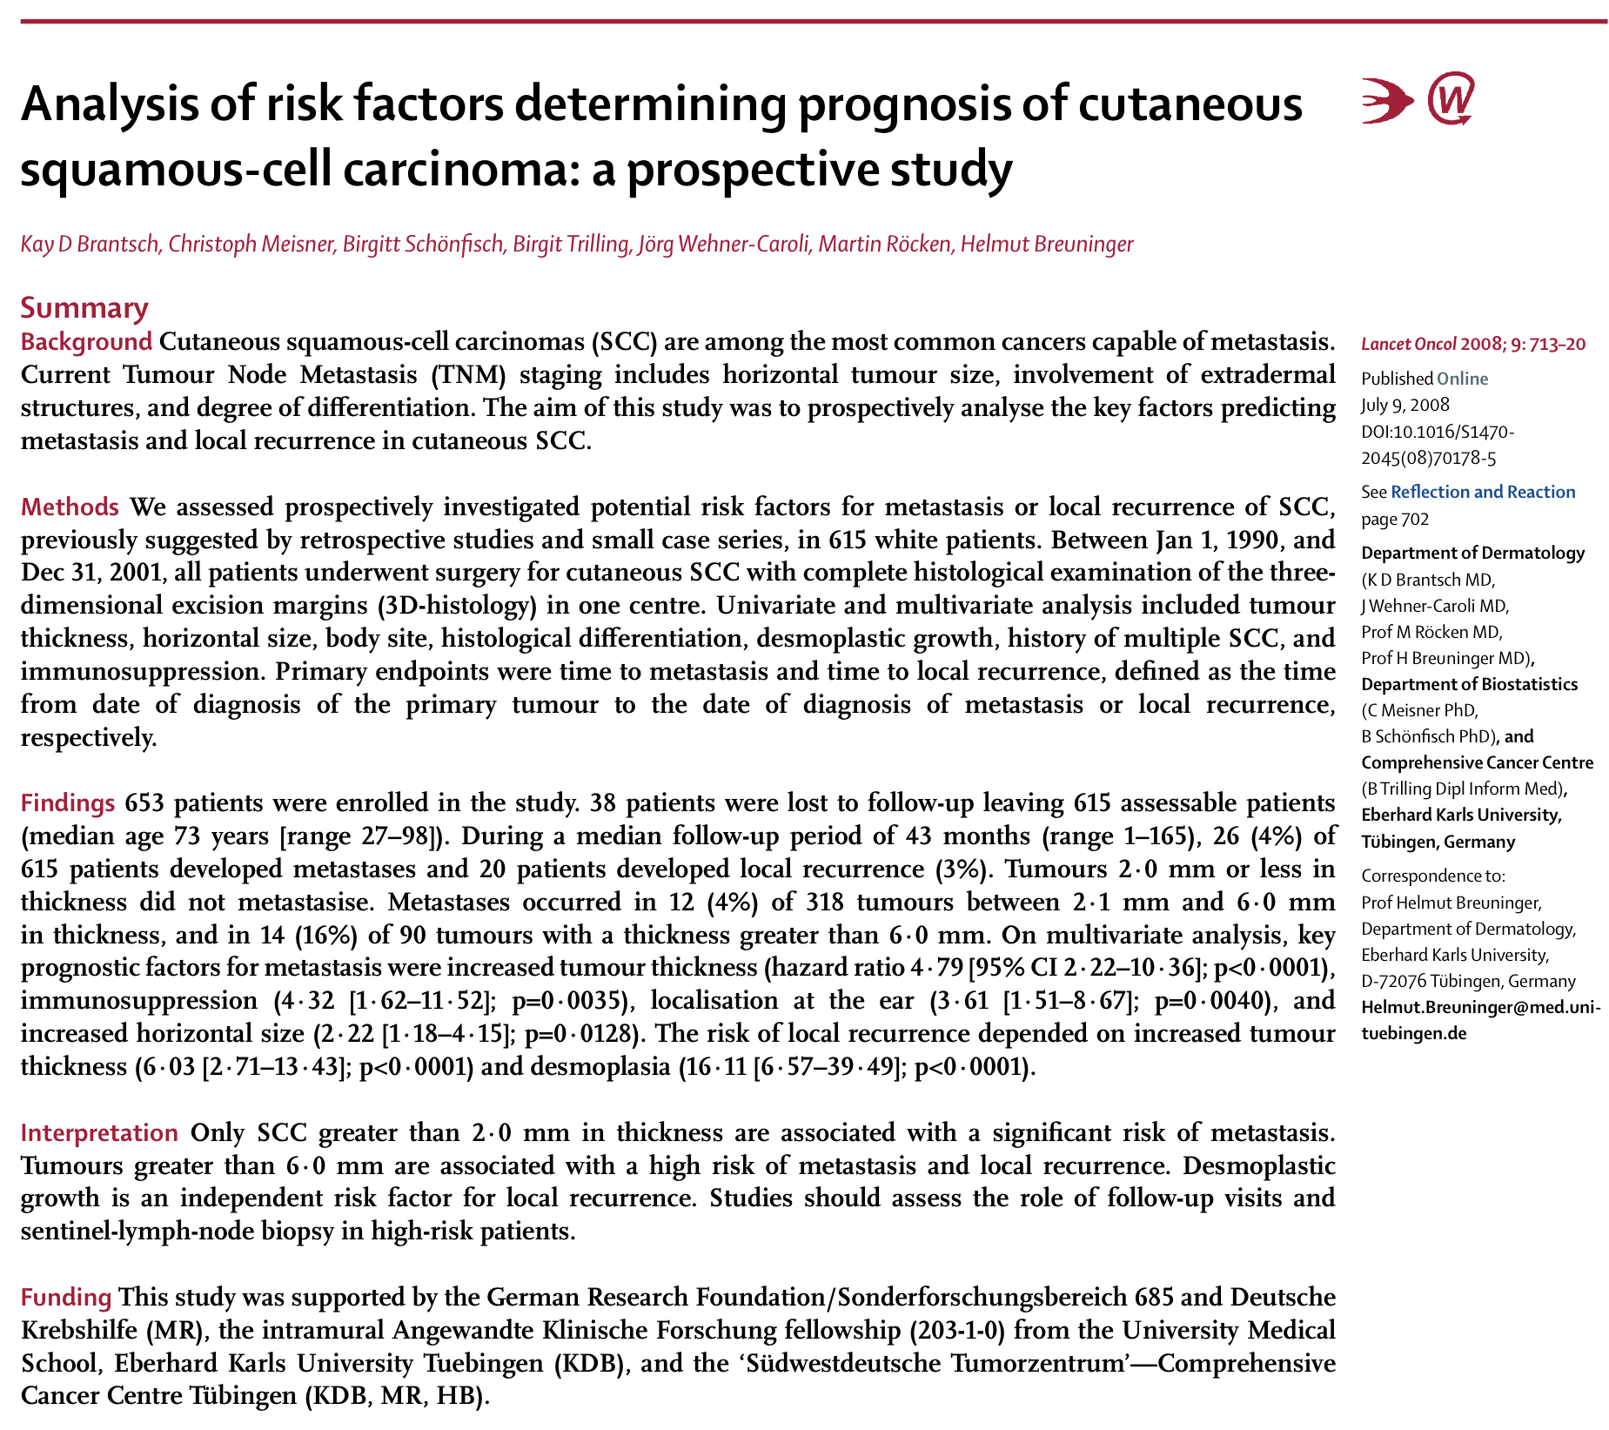
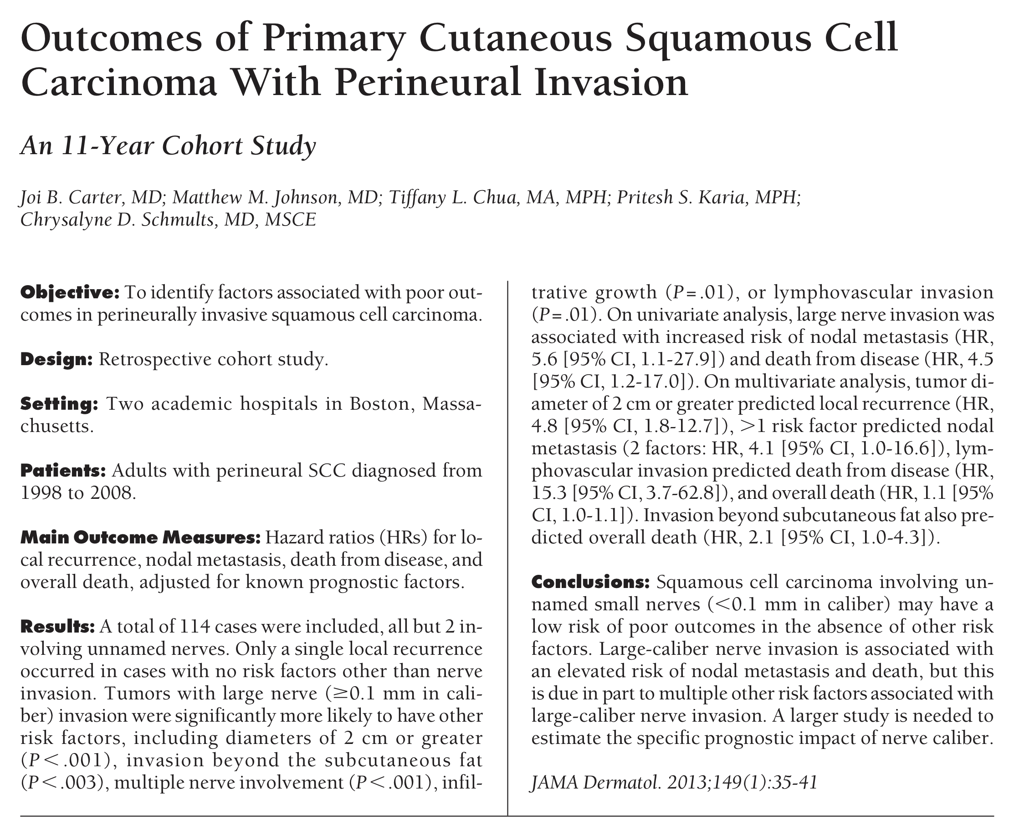
Notes:
Need to review how they measured thickness in brantsch study

Slide 11
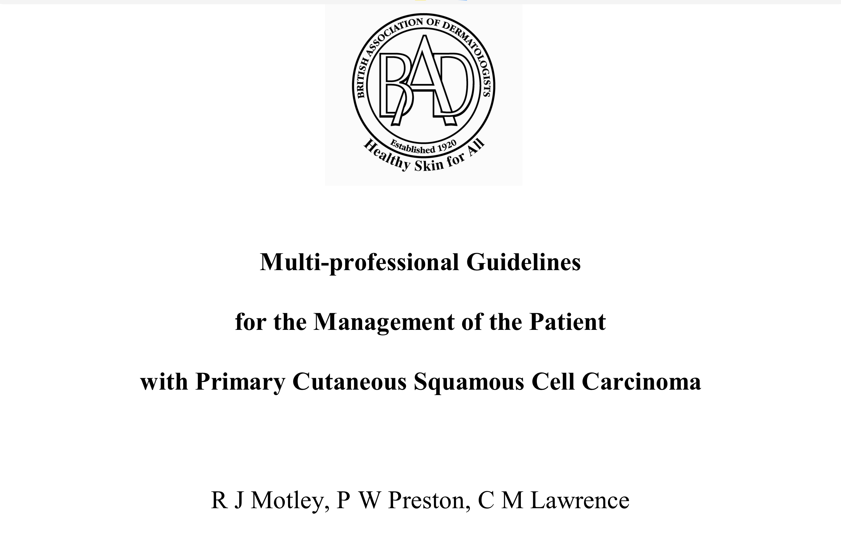
2010

Slide 12
Demand management and increasing quality

Slide 13
UHB FU proposal
Protocols for risk stratification pre-MDT meeting
Minimise discussions at MDT meeting
FU focussed on very high risk
Identify patients with higher need for face-to-face
Improve staging and cancer registration
Group FU education sessions
Reduce number & duration of face-to-face appointments
Standardise education and training
Can be delivered by non-clinical staff
Notes:
Last 2 meetings would have saved about 1 patient year 1 of fu ie 3 appointments whilst increasing fu for highest risk from 2-3yrs and adding group sessions for all
Currently low risk group only but will be for all risk groups post face to face

Slide 14
Audit
SCC recurrence or metastasis presenting last 3 years to UHB LSMDT
SSMDT data also collected, pending analysis
contributions from referring centres
Somerset cancer registry
9 cases UHB (3 more no notes)
16 NBT (data not yet cleaned)
Notes:
How many died due to the SCC
Why were some excluded and how many
About 9 recurrences/mets per year
How many total SCC excised? Approx 5000 excisions at UHB estimate 2/3 cancer =3300, if approx 40% were SCC = 1320 at UHB, let’s say same at NBT, I.e. approx 3000 per year would be 0.9% absolute risk overall
Quoted 3-5% risk in US, 1-2% risk of death

Slide 20
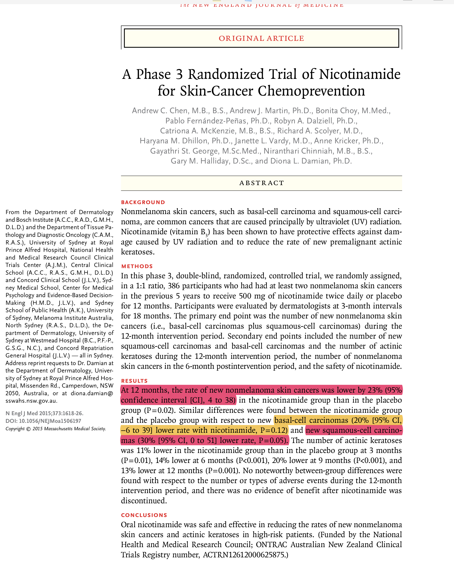
roughly = to getting 2 NMSC in 2 years instead of 3
Notes:
Australia. approx 0.6 NMSC lesions per patient fewer in nicotinamide group over 1 yr treatment 500mg bd
NB 8.2 NMSC mean per patient previous 5yrs = 1.64 per patient per year
roughly = to getting 2 NMSC in 2years instead of 3?
what is cost of tablets?
health system saves cost of surgery and probably some reduction in fu
hospital loses profit from surgery and fu but saves in resources and risk to missing cancer targets
many patient benefits for few risks
possible assessments if we use it: trajectory of NMSC development for individual and unit; cmpare avreage number of NMSC per year before and after and costs

Slide 22
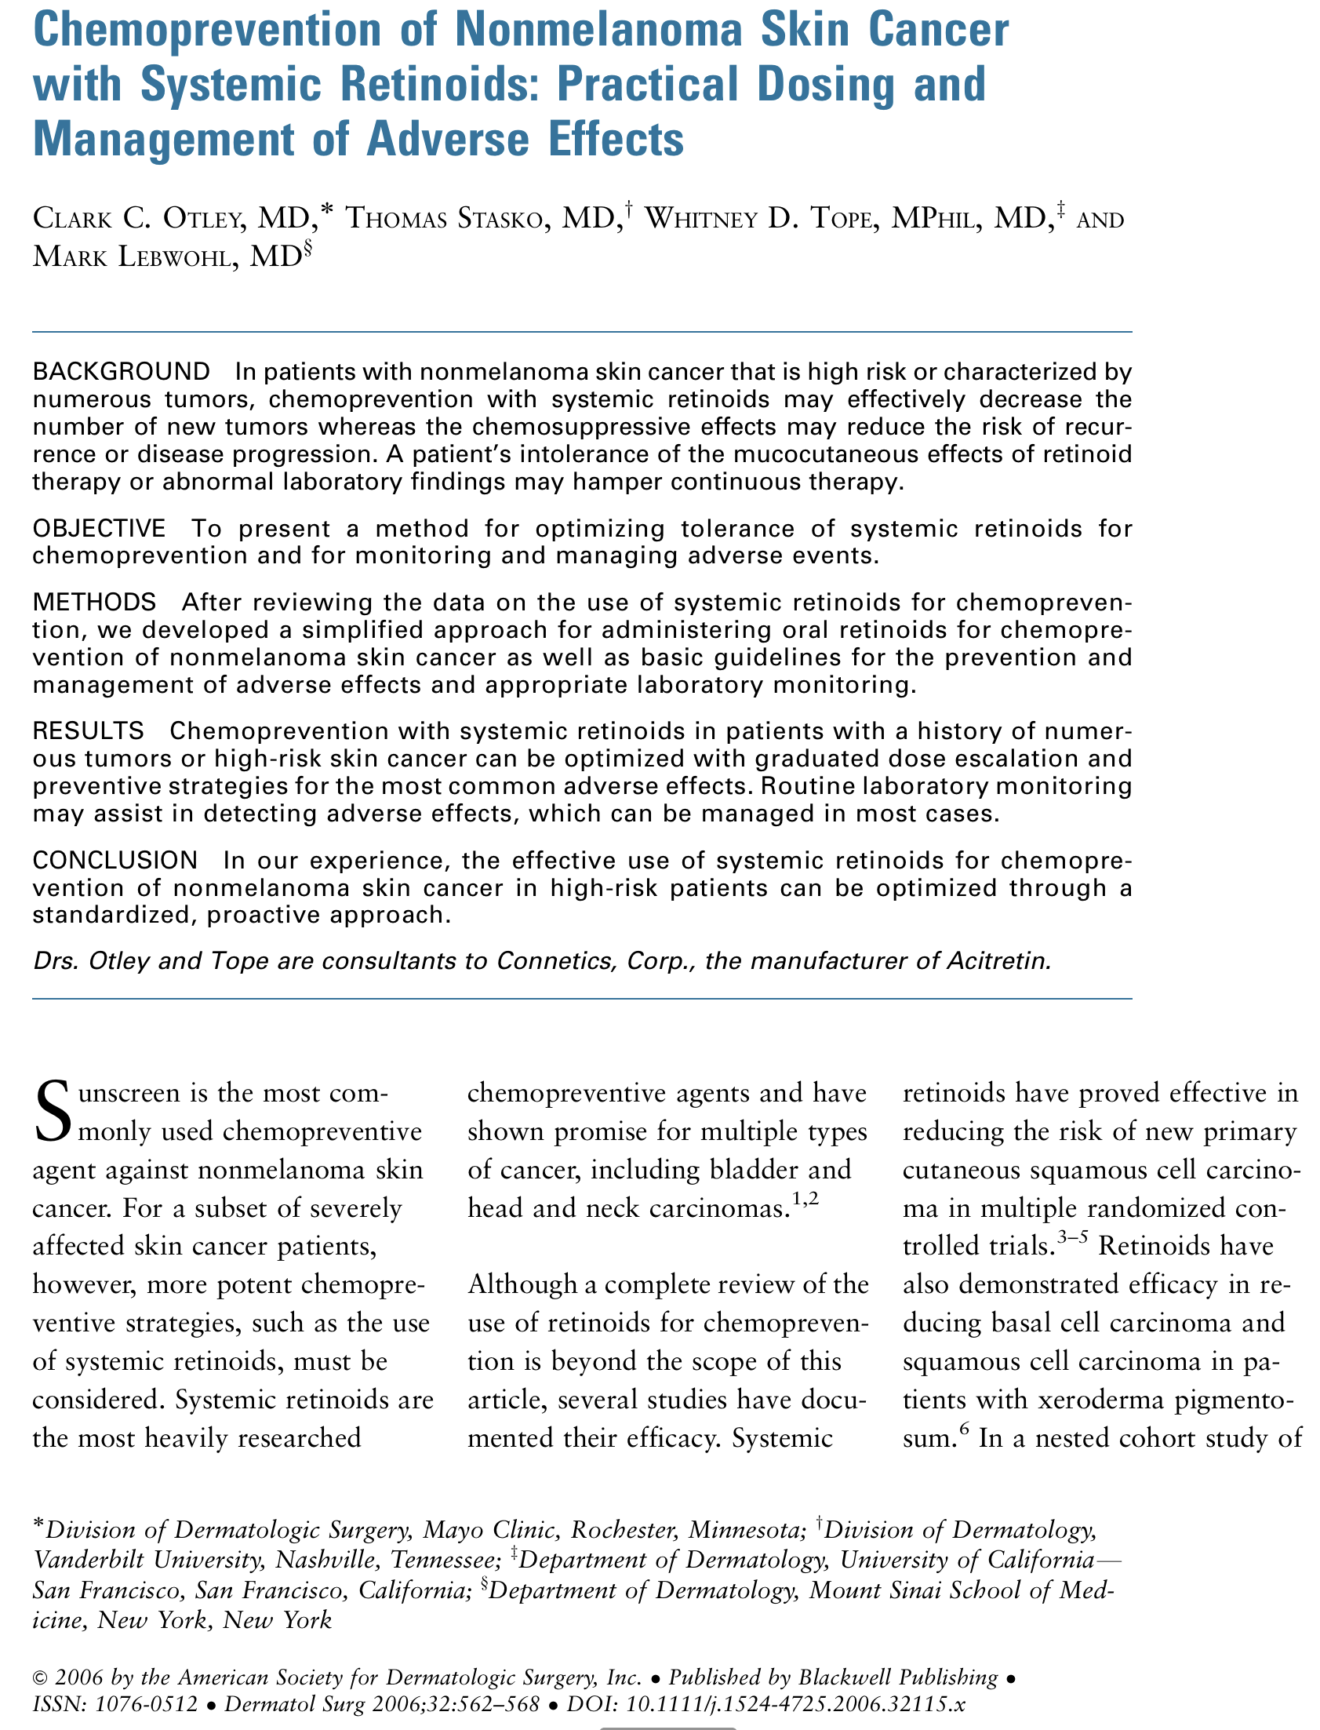

Slide 23
Acitretin 10-20mg od (check LFT & lipids)
Nicotinamide 500mg bd (care in renal failure, or with COCP; avoid with carbamazepine)

Slide 24
Summary
New SCC staging: AJCC & UICC 8
Key determinants of TNM stages
Measuring thickness
Recent key papers:
Prognostic risks
Prophylaxis
BAD guidance 2010 (draft revision due 2019)
Increasing SCC FU demand
Audit of recurrences
Proposed risk stratification
Notes:
Union for International Cancer Control
the American Joint Committee on Cancer

Slide 25
Questions

