Slide 1
“SWAG Cancer Alliance plans to introduce a Rapid Diagnostic Service which meets the needs of our population”
Nicola Gowen – Project Manager SWAG Cancer Alliance
UGI / HPB Clinical Expert Group 29th November 2019

Slide 2
Multi-diagnostic centres – MDC Pilot The aim of ACE wave 2 was to design a symptom-based pathway for individuals who have non-specific but concerning symptoms that are known to be representative of several cancers in line with Recommendation 21 of Achieving World Class Cancer Outcomes

Slide 3
Multi-diagnostic centres – MDC Pilot

Slide 4
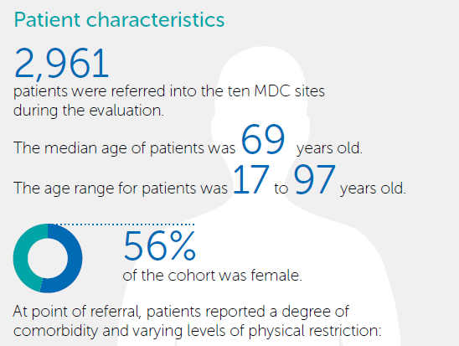
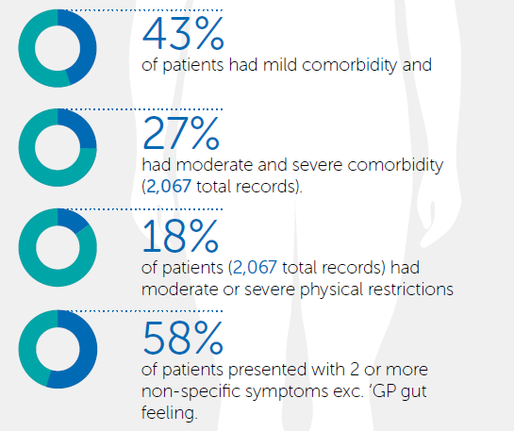
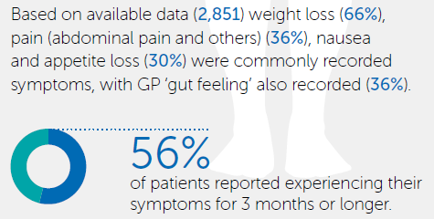

Slide 5
Site specific diagnosis

Slide 6
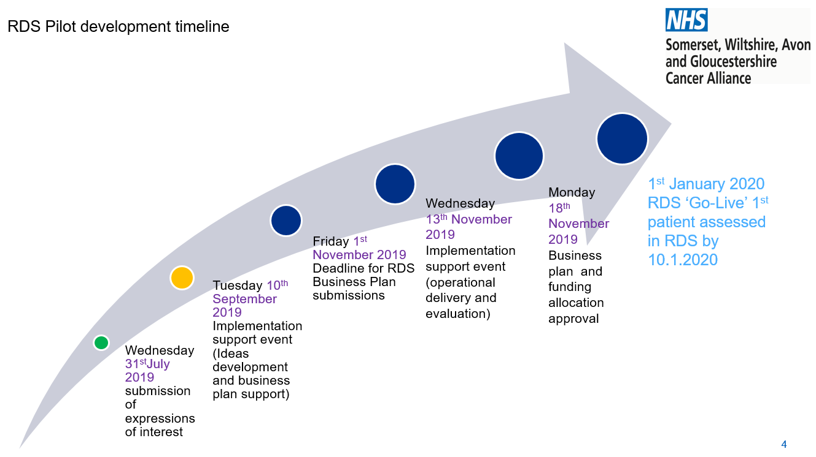
test

Slide 7
System wide approach to identifying and diagnosing these patients earlier / faster

Slide 8
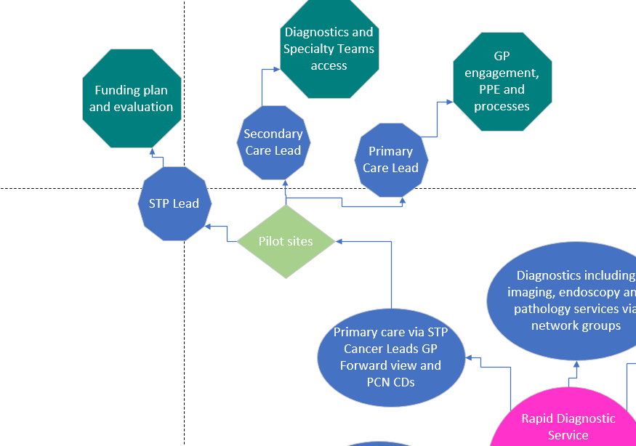

Slide 9
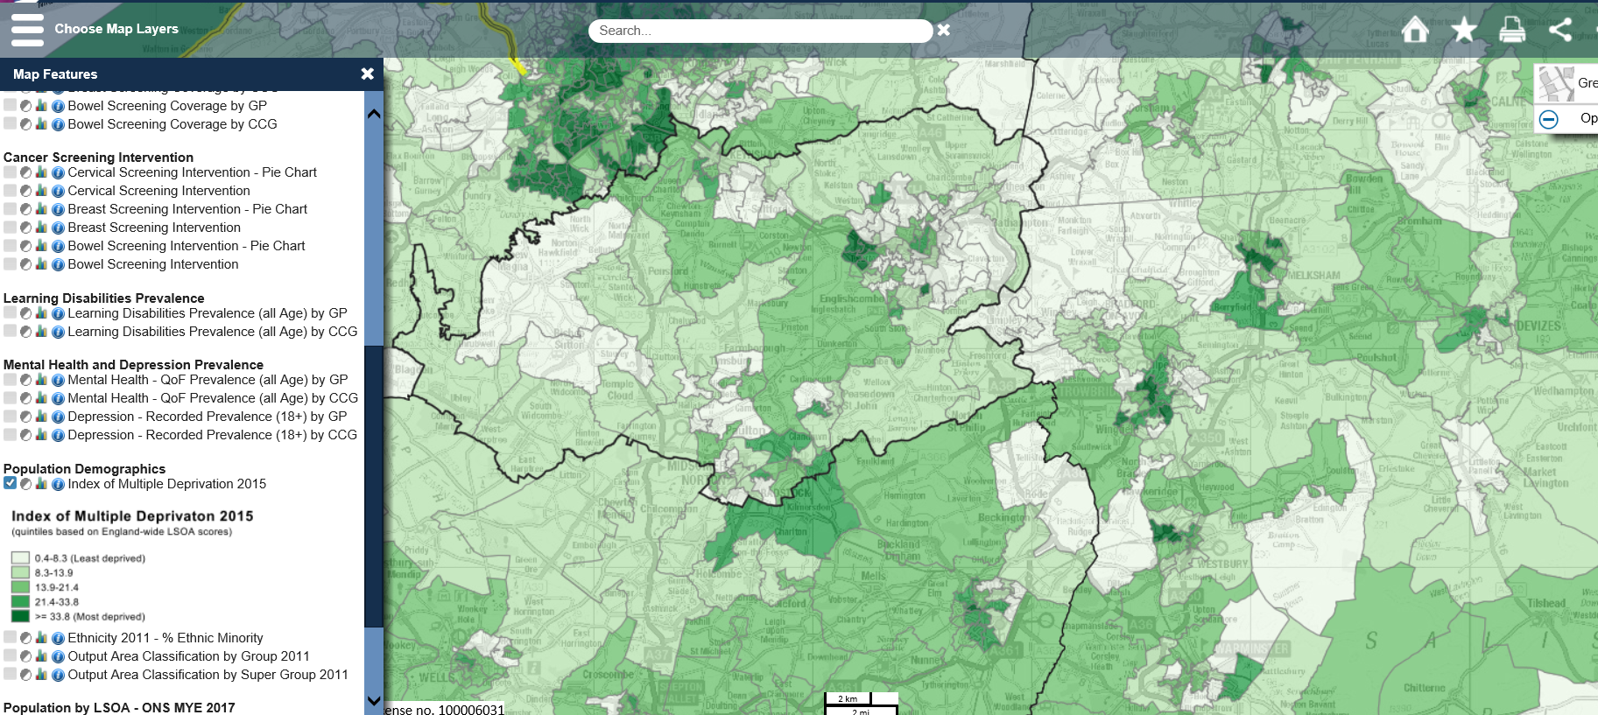

Slide 10
SWAG Cancer Alliance Population Coverage Phase 1 – 60,000 – 2PCNs
Intention to roll out to 180,000 (6PCNs) once robust referral and diagnostic demand established

Slide 11
Rural Rapid Diagnostic Service Model

Slide 12
Filter function tests should be used prior to referral to:
Support GPs to refer patients via the most appropriate route (i.e. non-specific symptoms or site-specific), leading to a higher referral quality;
Reduce the risk of test duplication later in a patient’s pathway;
Ensure all necessary pre-investigation testing (e.g. kidney function) has been completed, removing potential delays further along the pathway.

Slide 13
Core referral criteria for non-specific symptoms
New unexplained and unintentional weight loss (either documented >5% in three months or with strong clinical suspicion);
New unexplained constitutional symptoms of four weeks or more (less if very significant concern). Symptoms include loss of appetite, fatigue, nausea, malaise, bloating;
New unexplained vague abdominal pain of four weeks or more (less if very significant concern);
New unexplained, unexpected or progressive pain, including bone pain, of four weeks or more;
GP ‘gut feeling’ of cancer diagnosis - reasons to be clearly described at referral.

Slide 14
Phase 1
Serious but non specific pathway / vague symptoms
Phase 1 population coverage 60-180,000
Phase 1 PCN coverage 2-6
Evaluation: Cost:benefit, referral and diagnostic demand, outcomes and PPE

Slide 15
RDS Pilot – Phase 2
SWAG Vision
Improved patient experience during investigative phase of cancer pathways
Bespoke care coordination
Faster diagnosis closer to home
Enhanced interface between primary and secondary care to deliver
Optimise appropriateness and readiness for suspected cancer diagnostics
Bespoke RDS access to diagnostics
Phase 2
Stakeholder engagement continued and range of interest expressed from clinicians and managerial teams, risks raised acknowledged
Phase 2 Brief and request for expressions of interest circulated 21st November 2019
Expressions of interest submissions required January 24th 2020
Business Plan workbook submission required 13th March 2020
Successful plans agreed 27th March 2020

Slide 16
RDS Pilot development timeline – Phase 2
‘Go Live’ 11th May
Pilot model approval 27th March 2020
Business Plan Workbook submission 13th March 2020
Implementation event 4th February 2020
EoI submission 24th January 2020
January 2020 STP engagement event funded by Cancer Alliance advised
Early Phase 1 business intelligence
Brief and request for EoI 21st November 2019

