Slide 1
Complex Cancer Late Effects Rehabilitation Service (CCLERS)

Slide 2
Complex Cancer Late Effects Rehabilitation Service (CCLERS)
Highly specialised national service for adults with persistent pain and reduced physical function following their cancer treatment
Patient criteria:
Severe and persistent pain
Reduced physical function or mobility
Have tried treatment locally from a physiotherapist or pain clinic
Active treatment for cancer finished at least one year ago
Interdisciplinary team:
Occupational Therapists
Physiotherapists
Clinical Psychologist
Clinical Nurse Specialist
Pain Consultant
Notes:
CCLERS is a highly specialised National service – see slide for criteria (often patients have been told ‘we can’t do anything more for you’ by local services. We use an inter-disciplinary team approach – see slide for member of the team. and members of the team.
We are specialists in rehabilitation and chronic pain management, particularly neuropathic pain which doesn’t respond well to medication. Very often our patients will have tried a host of nerve pain medications with no or limited effectiveness. They have reached the end of the medical model in terms of pain.

Slide 3
Service History: From BRIRS to CCLERS
Breast Radiotherapy Injury Rehabilitation
Service (BRIRS) 2012
RAGE
+
Macmillan
=
Complex Cancer Late Effects Rehabilitation
Service (CCLERS) 2017
BRIRS
+
Macmillan
=
Any Treatment and Any Site A
Notes:
The CCLERS service developed from the BRIRS service, which is the Breast Radiotherapy Injury Rehabilitation Service.
This was established in 2012 for people with very specific symptoms – brachial plexopathy caused by radiotherapy for breast cancer.
The service was a result of a collaboration between a patient led action group, RAGE (Radiotherapy Action Group Exposure) and Macmillan Cancer Support. RAGE campaigned for many years for a specialist national centre staffed by professionals who understood their specific injuries and had the skills to manage their symptoms effectively. Reference to ‘Yesterdays Women’ describing their experience and journey – very moving accounts.
From the onset of BRIRS, referrals were also received from people with persistent pain post cancer treatment, but not specifically from radiotherapy treatment for breast cancer (ie Lung cancer or chemotherapy tx).
To address this, Macmillan funded a pilot in 2016-17 for this wider group of patients. This resulted in the expansion of the service to include people experiencing pain and physical limitation from ANY CANCER TREATMENT at ANY CANCER SITE .
The service is now funded by NHSE as a highly specialised service.
CCLERS patients are often difficult to identify as late effects like persistent pain can develop many years after cancer treatment has finished. Patients may have been discharged from cancer services and symptoms can present as new pathology and are not always recognised as late effects. Some CCLERS patients have undergone treatment over 25 years ago while others are within 2-3 years of their treatment. However all are trying to make sense of their symptoms when there seems no obvious cause.

Slide 4
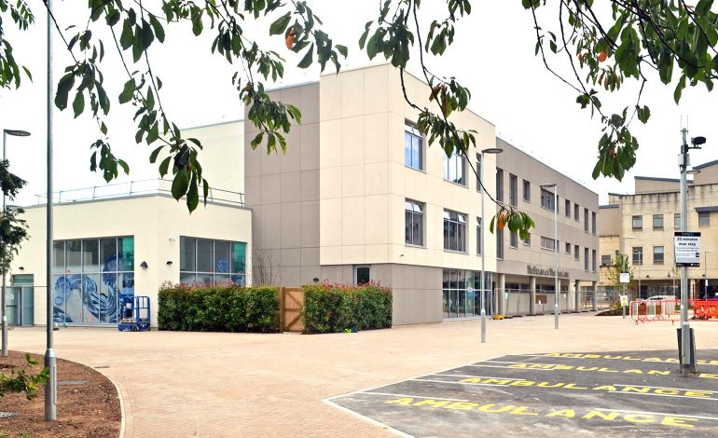
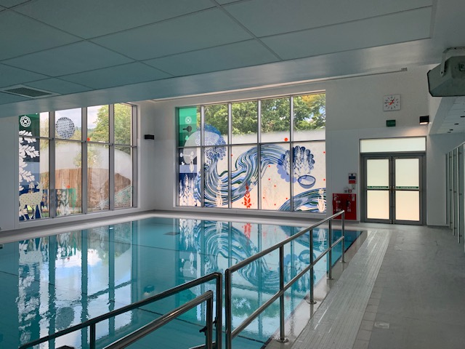
From ‘Min’ to RUH
Notes:
We are a service in transition. We have recently moved for the Mineral Hospital in the centre of Bath and are now based in the state of the art Brownsword Therapies Building in the RUH, with new facilities including a new gym, kitchen and hydro pool. Our patients will be moving to the new accommodation facilities in min-December, where they have their own bedrooms with en-suite bathrooms within shared flats; some of which have been adapted for wheelchair use. Patients were previously accommodated in an old nightingale ward in the Mineral Hospital.

Slide 5
CCLERS Pathway
Referral by Health Professional
Telephone Triage
Multi-Disciplinary Team Clinic
2-Week Residential Programme
Follow ups – 3, 6,12 months
Discharge
Notes:
This is the CCLERS pathway.
Any health professional can refer into the service and the service is free for anyone registered with a GP in England.
Once referred patients are offered:
a telephone triage – with the CNS to assess their needs and take a full, holistic history.
They are then invited to attend a MDT Clinic in Bath with appts with and assessments by the Pain Consultant, Therapists and Psychologist.
If they have rehab potential and are willing/.able to attend, they are offered a place on a 2 week residential rehab programme which included sessions with specialist physios, sessions with Ots and psycghologist and activities such as yoga, mindfulness and qi-gong
They are followed up at 3 months (face to face in Bath) at 6 and 12 months by telephone and then discharged.

Slide 6
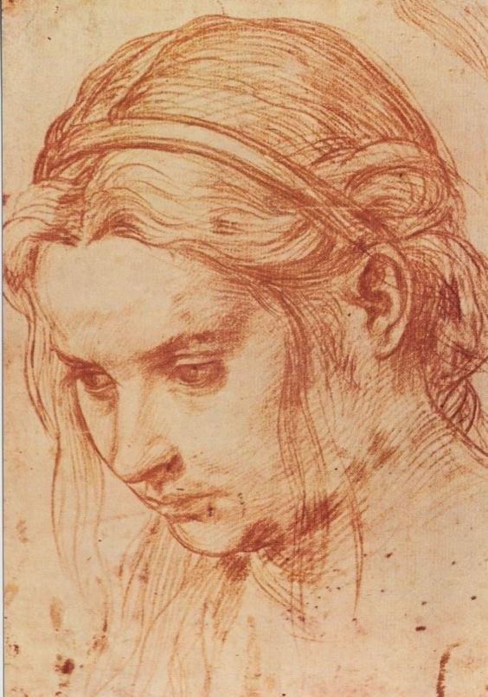
Meet Bonnie…
Presenting ….
Complex physical history
Widespread pain
Physical
Struggles to sit, stand or walk for long periods
Using a wheel chair most of the time and crutch for short distances; unsteady gait;
Restricted range of movement in her arms
Practical/Financial
Self-care independent but fatiguing
Misses work and leisure severely diminished
Assistance for shopping and domestic
Benefits
Emotional/Spiritual
Loss of purpose and identity
Socially isolated
Altered roles with parents and partner
‘Feels like an old lady’
Faith
Notes:
To show haw the service has worked with a CCLERS patient – I wanted to talk to you about Bonnie’s expereince. She has consented to letting us use her story but we are using a pseudonym to protect her identity.
Bonnie is 47 and was referred to CCLERS with chronic sever pain in lower back, both hips and radiating down both legs. These were late effects following pelvic surgery, chemotherapy and radiotherapy for non-Hodgekin’s Lymphoma in 1994. She also had a mild left hemiplegia since birth – thought to be caused by hypoxia and in 2011 had developed pain and weakness in her right arm which as been investigated and they are querying CRPS. She had a widespread pain picture and there was no unaffected limb.
She struggled to sit, stand up or walk for long periods because of her pain and was using a wheel chair for most of the time and a crutch for short distances. She had lost her confidence and had become reliant on her partner and her mother for assistance with some activities, which was affecting the quality of her relationships. She has stopped going out with friends and to church and only left the house for hospital appts and ‘chores’. She lived alone and felt quite socially isolated. She said that she ‘felt like an old lady’ – her world had retracted. She had tried many meds for pain, including morphine with little effect.

Slide 7
Inter-disciplinary Interventions
Physiotherapy
Psychology
Occupational Therapy
Notes:
Bonnie attended our last CCLERS inpatient programme in summer 2019.
The inter-disciplinary approach is absolutely central to how we work on the IP programme. We work closely to support Bonnie to identify golas and self-manage her pain. We have regularly handovers; we tailor the programme to each individual and often undertake joint therapy sessions to support rehab goals.

Slide 8
Psychology
Stuck
‘You can’t do that - so don’t bother trying’
Heightened fear and anxiety
Difficult to identify first steps
Values
Notes:
In Bonnie’s psychology sessions, she described herself as feeling ‘stuck’ and not able to move towards anything she would like to be doing.
She repeatedly told herself ‘you can’t do that so don’t bother even trying’. She talked about a heightened sense of anxiety when she tied new things and often didn't do them because she was trying to protect herself.
She found it difficult to identify first steps or ways she could get out of her current situation.
The psychologist asked Bonnie to complete a Values questionnaire, where she identified values important to her in different domains of her life and connected these values to her sense of self. This enabled her to establish short term goals in the direction of what she valued most. The Values questionnaire was the key to unlocking how Bonnie could be supported to think about what and how she could improve her current situation.

Slide 9
Occupational Therapy
Notes:
The OT worked with Bonnie to identify that the important first step for Bonnie was ‘connecting to others’ – not just in terms of social contact but also by improving the quality of her relationships with her mother and partner.
Bonnie’s faith was important to her but she had not been to church for many years because of transport/discomfort issues. Bonnie decided that an easy first step which connected with her values was to contact her local priest and ask for a home visit. She could then explore how she could engage more with the church community.
Because of difficulties using her right hand and gripping kitchen equipment, Bonnie found it difficult to prepare food in her kitchen. She decided that it was important to her make a meal for her partner independently – she chose a Spag Bog. She planed how she could do this with the OT and the plan included how she could reorganise her kitchen to better support her, the use of kitchen aids and a trolley.
Bonnie also identified how she wanted to spend more quality time with her mother which wasn’t about doing house work. We gave advice and provided a letter to support Bonnie with a PIP application and discussed how this money could be used to fund a cleaner and reduce her reliance on her mother.

Slide 10
Physiotherapy
Neuro-cognitive approach:
Pain only awareness v Awareness of ‘other’ sensations – pressure, weight, posture.
Awareness of posture and gait
Land based 1-2-1 therapy:
Exercise and stamina – yoga; qigong
Hydrotherapy:
Practice walking and weight transfers
Increase confidence
Notes:
Our physiotherapy department use a neuro-cognitive approach.
Because Bonnie is in such widespread pain – she is often only aware of the sensation of pain. The neuro-cognitive approach encourages Bonnie to become aware of other sensations in her body ie pressure, weight, joint posture and to – not block the pain – but to focus on these other sensations.
Pain had affected Bonnie’s sitting and standing posture and how Bonnie moved her trunk and shoulder to protect her painful right arm. She was unable to equally distribute her body weight because of pain – when she sat, she leaned to the left to avoid pain on her right hip. Also when walking, Bonnie found it hard to transfer between her right and left feet and so her sense of instability increased. The neuro-cognitive approach made her more aware of this and worked with Bonnie to correct this and gain confidence to use all her body. She practiced walking in hydrotharapy and engaged in yoga and qigong to strengthen her core and improve her posture and endurance.
By the end of the programme:
Bonnie was able to sit, stand and walk in a more normal way.
Her improved perception of her body meant that she was able to transfer her weight from Left to Right more dynamically
Her endurance had improved and she was able to stand up and walk for longer periods.
This meant that Bonnie was better able to plan other activities like preparing a meal or attending a swimming pool.
Hydropool example – needed a wheelchair to steps and x2 to support her up steps into hydro pool and only in shallowest part – walking independently with crutch to steps and ascending steps independently to pool – deep end.

Slide 11
Group Sessions
Communication
Sleep
Sensory workshop
Relaxation
Mindfulness
Pacing
Notes:
Bonnie attended groups on the following – see slide.
Also formed good relations with others attending the programme.

Slide 12
Bonnie’s Outcomes
Questionnaire | Median Score pre programme | Median score post programme
Pain Self-Efficacy | 17/60 | 48/60
Chronic Pain Acceptance | 47/156 | 61/156
PHQ-9 Depression Scale | 10/27 | 4/27
Notes:
We asked Bonnie to complete self-reported questionnaires pre and post the residential programme.
These included:
Pain Self-Efficacy Qu - which measures confidence to undertake activities despite being in pain
Chronic Pain Acceptance Qu – which measures of acceptance of pain. Acceptance of chronic pain is when people reduce attempts to avoid or control pain and focus on engaging in valued activities and pursue meaningful goals
Depression Severity Tool: Scores of 10-14 indicate a moderate depression severity; Scores between 0-4 indicate no depression severity.

Slide 13
“I feel so much more confident. I feel really proud of myself. I feel I have found ‘me’ again – yipee!”
Notes:
We received this feedback for Bonnie on leaving the residential programme.

Slide 14
CCLERS Service Outcomes 2018-19
Measures | Pre-Programme Median Scores | Three Month Post- Programme Median Scores | Twelve Month Post- Programme Median Scores
Brief Pain Inventory (Severity) | 6.25 | 5.0 | 0.50
Brief Pain Inventory (Interference) | 6.14 | 3.4 | 0.71
Acceptance & Action Questionnaire 2 | 41 | 44 | 54
Upper Extremities Functional Index | 31.50 | 42 | 39
Patient Health Questionnaire – 9 (depression scale) | 10 | 3 | 2
Generalised Anxiety Disorder -7 | 4 | 3 | 1.5
Notes:
We are reviewed yearly by NHSE HSS Commissioners and report on the following patient self-reported outcomes.
Outcome measures are taken prior to the programme at the MDT Clinic for a baseline and at 3 and 12 months post the programme.
Each of the BPI subscales is scored out of 10. Higher scores are indicative of a greater pain perception and greater pain interference.
The AAQ-2 is scored out of 70; the higher the score the greater the level of acceptance.
The UEFI is scored out of 80: the lower the score the greater the level of difficulty associated with upper limb functionality. This is a little outdated since the service moved to CCLERS and we are looking a lower limb functionality as well now.
The PHQ-9 is scored out of 27: the lower the score the lower the depression severity.
The GAD-7 is scored out of 21: the lower the score the lower the generalized anxiety.
Our current targets are set for 15-20 patients to be seen at MDT and IP in a year because CCLERS is a new service and trying to get established; There is certainly capacity to expand if demand increases - we only see the most complex patients who have seen no improvement from local pain/rehab/late effects services and are considered complex. It is difficult to really assess how many patients have this profile and we are still promoting the service nationally.

Slide 15
“I have been able to improve the quality of my movement and this has helped me continue with the things that I enjoy.’
“The programme has given me the tools to move forward in a sustainable, safe way. I have acquired confidence to do rehab with my body as it is. I felt heard, seen and listened to.
“I have a better understanding of how to help myself with correct posture, exercise, pacing and relaxation”
Notes:
Here is some more patient feedback on the IP programme.

Slide 16
Now What?
National promotion of the service
Co-designing a bespoke CCLERS programme based on patient feedback
Regional Late Effects Network
Research Portfolio:
What are the experiences and health care needs of cancer survivors and does current service provision meet their needs? PhD
What are the holistic experiences of adults living with long-term the consequences of cancer and its treatment? A qualitative evidence synthesis. Masters
Notes:
Moving forward…
This is still a relatively new service and we need to make sure that it has a national footprint so that patients can access it across the country. A lot of my role is about raising the profile of the service.
We are in the process of adapting the programme so that we can better manage the psychology of Cancer early on in the residential programme – particularly to develop a range of strategies for the management of fear of recurrence which is a big issue for many CCLERS patients. It is also important to create a safe space for patients to tell their stories and difficulties that they have had being believed or finding answers re symptoms.
We are keen to connect with regional late effects clinics – but am realising that there is patchy coverage for these services across the country. Many areas are just setting up these services. We are hoping to develop a virtual LE MDT and am in discussions about how to take this forward.
We are also working closely with researchers in the University of the West England around exploring the experiences and perceptions of services for people who are cancer survivors or living with long-term effects.

Slide 17
Thank you!
Any questions?
jcook@nhs.net
Ruh-tr.rnhrdcclersinfo@nhs.net
01225-473481
www.crpsandcancerlateeffects-bath.org.uk

