Slide 1
SWAG Urological Cancer Survey on Optimising the Use of Radiological Resources during the COVID-19 Pandemic
For agreement at the Urology Clinical Advisory Group Meeting
Thursday 10th September 2020

Slide 2
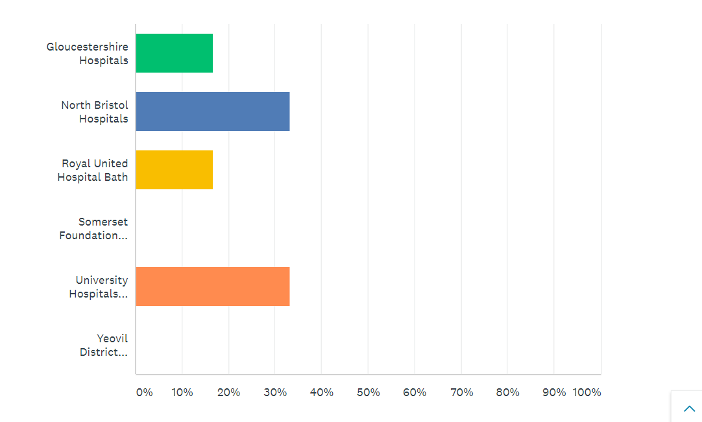
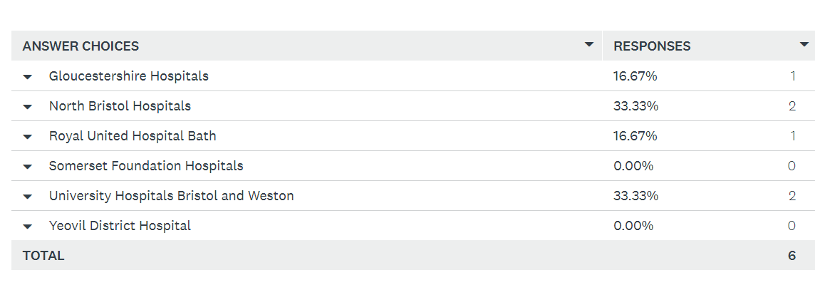
Question 1: Name of Organisation

Slide 3
Question 2: Job Title
Consultant Radiologist
Consultant Urologist
Consultant Urological Surgeon
Consultant Oncologist
Consultant Clinical Oncologist
Consultant Urological Surgeon

Slide 4
Question 3: Prostate Cancer
Please provide: Key priorities dependent on radiology.
Areas in the pathway where scanning can be reduced, e.g. PSMA PET as an alternative to a bone scan and CT for Staging. For active surveillance: perhaps omit MRI follow up for patients with low risk prostate cancer and a stable PSA, as reviewed on a case by case basis.

Slide 5
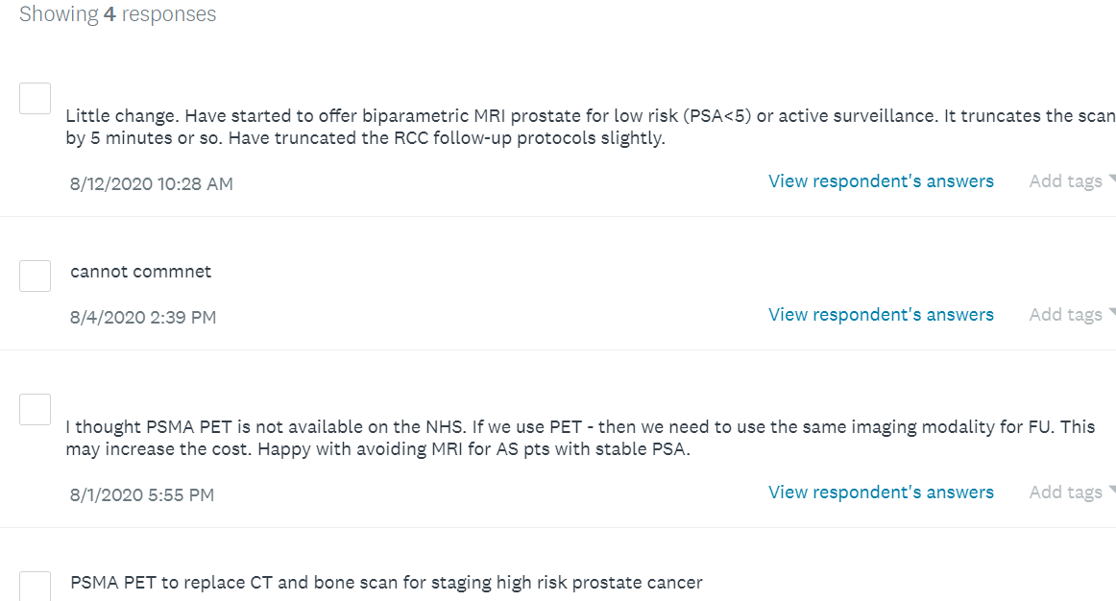
Answers

Slide 6
Question 4: Renal Cancer
Please provide:
Key priorities dependent on radiology.
Areas in the pathway where scanning can be reduced, e.g. surveillance strategies of untreated small renal masses and post treatment surveillance.

Slide 7
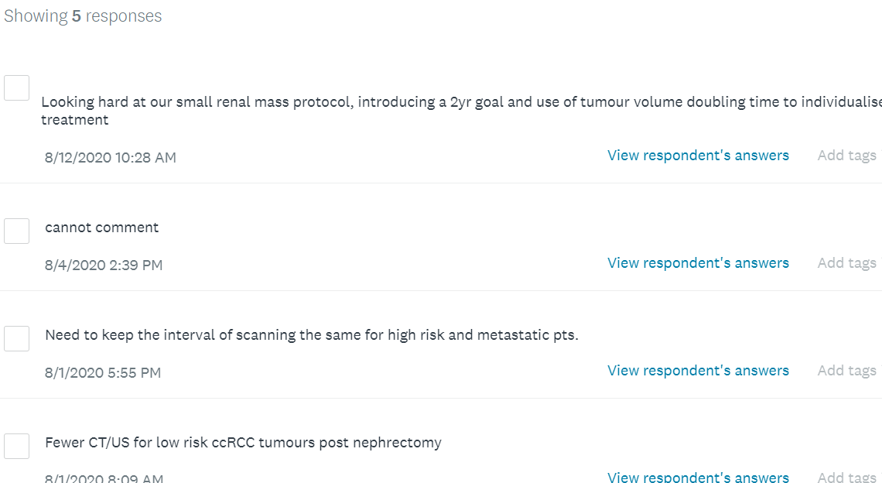
Answers

Slide 8
Question 5: Bladder Cancer
Please provide:
Key priorities dependent on radiology
Areas in the pathway where scanning can be reduced, e.g. those cases with lower risk visible haematuria and a normal ultrasound scan may not need a CTIVU as part of their initial pathway assessment.

Slide 9
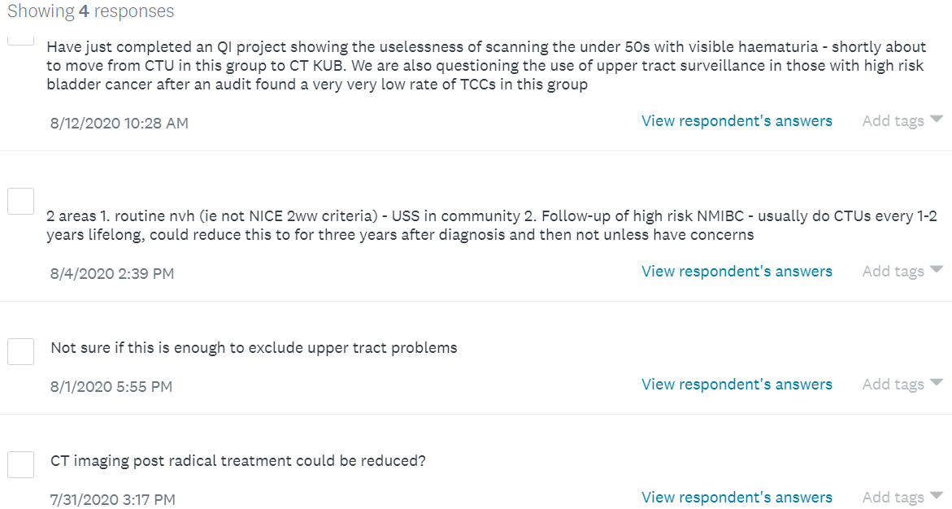
Answers

Slide 10
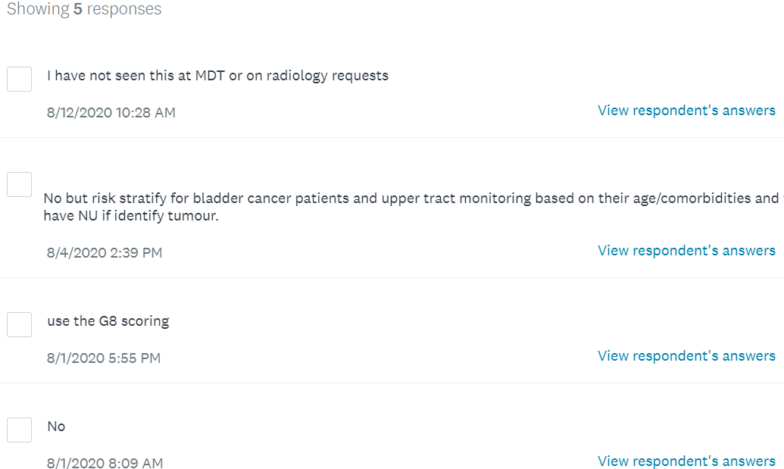
Question 6: Are you using a risk stratification tool to modify standards of care, e.g. Rockwood Frailty Score?

