Slide 1
Streamlining the Breast MDT

Slide 2
Need for streamlining:
Many of the outcomes for MDT are protocolled and require no discussion.
The complex cases can now be very complex requiring potentially long discussions and input from all disciplines.
Oncology time is a precious resource at present.
The cost of the MDT is high given the numbers of representatives.
Concentration decreases over time.

Slide 3
Purpose of the MDT
Discussion between multi disciplines to determine best decision made for (? complex/ ? all ) cases.
Ensure correct pathway for all patients with no ‘drift’
Trials to be discussed
Educational component.

Slide 4
Preliminary data collected for NHS Eng
Recorded time for each patient for NHS England study
Became clear that we were spending minimal time on many patients average 20-60 sec.
Initial feeling: lets carry on with what we are doing

Slide 5
Who do you discuss?
At present, general consensus at RUH
Discuss every patient

Slide 6
Methods for Streamlining
Simple cases
All information required to make a plan, available to be easily read.
Provisional plans already entered
2. Complex cases
Ensure have a specific question
all information required to make a clinical decision is available
3. All oncology patients at start

Slide 7
Strategies to improve/ streamline MDT at the RUH
A. Produced an electronic system to add patients with drop down box against categories.
Post op Malignant.
Her 2 result
Complex radiology discussion ( CT , bone scan)
Surgical/ Oncology discussion
Metastatic patients
Expected malignant core biopsy results ( R4, R5, B5)
Breast MRI results
MDT approval required (eg Risk reduction surgery)
Pts for registration only
Expected benign biopsy ( R1-3)
Expected benign biopsy telephone results
Post op Benign
Other

Slide 8
B. Improve the preparation
If the preparation included provisional outcomes for all cases,
with all relevant information available for oncology to ratify
this will dramatically quicken the straightforward cases.

Slide 9
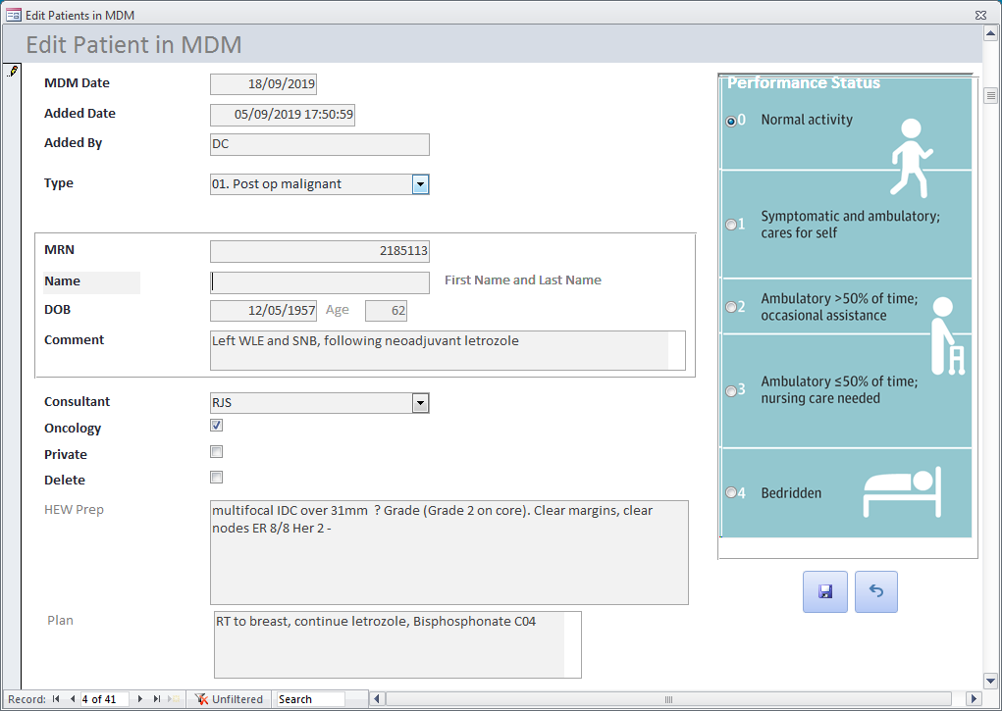
For example

Slide 10
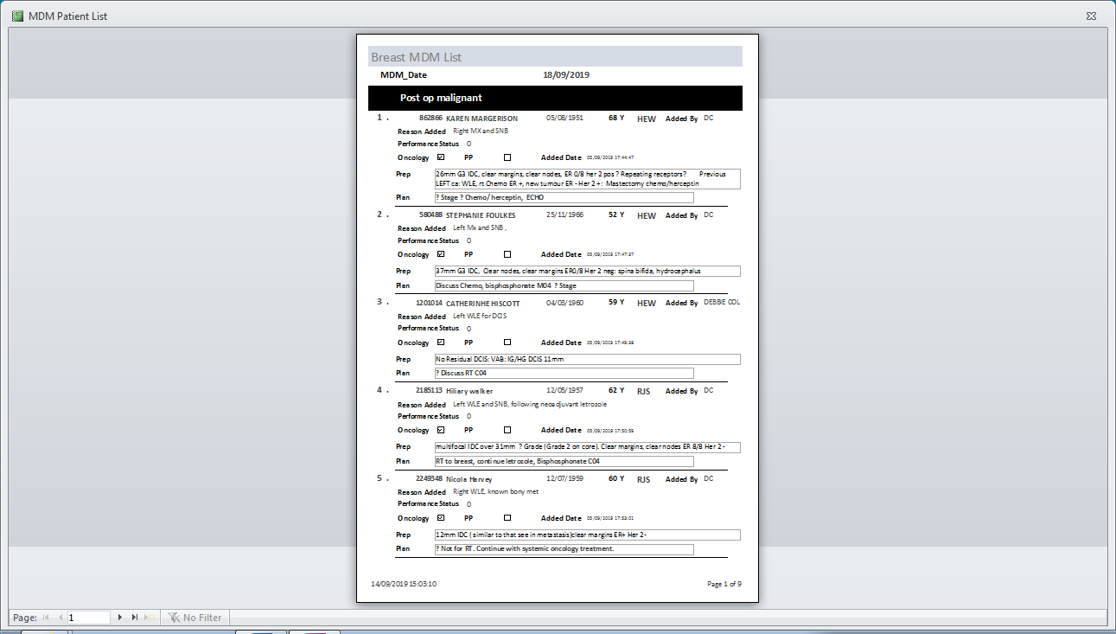
xxxxxxxxx
xxxxxxxxx
xxxxxxxxx
xxxxxxxxx
xxxxxxxxx

Slide 11
Preparation
4 hours preparation time from a senior member of the MDT in order to look up results, documents and proposed plans.
All expected benign cases will be prepared by the breast radiologist.
Preparation can be sent to MDT co-ordinators prior to the meeting so less time communicating outcomes and typing.

Slide 12
During the meeting
The MDT will be able to sense check and ratify.
Make changes as appropriate

Slide 13
Potential Risks
Having one member of the team doing the preparation may include odd mistakes and need to rely on all members of the team being actively engaged to note these.
A single team member may make a similar mistake each week which may not be noticed by the rest of the MDT.
Having one member of the team making provisional decisions may lead to bias in treatment pathways.

Slide 14
Example Postop Malignant
Any previous treatment neoadjuvant or from previous breast cancer
Side Grade, type, ER Her2
Size, nodes, margins
Relevant PMH / FH
Plan: (a) Provisional plan to be recorded
(b) Provisional oncology appointment to be recorded
(c) Follow up plan: BCS Mammogram, MRI, and CT follow up
eg Right G2 ILC ER 2/8, Her 2 +
40 mm clear margins 0/2LN
Plan: For chemo, herceptin, RT: FU imaging BCS MGM with MRI annually for 3 years M04

Slide 15
Expected malignant ( e.g. R5, R4 core biopsy, ABS B5)
(a) Side, Size, number of foci if greater than 1, Grade, type, ER, Her 2 if known, LN
(b) TNM staging
(c) PS
(d) Relevant PMH
(e) Provisional plan

Slide 16
Complex radiology discussion ( CT, bone scan etc)
Reason for the scan ( what question is being asked)
Relevant previous pathology and treatment
Relevant PMH
Radiology to present result

Slide 17
How are we doing so far
All patient requiring oncology input discussed between 8.30 and 9.30am most of the time
Whole meeting length between 8.30 and 10-10.30am.
Still some adjustments with the prep.
Perhaps we might get to the stage where we stop discussing the simple cases?

