Slide 1
RFA in the management of pulmonary tumours
Dr John Hughes
University Hospitals Bristol

Slide 2
Radiofrequency and Microwave
Heat tissue to > 60°C
RFA
Heat induced with 500 kHz AC
MICROWAVE ablation
Microwave frequency 950 MHz
Better penetration of air
Better heat sink effects
Much shorter ablation times

Slide 3
Indications
Treatment of bronchogenic carcinoma with curative intent in patients not suitable for surgery or radical radiotherapy
Treatment of pulmonary metastases with curative intent

Slide 4
Indications
But we can’t guarantee cure…. so it’s more curative hope-ish

Slide 5
SABRT and VATS…

Slide 6
Technique
Standard biopsy technique
LA (deep conscious sedation) or GA
Day case

Slide 7
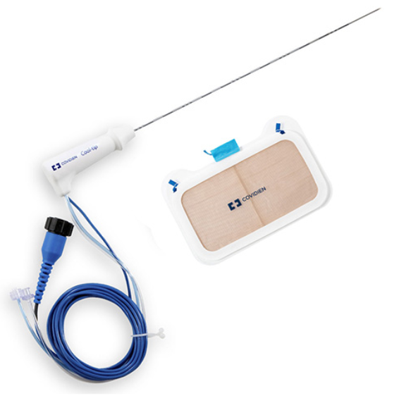

Slide 8
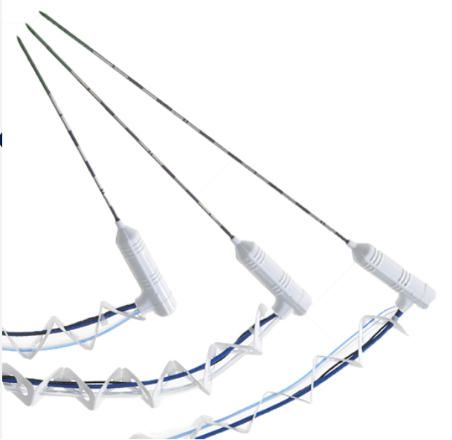

Slide 9
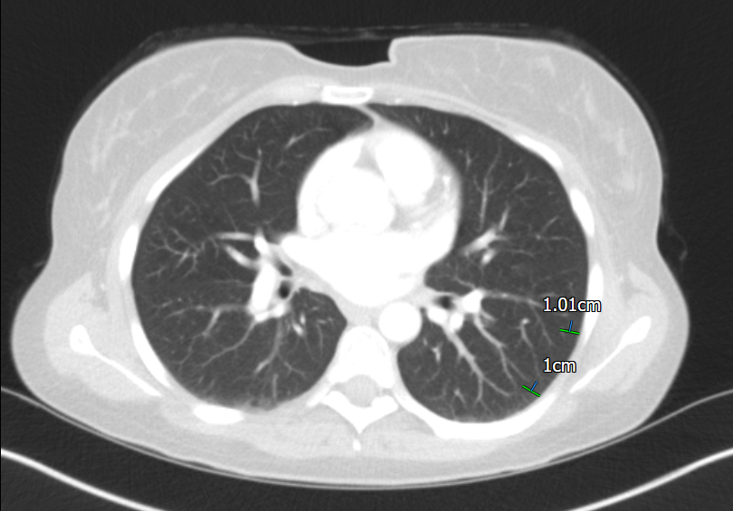

Slide 10
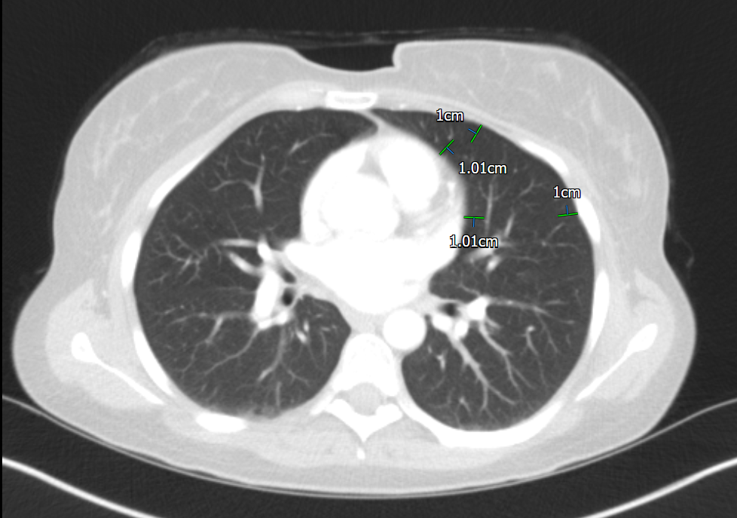

Slide 11
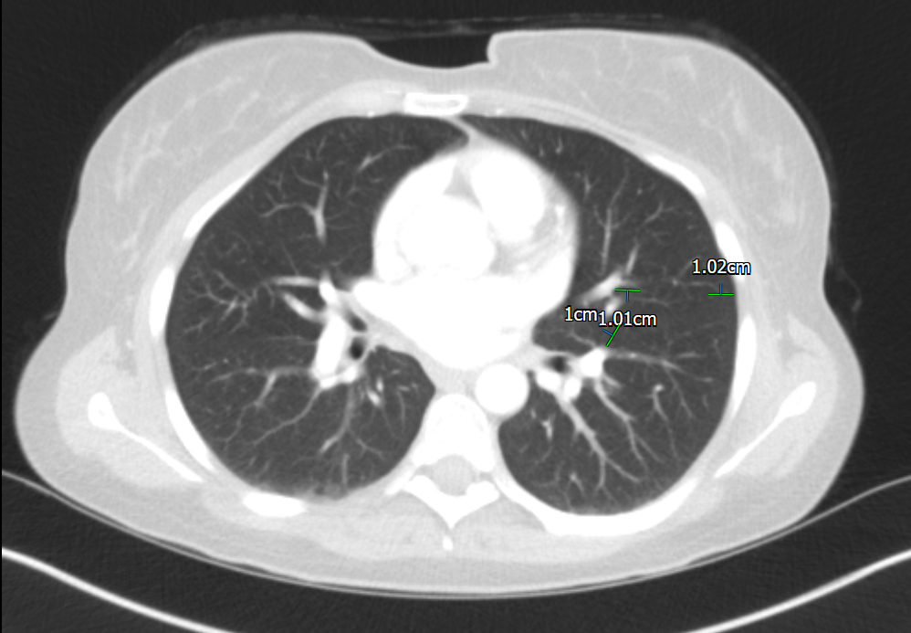

Slide 12
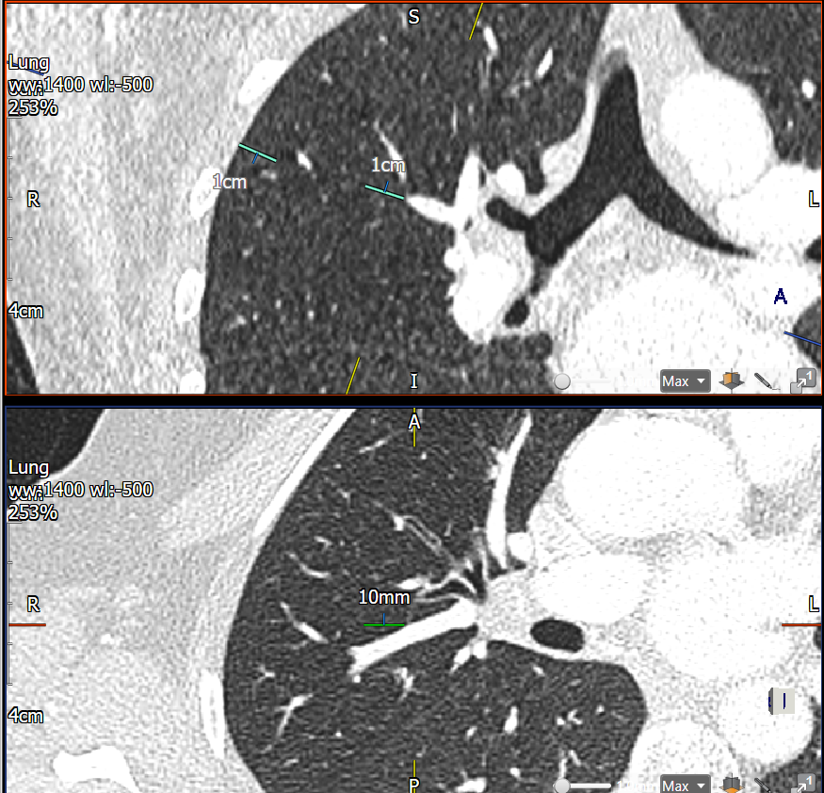

Slide 13
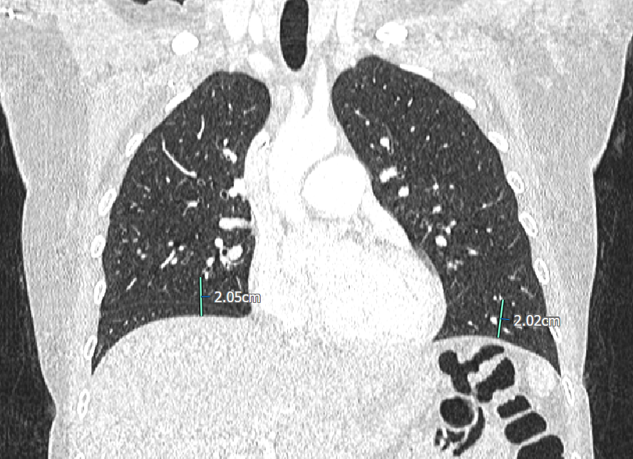

Slide 14
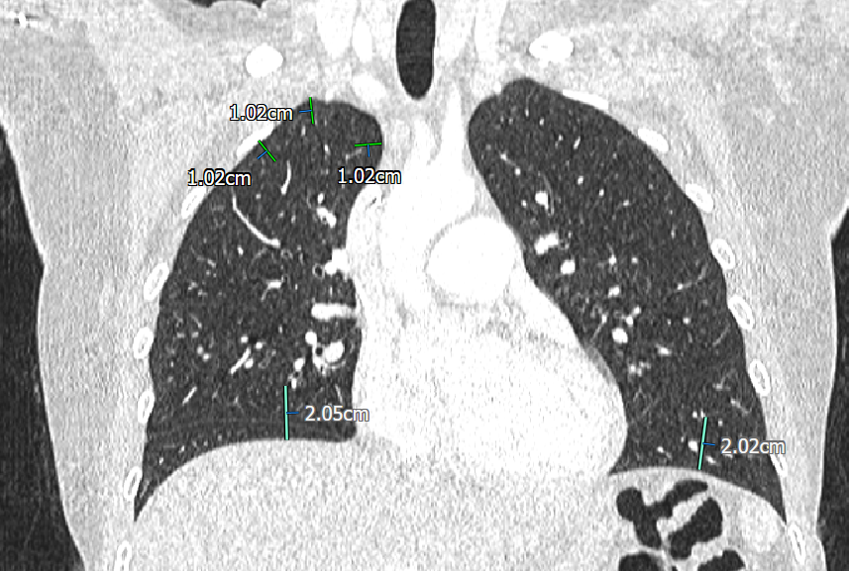

Slide 15
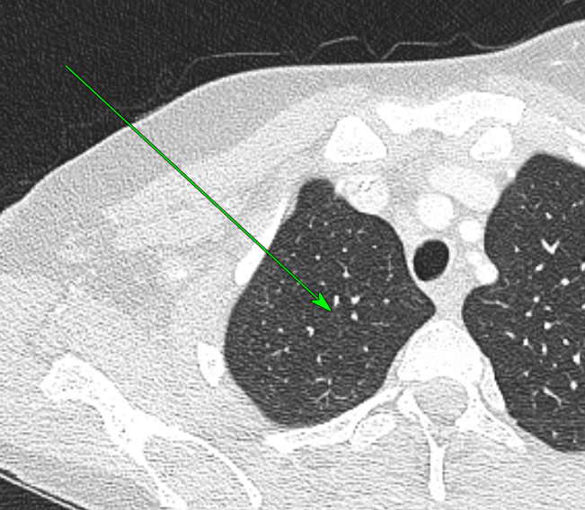

Slide 17
Complications
Pain
Pneumothorax
Haemorrhage
Infection
Death
Treatment failure
Failure to achieve control
Recurrence

