Slide 1

Somerset, Wiltshire, Avon & Gloucestershire Cancer Alliance welcomes you to our inaugural
MS Teams LIVE Event:
Rapid Diagnostic Services
08.09.2020

Slide 2
Introduction
Dr Amelia Randle, Clinical Director, SWAG Cancer Alliance

Slide 3
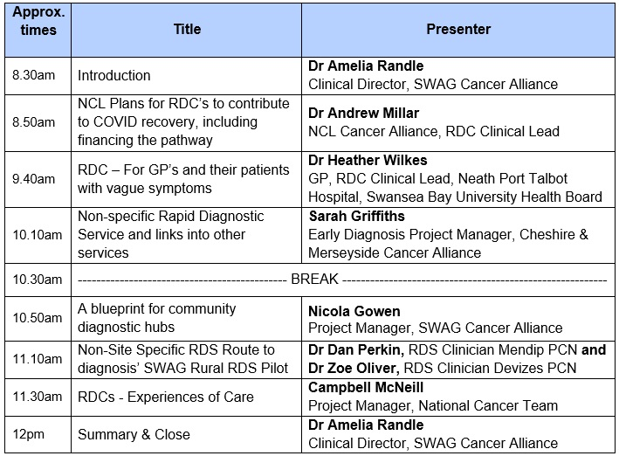
Timetable:

Slide 4
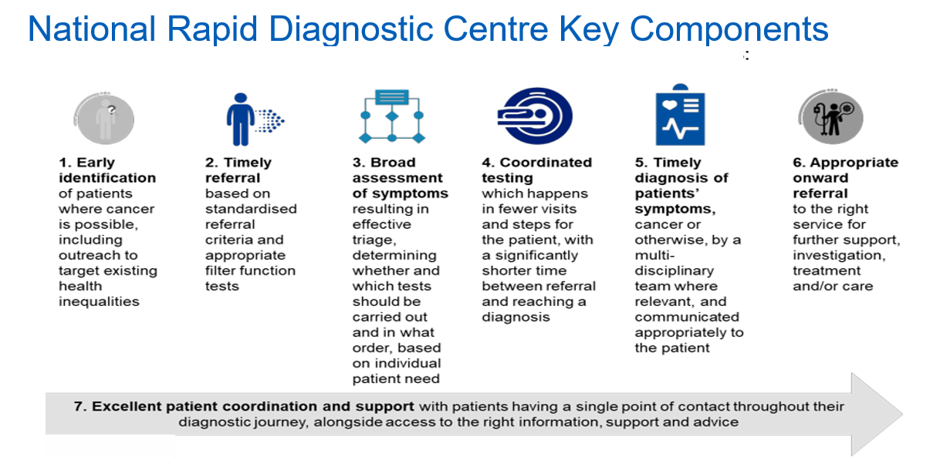

Slide 5
PCN
RDC
HUB
RDC
SECONDARY

Slide 6


NCL Cancer Alliance
RDC / MDC Experience, Plans and Challenges
Dr Andrew Millar, RDC Clinical Lead, NCL Cancer Alliance
Disclosures: Funding from Cancer Research UK, Gilead Sciences Ltd, Janssen Ltd, Merck Sharp & Dohme Ltd, Director of GI Diagnostics Ltd, shareholder in Medefer Ltd
Bringing together hospital trusts, GPs, health service commissioners, local authorities and patients
in north central London to transform cancer care.
www.nclcanceralliance.nhs.uk

Slide 7
RDCs in NCL – Todays Topics
Learning from the ACE MDC project
NCL Cancer Alliance plans for RDCs
The NCL finance model for RDCs
How should RDCs contribute to COVID-19 Recovery
Adopting a 2WW pathway - integration into RDC
Research opportunities
Bringing together hospital trusts, GPs, health service commissioners, local authorities and patients
in north central London to transform cancer care.
www.nclcanceralliance.nhs.uk

Slide 8
RDCs in NCL – Learning from ACE MDCs
Bringing together hospital trusts, GPs, health service commissioners, local authorities and patients
in north central London to transform cancer care.
www.nclcanceralliance.nhs.uk

Slide 9

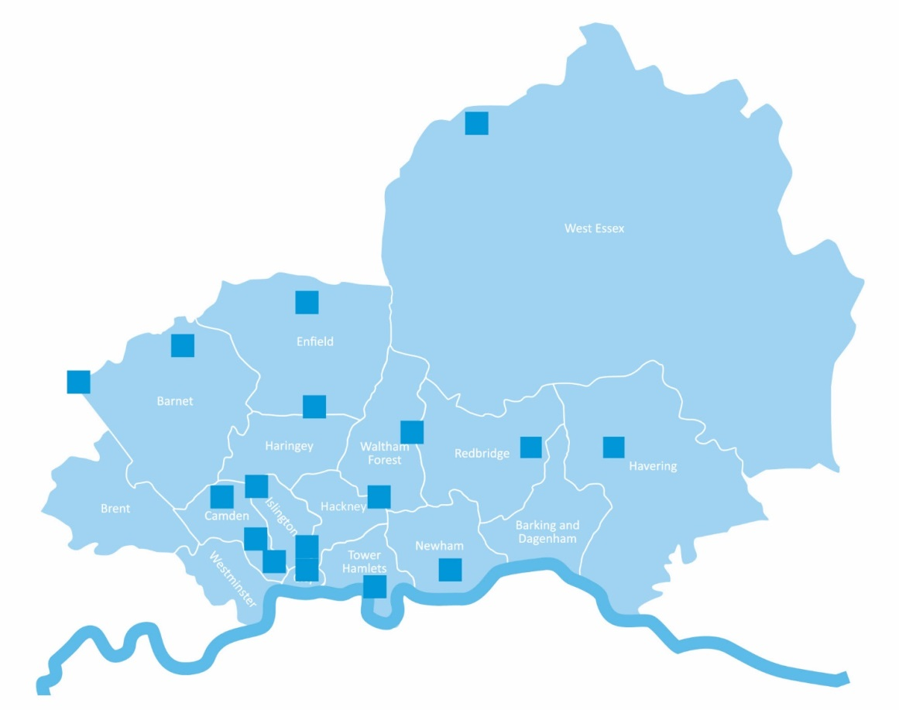
London ACE Program MDCs - Operational Principles
Suspect cancer but 2WW pathway unclear – mainly NSCS
CNS / ANP Support during diagnostic phase
Establish diagnosis/onward path not just rule out cancer
Achieve the 28 day Faster Diagnosis Standard
Not just for cancer – other serious conditions
Recognise patient complexity
North Middlesex
Referral Criteria
Royal Free
New unexplained abdominal pain
Unexplained weight loss
Painless jaundice
Unexplained nausea / loss of appetite
GP gut feeling of GI cancer
BHRUT
Barts Health
UCLH
Southend

Slide 10












UCL Cancer Collaborative
Multidisciplinary Diagnostic Centre (MDC) pathway
The Patient Journey:
0-2 days
0-2 days
0-3 days
0-15 days
0-5 days
0+ days
GP Visit
Triage
Hospital Visit 1
Hospital Visit 1 +
Follow up
Onward referral
Patient presents to GP with vague symptoms or unexplained test results
Multiple investigations possible (i.e. ultrasound then CT scan)
Clinical judgment to select first investigation
?
Referral to MDC
CT Scan
Referral to 2WW pathway for cancer
Initial call with CNS, for a holistic patient history (including mental health and social factors) and book tests
F2F consultation with CNS if particularly complex or frail
GP organise 1st tier investigation (bloods, urine, chest x-ray, etc)
Endoscopy
F2F consultation to discuss results and next steps
Referral to secondary specialist for serious non-cancer disease
Other investigations (colonoscopy, ultrasound, MRI, chest X Ray, etc)
Referral to GP for non-serious diagnosis
Key
If clinically necessary

Slide 11

Diagnostic tests performed in our MDC Sites (Apr 17 – Apr 19)
CT abdomen (24%), and CT chest (20 %) were the most performed diagnostic tests in MDC sites amongst known tests.
Source: UCLH, NMUH, RFH, BHRUT and SUH data

Slide 12
Cancer conversion rate & time to diagnosis – NCEL MDCs
Cancer conversion rate & time to diagnosis (Apr 17 – Apr 19)
Issues arising
  Clinic space and availability of diagnostics a challenge
  Inappropriate referrals an issue – need more redirection
  Staff recruitment a challenge – short term posts or diverted from existing work

Slide 13
Referral reasons (Apr 17 – Apr 19)
The highest proportion of referrals are associated with weight loss 40% followed by abdominal pain 21%.
UCLH has had 497patients with weight loss which was the highest in this category amongst all trusts.
Source: UCLH, NMUH,RFH, BHRUT and SUH data

Slide 14
Diagnosis (Apr 17 – Apr 19)
Percentage Break down
94% of patients’ outcome non cancer
6% the outcome cancer
Source: UCLH, NMUH, RFH, BHRUT and SUH data

Slide 15
Total cancer types (Apr 17 – Apr 19)
Pancreatic is the highest diagnosed cancer at 16% followed by lung and colon cancers at 14%.
Source: UCLH, NMUH, RFH, BHRUT and SUH data

Slide 16
Percentage of Accepted and Rejected referrals (Oct 18 – Apr 19)
74% of the referrals accepted and 26% of the referrals rejected at UCLH, RFH, and BHRUT between October 18 and April 19.
Source: UCLH, RHF, and BHRUT

Slide 17
Percentage of Referrals by Borough (Apr 17 – Apr 19)
We received the highest number of referrals from Camden, amongst all boroughs by 29%. .
Source: UCLH, NMUH, SUH, RFH and BHRUT data

Slide 18
MDCs in London – what we learned
Cancer conversion rate : 4.62%
Diagnosis:
  Pancreatic, lung and colon cancers + hard to diagnose cancers
  58.5% had significant ‘Non-cancer’ diagnosis
Time to diagnosis: 50% of patients were FDS compliant
Reason for referral: mainly weight loss, abdominal pain
Diagnostics: CT scan and endoscopy
Patient experience: high levels of satisfaction
Number of referrals: steady increase – matches pathway awareness

Slide 19
RDCs in NCL – Challenges
Existing services stretched therefore need significant resource in staffing and diagnostic services – new or diverted capacity?
RDC CNS role needs development program – ANP/Nurse consultant can lead pathway triage - significant role for CNS support in diagnostic pathway
With scale a physical space needed to coordinate and deliver care
Need better triage criteria for non-specific symptoms – Amount? Duration? Age? Pattern? Associations?
Clear process for managing inappropriate referrals - recognition of workload of diversion process
GP Comms need structure – existing process – learning events/news letters etc is patchy and slow -
Need to define which clinicians optimal for RDC lead and team roles
Bringing together hospital trusts, GPs, health service commissioners, local authorities and patients
in north central London to transform cancer care.
www.nclcanceralliance.nhs.uk

Slide 20

NCL PLANS FOR RDCS

Slide 21
NCL Alliance RDC
Referral criteria and sites
Inclusion criteria: Patients experiencing any of the following symptoms (variation to National)
  Unexplained and unintentional weight loss >5% in 3 months or equivalent
  Unexplained constitutional symptoms (loss of appetite, fatigue, nausea, malaise, bloating)
  Unexplained vague abdominal pain of >4 weeks
  Unexplained new or progressive pain, including bone pain of 4 weeks or more (not in first 6 months)
  GP ‘gut feeling’ of cancer diagnosis (GI at UCLH)
Exclusion criteria:
  Specific alarm symptoms warranting referral onto site-specific suspected cancer pathway
  Patient too unwell to attend as an outpatient / needs acute admission / (patient refusal/unavailable)
  A serious non-cancer diagnosis suitable for another pathway is highly likely (e.g. TB)
  (Already under another team on 2WW pathway)
North Middlesex
Royal Free
UCLH

Slide 22
RDC Referral Vetting - NMUH
Consultant/ANP Vetting
ACCEPT
UGI FDS
STT OGD
+/- SVN Clinic
RDC ONLY
?Telephone History
Consultant specifies tests + clinic code
REDIRECT
Another Internal pathway
UGI FDS / RDC
Book RDC / Cancer Clinic / Target slot
Consultant books tests required and clinic code
Redirect back to GP
RDC CNS takes history and proceeds with tests or revetting with RDC Consultant
Arrange internally – referral to Reg/2WW team and GP letter
Letter to primary care
Another External pathway
Arrange+ letter to external agency and GP
Navigator arranges tests and clinic appointment

Slide 23
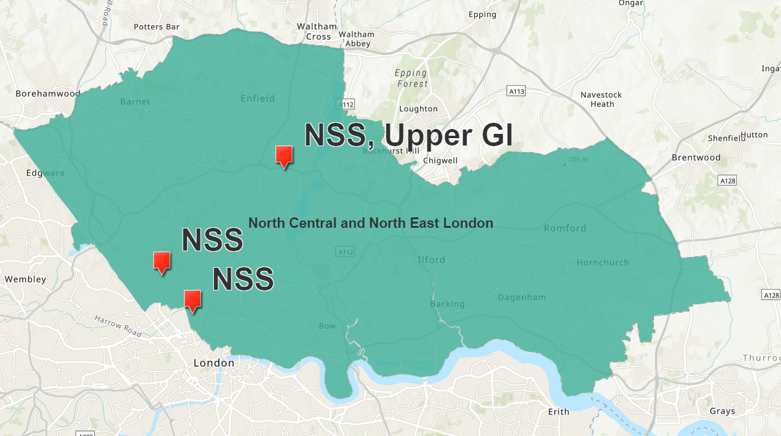



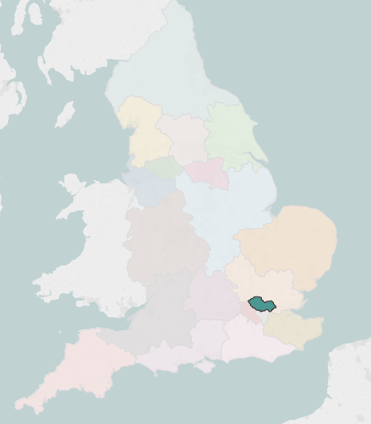





North Central London (NCL) Cancer Alliance – 2020/21 Plans
RDCs are well established in NCL having originally been set up to support the Accelerate, Coordinate, Evaluate (ACE) programme at Royal Free London (RFL), North Middlesex University Hospital (NMUH) and University College London Hospitals (UCLH). Their 20/21 plan will expand these services.
Contact: ogregory@nhs.net
Two Planned RDC pathways
Non-specific Symptoms
Upper GI
Planned non-specific symptoms % population coverage
2 RDC pathways planned
Workforce
Core facts
Population size – 1,642,341
ICS – 1
STPSs – 1
CCGs – 1
Number of trusts -
Clinical Service Lead
RDC
Consultant
Speciality
Consultant
GP
Radiologist
Management
Support
Clinical
Nurse
Specialist

Slide 24
NCL RDC FINANCIAL MODEL

Slide 25
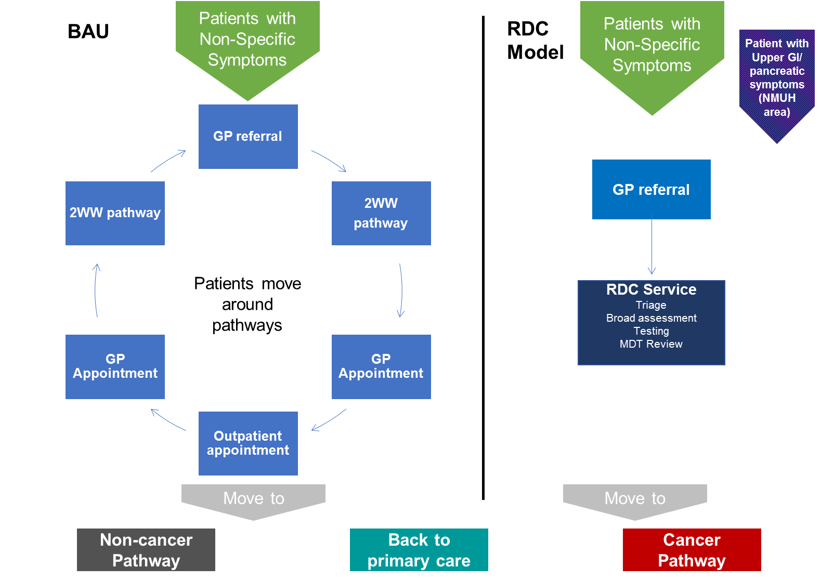
RDCs will solve the problem of patients being referred to multiple diagnostic pathways
There is a cohort of patients who have multiple 2WW referrals (and other types) from their GP, creating additional demand for appointments and diagnostics:

Slide 26
Annex: Financial modelling assumptions
Existing 2WW/ outpatient appointments are costed at a £258 tariff rate
Diagnostic activity rates. Activity levels for diagnostics are based on the rates of activity for MDC patients between February 2018-January 2019:
Figure: Assumptions about diagnostic activity rates (per 100) in BAU, additional first time 2WW appointments, and in the RDC
Where patients are having multiple referrals into a 2WW pathway, they will have on average 2.1 first time 2WW appointments (e.g. most will have two appointments and a small minority have three plus) compared to 1 for the other cohort. NCL data suggest c90% have two first 2WW referrals and c10% have three plus 2WW referrals.
RDCs will provide a definitive diagnosis of cancer/ clear management for all patients, without the need for additional first time 2WW referrals. This will mean that each patient will only require one RDC appointment compared to 2+ first time 2WW appointments.
Tariffs costs for 2WW referrals and diagnostic and imaging activity are based on figures for UCLH (currently clarifying for NMUH and RFH.
Activity | Activity rate per 100 patients in BAU 2WW first time appointments (for non-specific cohort) | Additional activity rate per 100 patients having additional 2WW appointments after multiple referrals | Activity rate per 100 RDC patients | Tariff cost per activity
Gastroscopy | 37.9 | 3.3 | 37.9 | £508
Colonoscopy | 18.3 | 2.2 | 18.3 | £660
CT Scan | 59.1 | 19.8 | 59.1 | £106
Ultrasound | 8.4 | 16.5 | 8.4 | £105
Notes:
Clarify CT scan

Slide 27
Made up of additional 2WW appointments from:
We can estimate the number of patients in NCL that RDCs will stop moving through multiple 2WW referrals
66,915 total 2WW first time appointments
5,265 additional first time 2WW appointments
3,156 potentially avoidable 2WW appointments
1-31 days of referral:
32-180 days of referral:
(likely tumour groups lower/ upper GI, haematology, gynae urology)
31-180 days of referral:
(other tumour groups):
90%
70%
20%
1,497 of 1,664 appointments
1,314 of 1,877 appointments
1,314 of 1,877 appointments
RDCs can create a net saving of 3,156 first time outpatient appoints from 2,810 patients. This could reduce the number of 2WW appointments by 5,966.

Slide 28
Annex: Assumptions about the number of patients the RDC can more efficiently diagnose
By quantifying the number of appointments for patients referred to multiple 2ww pathways we can estimate the opportunities for reducing unnecessary 2WW appointments and diagnostics activity
In 2018-19 out a total of 66,915 2WW referrals leading to first time appointments, around 5,265 2WW referrals led to additional first time appointments in NCL
We estimate that up to 3,156 first time 2WW appointments from an estimated 2,810 patients could be avoided by implementing the RDC model in NCL. Referring 2,810 patients to an RDC would reduce the annual number of first time 2WW appointments from 66,915 to 60,949
These figures are based on predictions about the suitability of RDCs for three sub-cohorts of patients who currently have multiple 2WW referrals:
Patient sub-cohort | Number of additional appointments | Estimated proportion of duplicate appointments that could be absorbed by the RDC (%) | Number of 2WW appointments from multiple referrals potentially avoided | Estimated potential patients | Gross number of 2WW appointments potentially avoided (All first time 2WW appointments)
1-31 days of first referral | 1,664 | 90 | 1,497 | 1,327 | 2,824
32-180 days of first referral (likely tumour groups: Lower GI, Upper GI , haematology, gynae, and urology) | 1,877 | 70 | 1,314 | 1,177 | 2,491
32-180 days of first referral (other tumour groups) | 1,724 | 20 | 345 | 306 | 651
Total | 5,265 | n/a | 3,156 | 2,810 | 5,966
A predicted net reduction of 3,156 first time appointments from 2,810 people with suspected cancer provides a basis for a making a financial case for RDCs
Notes:
Keep to broad GI.
Action: confirm data source

Slide 29
We can estimate savings for an average patient using an RDC rather than multiple 2WW referral pathways
First appointment cost
First appointment diagnostics cost
Additional (2+) first appointment costs
Additional appointment diagnostic costs
Total costs
£243
£364
£267
£66
£940
BAU 2WW
+
+
+
=
£344
£364
£0
£0
£708
RDC
+
+
+
=
A patient going through multiple 2WW referral pathways in NMUH is on average £232 cheaper to diagnose in an RDC compared to BAU

Slide 30
NMUH Model – BC makes a clear clinical and financial case for RDCs
RDCs address referral to multiple diagnostic pathways with a higher quality more efficient patient experience
In NCL predicted that RDCs will stop 2,810 people having 3,156 first time appointments.
RDC provides a clear clinical model that meets national policy expectations and responds to a clear local need
An RDC tariff of £344.09 can deliver a clinically, operationally and financially sustainable model- accepting 960 referrals each year at NMUH
At NMUH- 293 patients out of a cohort of 937 need to pass through the RDC each year for it to be viable
The above points provide a working basis for commissioning the three proposed RDC sites at a £361 tariff rate per patient

Slide 31
Annex: scenarios to demonstrate the financial case for RDCs compared to BAU in NCL
Costs and potential savings associated with the different scenarios. Average costs across NCL Sites (NMUH, RFH, UCLH):
Scenario | Proportion of patients from the multiple 2WW referral cohort ('bouncers') | Proportion of patients from the single 2WW referral cohort | Cost BAU (2,880 patients) | Cost for three RDCs | Cast savings per patient | Savings for NCL RDCs | Maximum RDC tariff
Break even: Conservative mix of patients AND no additional diagnostics activity for patients with additional 2WW referrals | 39 | 61 | £2,073,511 | £2,072,106 | £0.49 | £1,404 | £355.82
Likely scenario: Clinically predicted mix of patients AND assuming clinically indicated rates additional diagnostics activity for patients with additional 2WW referrals | 72 | 28 | £2,470,415 | £2,072,106 | £138.30 | £398,309 | £493.63
Figure: RDC costs in potential scenarios of patient types (nab all costs except the tariff are annual)
RDCs will generate significant savings compared to BAU in the clinically predicted scenarios. At an average £355 tariff across NCL the service is cost effective even in conservative scenarios.
Notes:
Example patient journey with costs
Show diagnostic cost per patients

Slide 32
The existing MDC approach gives us a viable clinical model to adapt for RDCs
NMUH staff model and costs
Staff group | Banding/ PA | Role description | Annual cost (NMUH)
Service lead | 0.75PA | Provides leadership for the service. Supports service development at a clinic and an alliance level. | £11,522.25
RDC Consultant | 2.25 PA | Provides the following clinical support: | £34,566.75
 |  | 1 clinic (1.5 PA)
 |  | Admin for clinic (0.25 PA)
 |  | MDT/ data validation 0.5 PA
Specialty Consultant (e.g.: respiratory) | 0.25 PA | Provides specialist clinical advice and guidance, including inputting into MDTs. | £7,681.50
GP/ Second Consultant | 1.25 PA | Provides primary care input into delivery of RDC clinics. This role would be covered by an additional consultant led clinic if no GP is available. | £19,203.75
 |  | Supports engagement with primary care.
Radiologist | 2 PAs | Provides dedicated timely radiology reporting that the general list will not provide. Assumes 10-15 CTs require reporting per week, majority of scans are CT CAP. | £30,726
Management support | Band 8a (0.3 FTE) | Provides operational management support for the service. | £21,249
RDC CNS | Band 7 | Provides clinical expertise and patient support. Each CNS can manage 12 patients per week. | £57,176
Development CNS | Band 6 | Additional CNS resource to provide additional capacity to meet patient demand, and additional cover to ensure service resilience. | £48,895
Pathway navigator | Band 4 | Manage the referral pathway and provides cover for data manager during leave. | £33,242
Management overhead | n/a | Trust management overheads (e.g. estates and facilities, IT, back office…) | £66,065.39
 |  | Total: | £330,326.97
Notes:
To deliver the benefits of a faster and more definitive diagnosis process for patients, RDCs oadopted the above staffing model for the following reasons:
Consultant and/or GP led clinics ensure that clinicians with the experience and understanding of a range of conditions. This is a higher mix than a traditional 2WW clinic where given the less complex/ more specific nature of patient symptoms fu
Staffing levels allow for 2-3 clinics to run each week, ensuring that c. 20 patients can been assessed effectively
Formalised input from specialty consultants ensures that a clinical expertise from a wide range of clinical disciplines can be sought quickly
GP input will support engagement with primary care to drive appropriate referrals and provide advice about the detail of any diagnoses and advice for management plans
Sufficient CNS support to provide patients with advice and guidance related to the diagnosis process
Dedicated radiologist time will ensure that images are read and reported on quickly enough to meet the FDS standards, and that radiologist expertise can attend MDTs
Dedicated patient navigator to ensures that patients have a co-ordinated experience that ensures that appointments and diagnostic tests are scheduled quickly and efficiently
Learning from the MDC model suggests that the staffing model needs sufficient dedicated capacity and formalisation to remain sustainable, otherwise the service becomes

Slide 33
There are enough multiple 2WW referral patients for the NMUH RDC tariff to be viable to commissioners
A minimum of 293 patients or 30.5% of the multiple 2WW referral cohort in NMUH need to pass through the RDC rather than BAU 2WW referral pathways for the service to be cost effective at a tariff of £344.09:
Cohort | Patients having multiple 2WW referrals within a 1-180 day period | Patients having only one 2WW referral within a 1-180 day period
NMUH RDC Capacity/ NCL RDC Capacity | 960/ 2,880
Estimated patient cohort size NMUH/NCL | 937/2,810 | 20,201/60,602
Number of patients from cohort required to deliver a viable RDC service in NMUH | 293 | 667
Proportion of cohort required to use RDC services to deliver a viable NCL RDC service | Min 30.5% | Max 3.3%
Patient numbers likely to pass through an RDC assuming clinically expected patient mix (72% from multiple 2WW referrals cohort) | 691 | 269
% of cohort likely to pass through an RDC following clinically expected patient mix | 73.7 | 1.3
Even if the patient mix doesn’t follow clinical expectations there is a significant buffer that ensures the service remains financially viable at the proposed £344.09 tariff

Slide 34
To deliver this model we propose the following tariff at NMUH
The NMUH service model has been developed to deliver a service for 80 patients per month, which equates to 960 accepted patient referrals per year.
To deliver a viable service for 80 patients per month we propose a tariff rate of £344.09 per patient at NMUH (excluding diagnostics)
 | NMUH RDC | NCL RDC Total
Operating costs | £330,327 | £1,022,971
NMUH Tariff Per patient | £344.09

Slide 35
ADOPTING A 2WW PATHWAY

Slide 36
NMUH will incorporate UGI into the RDC + fast track for pancreatic cancer
ERS 2WW Referral Received
TC 2WW appointment made
Patient discharged at first OPA with letter (Covid-19 agreement)
Investigations requested by consultant - no staff facilitation
DNA
Follow up appointment TC/F2F/VC
Second appointment offered
Endoscopy only - referrer indicates discharge if normal
PREVIOUS Pathway

Slide 37
NMUH will incorporate UGI into the RDC – fast track for pancreatic cancer
UGI 2WW / Suspected Pancreatic cancer reviewed in daily Consultant led assessment
ACCEPT
STT Endoscopy - supported by Navigator Discharge if NAD
Consultant
TC/F2F OPA
REJECT / REDIRECT
Suitable for another Secondary care pathway
Nurse appointment (with consultant if pancreatic cancer with jaundice) - additional history - tests arranged +/- navigator support
Suitable for primary care
Indicate which and letter to GP written
Letter to primary care
STT CNS monitors and facilitates tests
ERS 2WW Referral Received - new DOS
(including filter function tests*)
Discussed at MDT or Consultant VC/TC/F2F
STT CNS Discharges patient
Cancer Diagnosed - referred to MDT
Discharge from 2WW pathway to primary care or 18 week secondary care pathway
NEW RDC UGI Pathway

Slide 38
RDCs ROLE IN COVID-19 RECOVERY
Limit visits to Hospital Trusts
  Avoid multiple 2WW referrals
  Telephone triage of referred patients
  Coordination of tests to same day where possible
Enable coordinated diagnostics with facilities in community diagnostic Hubs or Independent Sector Covid free sites.
Enable better stratification in site-specific pathways increases effectiveness
Potential to offer coordination of GP Direct Access

Slide 39
RDC DATA COLLECTION
Using clinical noting e-proforma for adoption into Trust EPR (Epic, Cerner, Medway)
Use online research facility (REDCap)
Peripatetic data manager to support Trusts
Patient and GP Experience surveys on line

Slide 40
RDC RESEARCH

Slide 41
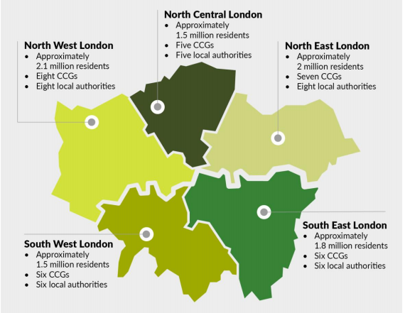
RDCs in London: 20/21 plans for roll out
NCL & NEL- MDCs at UCLH, NMUH, SUH, BHRUT, RFH
RMP-
Acute Diagnostic Oncology Clinic (ADOC) at ChelWest
SEL: RADC at GSTT
*STP map from King’s Fund review

Slide 42

RDC research
Pan London RDC research group met in late February to agree on workstreams and projects:
Breath Test Cancer Triage Tool
Big Data
Symptom Profiling
Exploratory biomarkers
Led by Richard Lee, RMH
Aim: Data linkage across primary and secondary care to identify ‘markers’ of disease presenting with vague symptoms.
Initial retrospective audit of RDC data sets to compare
Led by Andrew Miller, North Middlesex
Aim: to develop a risk score of disease using patient demographics, clinical results, and symptoms to aid clinical decision for investigation
Collation of self reported presenting symptoms by patients presenting to RDCs and clinical dataset
Led by Stephen Pereira, UCLH
Aim: to establish a biobank of samples of patients referred to RDCs
Extend ADEPT protocol to RDC sites for identification of markers of pancreatic cancer
Led by George Hanna, Imperial College
Aim: Identify VOC signature in patients referred to RDC, which may help triage patients to diagnostic tests
Sample size to determine number of RDC sites required
Breath sample to be collected by all patients referred to RDCs
RDC Research Fellowships
1-3 year research fellowships to support projects
Funding contributed by each of the cancer alliances
Cross site RDC working to facilitate collaboration
North Central London Cancer Alliance
North East London Cancer Alliance
RM Partners
South East London Cancer Alliance

Slide 43
UCL Cancer Collaborative – North Middlesex University Hospital
Multidisciplinary Diagnostic Centre (MDC) pathway
DRAFT
The Model:
Referral Criteria:
Criteria developed by MDC leaders, based on the type of patient that was frequently inappropriately referred to gastroenterology
Initial criteria for pilot developed for GI referrals only, to avoid being overwhelmed by referrals
All patients are eligible provided they have fit the referral criteria and cannot be explained by another (simple) diagnosis; if the referral is not appropriate then referred back to GP or internal referral to best pathway
Referral criteria:
  New unexplained abdominal pain
  Unexplained weight loss
  New and persistent unexplained nausea / loss of appetite
  Painless jaundice
  GP concern and / or gut feeling that there is an underlying GI malignancy
The Clinic:
Triage team made up of 1x clinical nurse specialist (full-time) and 1x consultant gastroenterologist (approx. 1 day/week)
Generalist knowledge and skills are considered key in the triaging role, rather than any particular clinical background – a broad knowledge base and broad interests are critical
Consultants have confidence to seek advice or refer onwards when required
Referrals reviewed by CNS and consultant within 48 hours of receipt (at daily meeting on Monday-Friday, approx. 1hr), but generally within 24 hours
CNS may call patient before consultant review if referral is unclear
The CNS and ACE admin support are responsible for all administrative and project management tasks
Clinic sees approx. 20-25 patients/month, with approx. 5-10 referrals rejected per month
Coordination:
Coordinate same day testing where feasible (e.g. bloods and CT scan)
Local agreement for timely diagnostics but no reserved appointments
Some difficulty arises when non-core MDC clinician sees patient (e.g. as backfill for MDC consultant) and may not book as urgent/part of the MDC 2WW pathway
While some tests can be coordinated for the same day, there is no space for patients to wait so they may go home in between
Diagnosis:
Diagnosis is based on all diagnostic results, held on electronic patient record
‘Patient discussions’ (i.e. discussion between CNS and consultant) occur on an ad hoc basis on receipt of test results and/or during daily MDC meeting
Informal advice is sought from other specialties through consultant-to-consultant discussions
Serious non-cancer diagnosis is anything that requires urgent secondary care in the next few weeks
Operate as a ‘rule-in’ service so where possible, avoid a ‘no diagnosis’ outcome to limit number of re-referrals by GPs
GP will always receive a letter regardless of the onwards referral route, and have access to the report via shared patient records (if in local area)
CT:
Most common type of imaging used in pathway (53% of patients will have a CT at some point)
Appointments are organised by the CNS with diagnostic staff, based on urgency
Access to CT varies from days to 2-3 weeks, though there is potential to access same-day CT if required
Referral
Triage
Testing
Diagnosis
Pre-referral Testing:
MDC requests a series of pre-referral tests, though will accept patients without them
Low risk of duplication for ‘local’ patients as the MDC has access to local shared care record (i.e. with partner GPs
Risk of duplication with out of area patients, as many get follow-up tests at their local hospital, which NMUH cannot see
Tests requested:
FBC
U&E
LFT
The Consultation:
CNS undertakes a telephone triage for all patients, and will bring in for a F2F appointment if particularly complex or there are frailty issues – this can be done on a daily basis
Triage is used to develop a detailed patient history to inform clinical judgement in sequencing of tests
Triage is holistic in nature, and includes medical and social factors
While a scoring system is not used, this is the preference of the MDC
Endoscopy:
35% of patients will have an endoscopy
More common due to the nature of the pilot (i.e. GI symptoms)
No access to same-day endoscopies
MDC is seeking to develop an evening endoscopy list to address access issues
Follow-Up:
Patients with a diagnosis of any kind have a F2F follow-up appointment (particularly if serious cancer or non-cancer diagnosis) – 2 x MDC clinics per week
If patient not available during MDC clinic time, diagnosis can be undertaken by any consultant (including by the MDC consultant) at a suitable time – may be by consultant in onward referral pathway. Intention is to deliver diagnosis as quickly as possible
All patients receive the summary letter (with test results) sent to GP, and it is written in patient-friendly language
TIBC
Ferritin
Glucose
CRP
HBA1c
Bone profile
(including CA)
Baseline demographics
Other investigations:
Patients will undergo additional biochemical testing (i.e. not in the GP filter function tests) or will have basic bloods (if not done by GP)
Other testing includes ultrasound, MRI, colonoscopy and chest X Ray
These tests may be undertaken first, followed by other tests (e.g. CT) on same day where possible
Onward Referral:
Cancer diagnoses are referred internally to appropriate site-specific pathway. Staging will be performed at the next site-specific MDT
Serious non-cancer diagnoses are either referred internally consultant-to-consultant or (sometimes) back to GP (provided there is an appropriate management plan)
If internal referral:
  Patients optimised in the interim by MDC staff (e.g. transfusions)
  GI – treated as a follow-up appointment
  Non-GI – treated as a new patient referral
  18 week wait starts from the time of the original referral, and placed as an urgent referral, so usually seen within 1-2 weeks
Non-serious diagnoses are referred back to GP, with advice
Referral Process:
MDC is currently funded to receive referrals from local GPs in their catchment though there are some out of area referrals
Standard referral form received via email (will progress to ERS in April 2019), which GPs access through EMIS
Referrals vetted on a daily basis, and registered on an internal 2WW pathway if accepted
Expectation that GPs will seek to exclude other diagnoses before referral (e.g. thyroid)
Majority of referrals (~95%) are accepted, but quality of referrals is average
Referral process supported by GP education and GP champions
Sequencing:
Currently, sequencing and scope of testing is determined based on clinical judgement of MDC consultant post-consultation
Tests are ordered after the patient consultation
Team seeks to minimise hospital visits and number of tests – do not appear to ‘frontload’ diagnostics, but will hold patients within the service until a diagnosis can be made
All patients re-reviewed at 21 days to determine appropriate next steps/tests
Reporting
Hot reporting available for imaging and histology within 5 days when requested
Endoscopies reported at time of test

Slide 44

Any questions?
This Photo by Unknown Author is licensed under CC BY

Slide 45
Final Summary

Slide 46


RDC -
For GP’s and their patients with vague symptoms
Dr Heather Wilkes, GP & RDC Clinical Lead, Neath Port Talbot Hospital
Swansea Bay University Health Board

Slide 47

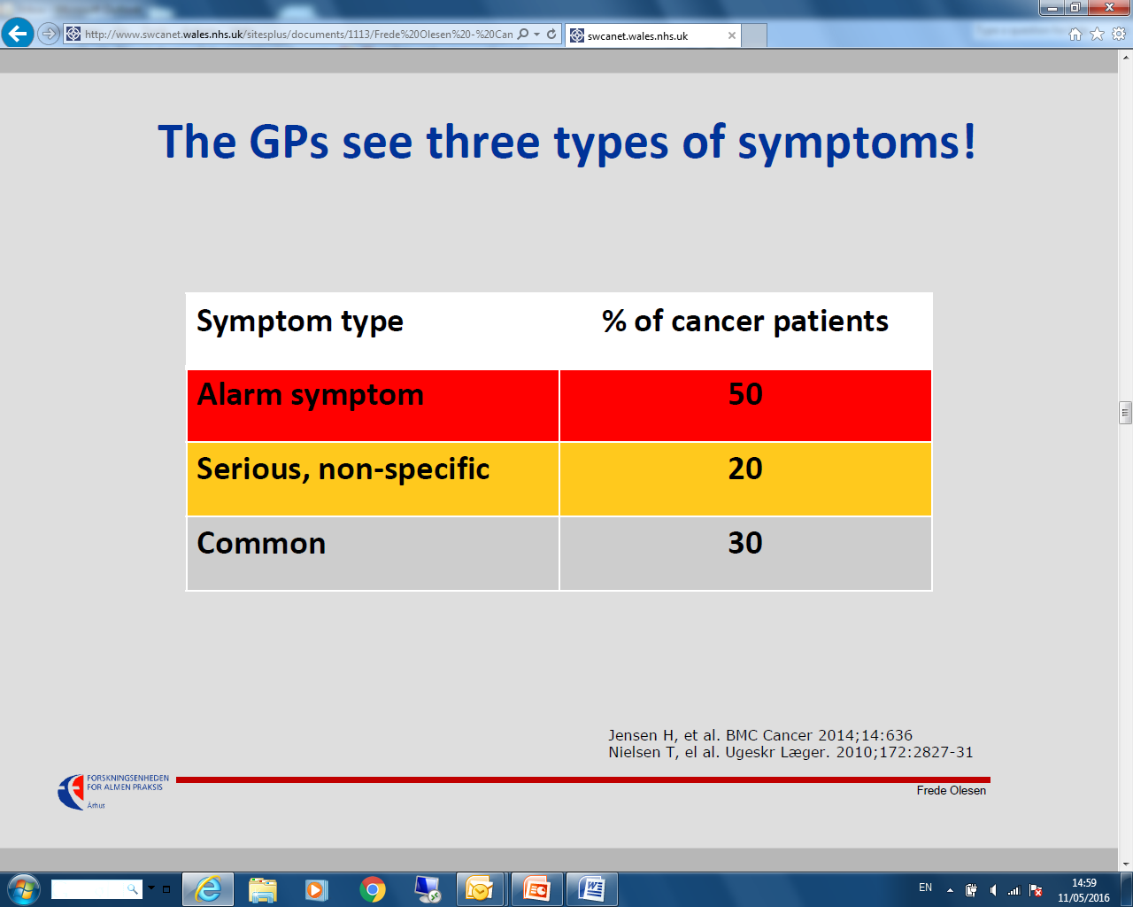
Notes:
Patients with cancer often present late or present with common, non specific symptoms.
Up to 50% of patients that are later diagnosed with a cancer DO NOT initially present with the traditional cancer red flags

Slide 48
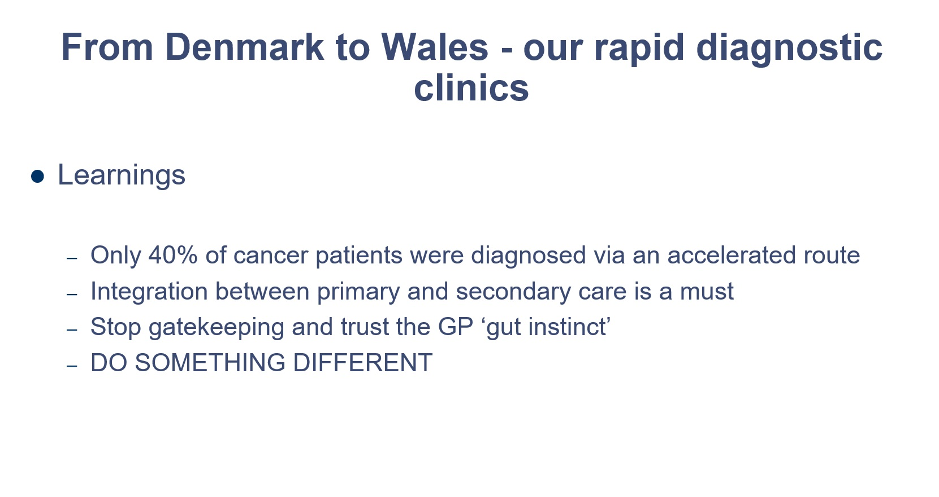
Notes:
Patients with cancer often present late or present with common, non specific symptoms.
Up to 50% of patients that are later diagnosed with a cancer DO NOT initially present with the traditional cancer red flags

Slide 49
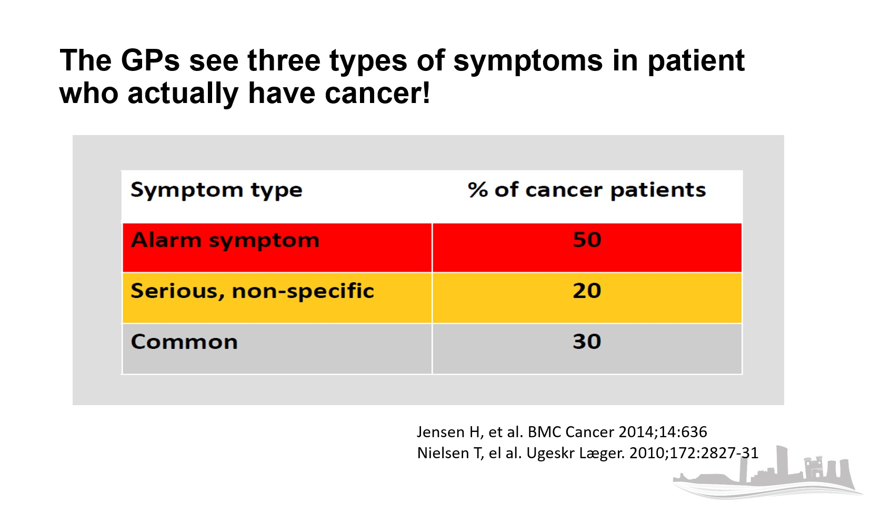
Notes:
Patients with cancer often present late or present with common, non specific symptoms.
Up to 50% of patients that are later diagnosed with a cancer DO NOT initially present with the traditional cancer red flags

Slide 50
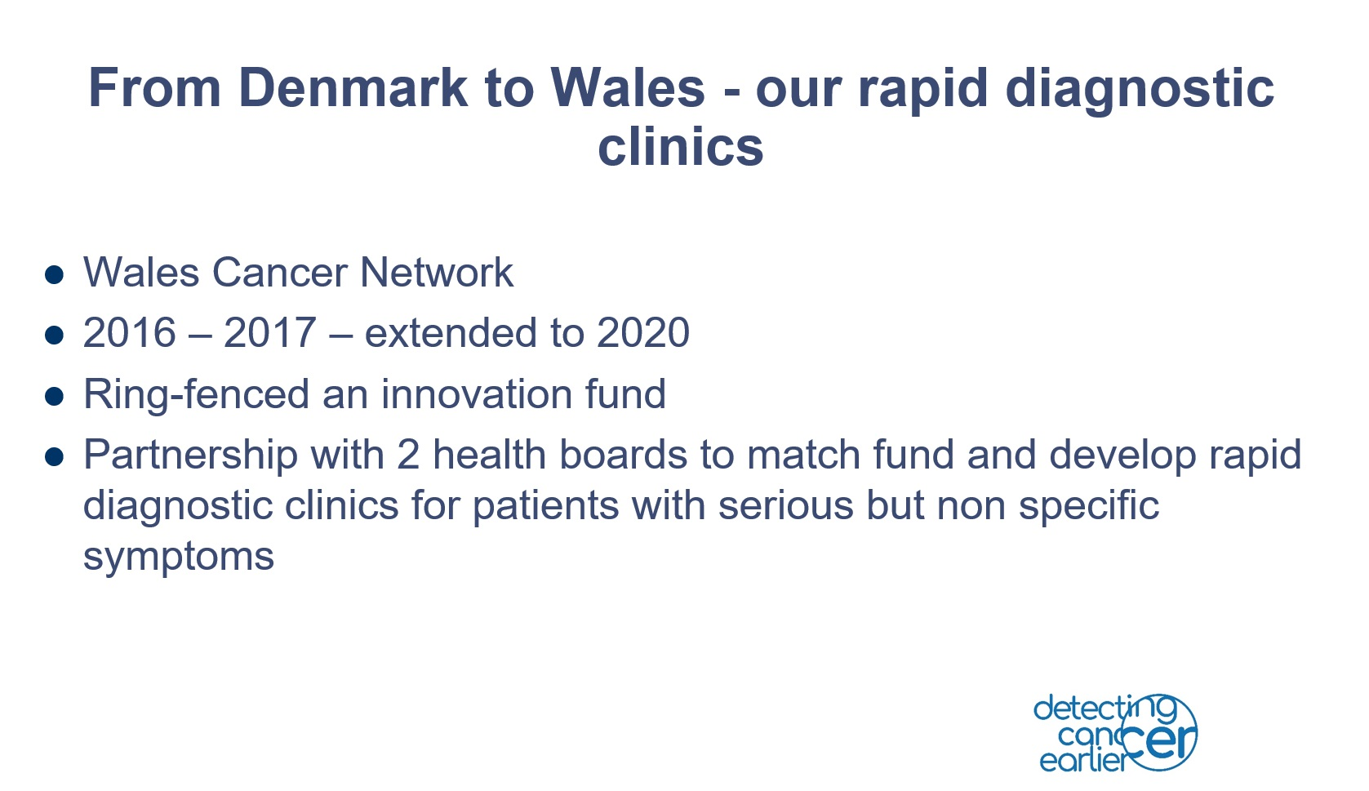

Slide 51
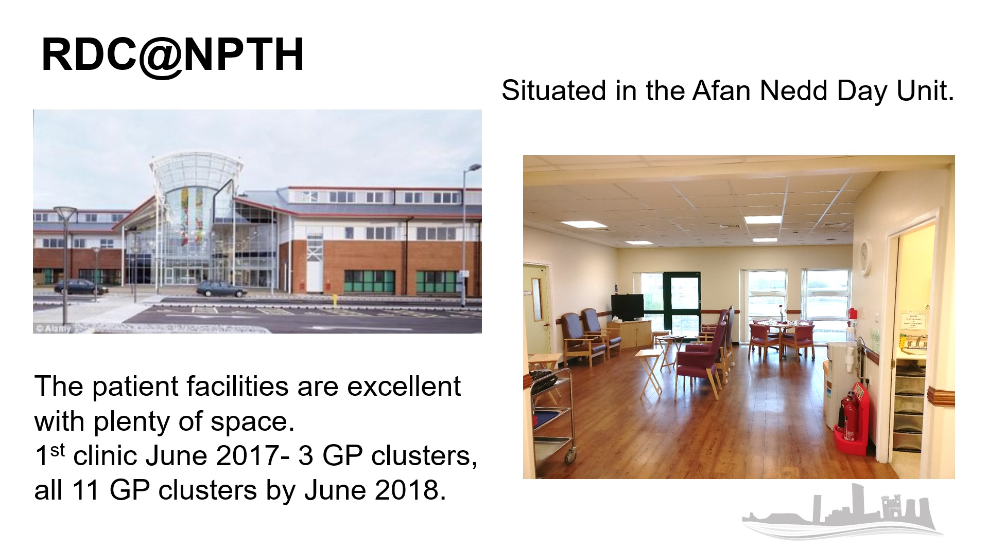

Slide 52
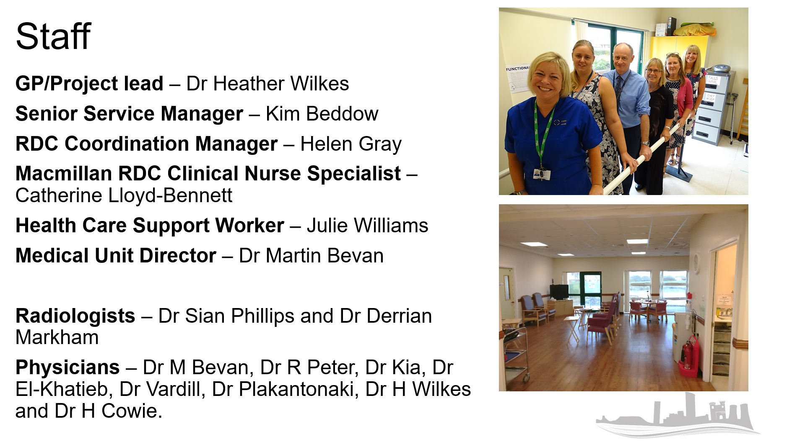

Slide 53

Rapid Diagnosis Centre
The RDC is a vague symptom pathway where the GP has a ‘gut feeling’ that there may be a sinister cause for these symptoms, possibly malignancy, BUT these patients do not fit traditional USC pathway as they do not have the usual site specific RED FLAG symptoms.
These patients are often downgraded in Wales by secondary care
Primary care access to diagnostics has been eroded over time and is patchy in provision
Notes:
Biggest influence in this area due to Lead GP from this area.
Didn’t want to be overwhelmed as not sure what would happen.
Red flags normally mean site specific so stay on USC pathway. RED flags come from NICE guidelines/Wales

Slide 54
Aims of the RDC@NPTH
Reduce the time to diagnosis in patients with non-specific symptoms but with the potential to have a serious underlying problem
Improve patient experience by means of timely and prompt investigations along with pathways of communication
Improve cancer mortality rates and long term survival in the longer term
Improve primary/secondary care joint working

Slide 55
What makes the RDC unique?
A primary care resource in a secondary care setting
Investigating patients who do not fit the traditional cancer pathway
Live reporting of CT scans
Radiologist-Physician discussions
CNS who provides support before, during and after clinic
Person centred care
Rapid reassurance for patients, families/carers and GPs

Slide 56
Vague symptoms – for examples/NOT a tick box list
Unexplained laboratory test findings (e.g. anaemia, thrombocytopenia, hypercalcaemia)
Unexplained weight loss
Severe unexplained fatigue
Persistent nausea or appetite loss
New atypical pain (e.g. diffuse abdominal pain or bone pain)
We do accept patients who have a past medical history of cancer – as long as the symptoms are not related to a monitored cancer.

Slide 57
RDC Criteria - inclusion
SET A
Panel A bloods (CRP, FBC, U&E, LFT, Bone, TFT, Glucose, HbA1c, Ferritin, Coeliac Screen, either PSA or CA125)
Dip urine (and record result in referral text)
Physical examination including a breast exam for women and a PR exam for men (and record result in referral text)
(Chest X-ray ? to continue)
To counsel patients as to why they are being referred.
- “Set A” has been requested & documented
- the patients red flag symptoms do relate to any USC pathway
- GP clinical suspicion of a serious disease that could be due to cancer/ GP “gut feeling”
- > 18 years of age
- GP is within pilot area
- The patient is well enough to go through the process
- The patient understands the process and is able to attend the RDC, possibly for a whole day at a time at short notice
- Telephone number for the patient

Slide 58
Imaging and reporting
Neath Port Talbot Hospital is a non-acute hospital
HB agreed to ring-fence 10 CT slots a week
Currently use half a CT session each morning
Any unused CT slots are returned to Radiology - no waste
Radiologist live reports and discussed same session with Physician to develop diagnosis/plan
Good engagement with secondary care clinicians/rotas filled

Slide 59
Results – up to March ‘20
1066 patients seen, 52 cancelled
1118 referrals accepted
298 referrals rejected
Age Range – 19-95 years
260 clinics held
Female 605 – 513 Male
Average age – 68.6 years

Slide 60
Cancer diagnoses
118 patients have been diagnosed with cancer
25x lung
15x renal
15x malignancy of unknown origin
10x pancreatic
11x colorectal
4x liver
5x Hodgkin’s lymphoma
6x B Cell lymphoma
2x leukaemia
3x melanoma
3x prostate
1x appendiceal
5x breast
2x bile duct
4x sarcoma
1x thyroid
1x gastric
1x oesophageal
1x cervical
2x myeloma
1x TCC
1x adrenal
3x ovarian
A further 39 people are being monitored
Cancer conversion rate 11.1%
75% diagnosed on the day

Slide 61
Patient outcomes – Non cancer diagnoses
Bronchiectasis
Heart failure
AVM
Stomach Ulcer
Sarcoidosis
Tuberculosis
Hyperthyroidism
PE/VTE
Phaeochromocytoma
Iatrogenic causes
Alcoholic liver disease
Syphilis
Haemophagocytic Lymphohistiocytosis
Polymyalgia Rheumatica
Mesenteric ischaemia
HIV
Hepatitis
Discitis
H Pylori
Haemachromatosis
Pancreatitis
Depression
Sepsis

Slide 62
Overall combination of symptomology

Slide 63
The case for change:
WGT – Weight loss ABDO – Abdominal pain
PAIN – Generalised pain FAT – Fatigue
ANAE – Anaemia NAU – Nausea
LAB – Unexplained laboratory result APP – Appetite loss
SOB – Shortness of breath
Cancer Diagnosis - % of overall symptoms
No Diagnosis - % of overall symptoms
All data included

Slide 64
As of end March 2020 the RDC has -
Accepted 1118 referrals of which 1066 patients have been seen
A cancer conversion rate of 11.1% (118 patients)
The most frequent being the traditionally harder to detect cancers of lung, renal, pancreas & malignancy of unknown origin
75% of those patients diagnosed with a cancer were diagnosed on the day of clinic
35% of patients referred have a significant non cancer diagnosis
All clinical information is available to all parties within 24hrs of clinic
Questionnaires to both patients and GPs show a 96+% satisfaction rate with the RDC, showing this new innovative service is already highly valued by the community it serves.
A further evaluation has been undertaken with regards to those patients that had ‘no diagnosis’ 1 year on from being seen in the RDC. From the responses from the original referring GPs, 92+% of patients have not had any significant diagnosis made after their RDC assessment.

Slide 65


Economic Evaluation of the SBUHB Pilot Rapid Diagnosis Centre

Slide 66
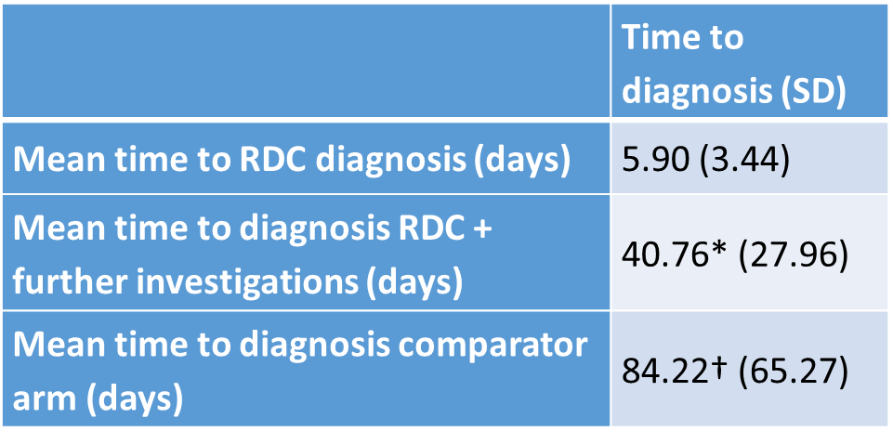
Economic Evaluation
‘The RDC addresses an unmet need and provides excellent value for money.’
Mean time between GP referral (to RDC or USC downgrade) and diagnosis was considerably reduced in the RDC group:

Slide 67
Results – Budget Impact
If the RDC was run at full capacity (5 patients per clinic) for one year, it would be £84,482 less expensive compared to USC downgrade.
Parameter | Cost with RDC | Cost without RDC (usual care) | Budget impact
Current provision (mean 4 patients per clinic) | £367,442.81 | £382,231.22 | -£14,788.41
Full capacity (5 patients per clinic) | £393,307.52 | £477,789.03 | -£84,481.51

Slide 68
Summary
While the RDC requires higher bulk investment compared to the conventional stepwise diagnosis approach, healthcare and investigative costs, especially for patients with an eventual cancer diagnosis, are considerably lower overall.
Waiting times until diagnosis are significantly reduced from a mean 84 days for comparator patients to 6 days for patients diagnosed during RDC and 40 days for patients requiring further investigations after their RDC appointment.
The cost-effectiveness of the RDC pathway to diagnosis depends on the number of patients being seen during each half-day clinic.

Slide 69
Comparison to initial evaluation
RDC implementation costs have decreased from £2,357.00 to £2,203.60 per clinic.
1.98% more patients have been diagnosed in clinic instead of being referred to further investigations.
The RDC is now cost-effective at a capacity of 3 patients and dominates usual care with 4 patients or more.
Overall, the RDC was less costly and more effective than usual care between June 2017 and December 2019 running at 4.13 patients per clinic.

Slide 70
Changes in Pathway due to COVID-19
Unfortunately due to COVID-19, the RDC had to close for a month due to all staff being redeployed. When clinic was reinstated the following changes had to be made.
Short term relocation of clinic – to OPD from Afan Nedd
Staggered approach to patient arrival – further work undertaken to streamline patients
Remote MDTs via Team
Remote signoff of Radiology requests
Change to Set A – no CXR’s to reduce footfall
No endoscopy list
Results given over the phone
Availability of follow up appointments for face-to-face results

Slide 71
References
Sewell B, Jones M, Fitzsimmons D (2018): Economic evaluation of the Swansea Bay University Health Board Rapid Diagnosis Centre. Swansea Centre for Health Economics, Swansea.
Sewell B, Jones M, Gray H, Wilkes H, Lloyd-Bennett C, Beddow K, Bevan M, Fitzsimmons D. (2020): Rapid cancer diagnosis for patients with vague symptoms: a cost-effectiveness study. Br J Gen Pract. doi: 10.3399/bjgp20X708077. [Epub ahead of print]

Slide 72

Any questions?
This Photo by Unknown Author is licensed under CC BY-SA

Slide 73
Final Summary

Slide 74

Non-specific Rapid
Diagnostic Service, and links into other services
Sarah Griffiths, Early Diagnosis Project Manager
Cheshire & Merseyside Cancer Alliance

Slide 75
Cheshire and Merseyside Cancer Alliance
Cheshire and Merseyside Cancer Alliance
Geographical Set Up
  - Population of 2.3 million
  - 9 District General Hospitals
  - Covered by 1 STP
RDS Core Team (as of July 2020)
  - 2 Senior Programme Managers
  - 2 Senior Pathways Managers
  - 1 Project Manager
  - Admin support

Slide 76
Background
Background
Utilisation of the National Cancer Transformation Fund in 2016
Developed a ‘Vague Symptom’ Service
  Patient symptom referral criteria
  Primary Care investigations prior to referral
  Primary Care referral form
  Agreed minimum dataset

Slide 77
Background
Background
Between April 2018 – May 2019 649 referrals
With a 10% conversion rate of cancer diagnosed**
8 Pilot Sites
  2 Single sites
  3 Joint models
Supported by:
  4 Clinical Nurse Specialist
  4 Support Workers
  Clinical Leads
Lessons Learnt
** The service wasn’t available to all GP Practices and Trusts started at different times

Slide 78
Rapid Diagnostic Centres
Rapid Diagnostic Centres
3 of the ‘Vague Symptom Sites’ transitioned into Non Specific Rapid Diagnostic Services (NSRDS)
Work is underway on establishing NSRDS within the other sites
How do we combat small referral numbers?
Developing other referral opportunities
and Primary Care Education

Slide 79
Non Specific Rapid Diagnostic Service – Primary Care
Non-specific Rapid Diagnostic Service – Primary Care
PLT
GP Bulletin
Practice Managers Meetings
Feedback to Primary Care
Information page on the CCG Intranet

Slide 80
Non Specific Rapid Diagnostic Service – Secondary Care
Non-specific Rapid Diagnostic Service- Secondary Care
Ambulatory Care
Malignancy of Unknown Origin
A&E
Radiology
Site Specific Areas
Upper GI

Slide 81
Non Specific Rapid Diagnostic Service – Upper GI
Non-specific Rapid Diagnostic Service – Upper GI
Upper GI 2WK Referral
Upper GI Referral Triage
Symptoms not consistent with NG 12
Symptoms consistent with NG 12
DRAFT - Initial Thoughts
Refer to NS Team for further investigation
Follow Optimal Pathway (STRT etc.)
Negative scope – symptomatic consistent with NS RDS referral criteria

Slide 82
Next Steps
Next steps
Establishing Task and Finish Groups
Developing local pathway
Aim to have diverted referrals from Upper GI to the NSRDS by January 2021

Slide 83
Any questions?
This Photo by Unknown Author is licensed under CC BY

Slide 84
Final Summary

Slide 85
Timetable:

Slide 86
A blueprint for community diagnostic hubs
Nicola Gowen, Project Manager
SWAG Cancer Alliance

Slide 87
Community Diagnostic Hubs (CDH)
Richards Review of Diagnostic Capacity: Recommends CDH as part of New Service Model for Diagnostics
Acute (A&E, same day emergency care and inpatient) and elective (GP and outpatient referrals) diagnostics should be separated wherever possible
Recognises:
Pre COVID-19: Diagnostic demand increasing and outstripped supply
IPC requirements COVID-19 reduced capacity
Need:
Increased equipment, facilities and workforce
Further efficiency improvements
CDH: Aims
Broad range of elective diagnostic services outside Acute provision
Utilise non traditional locations
Support equity of access
Improve outcomes; wait times, patient experience, productivity
Deliver a capacity deficit of less than 10% compared to an average of at least 30% in non-COVID minimal environments

Slide 88
CDH Services
Criteria for deciding on services to be located in a CDH will include:
The need to provide safe, COVID-minimal facilities and to maximise throughput.
Convenience and accessibility for patients.
Services for which demand is outstripping capacity.
Symptomatic presentations that may need multiple diagnostics, which can safely be undertaken off the acute site.
Scale of services needed to provide safely efficient diagnostics and ongoing monitoring.
Core Services:
Imaging: CT, MRI, ultrasound, plain X-ray
Cardio-respiratory: echocardiography, ECG and rhythm monitoring, spirometry and some lung function tests, support for sleep studies, blood pressure monitoring, oximetry, blood gas analysis
Pathology: phlebotomy
Endoscopy: facilities are undoubtedly needed though better delivered at scale and may therefore only be provided in some CDHs, or as standalone facilities.
Consulting and reporting rooms.
Additional services may include:
Mammography
Ophthalmology
DEXA scan
Antenatal screening
Hysteroscopy and colposcopy
Cystoscopy
Urodynamics
Audiology
Fibroscan

Slide 89
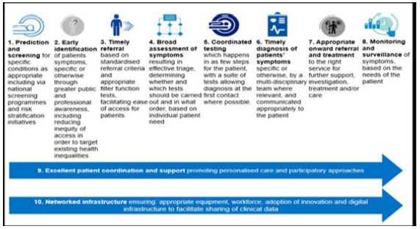
CDH: Key components
Service models could for example, deliver:
Dermatology
Dermatoscopic images support PC and tele pathways
Urology clinics
Haematuria / raised PSA
Screening
Mammography
Colposcopy
Colonoscopy
Gynaecological investigations (colposcopy)
Bundled pathway diagnostics
Out of scope: complex endoscopies / MR / CT
GA diagnostic procedures

Slide 90

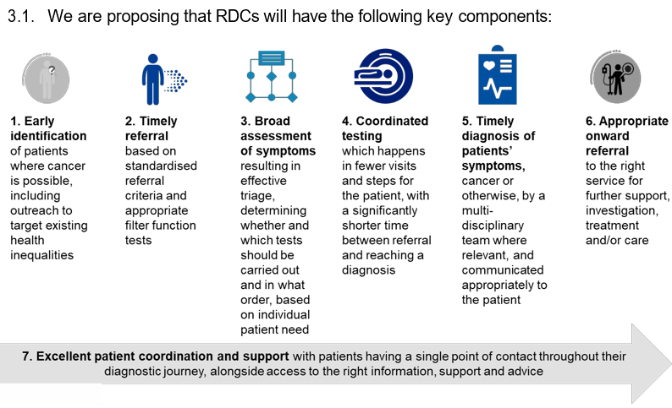
Alignment with Rapid Diagnostic Centres
  Cancer Alliance plans include delivery of the RDC service model for the management of all cancer pathways by 2023/24, this requires a clear relationship between RDCs and CDHs.
  CDHs will need to be aligned with the delivery of RDCs.
  For patients with suspected cancer, the CDHs should incorporate the RDC service model as set out in the RDC specification.
National Rapid Diagnostic Centre Key Components

Slide 91
CDH: Features
  Location
  Closer to home
  Sited away from acute hospitals, with public transport links and car parking
Opportunity to co-locate with primary care teams
Improve equity of access
  Sites will need to be suitable for equipment and safety
Inspection and accreditation
CQC registration and inspection and should meet accreditation standards as set out for each diagnostic service.
Safety/IPC
Rapid COVID testing required each site. Mandated IPC measures will need to be in place:
Workforce
Staffed in line with core workforce requirements with regular access to other key clinical specialists.
The workforce work in rotation across the CDH and acute sites
Critical mass of staffing to undertake procedures should be considered when determining safety.
The layout should support efficient utilisation of the workforce.
Improve the offer to staff with new roles providing development opportunities, flexibility, teaching and training and a chance to work in innovative ways.
Integrated care/IT interoperability and connectivity
Wherever possible CDHs should be integrated with NHS IT systems (e.g. EPR, PACS/RIS, LIMS, Order Comms). The infrastructure will need to support system wide escalation pathways.
Performance and quality measures
Expected to meet existing diagnostic services performance and quality standards
Risk management
CDHs working with multiple organisations require robust risk management.

Slide 92
CDH: Referral criteria: Elective Diagnostics
Informed by the use of decision support tools
Referred by primary or secondary care
Advice and guidance
Triage based investigation decision
Bookings should be by appointment, where possible providing patient’s choice.
Right test(s), first time, where possible on the same day
  Integrated symptom-based pathways to diagnosis agreed underpinned by IT connectivity.
  Patients pre-appointment info completed and provided prior to their appointment
Requesting clinicians should have access to advice on the interpretation of results
Diagnostic report visibility to MDT

Slide 93
Approach to Implementation
  Three CDHs per million population
  Initially hosted by acute providers.
  June 2020 - March 2021, systems should maximise use of existing diagnostic facilities on ‘cold’ NHS sites and the Independent Sector.
September 2020, develop long-term plans for the sustainable development of CDHs for implementation from April 2021.
National support
Overall development and shared learning
CDH implementation, governance and quality assurance
Resource requirements – workforce and equipment
Success criteria evaluation
Training and development
Research, innovation and digital requirements
Wider diagnostic transformation
Alignment with other programmes such as outpatients transformation
Communication and engagement

Slide 94
Any questions?
This Photo by Unknown Author is licensed under CC BY-SA

Slide 95
Final Summary

Slide 96
Non site specific RDS route to diagnosis’
SWAG Rural RDS Pilot
Dr Zoe Oliver, RDS Clinician Devizes PCN

Slide 97
Devizes Rapid Diagnostic Service
Once Weekly Clinic GP + ‘Clinical Navigator’
3 new referrals + 3 follow up’s (pre-COVID)
GP’s refer with Ardens Form on System One
Investigations BEFORE being seen – CXR, Filter function bloods
All urgent investigations/referrals seen at Bath
Direct access to CT imaging and MDT
Follow-up 1 week later

Slide 98
Referral Outcomes
Referral Outcomes
12 Referrals
11 CT
2 Cancer
2 Other
5 FIT
5 Normal
1 No Investigation
Other

Slide 99
Diagnoses
2 Cancers
  1 Head and Neck (metastatic – started as CUP)
  1 Haematological
Heart Failure (clinical diagnosis)
Vasculitis (diagnosed on CT)
Lung indeterminate – now under respiratory

Slide 100
Appropriate Referrals
All appropriate - filter function tests and triage makes this the case.
Cancers
  Head & Neck/CUP may have gone through ENT or GP ordered CT scan – so although diagnosed at late stage, was still faster than non RDS route
  Lymphoma – had been rejected by haematology and referring GP struggled to get her seen. She was elderly and didn’t want treatment.

Slide 101
COVID Challenges
Reduced numbers
Staggered virtual consult followed by F2F examination
Reduced access to community CXR and CT at RUH
Delayed follow up as a result

Slide 102
Any questions?
This Photo by Unknown Author is licensed under CC BY

Slide 103
Referral Criteria – Appendix 1
Essential |  | There is no other urgent referral pathway suitable for this clinical scenario
Essential Tick all that still apply after primary care assessment |  | Unexplained Weight Loss | Kg loss Duration | ___ kg __weeks
 |  | Patient Reported Severe unexplained fatigue | TSH (within 1m) | ______ miu/L
 |  | Persistent nausea or appetite loss
 |  | New atypical pain (eg. diffuse abdominal pain or bone pain) | Site?
 |  | Unexplained laboratory test findings (eg. anaemia, thrombocytosis, hypercalcemia) | Please specify
 |  | Ongoing symptoms despite one negative 2ww referral | Site?
 |  | GP Clinical Suspicion of cancer or serious disease / GP “gut feeling”

Slide 104
Final Summary

Slide 105
RDC’s –
Experiences of care
Campbell McNeill, Project Manager, National Cancer Team

Slide 106
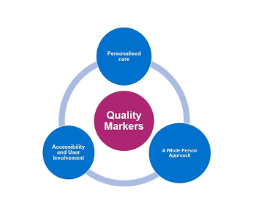

The Experience of Care
Campbell.McNeill@nhs.net

Slide 107
Development Timeline
March 2020 – QMs / 32 ideas and 8 assessment questions developed and approved
June 2020 – QM approach redefined for the response to the pandemic
July 2020 - 9 ideas from the QM processes included in the Urgent Cancer Diagnostic Services Guidance
August 2020 – Experience of Care Hub developed in the Futures Platform to support sharing, learning and collaboration on how these ideas ( and others) can support the Experience of care on the RDC pathway

Slide 108
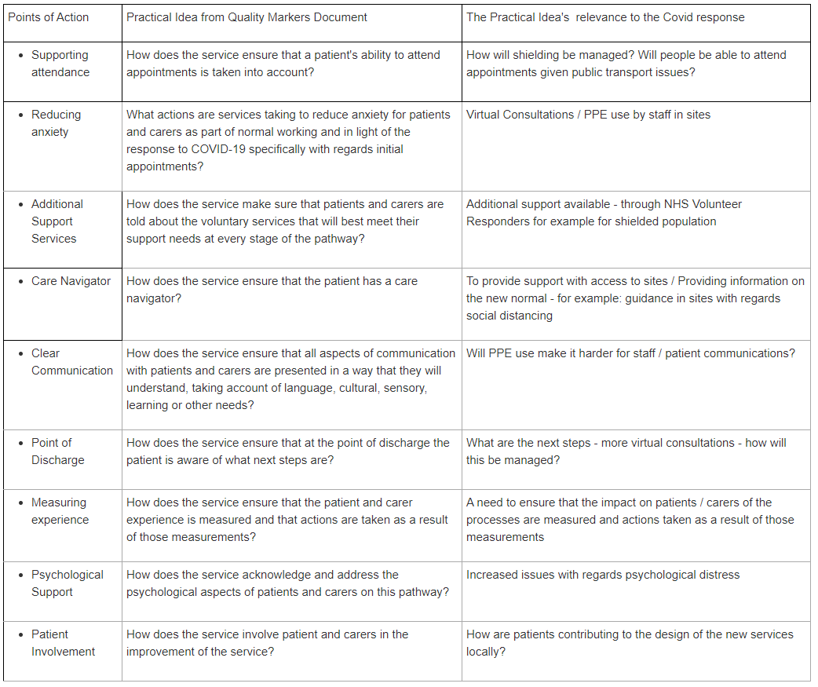
Experience of care – Points of Action

Slide 109
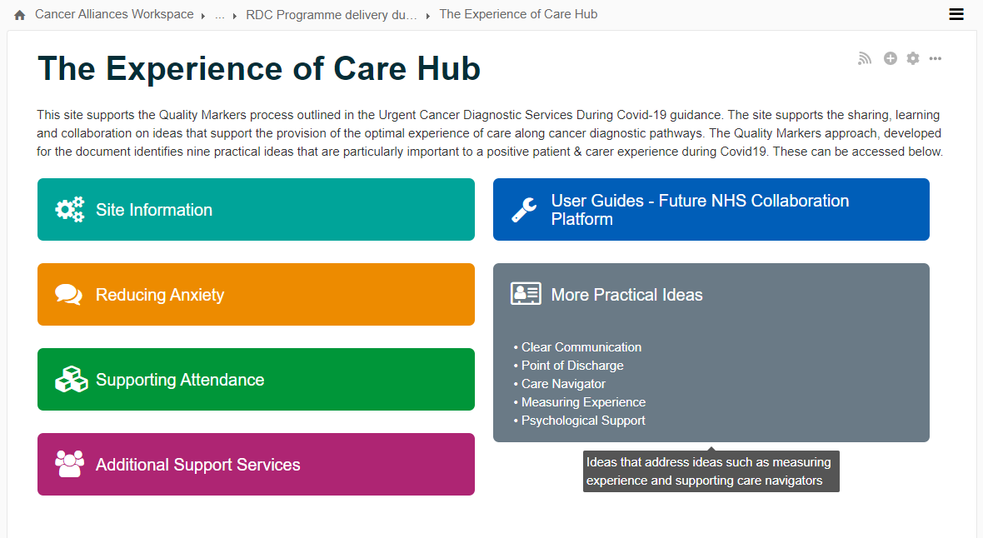
Future NHS Collaboration Platform
https://future.nhs.uk/connect.ti/canc/view?objectId=21044496

Slide 110
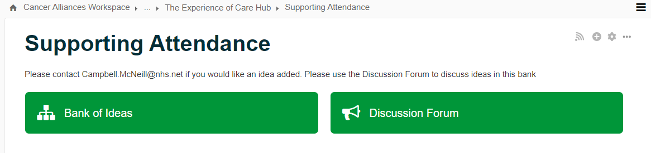
Banks of Ideas / Discussion

Slide 111
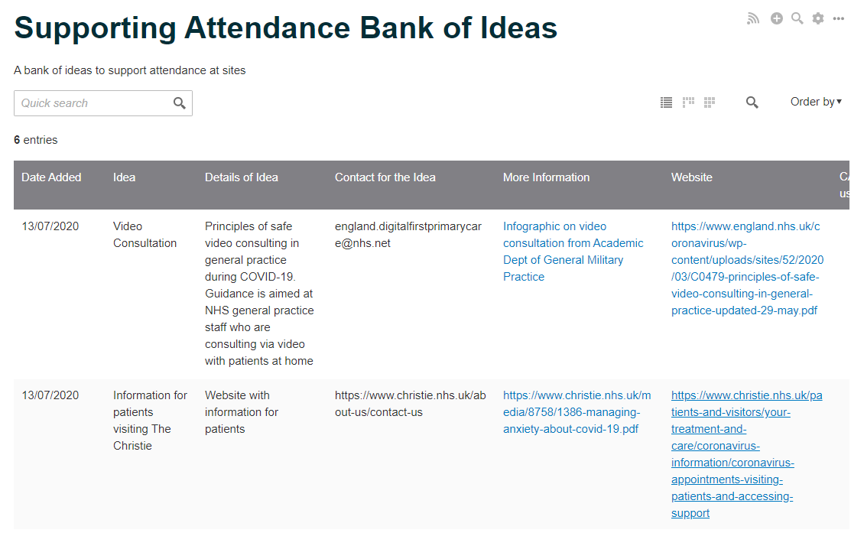
Sharing Ideas

Slide 112
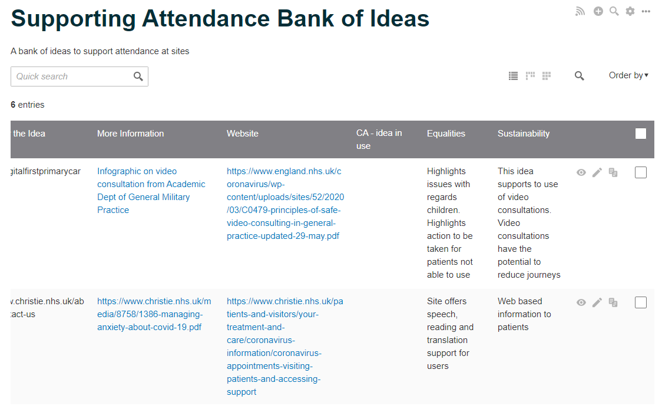
Equalities and Sustainability
Notes:
David McN to welcome delegates, cover house keeping and deliver introductions

Slide 113
Next Steps
Contact with Cancer Alliances to discuss the Hub
Sharing Learning and Collaboration on ideas

Slide 114
Any questions?
This Photo by Unknown Author is licensed under CC BY-SA

Slide 115
Final Summary

Slide 116
SWAG Rural RDS Pilot
Dr Dan Perkin, RDS Clinician Mendip PCN
Presented by – Dr Amelia Randle, SWAG Cancer Alliance

Slide 117

Mendip PCN
5 practices
~ 35k patients
1 session / week (pre COVID)
Open to patients from all practices
All seen by leading clinician

Slide 118

Patient 1
83 Year Old Male
Referred 06/01/2020
Triaged 07/01/2020
Seen 14/01/2020
Main sx diarrhoea and fatigue / SOB
Hx of cardiac arrest and subsequent HF
Little on filter function tests

Slide 119
Patient 1
Bowels longer standing
Sx mainly since arrest
Imaging not arranged
Faecal elastase and FIT normal
Symptoms thought to relate to HF and system effects of arrest. Improved on optimised HF treatment

Slide 120

Patient 2
74 Year Old Female
Referred 23/01/2020
Triaged 23/01/2020
Seen 28/01/2020
Symptoms of fatigue and weight loss
Onset May 2019

Slide 121
Patient 2
Hx of viral encephalitis with prolonged admission
On Keppra since
Sx onset from then
Additional lx myeloma screen, pro-BNP, coeliac screen, haematinics
Non cancer Dx, due to recovery of significant illness

Slide 122
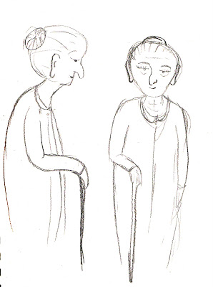
Patient 3
70 Year Old Female
Referred 23/01/2020
Triaged 23/01/2020
Seen 28/01/2020
Acute self-limiting UGI bleed in December / fatigue
Malaena and Hb drop-presented well after the event
No further
Hb came up and FIT negative

Slide 123
Patient 3
HRCT Chest (inflammatory changes on CXR) –
still awaited (non 2ww and cancelled initial appt)
d/w gastro cons connect-for OGD non 2ww
Healing GU being monitored

Slide 124

Patient 4
81 Year Old Female
Referred 27/01/2020
Triaged 28/01/2020
Seen 04/02/2020
Persistent nausea / vomiting / diarrhoea, weight loss, anorexia
Bloods arranged
CT C/A/P/colon + OGD as fastrack
Admitted same week with AKI

Slide 125
Patient 4
On d/c ix re-arranged
CT lung nodule, nil else, colon not done
UGI sx resolved so endoscopy request not re-initiated
CT colon with nodule follow up – rectal thickening
Nil on sigmoidoscopy (July 2020)
Non cancer Dx (likely all resp infection with resolution)

Slide 126

Patient 5
69 Year Old Female
Referred 07/02/2020
Triaged 10/02/2020
Seen 11/02/2020
Abdominal pain, anorexia and weight loss
No filter function bloods
Done when seen
CT C/A/P

Slide 127
Patient 5
Likely colon cancer on CT 14/02/2020
d/w own surgery re: 2ww lower GI referral
Admitted RUH acutely 01/03/2020 with large bowel obstruction
Cancer diagnosis (colon)

Slide 128

Patient 6
69 Year Old Female
Referred 17/02/2020
Triaged 17/02/2020
Seen 18/02/2020
Cough, anorexia, nausea, weight loss
Background hx bronchiectasis
CT 21/2 collapse consolidation, infective changes
Prolonged abx and resp involvement

Slide 129

Patient 7
71 Year Old Female
Referred 09/03/2020
Triaged 09/03/2020
Seen 10/03/2020
Abdominal pain, nausea, anorexia
CT C/A/P and endoscopy 2ww
CT nil of concern
OGD didn’t happen ?due to C-19.
Ultimately, OGD as in-patient at RUH 15/06/20
showed gastric cancer

Slide 130
Summary
7 patients
2 with cancer
Both presented late
Both admitted with acute crisis
1 of which may have been prevented, had COVID-19 not
interrupted the referral process

Slide 131
Summary of Presentations
Dr Amelia Randle, Clinical Director, SWAG Cancer Alliance

Slide 132
SWAG Upcoming Events - Calendar
Date | Time | Event | Platform
Wednesday 09 September | 1pm – 2pm | FIT <10 Testing Pathway Webinar | MS Teams Meeting
Wednesday 16 September | 1pm – 2pm | PCN Cancer Early Diagnosis DES: Reviewing referral practice for suspected cancers, including recurrent cancers | MS Teams
Thursday 17 September | 1pm – 2pm | FIT <10 Testing Pathway Webinar | MS Teams Meeting
Wednesday 23 September | 1pm – 2pm | PCN Cancer Early Diagnosis DES: Improving local uptake of National Cancer Screening Programmes | MS Teams
Wednesday 30 September | 1pm – 2pm | PCN Cancer Early Diagnosis DES: Establishing a community of practice between practice-level clinical staff, to support delivery of the PCN DES requirements | MS Teams
Expressions of interest to attend any of our events should be sent to: England.swagca@nhs.net

Slide 133
Closing thoughts
Dr Amelia Randle, Clinical Director, SWAG Cancer Alliance
Many thanks for joining us today, if you have any further questions
or wish to get in touch about this or any future webinars we are running, please contact us:
England.SWAGCA@nhs.net

