Slide 1
SWAG Cancer Network Meeting 23 May 2018
1. Network pathology comparison between sites for use of cancer datasets, sentinel node work and BRAF testing
2. Rising incidence of SCC & KA with future trends
3. KA reporting differences & proposed KA study
Dr Paul Craig
Histopathology, Gloucesterhire Hospitals NHSFT

Slide 2
SWAG Skin Cancer Network pathology comparison between sites for use of cancer datasets
 | Bath | Bristol | Glos | Taunton | Weston | Yeovil
RCPath melanoma dataset used? | Y | Y | Y | Y | Y
RCPath melanoma in situ dataset? | Y | Y | N | N | Y
RCPath SCC dataset used? | Y | Y | Y | N | Y
RCPath SCC dataset for non-excisions (punch, curettage etc)? | N | N | Y | N | N
RCPath BCC dataset used? | Y | Y | N | N | Y
RCPath BCC dataset for non-excisions (punch, curettage etc)? | N | N | Y | N | N
RCPath dataset for adnexal carcinoma? | N | Y | Y | Y | Y
RCPath dataset for Merkel cell carcinoma? | N | Y | Y | Y | Y

Slide 3
SWAG Skin Cancer Network pathology comparison between sites for use of BRAF testing
 | Bath | Bristol | Glos | Taunton | Wescton | Yeovil
Do you test melanoma for BRAF mutation status reflexly for all primary melanoma? reflexly for all pT4b melanoma? Following MDTM or oncology request? | b | b | c | c | c
Do you use PCR/Cobas test for all melanoma BRAF testing? Use immunohistochemistry for BRAF V600E and then only send negative cases for PCR/Cobas test | a | a | a | a | a

Slide 4
SWAG Skin Cancer Network pathology comparison between sites for melanoma sentinel node work
 | Bath | Bristol | Glos | Taunton | Weston | Yeovil
Do you report sentinel lymph node biopsy for melanomas? | N | Y | Y | N | N
Do you use EORTC protocol as suggested by RCPath or a modified protocol? |  | Modified | EORTC

Slide 5
Melanoma focus meeting
Cambridge 18 May 18
Consensus from melanoma surgeons, dermatologists, pathologists etc. following MSLT2:
Completion lymphadenectomy no longer appropriate following positive sentinel lymph node biopsy

Slide 6
PUBLIC HEALTH ENGLAND DATA 2016
BASED ON HISTOPATHOLOGY REPORTS RECORDED BY CANCER REGISTRIES
& DATA FROM GLOUCESTERSHIRE HISTOPATHOLOGY REPORTS
In 2016, in the UK population of over 64 million
there were over 210,000 new non-melanoma (keratinocyte) skin cancers (KC)
including over 45,000 primary cutaneous squamous cell carcinomas (cSCC)
remaining 165,000 mainly basal cell carcinomas but these are under-recorded, and only the first is recorded & often multiple per patient!
1,700 patients with definite metastatic primary cutaneous SCC

Slide 7
UK wide data. Courtesy Brian Diffey; presented at 3 Counties Skin Cancer Network Meeting 2011

Slide 8
OFFICE FOR NATIONAL STATISTICS DATA (VIA 2011 CENSUS DATA)
Demographics of Gloucestershire:
95.4% white ethnicity (unlike major cities) & 4.6% from Black and ethnic minority backgrounds (2011 Census)
The dominating feature of ONS population projections for 2014 to 2039 in Glos is the sharp increase in population in the age group 65 or over, which is projected to increase from 123,800 in 2014 to 206,300 in 2039 (an increase of 66.6%).
This increase is sharper than the national trend for England and Wales and means that by 2039, the proportion of people in Gloucestershire in this age group will have risen to 28.9%.
Skin cancer affects almost exclusively skin type I&II patients (white ethnicity)

Slide 9
PUBLIC HEALTH ENGLAND DATA
BASED ON HISTOPATHOLOGY REPORTS RECORDED BY CANCER REGISTRIES
& DATA FROM GLOUCESTERSHIRE HISTOPATHOLOGY REPORTS
In Gloucestershire, from histopathology reports
2008 & 2009 Total cases of primary cutaneous squamous cell carcinomas and keratoacanthomas = 1070 (cSCC alone = 947)
2016 & 2017 Total cases of primary cutaneous squamous cell carcinomas and keratoacanthomas = 1505
(cSCC alone = 1252)
In 8 years an increase in 41% of SCC & KA
HELP! Huge resource requirement – needs to be planned for
SWAG cancer network could help by writing to chief executives etc?
Next SWAG meeting to address this (when NHS future clearer after 3 July)

Slide 10
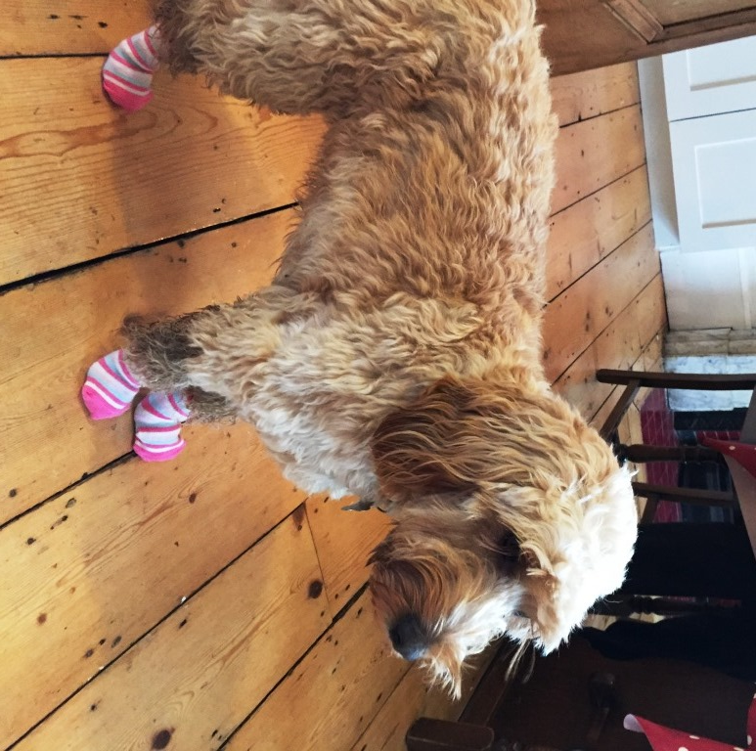

Slide 13
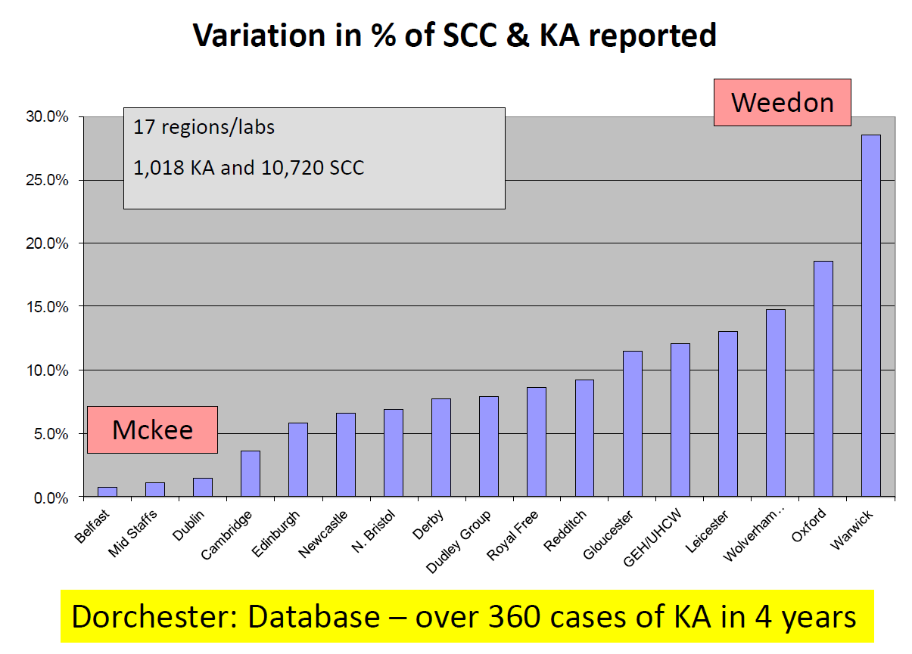

Slide 14
Pathological diagnosis by pathologist of KA and cSCC in 2 yrs to Sep 09
KA SCC KA/KA +SCC
Glos (KA=12%)
54 285 16%
26 202 11%
7 87 7%
10 122 8%
0 26
3 10
3 12
8 59
1 11
0 3
1 26
6 47
4 40
0 9
KA SCC KA/KA +SCC
N Bristol (KA=7%)
2 96 2%
6 137 4%
4 74 5%
3 109 3%
7 56 11%
10 49 17%
3 42
2 30
2 63
1 2
5 56
9 12
0 30
72
1 2

Slide 15
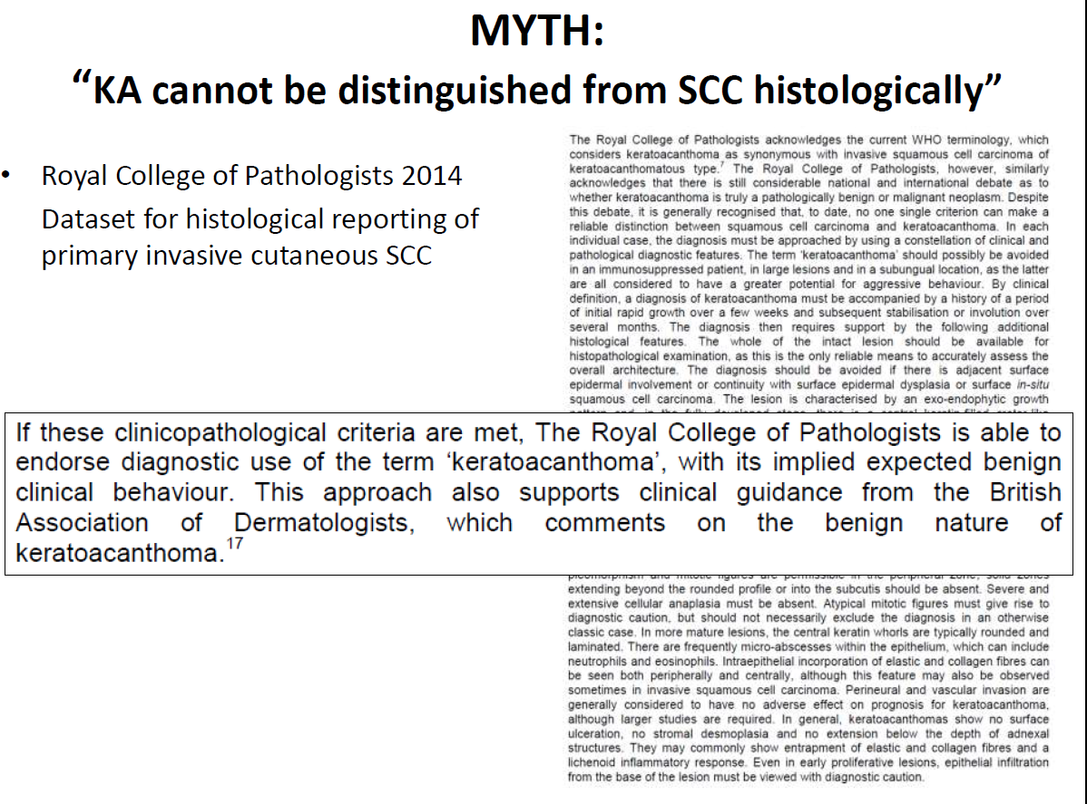

Slide 16
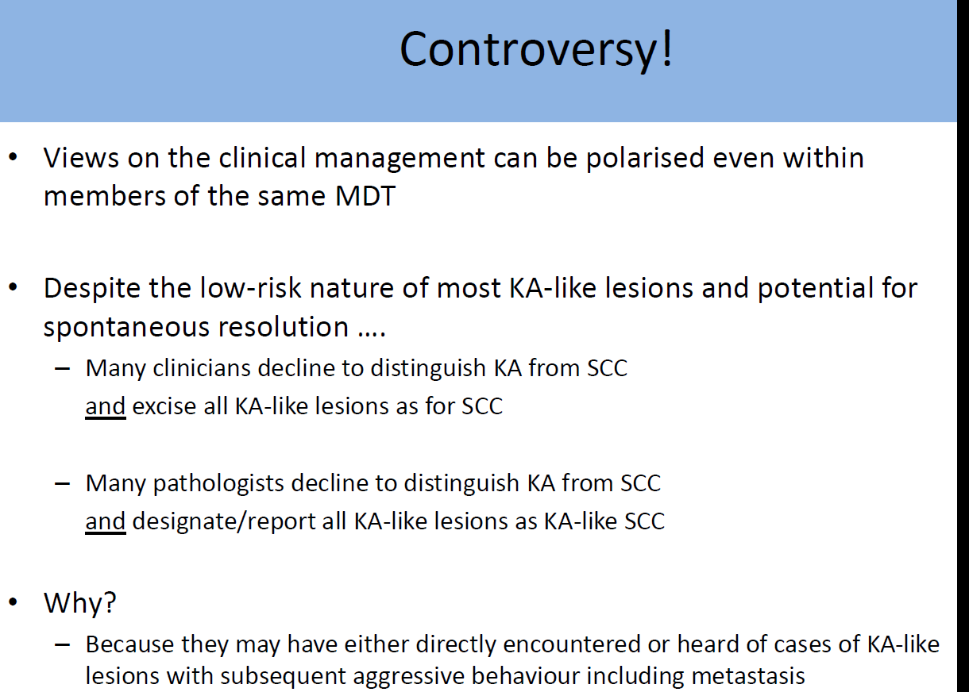

Slide 17
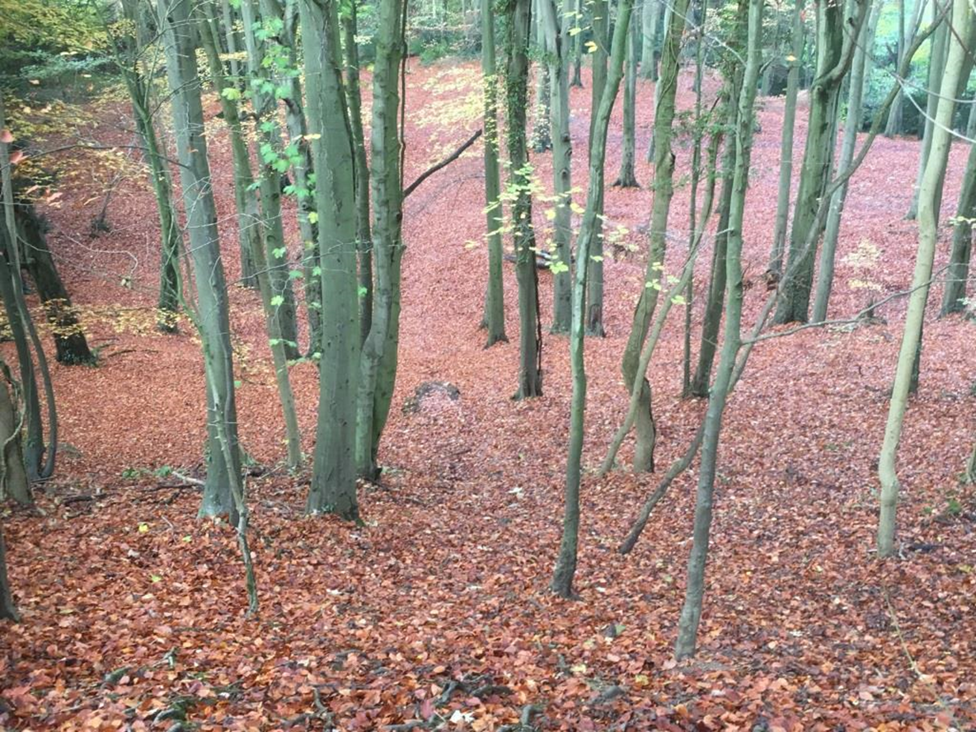
If interested email
Paul.craig2@nhs.net or
Saleem.taibjee@dchft.nhs.uk

