Slide 1
Prehabilitation Guidelines and WesFit Trial
Catherine Neck
Macmillan Cancer Rehabilitation/ LWBC Lead
SWAG Alliance

Slide 2
The Macmillan-RCoA-NIHR Expert Group on Prehabilitation before Cancer Therapy
Fit for and After Cancer Therapy (FACT)

Slide 3
Aims
The aims of the principles and guidance would be to change practice and behaviour to benefit patients by:
Influencing national, regional and local policy in relation to the delivery of care for those with cancer
Influencing the provision of care for those with cancer through guidance of care providers.
Educating patients, clinicians, academic colleagues, providers and policy makers

Slide 4
Background: partnership
Macmillan
RCoA
NIHR

Slide 5
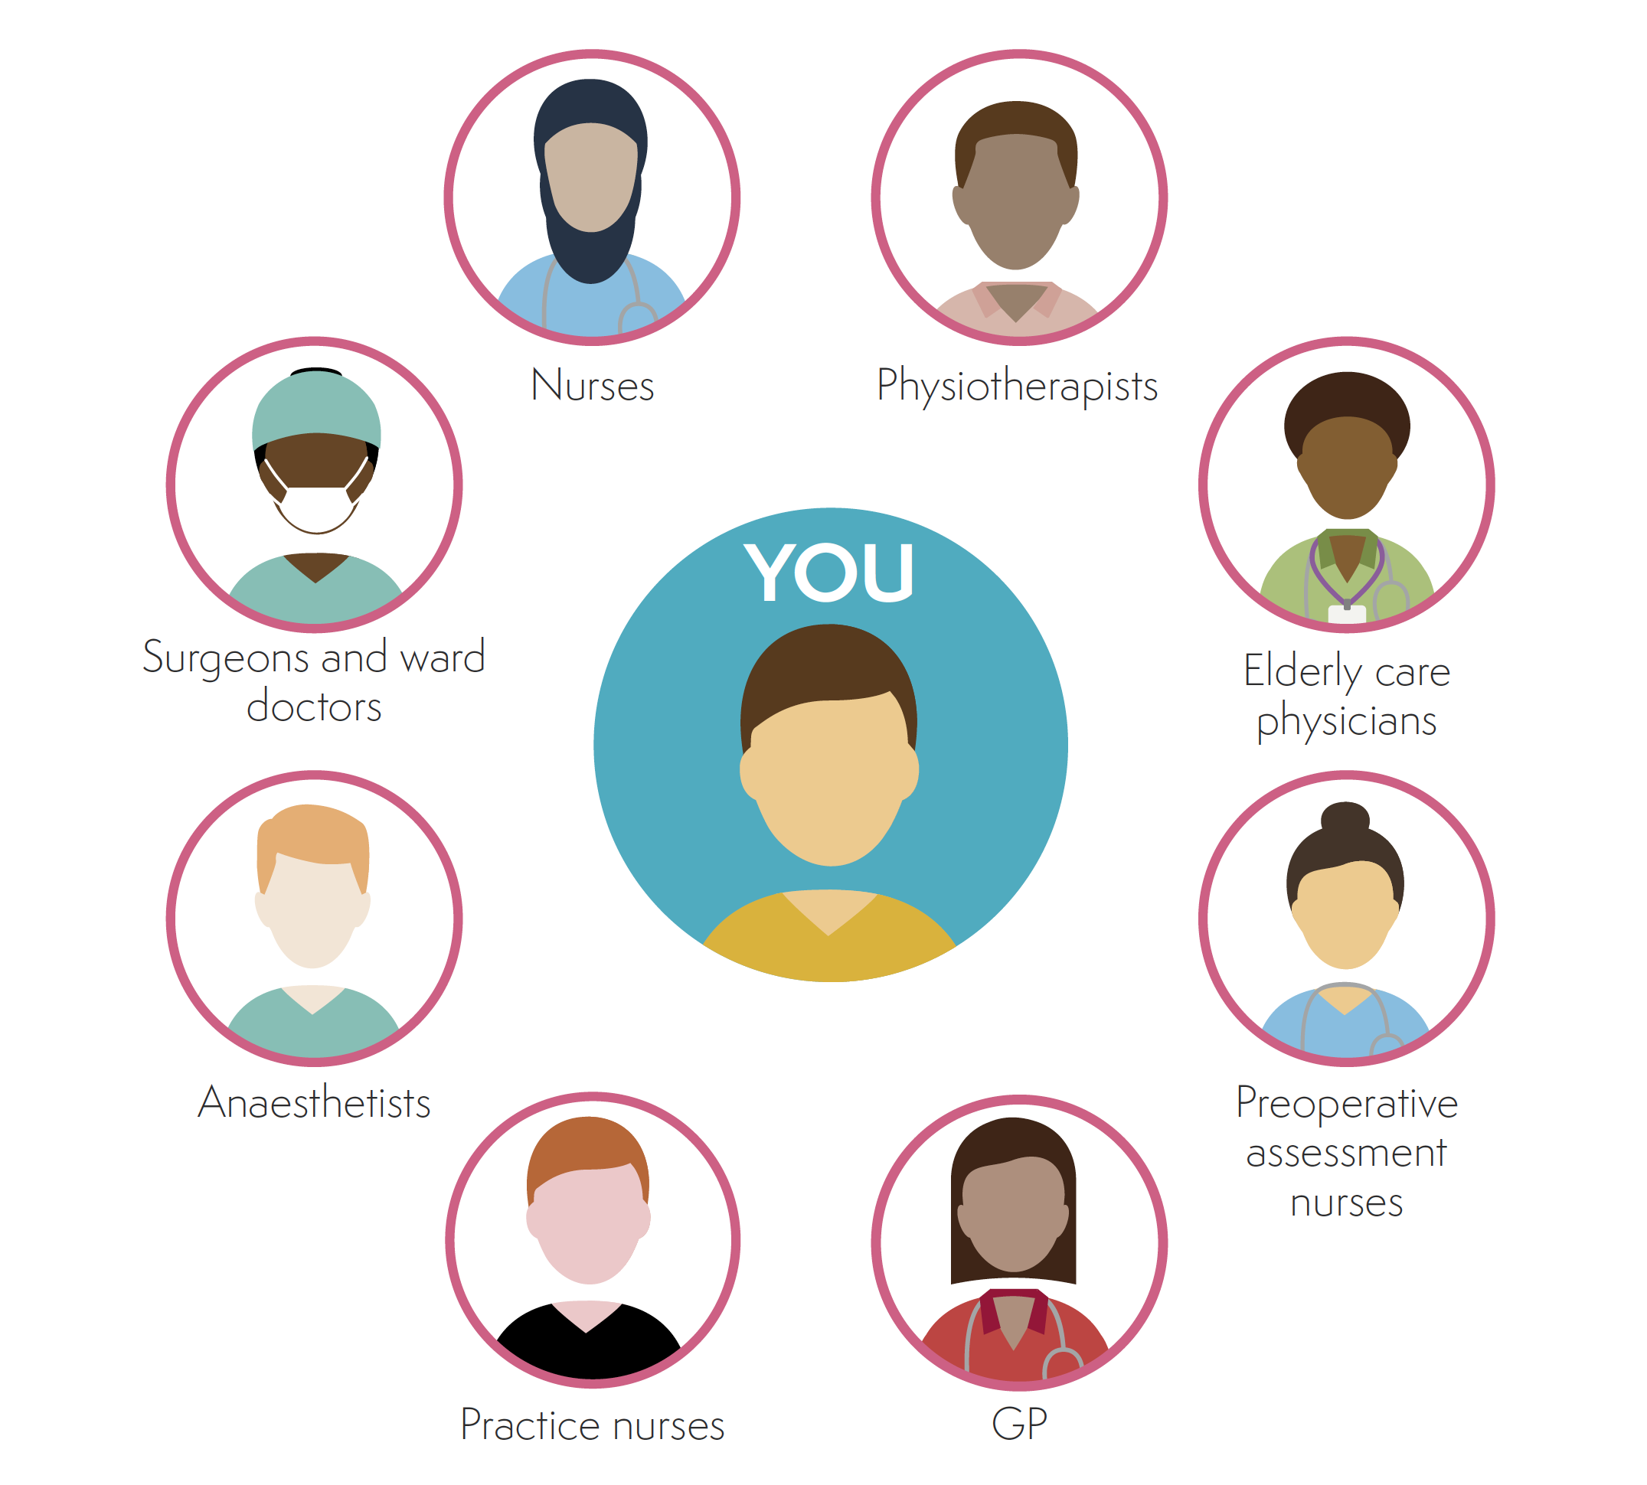
Background: partnership
Macmillan
RCoA
NIHR

Slide 6
Background
Macmillan
RCoA
NIHR

Slide 7
Background: progress
Expert groups:
Physical activity and exercise
Nutritional support
Psychological support and behavioural modification
Parallel work-streams
Evidence synthesis
Patients (PCIPIE)
Health economics

Slide 8
Expert Group: members
Chair & deputy (relevant delivery professional)
Oncologist
Surgeon
Anaesthetist
International guests
Relevant AHP
Lay/patient
Early career researcher

Slide 9
End Product
A suite of useful resources actively aimed at:
People with a cancer experience (including carers and loved ones)
Health professionals
Commissioners
The guidance will be applicable to those with any tumour type.

Slide 10
WesFit Trial
Wessex Fit for Cancer Surgery Trial
Exercise training with behaviour change support
Phase III pragmatic 2x2 factorial design randomised trial, assessing efficacy of implementation of a prehabilitation programme in patients undergoing cancer surgery
Patients undergoing intra-cavity elective major surgery; oesophageal, gastric, colorectal, thoracic and urology
Notes:
Exercise programme –structured response exercise training (SRETP)
Delivered by personal trainers (PT) with level 4 cancer and exercise rehab qualification. Exercise intensity is tailored to patient fitness. Interval training on a stationary bike 3x per week until surgery. Follow-up contact with PT 12 weeks after surgery
Psychological support
Weekly access to counselling and psychological support at local cancer information and support centres
All groups
Access to enhanced recovery package with health and wellbeing events held prior to surgery

Slide 11
WesFit Team
CI – Professor Sandy Jack
Mike Grocott
Malcolm West
Denny Levett
Judith Cave
Tim Underwood
Matt Hayes

Slide 13
Interest from other cancer centres across the South of England and Leicester to be involved in the study
Currently scoping interest from SWAG cancer surgical teams to be involved

