Slide 1



Heading to go here
The Poor Prognosis Letter Project
University Hospitals Bristol
Supportive and Palliative Care Team

Slide 2
The Poor Prognosis Letter (PPL) journey
Problem
Process
Future

Slide 3

The problem
DOH 2008
Recognising the end of life
Communication
Patient choice
ACP

Slide 4
Process
Specialty teams
(indicators of poor prognosis)
GP end of life leads
(information)
Palliative care team
IT
Patients

Slide 5
The Poor Prognosis Letter
  Top box – admission to hospital
  3. Prognostic criteria
  9. Patient’s understanding
  11. Preferences for future treatment

Slide 6
Notes:
This slide will go. I am going to print off and laminate a mock version of the letter

Slide 7
Notes:
This slide will go. I am going to print off and laminate a mock version of the letter

Slide 8
Notes:
This slide will go. I am going to print off and laminate a mock version of the letter

Slide 9
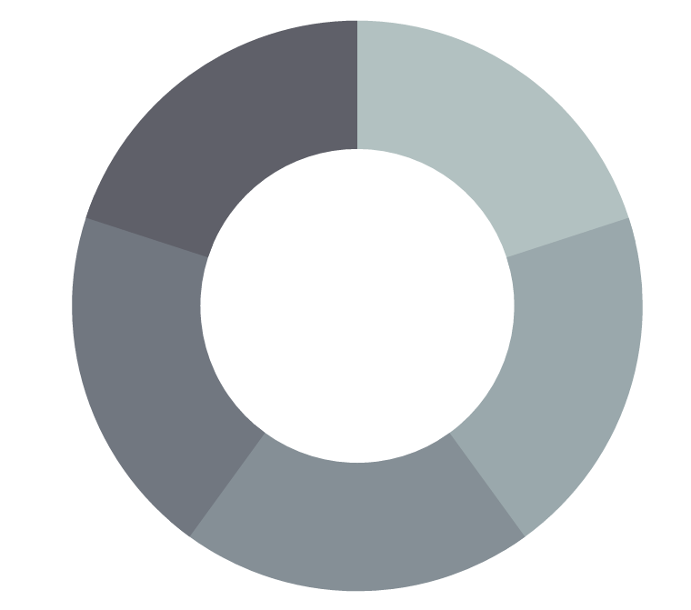
The opportunity
Improving
Communication
Quantifying
Impact
Improving the patient experience
Involving
GPs
DNs OOH
Changing culture

Slide 10
Embedding in UHBristol end of life care initiatives
Treatment Escalation Personalised Plans
DNACPR
PPL
PPL
Communication skills training
End of life CQUINs

Slide 11
Impact
National
Primary care - EPaCCS
Trust
Patient
1500

Slide 12
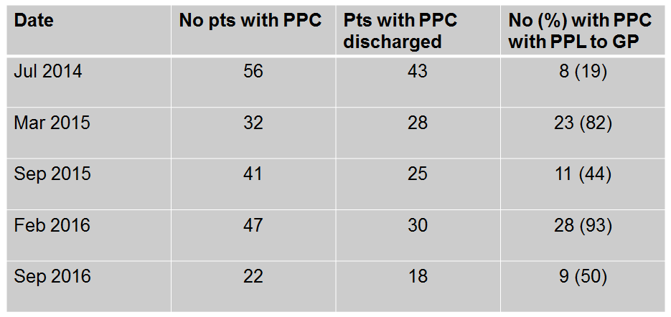
Data so far – poor prognosis letter audits

Slide 13
Audit of PPLs in general surgery
Retrospective audit of patients from 2015/16
26 patients had letters sent; all had died
All patients had been referred to community palliative care services
Prospective audit Sept-Nov 2016
16 patients identified as having a prognosis of less than 12 months
12/16 patients survived until discharge; 6 had PPLs sent to GP

Slide 14
Impact so far – examining a sample of PPLs
185 patients had a letter completed April – October 2015
All patients had died – median survival 31.5 days
68/185 (36%) patients died in hospital
  (Bristol CCG average = 46% currently)
13/24 GPs of patients who had PPLs sent October 2016 contacted successfully
  7 positive
  3 neutral
  3 ‘out of area’ GPs

Slide 15
Feedback from the GPs
“
”
Really good letter, really clear… makes a GP stop and think I need to do something.
Her son is forceful about what he wants done for his mother and the letter has helped with that.
Useful and thought provoking.
It’s a good initiative.
I sat down and spoke to the patient regarding his wishes…it made me think about what’s going on and what I need to do next.

Slide 16
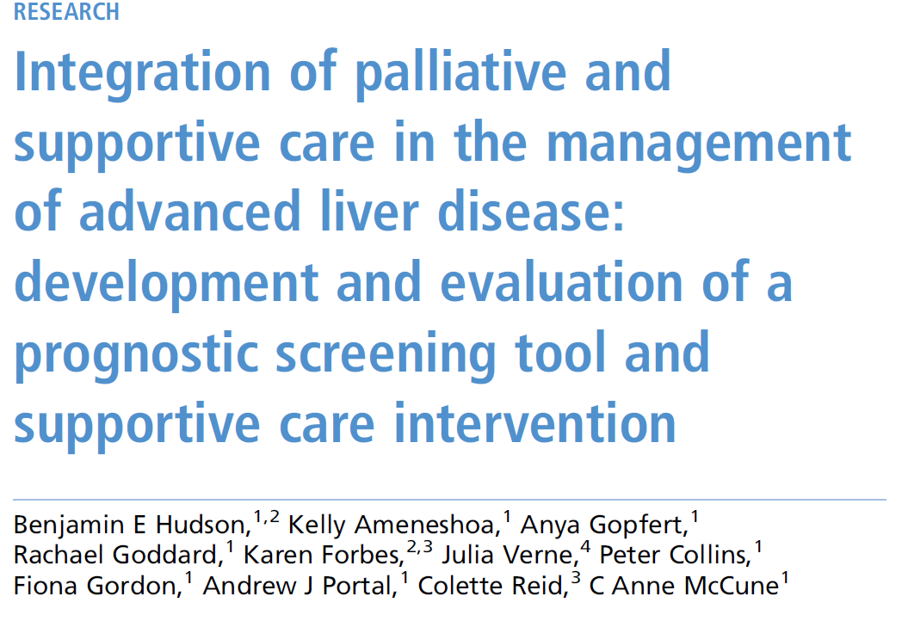
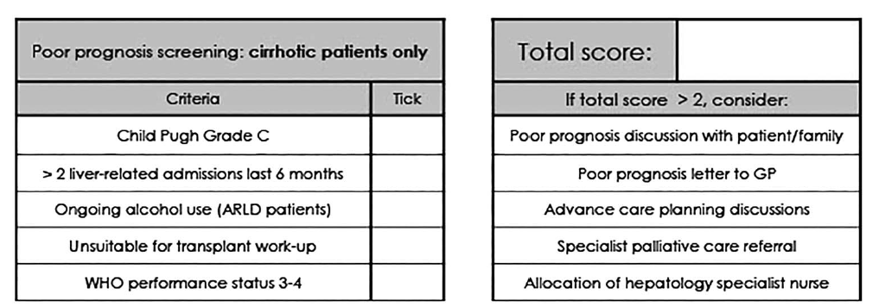
Hepatology
February 2017
BASL (British Association for the Study of the Liver) – meeting devoted to end of life care at King’s College Hospital
Hudson BE et al. Frontline Gastroenterology http://dx.doi.org/10.1136/flgastro-2016-100734
Notes:
This information will now be in slide 10, although I may add the reference (after I’ve tidied it up)

Slide 17
Challenges
Median survival only 31 days – prognostication still overcautious
Some teams remain resistant to identifying patients with poor prognosis

Slide 18
Aspirations for the future
Prospective database to allow us to monitor median survival and place of death
To shift the care of patients in the last year of life from the ‘technological imperative’ to a ‘good death imperative’

Slide 19
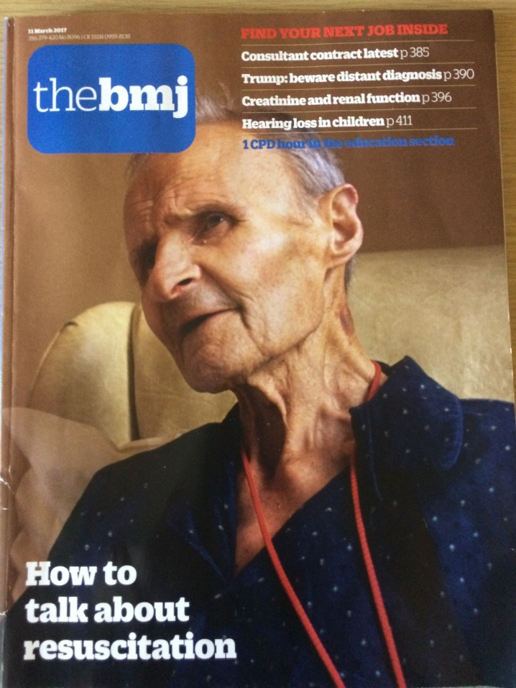
The vision

Slide 20
The vision
“I sat down and spoke to the patient regarding his wishes…”

Slide 21
What’s happened since May 4th 2017
  Loss of End of Life CQUIN – so no resources
  Numerous requests for the letter across the UK – Highlands, Bath, London
  Personal feedback from ITU consultant about a PPL being used to make a decision re ITU admission
  Teaching feedback from senior doctors about its usefulness in recognising the dying patient and shifting goals of care to end-of-life care

Slide 22
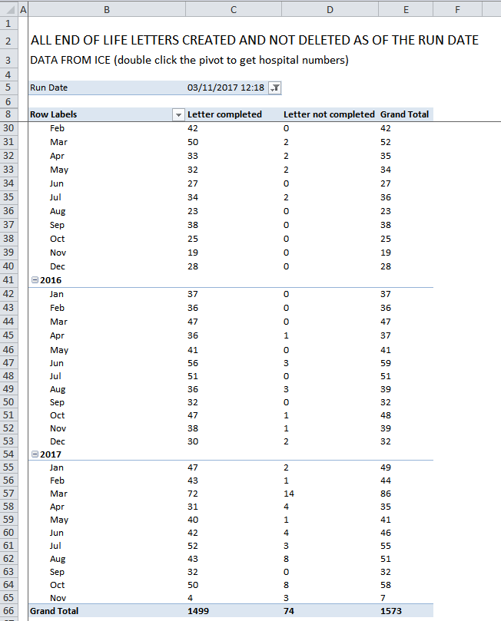

Slide 23
Lessons learnt
  Anything worth doing takes time and effort (the only place success comes before work is in the dictionary)
  Use junior medical colleagues as allies – they see everything and go everywhere
  Don’t give up

