Slide 1
POSNOC & ATNEC trials - update
Amit Goyal (Chief Investigator)
Consultant Oncoplastic Breast Surgeon & Associate Professor
Royal Derby Hospital, Derby, United Kingdom

Slide 2
POSNOC POsitive Sentinel NOde: adjuvant therapy alone versus adjuvant therapy plus Clearance or axillary radiotherapy
A randomised controlled trial of axillary treatment in women with early stage breast cancer who have metastases in one or two sentinel nodes
www.posnoc.co.uk
@POSNOC

Slide 3
POSNOC
Largest UK breast cancer surgical trial
1st UK led international breast cancer surgical trial
Notes:
The greatest achievement of the trial to date are
Supported by 19 AUZ recruiting sites

Slide 4
Trial design
Patients with T1-2 invasive breast cancer undergoing lumpectomy or mastectomy and sentinel node biopsy
1 or 2 Sentinel Node Macrometastases
Randomise (n=1900)
Systemic therapy alone
Systemic therapy plus axillary treatment
(axillary node clearance or axillary RT)
Breast or Chest wall RT, Systemic Therapy, Follow-up 5 years
Axillary recurrence, Arm morbidity, QoL, Survival

Slide 5
Inclusion Criteria
Women will be eligible for inclusion only if ALL of the following criteria apply:
18 years or older
T1 or T2
Unifocal or multi-focal invasive tumour
1 or 2 nodes with macrometastases
Fit for axillary treatment and adjuvant therapy

Slide 6
Exclusion Criteria
Women will be excluded if they have:
Bilateral invasive breast cancer
more than 2 nodes with macrometastases
neoadjuvant therapy for breast cancer except
if sentinel node biopsy performed prior to neoadjuvant therapy in women with early breast cancer
short duration of neoadjuvant endocrine therapy is acceptable (up to 3 months)
Previous ipsilateral axillary surgery
not receiving adjuvant systemic therapy
previous cancer less than 5 years previously or concomitant malignancy except
basal or squamous cell carcinoma of the skin
in situ carcinoma of the cervix
in situ melanoma
contra - or ipsilateral in situ breast cancer

Slide 7
POSNOC vs. Z11
 | Z11 | POSNOC
Size of metastases | micrometastasis or macrometastasis | macrometastasis
Macrometastases | 430 | 1700*
Extranodal invasion | x | √
Mastectomy | x | √
Radiotherapy quality assurance | x | √
Mandatory pre-op axillary ultrasound | x | √
Sentinel node biopsy before NACT | x | √
*POSNOC recruitment ongoing (sample size 1900)

Slide 8
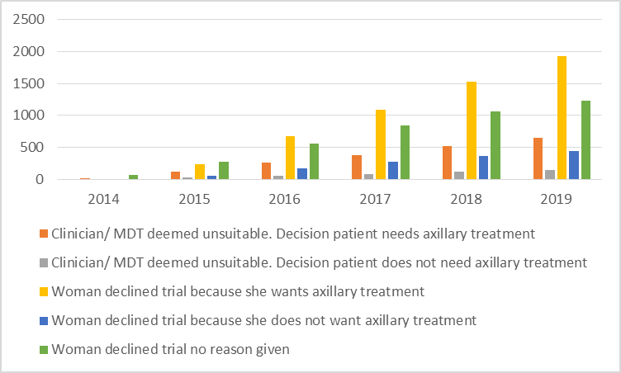
Reason for non-enrolment

Slide 9
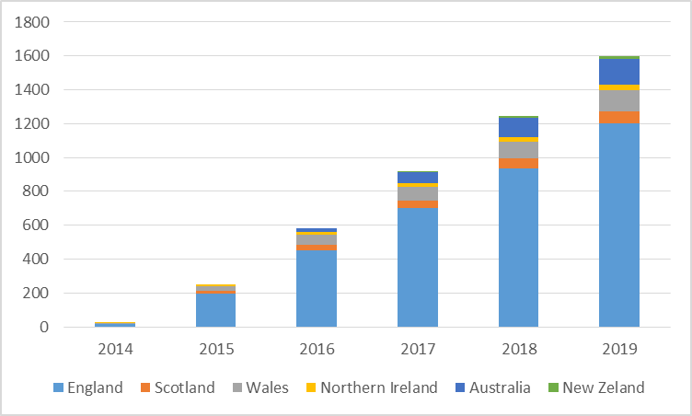
Recruitment

Slide 10
TOP 10
1 | Royal Derby Hospital | 93
2 | Wythenshawe Hospital | 39
3 | Southmead Hospital | 38
4 | Castle Hill Hospital | 36
5 | John Radcliffe Hospital | 35
6 | Belfast City Hospital | 34
7 | Aberdeen Royal Infirmary | 34
8 | Royal Melbourne Hospital | 34
9 | Royal Marsden Hospital | 33
10 | The Royal Sussex County Hospital | 31

Slide 11
ATNEC Axillary management in T1-3N1M0 breast cancer patients with needle biopsy proven nodal metastases at presentation after neoadjuvant chemotherapy
@ATNEC1

Slide 12
Largest UK neoadjuvant breast cancer surgical trial
1st UK led international neoadjuvant breast cancer surgical trial

Slide 13
Research Question
T1-3N1M0 who convert to no residual cancer in the lymph glands (ypN0) after NACT - omitting axillary treatment (removing all lymph glands in the armpit or radiotherapy to the armpit), is non-inferior (no worse) than axillary treatment

Slide 14
T1-3,N1,M0 early stage breast cancer with needle biopsy (fine needle aspiration or core biopsy) documented axillary node metastasis
ATNEC trial Axillary management in T1-3N1M0 breast cancer patients with needle biopsy proven nodal
metastases at presentation after neoadjuvant chemotherapy
Mark the axillary node proven to have cancer cells on needle biopsy
(using clip or carbon dye or seed – as per local practice)
NEOADJUVANT CHEMOTHERAPY (NACT)
Axillary ultrasound
Breast wide local excision or mastectomy + dual tracer sentinel node biopsy (at least 3 nodes removed – sentinel nodes + marked node)
Nodal metastasis
(ITCs, micro or macrometastases)
Eligible, consent and register
No nodal metastasis
Standard axillary treatment and follow-up
RANDOMISATION 1:1
ALND, axillary lymph node dissection
ART, axillary radiotherapy
Sample size – 1900, Follow up – 5 years
Co-primary outcomes – Disease free survival, Lymphoedema
Axillary treatment (n=950)
ALND or ART (as per local practice)
No Axillary treatment (n=950)

Slide 15
Study Design
Pragmatic randomised, multi-centre, international trial
Number of sites 100 (Target: 5 randomised per year/site)
Sample size = 1900
Timeline
Trial start date – 01 March 2020
Notes:
AMIT

Slide 16
Inclusion Criteria
Age ≥ 18
Male or female
T1-3N1M0 breast cancer at diagnosis (prior to NACT) by AJCC staging 7th edition
FNA or core biopsy confirmed axillary nodal metastases at presentation
Oestrogen receptor, progesterone receptor and HER2 status evaluated on primary tumour
Received standard NACT as per local guidelines
Ultrasound of the axilla at completion of NACT
Undergo dual tracer sentinel node biopsy after NACT and at least 3 nodes removed (sentinel nodes and marked node)
No nodal metastases post NACT (isolated tumour cells, micro or macrometastasis)

Slide 17
Exclusion Criteria
Bilateral invasive breast cancer
Sentinel node biopsy prior to NACT
Previous axillary surgery on the same body side as the scheduled targeted sampling
Previous cancer within 5 years or concomitant malignancy
Stratification
Institution
Type of breast surgery (wide local excision or mastectomy)
receptor status (triple negative, HER2+, ER/PR+ and HER2-)

Slide 18
Outcomes
Primary
Disease free survival
Lymphoedema (co-primary outcome)
Defined as ‘YES’ to arm swelling now and arm heaviness in past year (LBCQ questionnaire)
Secondary
Arm morbidity and quality of life (QuickDASH, EQ5D5L)
local (breast or chest wall) and regional (nodal) recurrence
distant metastasis, axillary recurrence free interval, overall survival
contralateral breast cancer
non-breast malignancy
economic evaluation

Slide 19
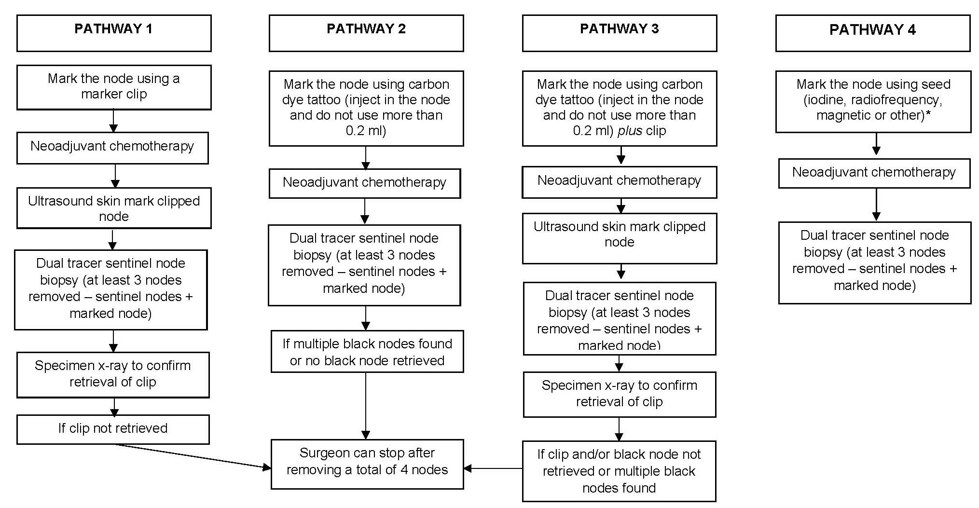
Marking of node
Sites can adapt the pathways to their local preference. *Subject to CE marking. The node may be marked at the time of needle biopsy or at a separate visit.

Slide 20
Radiotherapy QA
National Radiotherapy Trials Quality Assurance (RTTQA) Group
Mount Vernon Cancer Centre | HA6 2RN

Slide 21
#makelymphoedemahistory
Contact: amit.goyal@nhs.net
Please sign up !!!
Yeovil District Hospital NHS Foundation Trust | Poole Hospital NHS Foundation Trust
Cheltenham General Hospital | Royal United Hospitals Bath

