Slide 1

SWAG Cancer Alliance
PCN Cancer Early Diagnosis DES
Improving local uptake of National Cancer Screening Programmes
Wednesday 23 September 2020

Slide 2
Introduction
Dr Amelia Randle, Clinical Director, SWAG Cancer Alliance

Slide 3


Improving Cancer
Screening Uptake
Dr Jon Roberts
Screening and Immunisation Lead
Public Health England/NHS England & Improvement

Slide 4
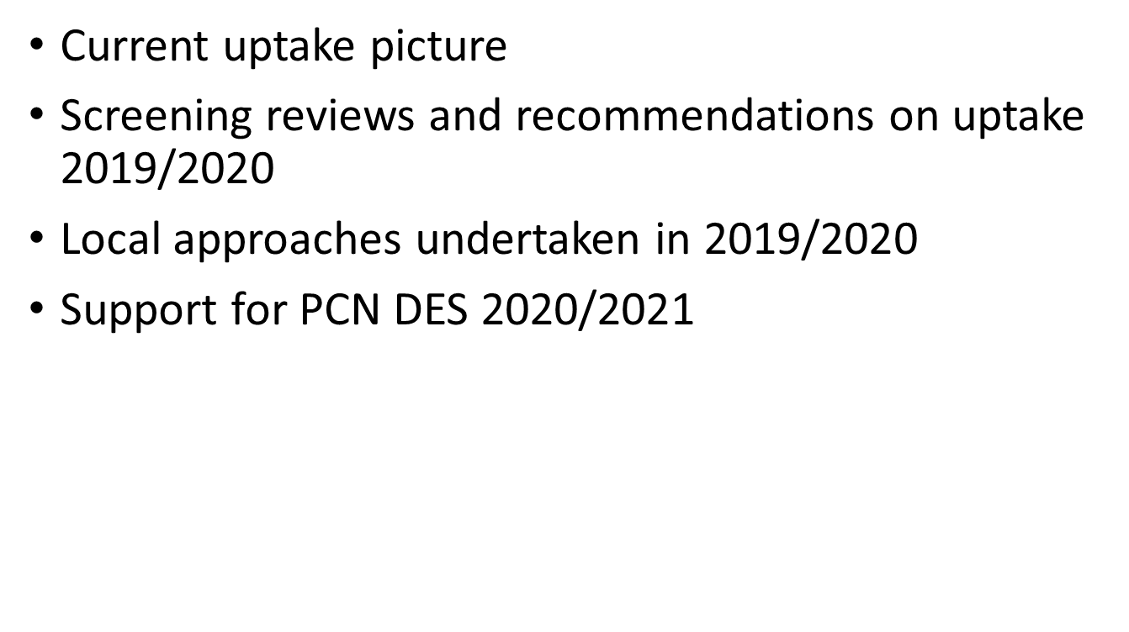
To Cover

Slide 5
Cancer Screening headlines
Breast
High risk and ladies within the system continued throughout period programme paused
Capacity is currently 60% of pre-covid levels owing to infection control and social distancing requirements.
All programmes, with exception of Somerset who had a backlog prior to COVID, have now invited all women who had an appointment which was cancelled owing to the programme pausing and are now inviting women overdue an appointment. There is a considerable backlog, increasing every month, with some programmes unlikely to fully recover until 2022.
To help recover quicker self referrals for 71+ year olds have been temporarily ceased, invites are now open appointments – lady must book convenient time rather than being given a fixed appointment, text messaging reminders are being introduced and the age extension trial has permanently ceased (eligible population will only be 50-70 year olds). An adopt & adapt session is planned and opportunities to increase capacity being investigated.
Bowel
Screen positives and those invited but not screened owing to programme pause have now been offered an appointment
Adapt and adopt event has identified priorities for Endoscopy recovery owing to reduced capacity owing to infection control requirements.
Delay to FIT 120 kits being sent out – 16-18 weeks
Bowel Scope currently on hold, likely to be permanently decommissioned and replaced with FIT testing.
Cervical
Invitation and reminder letters for cervical are returning to normal with backlogs of letter paused clearing.
NBT Lab is at 100% pre-covid capacity, turnaround times for reporting on tests is 6 days against England average of 7.
Potential delays owing to Hologic consumable shortage at end of September (just breaking)

Slide 6

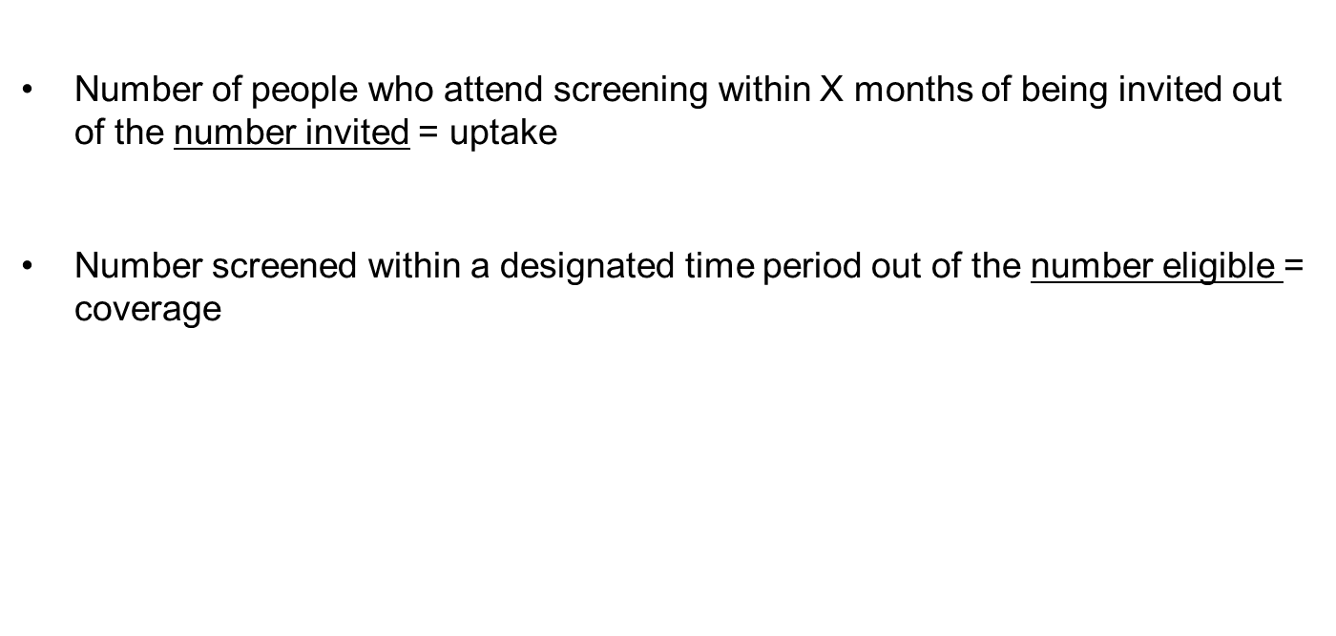
Uptake and Coverage

Slide 7
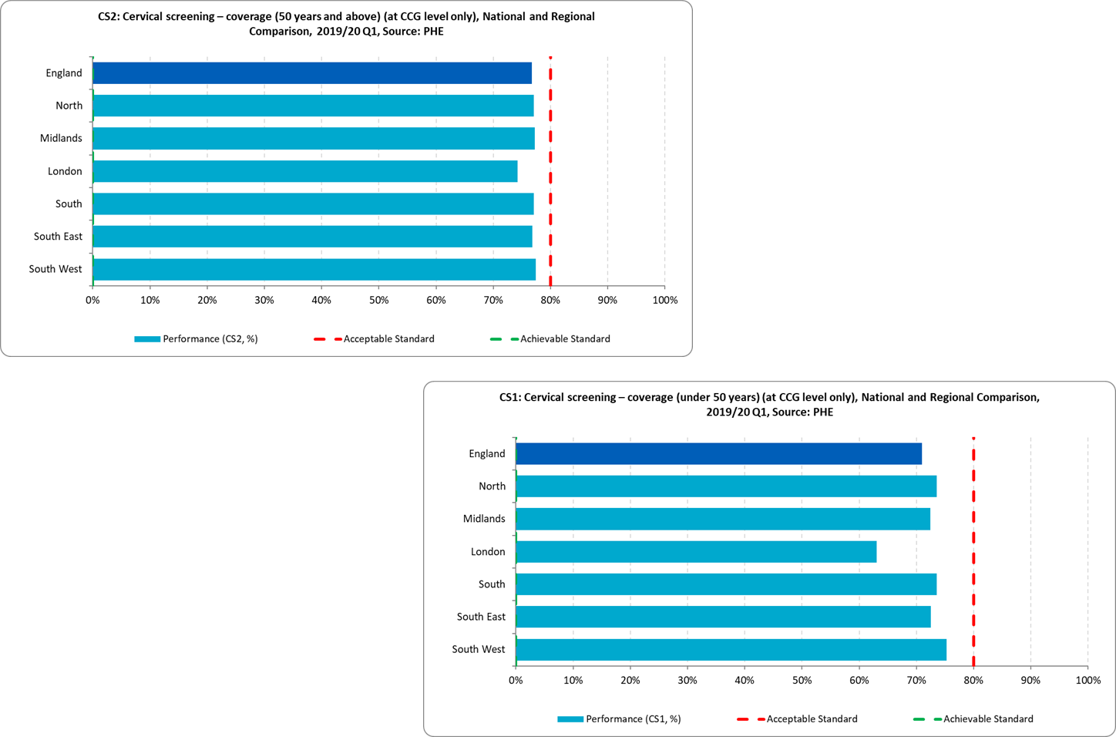
South West Cervical Screening Coverage

Slide 8
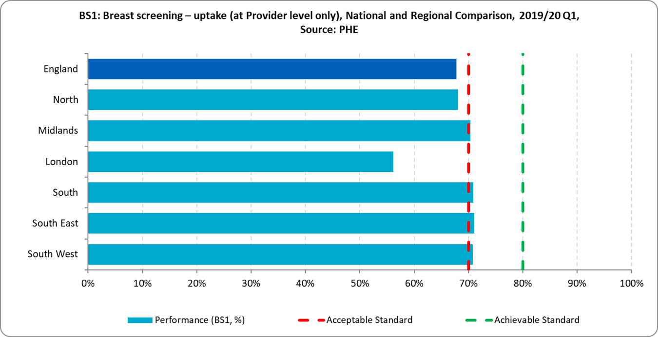
South West Breast Screening Uptake

Slide 9
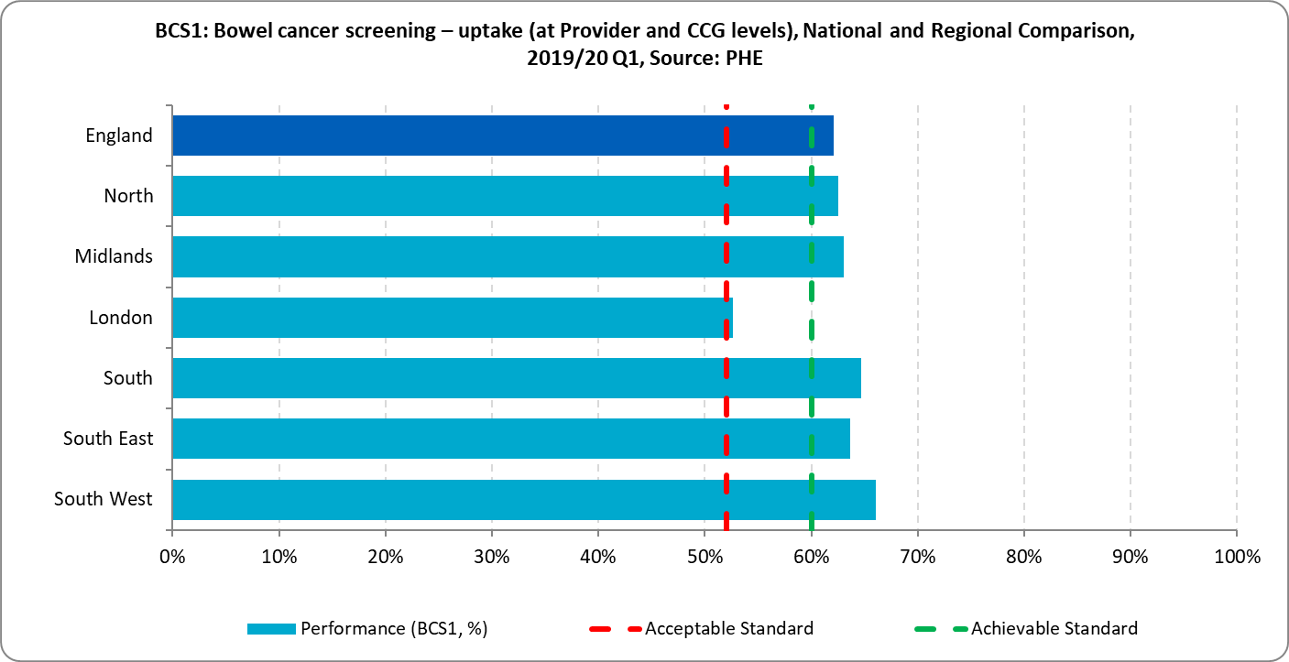
South West Bowel Screening Uptake

Slide 10
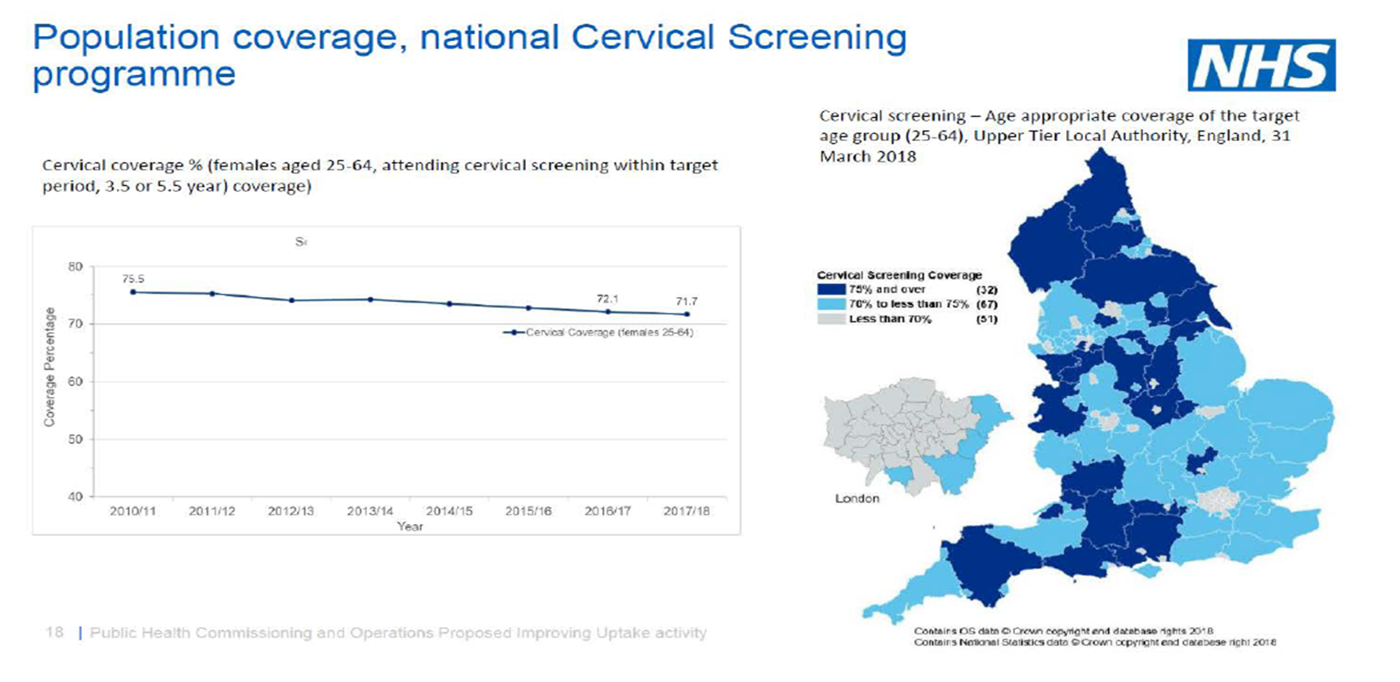

Slide 11
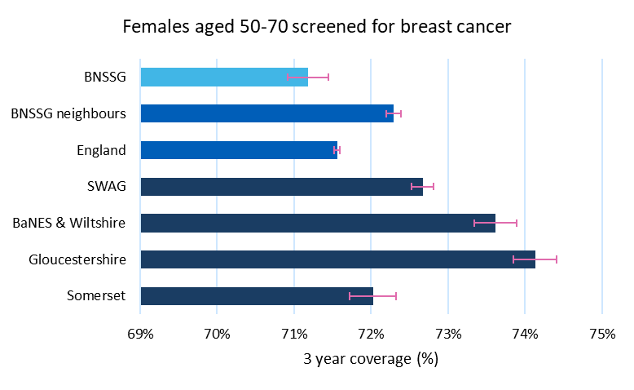
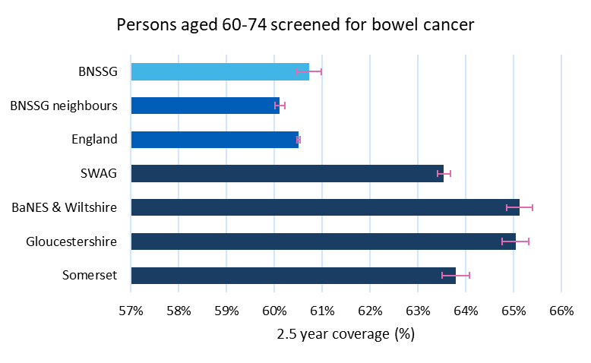
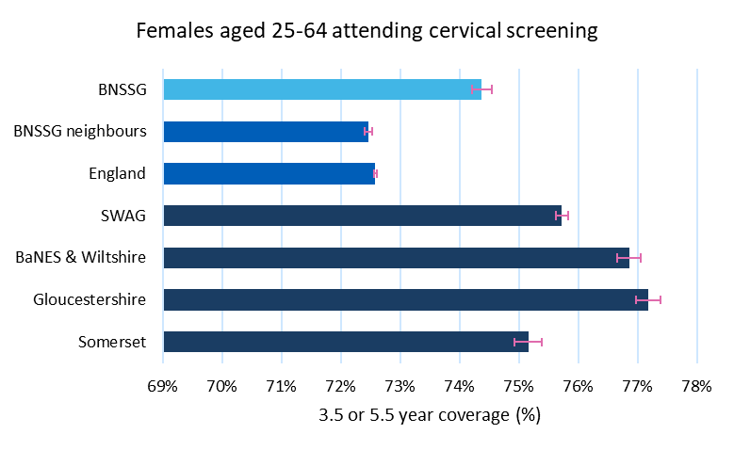

Slide 13

NHS Long Term Plan
NHS England has asked Sir Mike Richards to lead a review of the current cancer screening programmes and diagnostic capacity. This will make initial recommendations by Easter 2019 and be finalised in the summer 2019, to further improve the delivery of the screening programmes, increase uptake and learn the lessons from the recent issues around breast and cervical screening, and modernise and expand diagnostic capacity. We will take forward the findings of the review as part of this Plan.

Slide 14
Primary Care Networks
January 2019, NHS England and GPC England agreed Investment and Evolution: a five-year GP contract framework which aimed to alleviate the workforce pressures on general practice, secure enhanced investment into primary medical care, and roll out new service models – in collaboration with community services and other providers – to secure major improvements in proactive and preventative care for patients.
A cornerstone of the new GP contract framework is the creation of primary care networks (PCNs) through the new Network Contract DES.

Slide 15
Cancer Early Diagnosis DES
The NHS Long Term Plan (LTP) sets an ambition that, by 2028, the proportion of cancers diagnosed at stages 1 and 2 will rise from around half now to threequarters (75%) of cancer patients. Achieving this will mean that, from 2028, 55,000 more people each year will survive their cancer for at least five years after diagnosis.
Primary care has a vital role to play in delivering this ambition, working closely with wider system partners including Cancer Alliances, secondary care, local Public Health Commissioning Teams and the voluntary sector.
Through the requirements in the Network Contract DES, primary care networks will:
  Improve referral processes across GP practices, including by introduction of locally agreed standardised systems and processes for identifying people with suspected cancer, referral management and safety netting
  lead and coordinate the contributions of practices and the PCN to efforts to increase the uptake of existing National Cancer Screening programmes among their local populations.
  Improve outcomes through reflective learning and collaboration with local partnerships

Slide 16
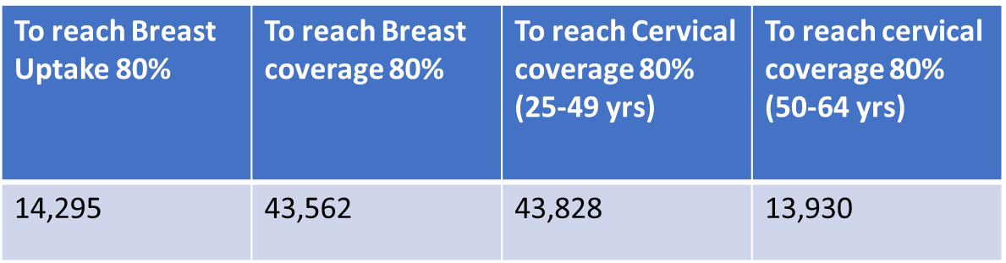

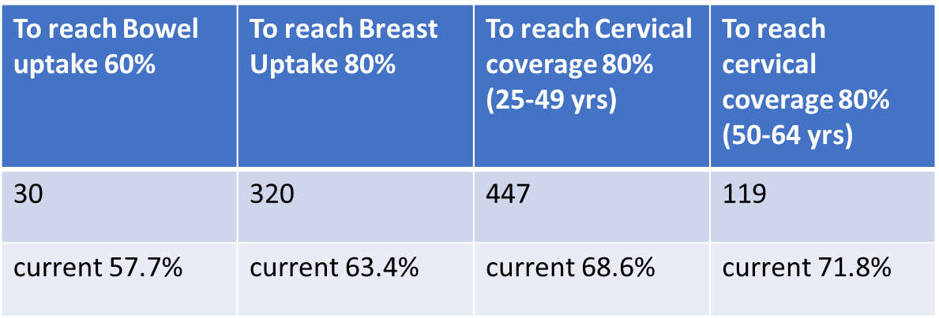
Gap analysis to reach target ambitions SW

Slide 17

Richards Review
Uptake Recommendation
High priority should be given to spreading the implementation of evidence-based initiatives to increase uptake. This will require an integrated system approach and should include:
  Implementing text reminders for all screening programmes
  Further pilots of social media campaigns with formal evaluation and rollout if successful
  Spreading good practice on physical and learning disabilities
  Encouraging links with faith leaders and community groups and relevant voluntary, community and social enterprise organisations that work with the NHS at national, regional and local levels to reduce health inequalities and advance equality of opportunity
  Increasing awareness of trans and gender diverse issues amongst screening health professionals
  Consideration of financial incentives for providers to promote out of hours and weekend appointments.

Slide 18
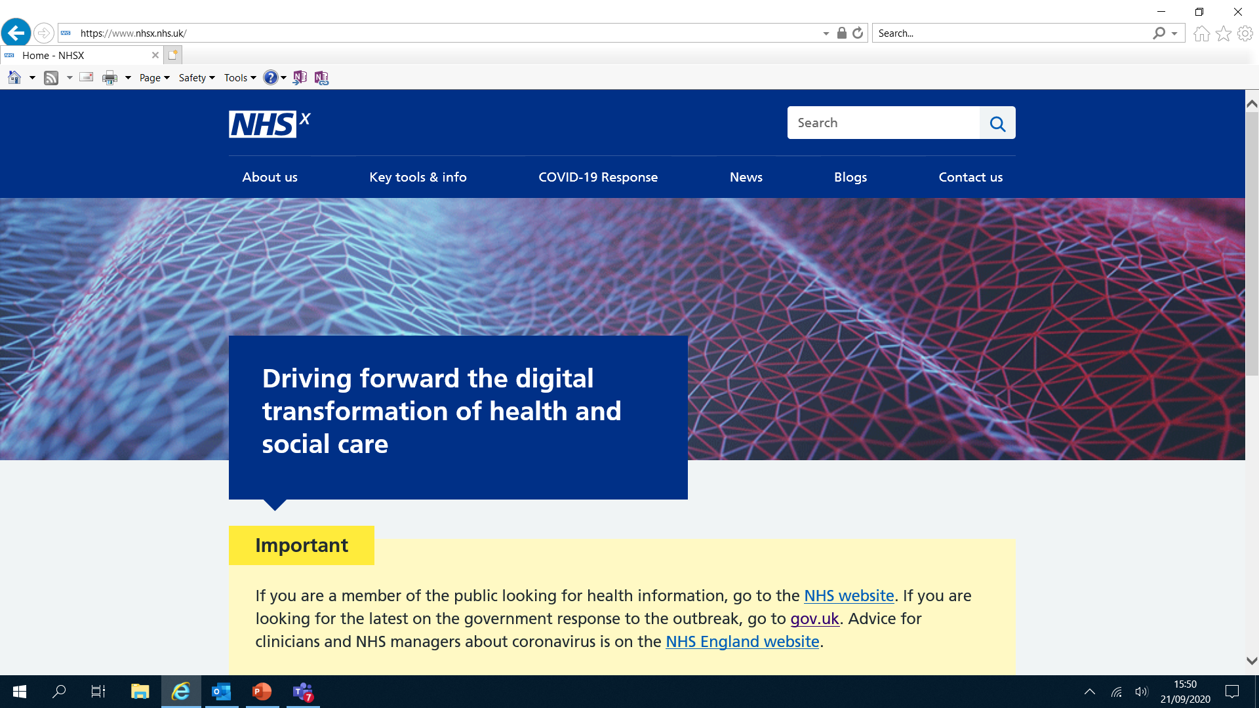
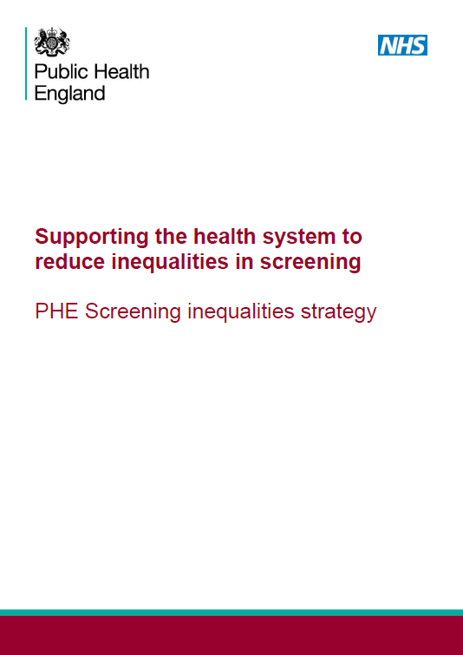
Response 2019/20
National IT screening infrastructure projects NHSX
Focus on inequalities in screening (PHE)
Local initiatives via cancer alliances
  SW wide project resource database
  Mapping software
  £274k pooled Innovation fund (Cervical)
  Other projects (LD film Breast Avon)
Next Steps (2020/21)
  Commitment to £180k projects in 2020/21
  Resources for PCNs

Slide 19


Slide 20
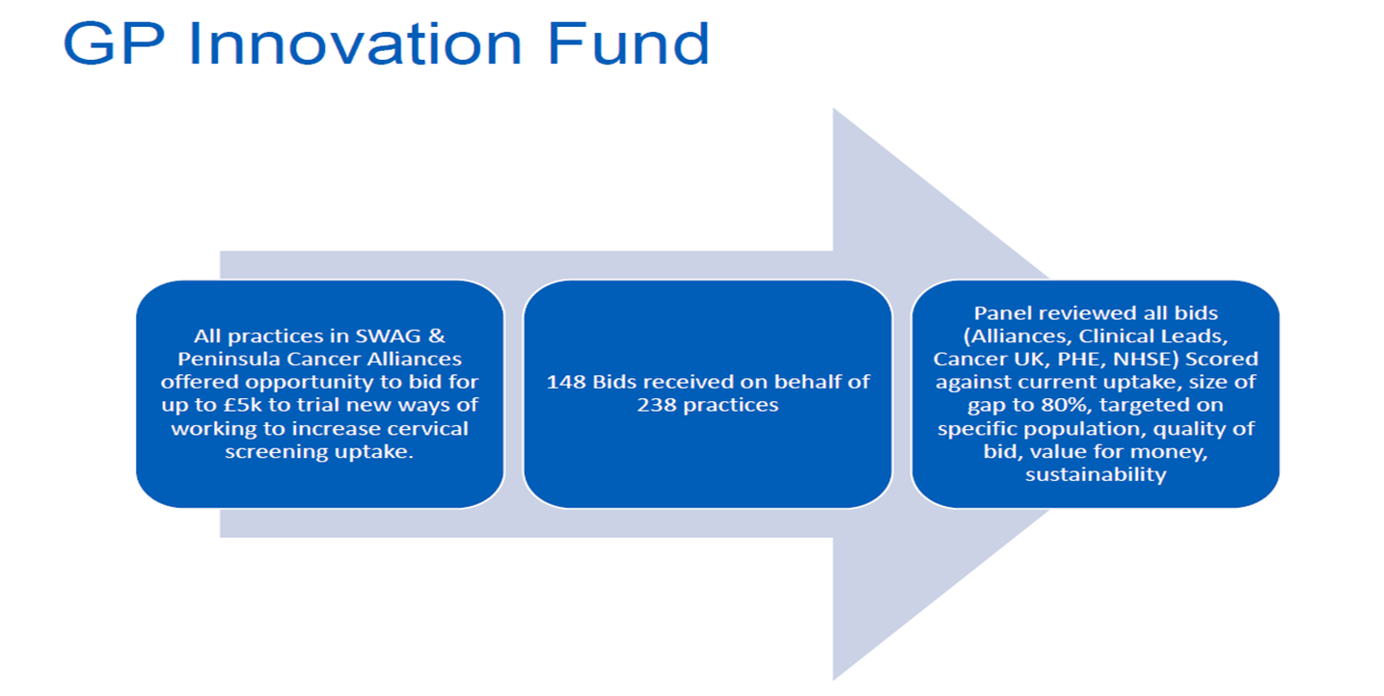

Slide 21
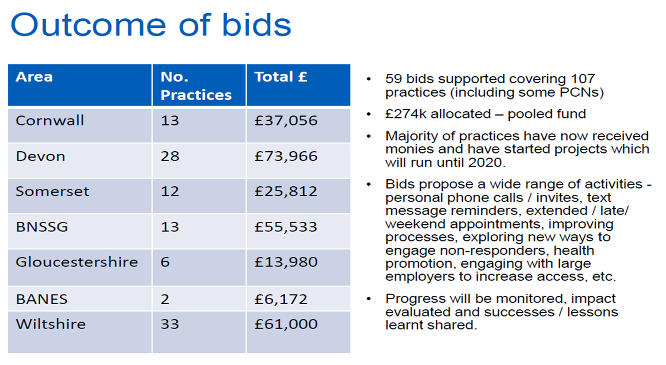

Slide 22
Types of projects
Women’s Health Awareness Day
Use of health coaches to speak to patients and understand reasons for not attending
More drop in clinics and more extended hours appointment times and clinics
Pre booked smear clinics in July and October
Dedicated cervical smear clinics on Monday evenings
Nurses calling non-attenders (DNAs) and patients who haven’t been to a smear test for a while, encouraging them to book an appointment.
SMS text and email communication with patients
Calling patients to book an appointment for the call and recall system so able to ask questions
Alerts in patient records on screen to chase patients with overdue smears
Whole team meetings to create new ideas to promote cervical screening
Sharing video links and information from Jo’s Cervical Trust
Translating letters and posters to patients’ first language
Increased social media presence on website and Facebook
Easy read booklets for patients with learning difficulties
Cervical Screening articles published in local newsletter.

Slide 23
Evaluation findings
Overall Figures from September 2019 to June 2020 | Age Cohort | Somerset | BNSSG | Glos | BaNES | Wilts | Total
No of participating Practices/PCNs | - | 3 | 13 | 5 | 2 | 3 | 26
No of benefiting Practices | - | 11 | 13 | 5 | 2 | 31 | 62
Total number of women contacted as a direct result of project | 25 – 49 | 1,038 | 8,598 | 3,584 | 1,116 | 1,796 | 15,936
 | 50 - 64 | 745 | 1,754 | 737 | 119 | 1,272 | 4,594
Total number of women attending for cervical screening as a direct result of project | 25 – 49 | 228 | 1,480 | 354 | 173 | 127 | 2,344
 | 50 - 64 | 84 | 306 | 92 | 30 | 65 | 572
Total number of women attending for cervical screening within timeframe | 25 - 49 | 1,893 | 4,864 | 879 | 314 | 1,028 | 8,927
 | 50 - 64 | 650 | 978 | 208 | 72 | 489 | 2,386

Slide 24
Summary
Cancer screening remains a high profile and priority area
Significant changes to screening organisation and infrastructure following reviews/policy coming in 2020/21
Evidence base supports a mix of national/programme level changes but also local initiatives and innovation
Opportunities through the PCN/DES and cancer alliance to improve equity of screening access/uptake
Resources and support available (Alliance, CRUK, NHSE/I)

Slide 25

Meeting the Earlier Diagnosis challenge
Cancer Screening
Catherine Neck, Clinical Project Manager
Catherine.neck@nhs.net

Slide 26
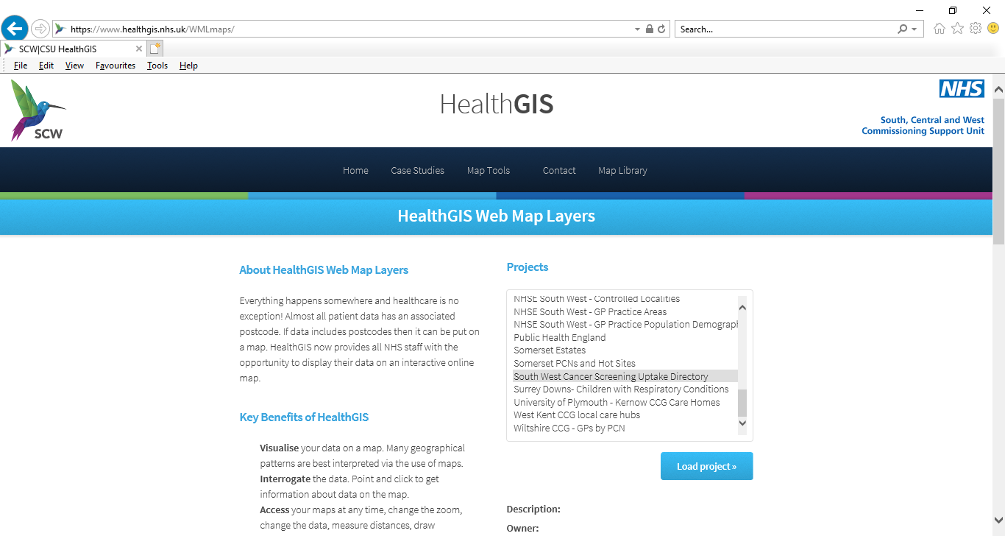

Slide 27
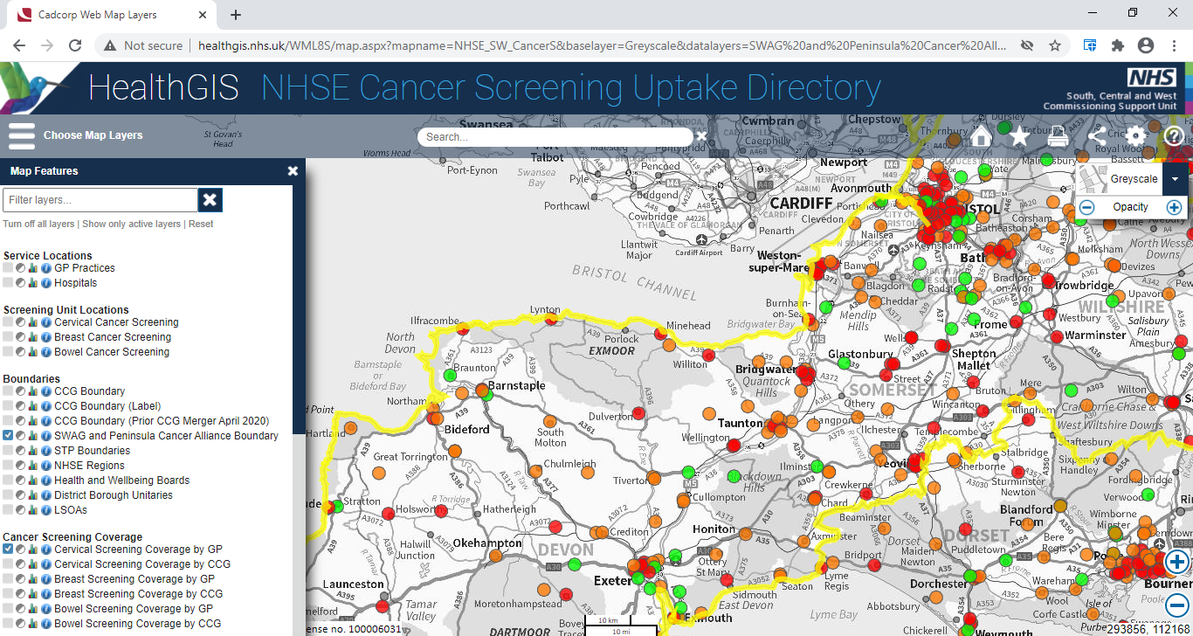

Slide 28
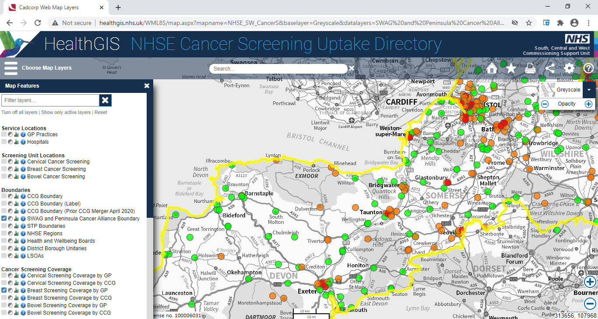

Slide 29
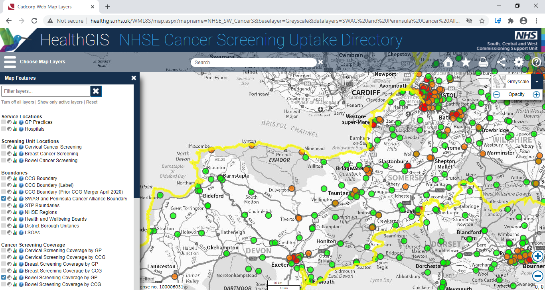

Slide 30
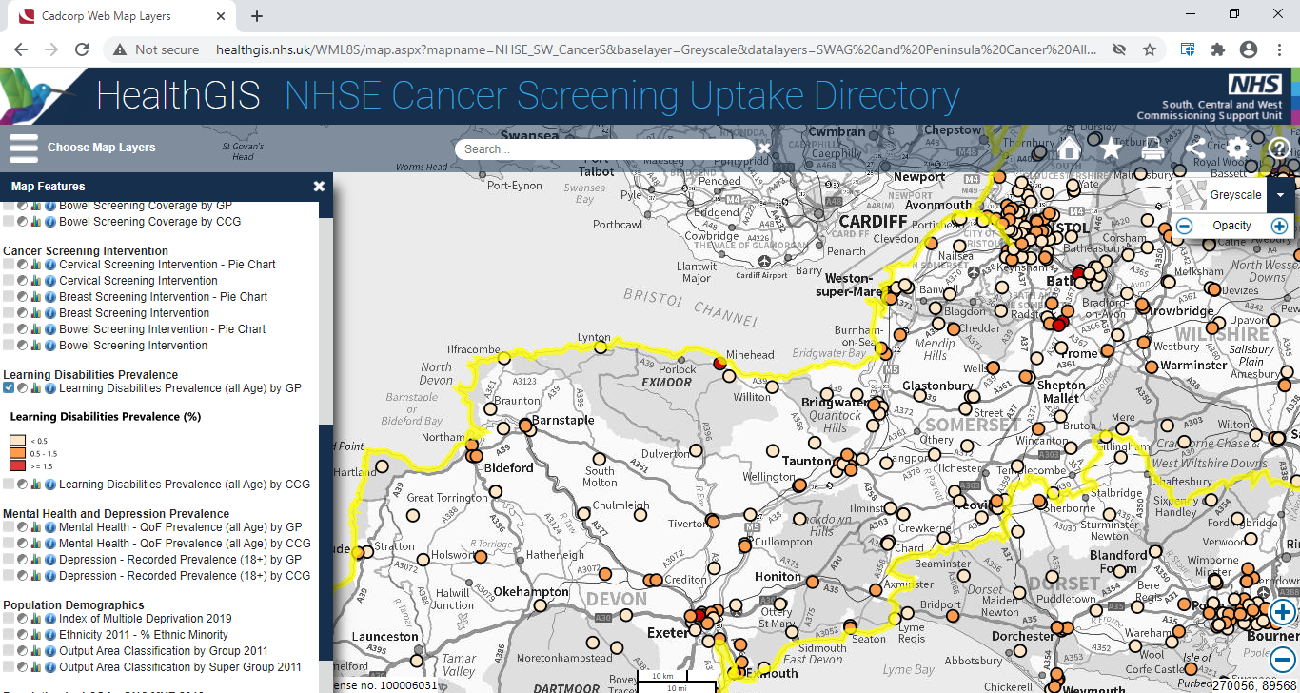

Slide 31
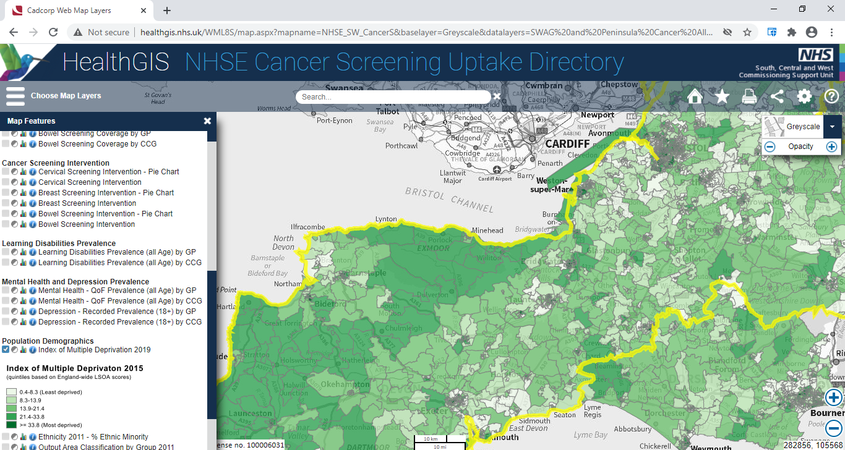

Slide 32
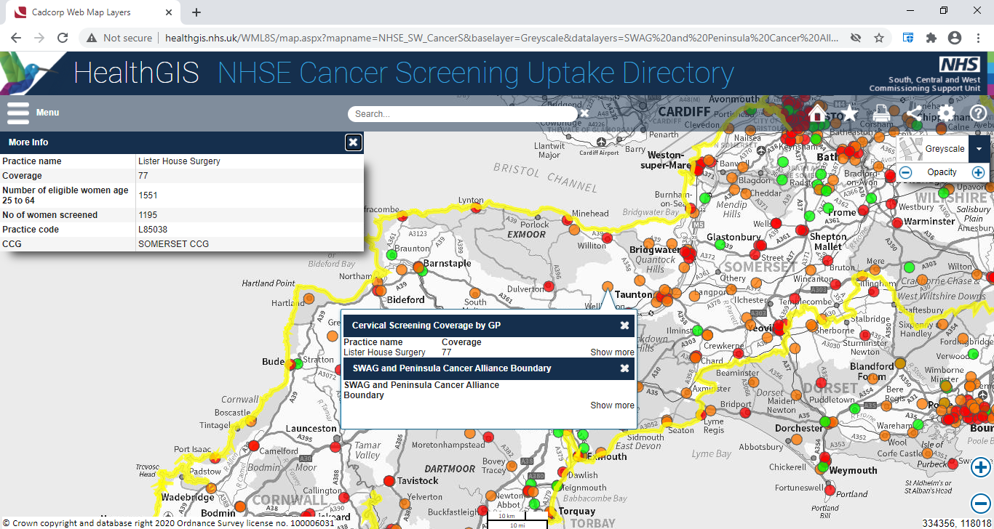

Slide 33
Questions & Answers
Led by
Dr Amelia Randle, Clinical Director, SWAG Cancer Alliance

