Slide 1
Oncology Update
Tom Bird
Clinical Oncologist
Bristol Haematology & Oncology Centre
UGI SSG Meeting
10th May 2019

Slide 2
Topics
Action points from last meeting
Current Trials
SWAG Oncology Guidelines
Oncology Journal Watch

Slide 3
Action Point 1:
It may be relevant to look into intra-peritoneal oncology treatment for palliative patients which is surgically delivered via a port-a-cath; this will be discussed with the oncologists.

Slide 4
Intraperitoneal Chemotherapy
No high level prospective evidence of a prolonged survival benefit in gastric cancer in either radical or palliative setting
GASTRICHIP trial evaluating adjuvant HIPEC
Colorectal: No established role
Ovarian: ?Possible survival benefit but not routinely used

Slide 5
Intraperitoneal Chemotherapy
X
X
X

Slide 6
Action Point 2:
Oesophageal & Junctional Adenocarcinoma:
The guidelines on who is suitable to receive tri or bi modality need to be clarified after results of a related clinical trial have been published.

Slide 9
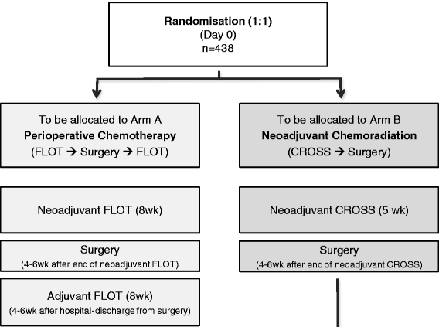
ESOPEC
NEOAEGIS

Slide 10
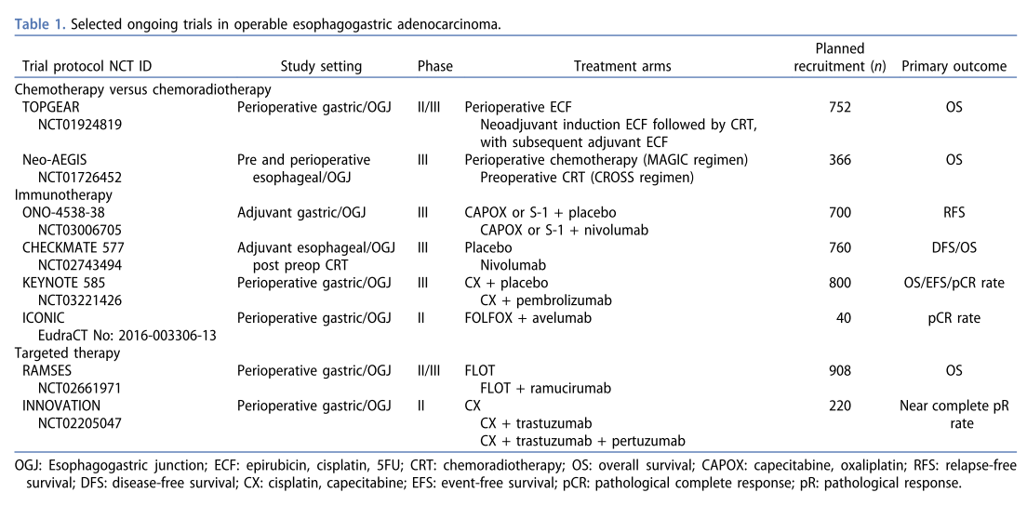

Slide 11
Topics
Action points from last meeting
Current Trials
SWAG Oncology Guidelines
Oncology Journal Watch

Slide 12
Current BHOC Trials
Oesophago-gastric
Peri-op: NEOAEGIS
KEYNOTE 585
Radical: SCOPE2
Post-radical: ADDASPIRIN
CYTOFLOC
1st line palliative: PLATFORM
Pancreas
Peri-op: None
1st line palliative: P.PANC / PRIMUS
(good PS):
1st line palliative: ACCELERATE
(poor PS)
HCC
Locally advanced: TACE-3
Advanced: COSMIC-312
Biliary tract
1st line palliative: TOPAZ-1

Slide 13
Topics
Action points from last meeting
Current Trials
SWAG Oncology Guidelines
Oncology Journal Watch

Slide 14
SWAG Oncology Guidelines
Local Guidelines for use in BHOC clinic
Potential to adopt/adapt them to be network guidelines
Weston
Taunton

Slide 15
Topics
Action points from last meeting
Current Trials
SWAG Oncology Guidelines
Oncology Journal Watch

Slide 16
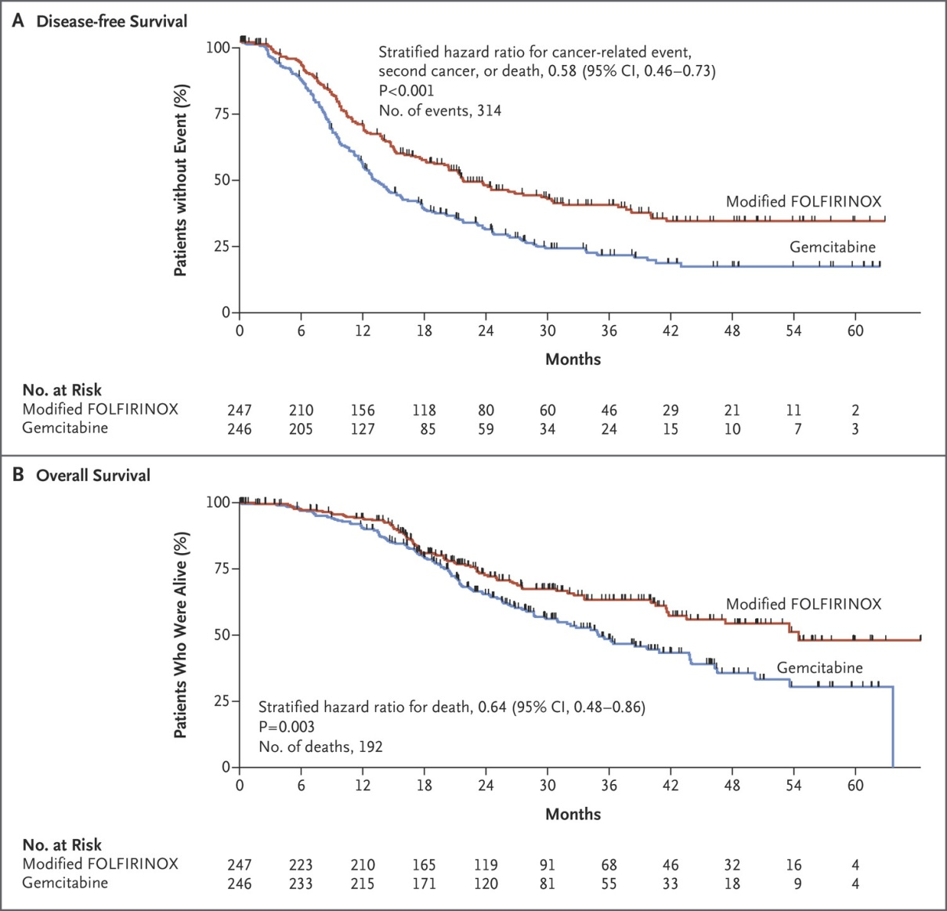
DFS:
1 year: 69.0% vs. 53.7%
2 years: 47.0% vs. 30.7%
3 years: 39.7% vs. 21.4%

Slide 17
PDL1≥1
Median OS:
9·1 months (95% CI 6·2–10·7) vs. 8.3 months

Slide 18
Pembrolizumab versus chemotherapy as second-line therapy for advanced esophageal cancer: Phase III KEYNOTE-181 study

Slide 21
Median OS: 35mo (95%CI 27- 46) vs. 50 months (95%CI 38-NR)
Est 3yr OS: 48% (95%CI 43-54) vs. 57% (52-62)
Est 5yr OS: 36% (95%CI: 30-42) vs. 45% (38-51)

Slide 22
30 day post-op death: 2% in the FLOT group vs. 3% in the ECF/ECX group
Surgical complications: 51% in the FLOT group vs. 50% in the ECF/ECX group
90-day mortality rate: 8% in the ECF/ECX vs. 5% in the FLOT group

Slide 23
Questions & Discussion

