Slide 1

Optimal Personalised Treatment of early breast cancer using Multi-parameter Analysis
OPTIMA Update
SWAG Network Breast Cancer Site Specific Group
1st March 2019

Slide 2
Outline
Overview of OPTIMA
Introducing the Qualitative Recruitment Study
Understanding OPTIMA Recruitment Obstacles
Addressing OPTIMA Recruitment Obstacles
OPTIMA Moving Forward

Slide 3
OPTIMA Aim
Find out if a multi-parameter assay (Prosigna) can effectively and safely identify if a patient is likely to benefit from adjuvant chemotherapy or not.

Slide 4
OPTIMA Rationale
Better targeting of chemotherapy
Avoid unnecessary side effects
Avoid delay in treatment that could help

Slide 5

Trial Design
Group 1
(Control)
Follow
up
10
years
Female or Male
age ≥40
post 1°excision
ER pos, HER2 neg
pN1-2/ pN1mi &pT≥20
/pN0 &pT ≥30
chemo.
endocrine
1
blinded to randomisation
R
high score
1
chemo.
endocrine
Group 2
(Test Directed)
treatment assigned by score
ROR ≥61
Prosigna
ROR<61
endocrine
low score
Primary outcomes: Treatment outcome for Group 2 not worse than Group 1.
Cost effectiveness evaluation of test directed treatment.

Slide 6
Recruitment Overview
1321
Patients
62
Feb 2019
94 sites
(inc Oslo, Norway)

Slide 7
Recruitment Target

Slide 8

The Qualitative Recruitment Study
Phase I: Understanding recruitment
(and identifying challenges)
Phase II: Delivering strategies to improve recruitment

Slide 9

Qualitative Recruitment Study
Phase I: Understanding recruitment obstacles (rapid)
Mapping recruitment pathways, assessing screening and eligibility procedures
Interviews with trial staff (and sometimes patients)
Audio-recordings of ‘recruitment consultations’
Document analysis (protocol, patient information, screening logs)
Observations of investigators meetings

Slide 10



Qualitative Recruitment Study
Phase I: Understanding recruitment obstacles (rapid)
Mapping recruitment pathways, assessing screening and eligibility procedures
Interviews with trial staff (and sometimes patients)
Audio-recordings of ‘recruitment consultations’
Document analysis (protocol, patient information, screening logs)
Observations of investigators meetings
Findings discussed with CI/TMG and ‘Plan of action’ agreed
Phase II: Addressing recruitment obstacles
Feedback/training
Written guidance and information
Changes to trial literature to improve clarity
Adjustments to trial pathways and processes

Slide 11
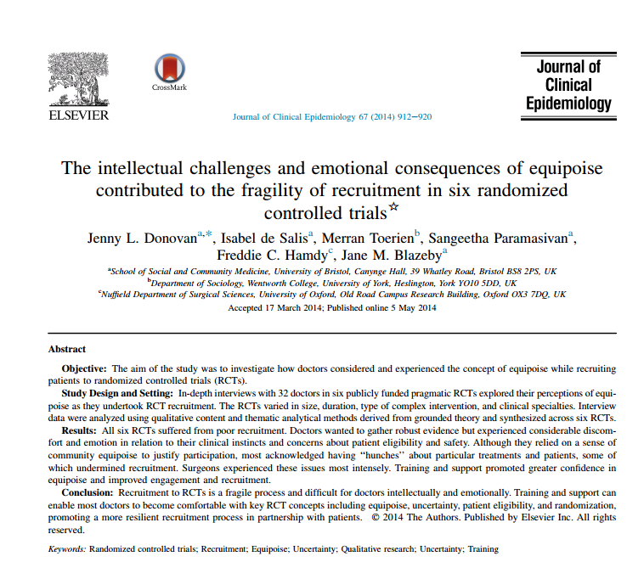
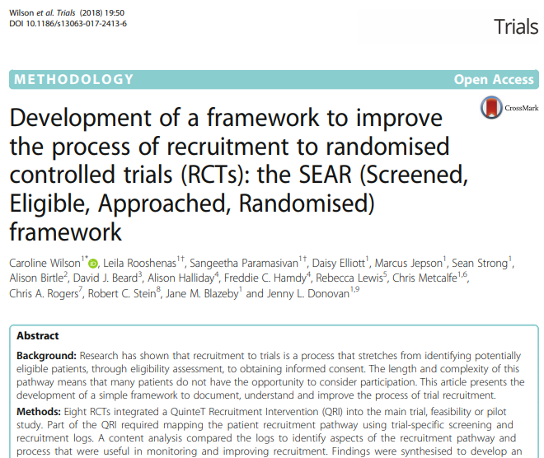
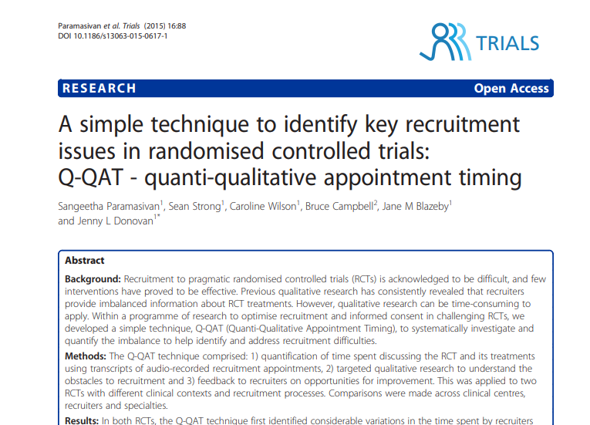
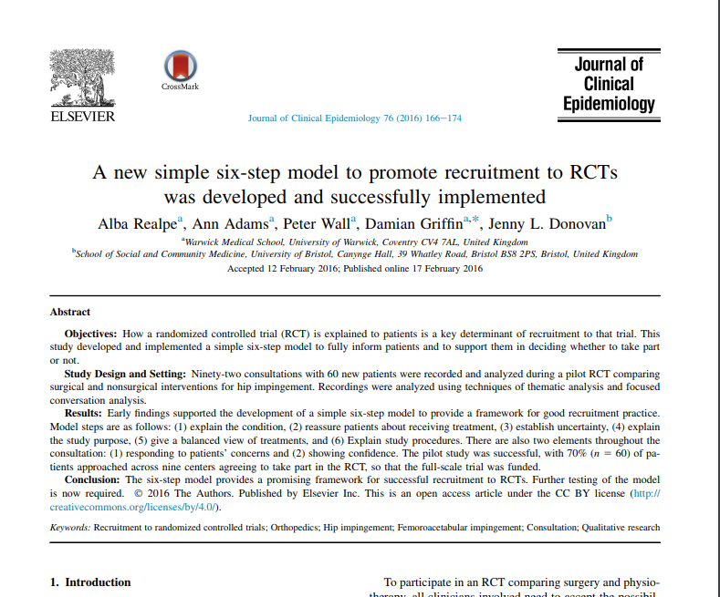
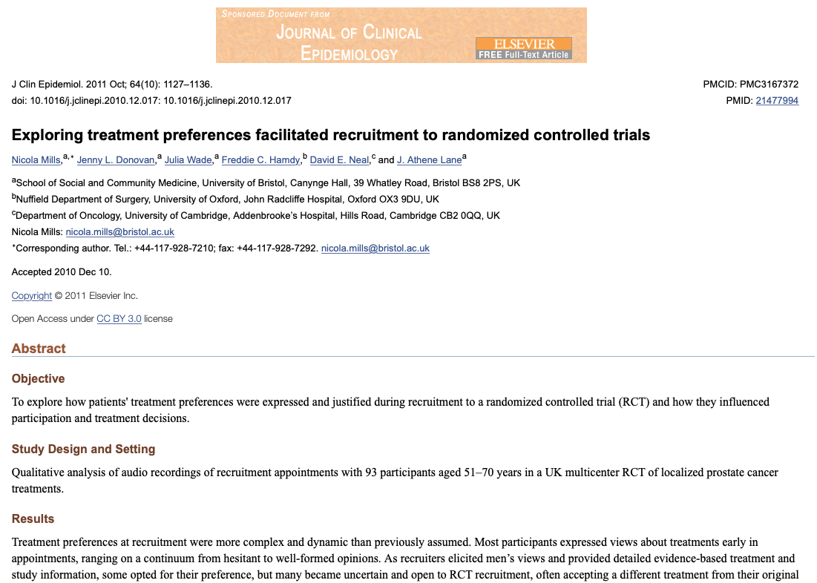
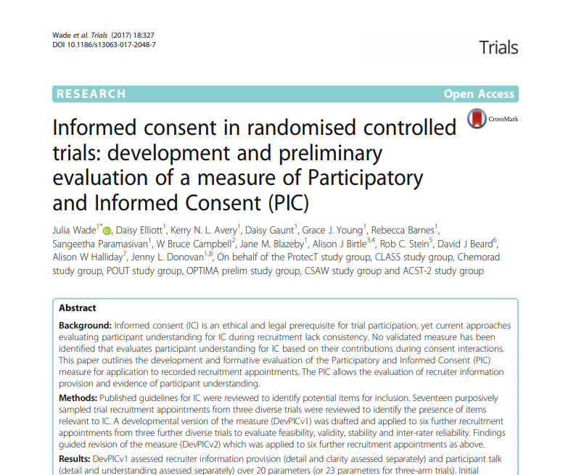
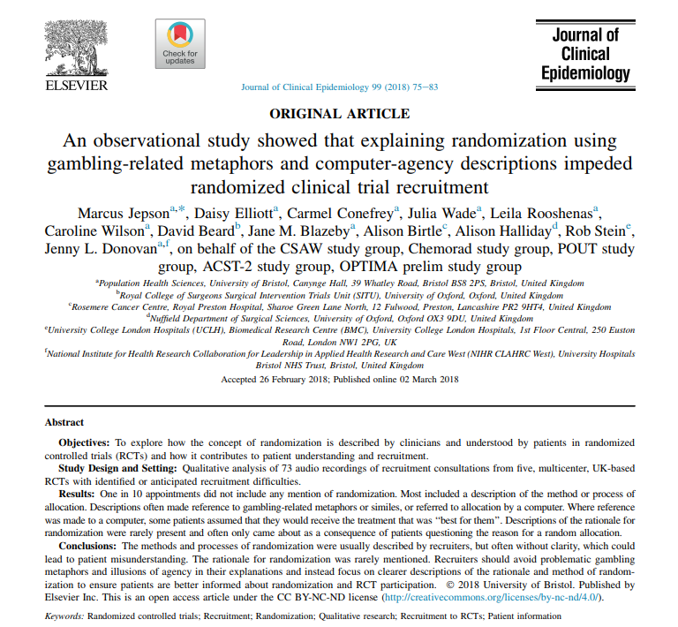
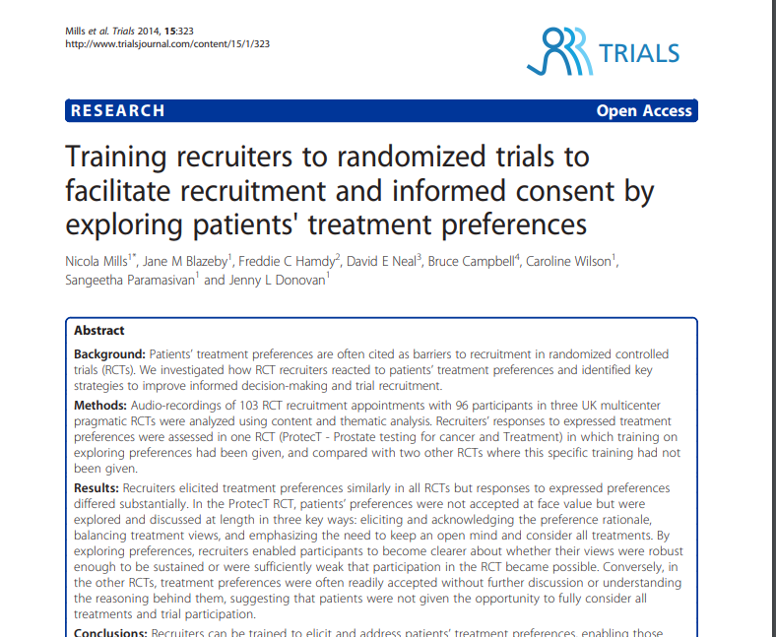
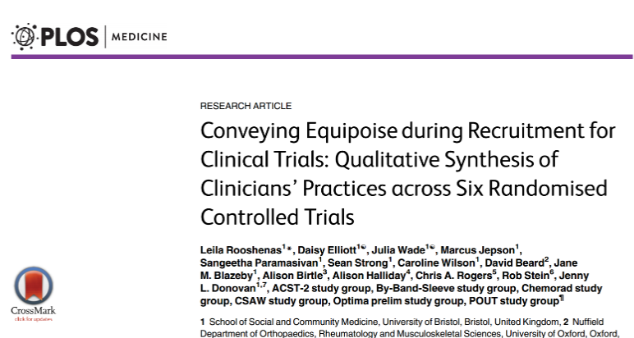
Accumulated knowledge from prior work

Slide 12

OPTIMA recruitment process
2075
MDT Screening for OPTIMA
1308
MDT Identify 63% as eligible patients
Surgical handover
1056
Approach 81% eligible patients
Recruitment appointment
454, 43% Recruited to OPTIMA
Sept 2017 – Dec 2019

Slide 13


Slide 14
Recruitment Challenges
Not all potentially eligible patients identified:
Oncotype Dx offered to some node positive patients
Equipoise issues:
  Eligibility criteria
    Node positive
  Poor prognosis
Comfort with Multi Parameter Assays
Not approaching all eligible patients
Subjective assessment outside eligibility criteria (patient considered too anxious, too emotional)
Identifying eligible patients
Patient Pathway
Approaching patients
Missing opportunities to randomise:
Structuring the appointment
Use of predictor tools
Talking about Prosigna test
Exploring patient preferences
Belief in the study
Recruitment Appointments
Losing eligible patients:
Surgeons pre-empting chemotherapy
43% of approached patients consent

Slide 15


Slide 16
Addressing Recruitment Challenges
Identifying eligible patients
Revise eligibility criteria
Explore recruiters’ issues - 6 Regional meetings, Investigator newsletters, Monthly newsletter & postcards
MDT focus – guidance note for surgeons, breast nurse specialist,
Promote OPTIMA at national meetings
Approaching Eligible Patients
Tips for surgeons and breast nurse specialists
Explore recruiters’ issues - 6 Regional meetings
Trailering OPTIMA with Patient Information Flyer
Recruitment Appointments
6 Regional feedback meetings
Individual recruiter
Targeted tips and guidance document
Audio-recording of appointments

Slide 17

OPTIMA Moving Forward

Slide 18
Protocol Changes 6.1
Better explanation of eligibility
Allow up to 8 weeks of neo-adjuvant endocrine therapy
  Participation in window studies permitted
  Will require a pre-treatment core biopsy for Prosigna testing
Allow entry up to 12 weeks post final surgery

Slide 19
Collaborations
Norwegian Breast Group
Possible other international collaborations

Slide 20
Communication
OPTIMA website and Twitter
TMG and PI relationships

Slide 21
Recruiting to target
Site recruitment target = at least one patient per month
Need to approach at least 2 patients per month

Slide 23

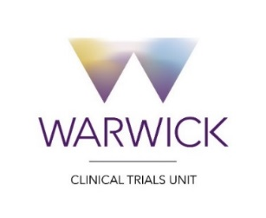





Trial Support
Sponsor
Co-ordinating Centre
Funder
Affiliates :
University of
BRISTOL

