Slide 1
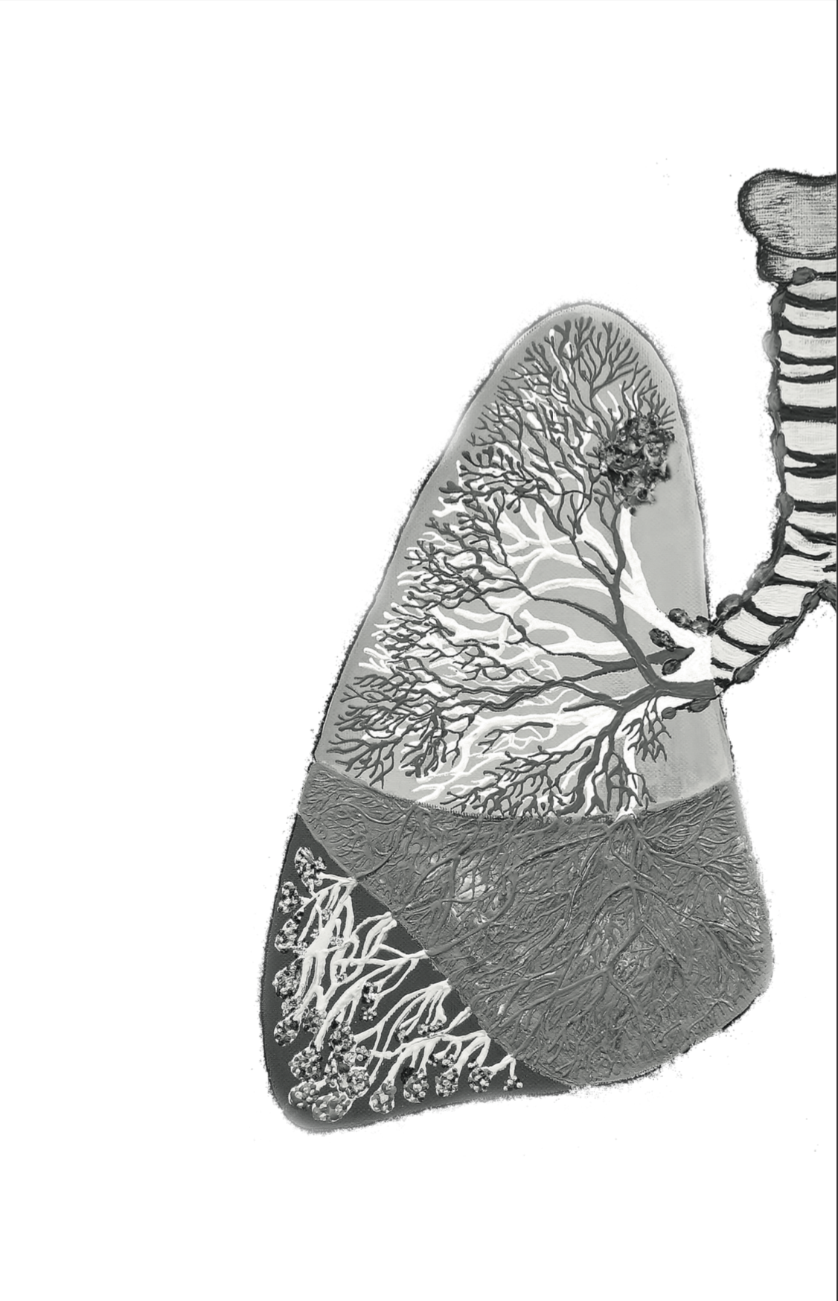
Lung Cancer screening.
The NELSON trial.
Eveline Internullo

Slide 2
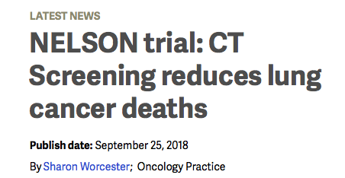

Slide 3
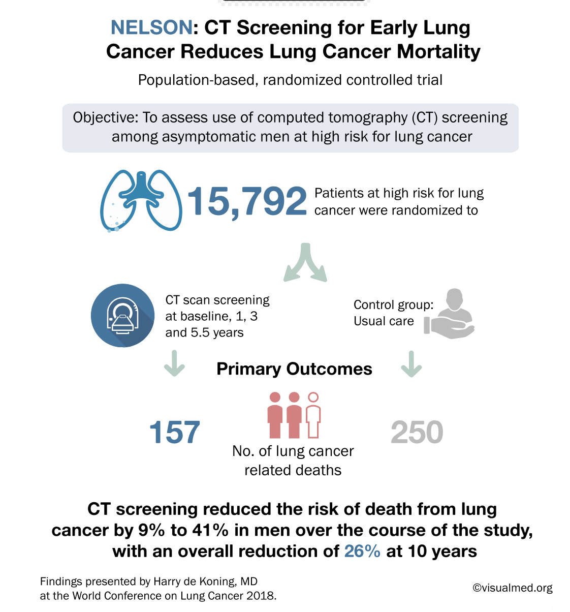
Dutch/Belgian
(2003-2018)
86%
compliance
10 y
follow-up
214

Slide 4
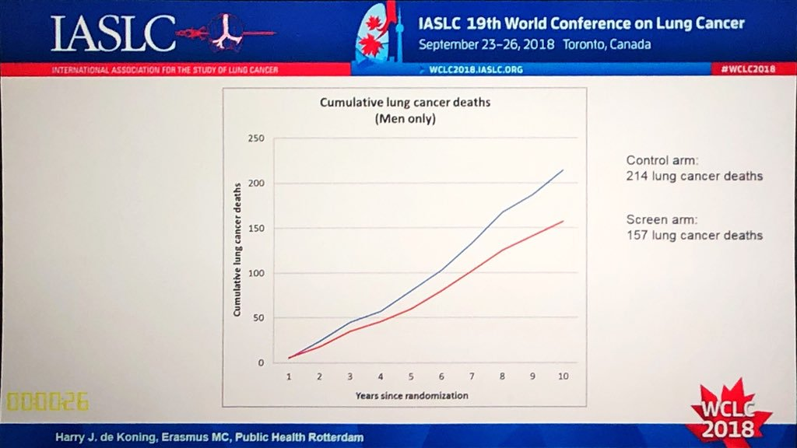

Slide 5
NELSON trial (2003-2018)
86% compliance
26% reduction in lung cancer mortality in men at 10y follow-up
67% of detected lung cancers in study group were stage Ia-II.
Notes:
Started 2003
CT at 0-1-3-5
Second largest trial I the world (NLST)

Slide 6
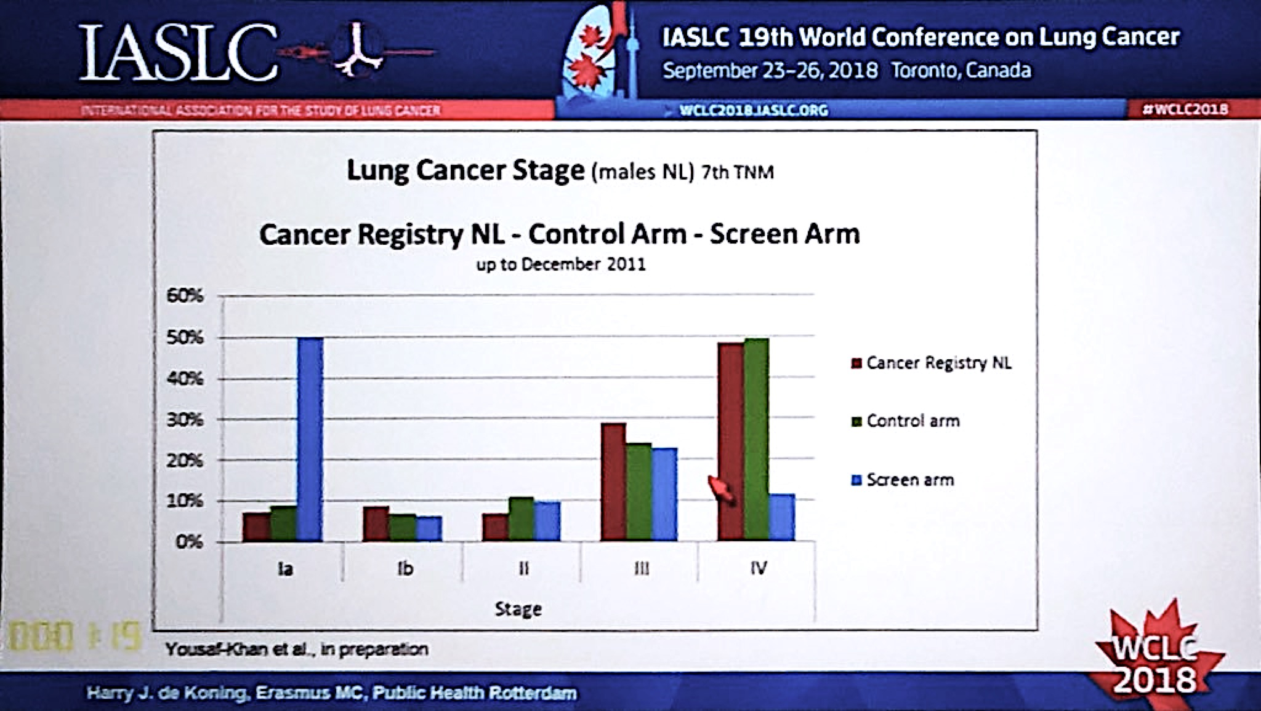
69% of detected lung cancers in study group were stage Ia-II
Notes:
STAGE SHIFT

Slide 7
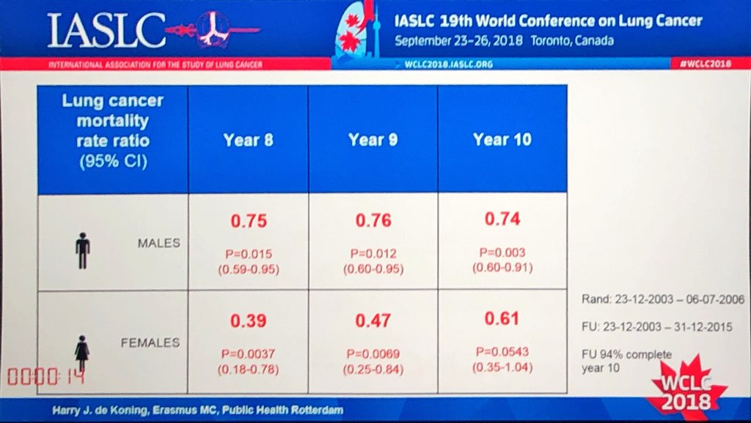

Slide 9
Histology shift
48% of the screening group cancers were slow growing (93% ADC)

Slide 10
Lung cancer screening - US
NLST
National Lung Screening Trial (NLST) - 2011
> 50,000 smokers and ex-smokers enrolled
LDCT vs CXR
20% decrease in lung cancer related death in the LDCT arm
25% false positive
Screening recommended since 2014
Still lot of work to implement guidelines in US and outside

Slide 11
LUNG CANCER SCREENING IN EUROPE

Slide 12
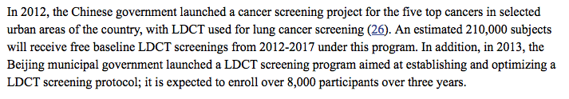
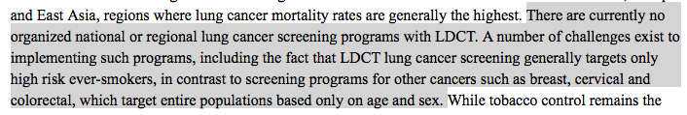
Lung cancer screening - Asia

Slide 13
Lung cancer screening
Still few years away…
Step-wise implementation?
Big impact
Massive stage shift to 67% stages 1-2
Smaller cancers... Smaller resections?

Slide 14


JCOG 0802
RCT LOBECOMY vs SEGMENTECTOMY/WEDGE
2020?
1100 pts
PRIMARY OUTCOME: overall survival (non inferiority of sublobar resection) for small peripheral (≤ 2 cm) NSCLC.
SECONDARY OUTCOMES
DFS
Rate of locoregional and systemic recurrence
Pulmonary function (and many more…)
CALGB 140503
RCT LOBECOMY vs SEGMENTECTOMY/WEDGE
March 2021
700 pts
PRIMARY OUTCOME: DFS (non inferiority of sublobar resection) for small peripheral
(≤ 2 cm) NSCLC.
SECONDARY OUTCOMES
- overall survival
- rate of loco-regional and systemic recurrence
- pulmonary function

