Slide 1







National Oesophago-Gastric Cancer Audit
2018 Annual Report

Slide 2
2018 Annual Report covers
Patients diagnosed with oesophago-gastric (OG) cancer between April 2015 and March 2017, in England and Wales
Patients diagnosed with oesophageal high-grade dysplasia (HGD) between April 2012 and March 2017, in England

Slide 3
High-grade dysplasia (HGD)
NOGCA received data on 2,059 patients diagnosed with HGD in NHS trusts between April 2012 and March 2017
The number of HGD records submitted to the Audit has declined each year
 | During period 2012-17
No. of patients | 2059
Male, n (%) | 1529 (74%)
Age in years, median (IQR) | 71 (64 to 79)
Patients with comorbidity, n (%) * | 383 (37%)
Source of referral, n (%)
Symptomatic | 1001 (53%)
Surveillance | 886 (47%)
*Collected from 2014; IQR – interquartile range

Slide 4
The proportion of patients receiving active treatment for HGD increased from 70% in 2012-13 to 75% in 2016-17

Slide 5
% Patients receiving active treatment for HGD shows considerable variation across Cancer Alliances in England

Slide 6
Local HGD data
Review the management and treatment plans for HGD patients in your Cancer Alliance and compare these results with national figures
Indicator | National | SWAG
% of patients whose diagnosis was confirmed by a second pathologist | 86% | 86.5%
% of patients discussed at the multidisciplinary team (MDT) | 86% | 65.9%
% of patients who received endoscopic treatment | 65% | 87.5%

Slide 7
HGD recommendations
We recommend regular review of cases and submission to the Audit by local teams to improve case ascertainment in regions where it is currently low.
Where appropriate, MDTs should ensure that cases of suspected HGD have been confirmed by a second pathologist.
NHS trusts should ensure there are clear protocols with neighbouring hospitals for the referral of all cases of HGD to the specialist MDT. Local audits should be undertaken to check all cases are discussed and to take any required action.
MDTs should ensure that all patients with HGD are considered for endoscopic treatment, in line with current recommendations. Those with high rates of non-treatment should consider a local audit to investigate the reasons for this.
Where necessary, referral pathways to specialist centres should be established to ensure recommended volumes are achieved.

Slide 8
Oesophago-Gastric (OG) cancer
2018 Annual Report focuses on patients diagnosed with invasive epithelial OG cancer between April 2015 and March 2017, in England and Wales
Data from 139 NHS trusts (England) and 6 local health boards (Wales)

Slide 9
Route to diagnosis
Among patients diagnosed with OG cancer in 2015-17, 13% were diagnosed following an emergency admission. There was substantial variation in emergency diagnoses by Cancer Alliance / Welsh region
Locally, 9.2% of patients were diagnosed following an emergency admission

Slide 10
Route to diagnosis
Diagnosed following an emergency admission. Variation in emergency diagnoses across SWAG.
Hospital | Total | n | %
Weston Area Health NHS Trust | 55 | 6 | 11.4%
Yeovil District Hospital NHS Foundation Trust | 44 | 0 | 0.0%
University Hospitals Bristol NHS Foundation Trust | 142 | 4 | 2.9%
Taunton and Somerset NHS Foundation Trust | 126 | 2 | 1.6%
Royal United Hospitals Bath NHS Foundation Trust | 100 | 16 | 15.7%
Salisbury NHS Foundation Trust | 82 | 10 | 11.5%
Gloucestershire Hospitals NHS Foundation Trust | 286 | 51 | 18.1%
North Bristol NHS Trust | 144 | 18 | 12.6%
 | 122 | 13 | 9.2%

Slide 11
Tumour stage at diagnosis
The proportion of patients diagnosed with early stage cancer has remained at ~12% over the last five years

Slide 12
Staging investigations
Patients diagnosed with OG cancer are recommended to have a CT scan to identify metastatic disease
90% of patients diagnosed in 2015-17 had an initial CT scan
This proportion rose from 86% in 2012-13 to 90% in 2016-17
Locally, 64.1% of patients had an initial CT scan

Slide 13
Staging investigations
Patients diagnosed with OG cancer are recommended to have a CT scan to identify metastatic disease across SWAG
Hospital | Total
Weston Area Health NHS Trust | 83.6%
Yeovil District Hospital NHS Foundation Trust | 68.2%
University Hospitals Bristol NHS Foundation Trust | 43.0%
Taunton and Somerset NHS Foundation Trust | 46.0%
Royal United Hospitals Bath NHS Foundation Trust | 34.0%
Salisbury NHS Foundation Trust | 85.4%
Gloucestershire Hospitals NHS Foundation Trust | 97.6%
North Bristol NHS Trust | 54.9%
 | 64.1%

Slide 14
Further staging investigations
PET-CT is recommended for all patients with oesophageal cancer being considered for curative treatment. Endoscopic ultrasound (EUS) is recommended to be used selectively for staging oesophageal cancers.
The use of PET-CT in patients with a curative treatment plan for oesophageal cancer increased from 63% in 2012-13 to 71% in 2016-17

Slide 15
Planned curative treatment
Overall, 39% of patients with OG cancer diagnosed in 2015–17 had a curative treatment plan
% patients managed with curative intent varied across Cancer Alliances / Welsh regions, but the values generally clustered around the national average

Slide 16
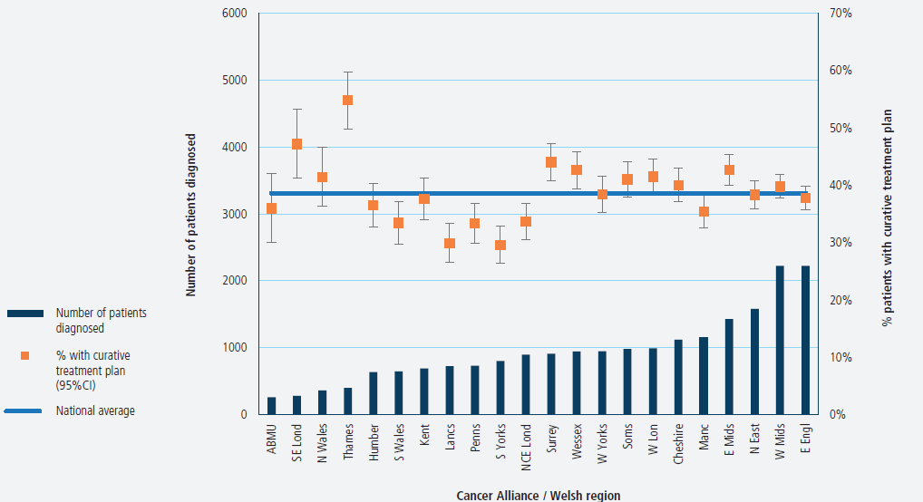

Slide 17
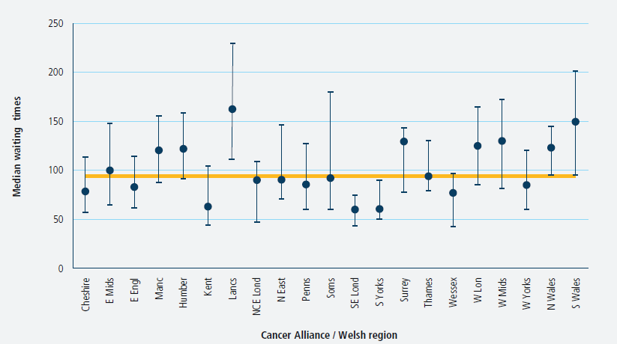

Slide 18
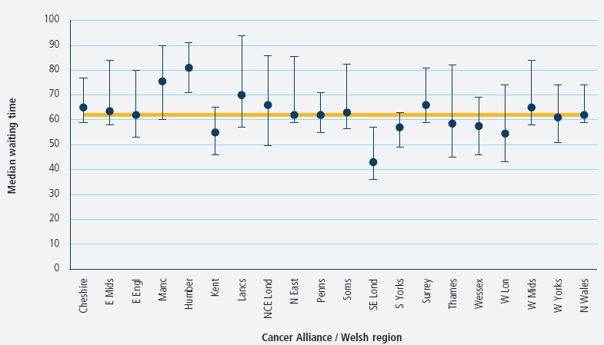

Slide 19
Curative surgery
Curative surgical records were submitted for 4,291 patients:
  2,658 oesophagectomies
  1,633 gastrectomies
 | Oesophagectomy |  | Gastrectomy
 | 2015-17 | 2013-15 | 2015-17 | 2013-15
30-day mortality | 2.4 | 1.6 | 1.3 | 1.9
90-day mortality | 3.9 | 3.2 | 3.3 | 4.1

Slide 20
Surgical Outcomes
All NHS Organisations achieved similar 90-day mortality after curative surgery
For 30-day postoperative mortality, one surgical centre had a rate that was slightly higher than expected given the volume of operations performed
30 day mortality
90 day mortality
30 day mortality rate:
UBHT 4 .4%
GRH 2.9%
90 day mortality rate:
UBHT 4.3%
GRH 2.8%

Slide 21
Pathology outcomes after surgery
Last year, the Audit introduced results on four new surgical indicators.
A lack of standardisation in the preparation of surgical specimens prevents these indicators being used for benchmarking across organisations
Indicator | National average | UBHT | GRH
Proportion of patients with adequate lymph nodes examined | 82.5% | 88.4 % | 86.1 %
Proportion of patients with positive longitudinal margins- oesophagectomy | 3.6% | 8.0 % | 3.8 %
Proportion of patients with positive circumferential margins-oesophagectomy | 25.0% | 26.5 % | 13.2 %
Proportion of patients with positive longitudinal margins- gastrectomy | 8.2% | 9.2 % | 19.6 %

Slide 22
Number of cases
Trust name | N oesophagectomies | N gastrectomies | Total cases | 30 day mortality rate | 90 day mortality rate | Length of stay (days) | % with adequate lymphnodes examined | % positive margins oeslong | % positive margins oes circ | % complete cases for gast long | % positive margins gast long
The Newcastle Upon Tyne Hospitals NHS Foundation Trust | 230 | 159 | 389 | 1.6% | 1.8% | 9 | 97.9% | 3.2% | N/A | 100.0% | 8.1%
Nottingham University Hospitals NHS Trust | 227 | 101 | 328 | 2.7% | 3.8% | 11 | 76.4% | 3.6% | 32.6% | 98.0% | 7.8%
Oxford University Hospitals NHS Trust | 209 | 83 | 292 | 0.9% | 1.8% | 10 | 92.8% | 2.5% | 14.2% | 98.8% | 4.2%
Guy's And St Thomas' NHS Foundation Trust | 193 | 98 | 291 | 0.3% | 0.3% | 10 | 85.6% | 3.6% | 32.1% | 100.0% | 5.8%
Sheffield Teaching Hospitals NHS Foundation Trust | 150 | 89 | 239 | 0.4% | 2.5% | 9 | 74.1% | 2.8% | 29.3% | 100.0% | 3.8%
Plymouth Hospitals NHS Trust | 200 | 35 | 235 | 1.4% | 4.5% | 10 | 87.4% | 2.4% | 31.3% | 97.1% | 5.2%
Salford Royal NHS Foundation Trust | 135 | 81 | 216 | 0.8% | 2.3% | 12 | 75.5% | 2.4% | 19.8% | 100.0% | 15.0%
University Hospitals of North Midlands NHS Trust | 135 | 75 | 210 | 3.9% | 6.5% | 12 | 87.7% | 3.5% | 31.0% | 89.3% | 12.0%
Cambridge University Hospitals NHS Foundation Trust | 129 | 78 | 207 | 0.0% | 1.5% | 10 | 85.5% | 0.8% | 19.4% | 100.0% | 4.9%
Leeds Teaching Hospitals NHS Trust | 120 | 84 | 204 | 0.0% | 3.8% | 11 | 79.9% | 8.2% | 43.6% | 100.0% | 15.1%
South Tees Hospitals NHS Foundation Trust | 120 | 77 | 197 | 2.3% | 3.3% | 13 | 75.4% | 8.8% | 33.0% | 90.9% | 13.6%
Mid Essex Hospital Services NHS Trust | 146 | 48 | 194 | 3.6% | 6.6% | 9 | 86.8% | 12.5% | 24.1% | 39.6% | 8.6%
Lancashire Teaching Hospitals NHS Foundation Trust | 128 | 65 | 193 | 1.4% | 2.0% | 12 | 45.6% | 3.2% | 47.0% | 98.5% | 11.6%
University Hospitals Birmingham NHS Foundation Trust | 114 | 68 | 182 | 0.5% | 1.0% | 12 | 93.4% | 1.6% | 20.1% | 97.1% | 6.6%
Bradford Teaching Hospitals NHS Foundation Trust | 116 | 60 | 176 | 2.5% | 4.5% | 15 | 90.9% | 4.9% | 34.8% | 100.0% | 5.6%
University Hospitals Of Leicester NHS Trust | 128 | 44 | 172 | 2.2% | 3.7% | 14 | 69.8% | 1.6% | 32.1% | 100.0% | 4.3%
University College London Hospitals NHS Foundation Trust | 77 | 94 | 171 | 0.7% | 1.3% | 12 | 79.0% | 2.7% | 25.8% | 96.8% | 6.1%
University Hospitals Bristol NHS Foundation Trust | 111 | 47 | 158 | 4.4% | 4.3% | 11 | 88.4% | 8.0% | 26.5% | 97.9% | 9.2%
University Hospitals Coventry And Warwickshire NHS Trust | 116 | 41 | 157 | 3.5% | 6.4% | 10 | 85.3% | 8.5% | 39.1% | 100.0% | 7.6%
Betsi Cadwaladr University Local Health Board | 92 | 62 | 154 | 6.9% | 8.0% | 9 | 75.8% | 1.8% | 23.4% | 50.0% | 6.4%
Portsmouth Hospitals NHS Trust | 106 | 46 | 152 | 2.5% | 5.6% | 11 | 79.6% | 2.7% | 17.2% | 100.0% | 8.5%
Norfolk And Norwich University Hospitals NHS Foundation Trust | 115 | 35 | 150 | 0.6% | 2.8% | 7 | 95.9% | 0.0% | 18.1% | 100.0% | 2.5%
University Hospital Southampton NHS Foundation Trust | 116 | 33 | 149 | 0.6% | 0.6% | 9 | 87.9% | 0.9% | 11.4% | 100.0% | 0.0%
The Royal Marsden NHS Foundation Trust | 70 | 72 | 142 | 2.1% | 2.8% | 11 | 94.4% | 1.5% | 19.8% | 100.0% | 2.8%
Gloucestershire Hospitals NHS Foundation Trust | 91 | 51 | 142 | 2.9% | 2.8% | 11 | 86.1% | 3.8% | 13.2% | 74.5% | 19.6%
Derby Hospitals NHS Foundation Trust | 94 | 42 | 136 | 0.8% | 2.3% | 11 | 85.3% | 4.2% | 23.0% | 95.2% | 14.7%
Royal Surrey County Hospital NHS Foundation Trust | 92 | 41 | 133 | 4.1% | 3.9% | 10 | 97.7% | 3.8% | 10.8% | 97.6% | 4.7%
Central Manchester University Hospitals NHS Foundation Trust | 77 | 49 | 126 | 3.4% | 3.3% | 14 | 76.2% | 5.5% | 39.9% | 100.0% | 4.5%
Hull And East Yorkshire Hospitals NHS Trust | 79 | 42 | 121 | 3.8% | 6.7% | 11.5 | 65.1% | 6.2% | 21.2% | 78.6% | 15.4%
Imperial College Healthcare NHS Trust | 56 | 62 | 118 | 1.1% | 2.2% | 10 | 100.0% | 0.0% | 3.9% | 98.4% | 0.0%
Heart Of England NHS Foundation Trust | 77 | 40 | 117 | 0.9% | 1.7% | 14 | 88.9% | 2.8% | 26.8% | 100.0% | 10.1%
Royal Liverpool and Broadgreen University Hospitals NHS Trust | 54 | 56 | 110 | 0.0% | 0.9% | 12 | 83.7% | 4.0% | 37.7% | 75.0% | 7.4%
Aintree University Hospital NHS Foundation Trust | 65 | 40 | 105 | 1.2% | 1.1% | 11 | 88.1% | 1.8% | 20.6% | 65.0% | 20.4%
Cardiff & Vale University Local Health Board | 61 | 43 | 104 | 2.5% | 3.6% | 12 | 49.4% | 0.0% | 45.6% | 65.1% | 11.5%
West Hertfordshire Hospitals NHS Trust | 59 | 41 | 100 | 5.1% | 5.9% | 13 | 96.0% | 1.5% | 26.6% | 100.0% | 12.5%
Brighton And Sussex University Hospitals NHS Trust | 69 | 18 | 87 | 0.0% | 1.7% | 10 | 28.0% | 5.2% | 13.1% | 83.3% | 6.3%
The Royal Bournemouth And Christchurch Hospitals NHS Foundation Trust | 61 | 18 | 79 | 2.1% | 4.1% | 12 | 89.3% | 2.5% | 19.7% | 72.2% | 12.2%
Barking, Havering And Redbridge University Hospitals NHS Trust | 43 | 30 | 73 | 0.0% | 0.0% | 10 | 72.6% | 0.0% | N/A | 100.0% | 0.0%
Abertawe Bro Morgannwg University Local Health Board | 30 | 19 | 49 | 2.9% | 2.8% | 11.5 | 50.0% | 8.5% | 15.1% | 52.6% | 8.4%
University Hospital Of South Manchester NHS Foundation Trust | 29 | 16 | 45 | 0.0% | 2.8% | 12 | 73.3% | 10.5% | 42.2% | 100.0% | 0.0%
Cwm Taf University Local Health Board | 8 | 8 | 16 | 0.0% | 8.8% | 15.5 | 28.6% | N/A | N/A | N/A | N/A

Slide 23
30 day mortality
Trust name | N oesophagectomies | N gastrectomies | Total cases | 30 day mortality rate | 90 day mortality rate | Length of stay (days) | % with adequate lymphnodes examined | % positive margins oeslong | % positive margins oes circ | % complete cases for gast long | % positive margins gast long
Cwm Taf University Local Health Board | 8 | 8 | 16 | 0.0% | 8.8% | 15.5 | 28.6% | N/A | N/A | N/A | N/A
University Hospital Of South Manchester NHS Foundation Trust | 29 | 16 | 45 | 0.0% | 2.8% | 12 | 73.3% | 10.5% | 42.2% | 100.0% | 0.0%
Barking, Havering And Redbridge University Hospitals NHS Trust | 43 | 30 | 73 | 0.0% | 0.0% | 10 | 72.6% | 0.0% | N/A | 100.0% | 0.0%
Brighton And Sussex University Hospitals NHS Trust | 69 | 18 | 87 | 0.0% | 1.7% | 10 | 28.0% | 5.2% | 13.1% | 83.3% | 6.3%
Royal Liverpool and Broadgreen University Hospitals NHS Trust | 54 | 56 | 110 | 0.0% | 0.9% | 12 | 83.7% | 4.0% | 37.7% | 75.0% | 7.4%
Leeds Teaching Hospitals NHS Trust | 120 | 84 | 204 | 0.0% | 3.8% | 11 | 79.9% | 8.2% | 43.6% | 100.0% | 15.1%
Cambridge University Hospitals NHS Foundation Trust | 129 | 78 | 207 | 0.0% | 1.5% | 10 | 85.5% | 0.8% | 19.4% | 100.0% | 4.9%
Guy's And St Thomas' NHS Foundation Trust | 193 | 98 | 291 | 0.3% | 0.3% | 10 | 85.6% | 3.6% | 32.1% | 100.0% | 5.8%
Sheffield Teaching Hospitals NHS Foundation Trust | 150 | 89 | 239 | 0.4% | 2.5% | 9 | 74.1% | 2.8% | 29.3% | 100.0% | 3.8%
University Hospitals Birmingham NHS Foundation Trust | 114 | 68 | 182 | 0.5% | 1.0% | 12 | 93.4% | 1.6% | 20.1% | 97.1% | 6.6%
Norfolk And Norwich University Hospitals NHS Foundation Trust | 115 | 35 | 150 | 0.6% | 2.8% | 7 | 95.9% | 0.0% | 18.1% | 100.0% | 2.5%
University Hospital Southampton NHS Foundation Trust | 116 | 33 | 149 | 0.6% | 0.6% | 9 | 87.9% | 0.9% | 11.4% | 100.0% | 0.0%
University College London Hospitals NHS Foundation Trust | 77 | 94 | 171 | 0.7% | 1.3% | 12 | 79.0% | 2.7% | 25.8% | 96.8% | 6.1%
Derby Hospitals NHS Foundation Trust | 94 | 42 | 136 | 0.8% | 2.3% | 11 | 85.3% | 4.2% | 23.0% | 95.2% | 14.7%
Salford Royal NHS Foundation Trust | 135 | 81 | 216 | 0.8% | 2.3% | 12 | 75.5% | 2.4% | 19.8% | 100.0% | 15.0%
Heart Of England NHS Foundation Trust | 77 | 40 | 117 | 0.9% | 1.7% | 14 | 88.9% | 2.8% | 26.8% | 100.0% | 10.1%
Oxford University Hospitals NHS Trust | 209 | 83 | 292 | 0.9% | 1.8% | 10 | 92.8% | 2.5% | 14.2% | 98.8% | 4.2%
Imperial College Healthcare NHS Trust | 56 | 62 | 118 | 1.1% | 2.2% | 10 | 100.0% | 0.0% | 3.9% | 98.4% | 0.0%
Aintree University Hospital NHS Foundation Trust | 65 | 40 | 105 | 1.2% | 1.1% | 11 | 88.1% | 1.8% | 20.6% | 65.0% | 20.4%
Plymouth Hospitals NHS Trust | 200 | 35 | 235 | 1.4% | 4.5% | 10 | 87.4% | 2.4% | 31.3% | 97.1% | 5.2%
Lancashire Teaching Hospitals NHS Foundation Trust | 128 | 65 | 193 | 1.4% | 2.0% | 12 | 45.6% | 3.2% | 47.0% | 98.5% | 11.6%
The Newcastle Upon Tyne Hospitals NHS Foundation Trust | 230 | 159 | 389 | 1.6% | 1.8% | 9 | 97.9% | 3.2% | N/A | 100.0% | 8.1%
The Royal Bournemouth And Christchurch Hospitals NHS Foundation Trust | 61 | 18 | 79 | 2.1% | 4.1% | 12 | 89.3% | 2.5% | 19.7% | 72.2% | 12.2%
The Royal Marsden NHS Foundation Trust | 70 | 72 | 142 | 2.1% | 2.8% | 11 | 94.4% | 1.5% | 19.8% | 100.0% | 2.8%
University Hospitals Of Leicester NHS Trust | 128 | 44 | 172 | 2.2% | 3.7% | 14 | 69.8% | 1.6% | 32.1% | 100.0% | 4.3%
South Tees Hospitals NHS Foundation Trust | 120 | 77 | 197 | 2.3% | 3.3% | 13 | 75.4% | 8.8% | 33.0% | 90.9% | 13.6%
Cardiff & Vale University Local Health Board | 61 | 43 | 104 | 2.5% | 3.6% | 12 | 49.4% | 0.0% | 45.6% | 65.1% | 11.5%
Portsmouth Hospitals NHS Trust | 106 | 46 | 152 | 2.5% | 5.6% | 11 | 79.6% | 2.7% | 17.2% | 100.0% | 8.5%
Bradford Teaching Hospitals NHS Foundation Trust | 116 | 60 | 176 | 2.5% | 4.5% | 15 | 90.9% | 4.9% | 34.8% | 100.0% | 5.6%
Nottingham University Hospitals NHS Trust | 227 | 101 | 328 | 2.7% | 3.8% | 11 | 76.4% | 3.6% | 32.6% | 98.0% | 7.8%
Abertawe Bro Morgannwg University Local Health Board | 30 | 19 | 49 | 2.9% | 2.8% | 11.5 | 50.0% | 8.5% | 15.1% | 52.6% | 8.4%
Gloucestershire Hospitals NHS Foundation Trust | 91 | 51 | 142 | 2.9% | 2.8% | 11 | 86.1% | 3.8% | 13.2% | 74.5% | 19.6%
Central Manchester University Hospitals NHS Foundation Trust | 77 | 49 | 126 | 3.4% | 3.3% | 14 | 76.2% | 5.5% | 39.9% | 100.0% | 4.5%
University Hospitals Coventry And Warwickshire NHS Trust | 116 | 41 | 157 | 3.5% | 6.4% | 10 | 85.3% | 8.5% | 39.1% | 100.0% | 7.6%
Mid Essex Hospital Services NHS Trust | 146 | 48 | 194 | 3.6% | 6.6% | 9 | 86.8% | 12.5% | 24.1% | 39.6% | 8.6%
Hull And East Yorkshire Hospitals NHS Trust | 79 | 42 | 121 | 3.8% | 6.7% | 11.5 | 65.1% | 6.2% | 21.2% | 78.6% | 15.4%
University Hospitals of North Midlands NHS Trust | 135 | 75 | 210 | 3.9% | 6.5% | 12 | 87.7% | 3.5% | 31.0% | 89.3% | 12.0%
Royal Surrey County Hospital NHS Foundation Trust | 92 | 41 | 133 | 4.1% | 3.9% | 10 | 97.7% | 3.8% | 10.8% | 97.6% | 4.7%
University Hospitals Bristol NHS Foundation Trust | 111 | 47 | 158 | 4.4% | 4.3% | 11 | 88.4% | 8.0% | 26.5% | 97.9% | 9.2%
West Hertfordshire Hospitals NHS Trust | 59 | 41 | 100 | 5.1% | 5.9% | 13 | 96.0% | 1.5% | 26.6% | 100.0% | 12.5%
Betsi Cadwaladr University Local Health Board | 92 | 62 | 154 | 6.9% | 8.0% | 9 | 75.8% | 1.8% | 23.4% | 50.0% | 6.4%

Slide 24
90 day mortality
Trust name | N oesophagectomies | N gastrectomies | Total cases | 30 day mortality rate | 90 day mortality rate | Length of stay (days) | % with adequate lymphnodes examined | % positive margins oeslong | % positive margins oes circ | % complete cases for gast long | % positive margins gast long
Barking, Havering And Redbridge University Hospitals NHS Trust | 43 | 30 | 73 | 0.0% | 0.0% | 10 | 72.6% | 0.0% | N/A | 100.0% | 0.0%
Guy's And St Thomas' NHS Foundation Trust | 193 | 98 | 291 | 0.3% | 0.3% | 10 | 85.6% | 3.6% | 32.1% | 100.0% | 5.8%
University Hospital Southampton NHS Foundation Trust | 116 | 33 | 149 | 0.6% | 0.6% | 9 | 87.9% | 0.9% | 11.4% | 100.0% | 0.0%
Royal Liverpool and Broadgreen University Hospitals NHS Trust | 54 | 56 | 110 | 0.0% | 0.9% | 12 | 83.7% | 4.0% | 37.7% | 75.0% | 7.4%
University Hospitals Birmingham NHS Foundation Trust | 114 | 68 | 182 | 0.5% | 1.0% | 12 | 93.4% | 1.6% | 20.1% | 97.1% | 6.6%
Aintree University Hospital NHS Foundation Trust | 65 | 40 | 105 | 1.2% | 1.1% | 11 | 88.1% | 1.8% | 20.6% | 65.0% | 20.4%
University College London Hospitals NHS Foundation Trust | 77 | 94 | 171 | 0.7% | 1.3% | 12 | 79.0% | 2.7% | 25.8% | 96.8% | 6.1%
Cambridge University Hospitals NHS Foundation Trust | 129 | 78 | 207 | 0.0% | 1.5% | 10 | 85.5% | 0.8% | 19.4% | 100.0% | 4.9%
Brighton And Sussex University Hospitals NHS Trust | 69 | 18 | 87 | 0.0% | 1.7% | 10 | 28.0% | 5.2% | 13.1% | 83.3% | 6.3%
Heart Of England NHS Foundation Trust | 77 | 40 | 117 | 0.9% | 1.7% | 14 | 88.9% | 2.8% | 26.8% | 100.0% | 10.1%
Oxford University Hospitals NHS Trust | 209 | 83 | 292 | 0.9% | 1.8% | 10 | 92.8% | 2.5% | 14.2% | 98.8% | 4.2%
The Newcastle Upon Tyne Hospitals NHS Foundation Trust | 230 | 159 | 389 | 1.6% | 1.8% | 9 | 97.9% | 3.2% | N/A | 100.0% | 8.1%
Lancashire Teaching Hospitals NHS Foundation Trust | 128 | 65 | 193 | 1.4% | 2.0% | 12 | 45.6% | 3.2% | 47.0% | 98.5% | 11.6%
Imperial College Healthcare NHS Trust | 56 | 62 | 118 | 1.1% | 2.2% | 10 | 100.0% | 0.0% | 3.9% | 98.4% | 0.0%
Derby Hospitals NHS Foundation Trust | 94 | 42 | 136 | 0.8% | 2.3% | 11 | 85.3% | 4.2% | 23.0% | 95.2% | 14.7%
Salford Royal NHS Foundation Trust | 135 | 81 | 216 | 0.8% | 2.3% | 12 | 75.5% | 2.4% | 19.8% | 100.0% | 15.0%
Sheffield Teaching Hospitals NHS Foundation Trust | 150 | 89 | 239 | 0.4% | 2.5% | 9 | 74.1% | 2.8% | 29.3% | 100.0% | 3.8%
The Royal Marsden NHS Foundation Trust | 70 | 72 | 142 | 2.1% | 2.8% | 11 | 94.4% | 1.5% | 19.8% | 100.0% | 2.8%
Abertawe Bro Morgannwg University Local Health Board | 30 | 19 | 49 | 2.9% | 2.8% | 11.5 | 50.0% | 8.5% | 15.1% | 52.6% | 8.4%
University Hospital Of South Manchester NHS Foundation Trust | 29 | 16 | 45 | 0.0% | 2.8% | 12 | 73.3% | 10.5% | 42.2% | 100.0% | 0.0%
Gloucestershire Hospitals NHS Foundation Trust | 91 | 51 | 142 | 2.9% | 2.8% | 11 | 86.1% | 3.8% | 13.2% | 74.5% | 19.6%
Norfolk And Norwich University Hospitals NHS Foundation Trust | 115 | 35 | 150 | 0.6% | 2.8% | 7 | 95.9% | 0.0% | 18.1% | 100.0% | 2.5%
Central Manchester University Hospitals NHS Foundation Trust | 77 | 49 | 126 | 3.4% | 3.3% | 14 | 76.2% | 5.5% | 39.9% | 100.0% | 4.5%
South Tees Hospitals NHS Foundation Trust | 120 | 77 | 197 | 2.3% | 3.3% | 13 | 75.4% | 8.8% | 33.0% | 90.9% | 13.6%
Cardiff & Vale University Local Health Board | 61 | 43 | 104 | 2.5% | 3.6% | 12 | 49.4% | 0.0% | 45.6% | 65.1% | 11.5%
University Hospitals Of Leicester NHS Trust | 128 | 44 | 172 | 2.2% | 3.7% | 14 | 69.8% | 1.6% | 32.1% | 100.0% | 4.3%
Nottingham University Hospitals NHS Trust | 227 | 101 | 328 | 2.7% | 3.8% | 11 | 76.4% | 3.6% | 32.6% | 98.0% | 7.8%
Leeds Teaching Hospitals NHS Trust | 120 | 84 | 204 | 0.0% | 3.8% | 11 | 79.9% | 8.2% | 43.6% | 100.0% | 15.1%
Royal Surrey County Hospital NHS Foundation Trust | 92 | 41 | 133 | 4.1% | 3.9% | 10 | 97.7% | 3.8% | 10.8% | 97.6% | 4.7%
The Royal Bournemouth And Christchurch Hospitals NHS Foundation Trust | 61 | 18 | 79 | 2.1% | 4.1% | 12 | 89.3% | 2.5% | 19.7% | 72.2% | 12.2%
University Hospitals Bristol NHS Foundation Trust | 111 | 47 | 158 | 4.4% | 4.3% | 11 | 88.4% | 8.0% | 26.5% | 97.9% | 9.2%
Bradford Teaching Hospitals NHS Foundation Trust | 116 | 60 | 176 | 2.5% | 4.5% | 15 | 90.9% | 4.9% | 34.8% | 100.0% | 5.6%
Plymouth Hospitals NHS Trust | 200 | 35 | 235 | 1.4% | 4.5% | 10 | 87.4% | 2.4% | 31.3% | 97.1% | 5.2%
Portsmouth Hospitals NHS Trust | 106 | 46 | 152 | 2.5% | 5.6% | 11 | 79.6% | 2.7% | 17.2% | 100.0% | 8.5%
West Hertfordshire Hospitals NHS Trust | 59 | 41 | 100 | 5.1% | 5.9% | 13 | 96.0% | 1.5% | 26.6% | 100.0% | 12.5%
University Hospitals Coventry And Warwickshire NHS Trust | 116 | 41 | 157 | 3.5% | 6.4% | 10 | 85.3% | 8.5% | 39.1% | 100.0% | 7.6%
University Hospitals of North Midlands NHS Trust | 135 | 75 | 210 | 3.9% | 6.5% | 12 | 87.7% | 3.5% | 31.0% | 89.3% | 12.0%
Mid Essex Hospital Services NHS Trust | 146 | 48 | 194 | 3.6% | 6.6% | 9 | 86.8% | 12.5% | 24.1% | 39.6% | 8.6%
Hull And East Yorkshire Hospitals NHS Trust | 79 | 42 | 121 | 3.8% | 6.7% | 11.5 | 65.1% | 6.2% | 21.2% | 78.6% | 15.4%
Betsi Cadwaladr University Local Health Board | 92 | 62 | 154 | 6.9% | 8.0% | 9 | 75.8% | 1.8% | 23.4% | 50.0% | 6.4%
Cwm Taf University Local Health Board | 8 | 8 | 16 | 0.0% | 8.8% | 15.5 | 28.6% | N/A | N/A | N/A | N/A

Slide 25
Length of stay
Trust name | N oesophagectomies | N gastrectomies | Total cases | 30 day mortality rate | 90 day mortality rate | Length of stay (days) | % with adequate lymphnodes examined | % positive margins oeslong | % positive margins oes circ | % complete cases for gast long | % positive margins gast long
Norfolk And Norwich University Hospitals NHS Foundation Trust | 115 | 35 | 150 | 0.6% | 2.8% | 7 | 95.9% | 0.0% | 18.1% | 100.0% | 2.5%
University Hospital Southampton NHS Foundation Trust | 116 | 33 | 149 | 0.6% | 0.6% | 9 | 87.9% | 0.9% | 11.4% | 100.0% | 0.0%
The Newcastle Upon Tyne Hospitals NHS Foundation Trust | 230 | 159 | 389 | 1.6% | 1.8% | 9 | 97.9% | 3.2% | N/A | 100.0% | 8.1%
Sheffield Teaching Hospitals NHS Foundation Trust | 150 | 89 | 239 | 0.4% | 2.5% | 9 | 74.1% | 2.8% | 29.3% | 100.0% | 3.8%
Mid Essex Hospital Services NHS Trust | 146 | 48 | 194 | 3.6% | 6.6% | 9 | 86.8% | 12.5% | 24.1% | 39.6% | 8.6%
Betsi Cadwaladr University Local Health Board | 92 | 62 | 154 | 6.9% | 8.0% | 9 | 75.8% | 1.8% | 23.4% | 50.0% | 6.4%
Barking, Havering And Redbridge University Hospitals NHS Trust | 43 | 30 | 73 | 0.0% | 0.0% | 10 | 72.6% | 0.0% | N/A | 100.0% | 0.0%
Guy's And St Thomas' NHS Foundation Trust | 193 | 98 | 291 | 0.3% | 0.3% | 10 | 85.6% | 3.6% | 32.1% | 100.0% | 5.8%
Cambridge University Hospitals NHS Foundation Trust | 129 | 78 | 207 | 0.0% | 1.5% | 10 | 85.5% | 0.8% | 19.4% | 100.0% | 4.9%
Brighton And Sussex University Hospitals NHS Trust | 69 | 18 | 87 | 0.0% | 1.7% | 10 | 28.0% | 5.2% | 13.1% | 83.3% | 6.3%
Oxford University Hospitals NHS Trust | 209 | 83 | 292 | 0.9% | 1.8% | 10 | 92.8% | 2.5% | 14.2% | 98.8% | 4.2%
Imperial College Healthcare NHS Trust | 56 | 62 | 118 | 1.1% | 2.2% | 10 | 100.0% | 0.0% | 3.9% | 98.4% | 0.0%
Royal Surrey County Hospital NHS Foundation Trust | 92 | 41 | 133 | 4.1% | 3.9% | 10 | 97.7% | 3.8% | 10.8% | 97.6% | 4.7%
Plymouth Hospitals NHS Trust | 200 | 35 | 235 | 1.4% | 4.5% | 10 | 87.4% | 2.4% | 31.3% | 97.1% | 5.2%
University Hospitals Coventry And Warwickshire NHS Trust | 116 | 41 | 157 | 3.5% | 6.4% | 10 | 85.3% | 8.5% | 39.1% | 100.0% | 7.6%
Aintree University Hospital NHS Foundation Trust | 65 | 40 | 105 | 1.2% | 1.1% | 11 | 88.1% | 1.8% | 20.6% | 65.0% | 20.4%
Derby Hospitals NHS Foundation Trust | 94 | 42 | 136 | 0.8% | 2.3% | 11 | 85.3% | 4.2% | 23.0% | 95.2% | 14.7%
The Royal Marsden NHS Foundation Trust | 70 | 72 | 142 | 2.1% | 2.8% | 11 | 94.4% | 1.5% | 19.8% | 100.0% | 2.8%
Gloucestershire Hospitals NHS Foundation Trust | 91 | 51 | 142 | 2.9% | 2.8% | 11 | 86.1% | 3.8% | 13.2% | 74.5% | 19.6%
Nottingham University Hospitals NHS Trust | 227 | 101 | 328 | 2.7% | 3.8% | 11 | 76.4% | 3.6% | 32.6% | 98.0% | 7.8%
Leeds Teaching Hospitals NHS Trust | 120 | 84 | 204 | 0.0% | 3.8% | 11 | 79.9% | 8.2% | 43.6% | 100.0% | 15.1%
University Hospitals Bristol NHS Foundation Trust | 111 | 47 | 158 | 4.4% | 4.3% | 11 | 88.4% | 8.0% | 26.5% | 97.9% | 9.2%
Portsmouth Hospitals NHS Trust | 106 | 46 | 152 | 2.5% | 5.6% | 11 | 79.6% | 2.7% | 17.2% | 100.0% | 8.5%
Abertawe Bro Morgannwg University Local Health Board | 30 | 19 | 49 | 2.9% | 2.8% | 11.5 | 50.0% | 8.5% | 15.1% | 52.6% | 8.4%
Hull And East Yorkshire Hospitals NHS Trust | 79 | 42 | 121 | 3.8% | 6.7% | 11.5 | 65.1% | 6.2% | 21.2% | 78.6% | 15.4%
Royal Liverpool and Broadgreen University Hospitals NHS Trust | 54 | 56 | 110 | 0.0% | 0.9% | 12 | 83.7% | 4.0% | 37.7% | 75.0% | 7.4%
University Hospitals Birmingham NHS Foundation Trust | 114 | 68 | 182 | 0.5% | 1.0% | 12 | 93.4% | 1.6% | 20.1% | 97.1% | 6.6%
University College London Hospitals NHS Foundation Trust | 77 | 94 | 171 | 0.7% | 1.3% | 12 | 79.0% | 2.7% | 25.8% | 96.8% | 6.1%
Lancashire Teaching Hospitals NHS Foundation Trust | 128 | 65 | 193 | 1.4% | 2.0% | 12 | 45.6% | 3.2% | 47.0% | 98.5% | 11.6%
Salford Royal NHS Foundation Trust | 135 | 81 | 216 | 0.8% | 2.3% | 12 | 75.5% | 2.4% | 19.8% | 100.0% | 15.0%
University Hospital Of South Manchester NHS Foundation Trust | 29 | 16 | 45 | 0.0% | 2.8% | 12 | 73.3% | 10.5% | 42.2% | 100.0% | 0.0%
Cardiff & Vale University Local Health Board | 61 | 43 | 104 | 2.5% | 3.6% | 12 | 49.4% | 0.0% | 45.6% | 65.1% | 11.5%
The Royal Bournemouth And Christchurch Hospitals NHS Foundation Trust | 61 | 18 | 79 | 2.1% | 4.1% | 12 | 89.3% | 2.5% | 19.7% | 72.2% | 12.2%
University Hospitals of North Midlands NHS Trust | 135 | 75 | 210 | 3.9% | 6.5% | 12 | 87.7% | 3.5% | 31.0% | 89.3% | 12.0%
South Tees Hospitals NHS Foundation Trust | 120 | 77 | 197 | 2.3% | 3.3% | 13 | 75.4% | 8.8% | 33.0% | 90.9% | 13.6%
West Hertfordshire Hospitals NHS Trust | 59 | 41 | 100 | 5.1% | 5.9% | 13 | 96.0% | 1.5% | 26.6% | 100.0% | 12.5%
Heart Of England NHS Foundation Trust | 77 | 40 | 117 | 0.9% | 1.7% | 14 | 88.9% | 2.8% | 26.8% | 100.0% | 10.1%
Central Manchester University Hospitals NHS Foundation Trust | 77 | 49 | 126 | 3.4% | 3.3% | 14 | 76.2% | 5.5% | 39.9% | 100.0% | 4.5%
University Hospitals Of Leicester NHS Trust | 128 | 44 | 172 | 2.2% | 3.7% | 14 | 69.8% | 1.6% | 32.1% | 100.0% | 4.3%
Bradford Teaching Hospitals NHS Foundation Trust | 116 | 60 | 176 | 2.5% | 4.5% | 15 | 90.9% | 4.9% | 34.8% | 100.0% | 5.6%
Cwm Taf University Local Health Board | 8 | 8 | 16 | 0.0% | 8.8% | 15.5 | 28.6% | N/A | N/A | N/A | N/A

Slide 26
% with adequate lymph nodes examined
Trust name | N oesophagectomies | N gastrectomies | Total cases | 30 day mortality rate | 90 day mortality rate | Length of stay (days) | % with adequate lymphnodes examined | % positive margins oeslong | % positive margins oes circ | % complete cases for gast long | % positive margins gast long
Imperial College Healthcare NHS Trust | 56 | 62 | 118 | 1.1% | 2.2% | 10 | 100.0% | 0.0% | 3.9% | 98.4% | 0.0%
The Newcastle Upon Tyne Hospitals NHS Foundation Trust | 230 | 159 | 389 | 1.6% | 1.8% | 9 | 97.9% | 3.2% | N/A | 100.0% | 8.1%
Royal Surrey County Hospital NHS Foundation Trust | 92 | 41 | 133 | 4.1% | 3.9% | 10 | 97.7% | 3.8% | 10.8% | 97.6% | 4.7%
West Hertfordshire Hospitals NHS Trust | 59 | 41 | 100 | 5.1% | 5.9% | 13 | 96.0% | 1.5% | 26.6% | 100.0% | 12.5%
Norfolk And Norwich University Hospitals NHS Foundation Trust | 115 | 35 | 150 | 0.6% | 2.8% | 7 | 95.9% | 0.0% | 18.1% | 100.0% | 2.5%
The Royal Marsden NHS Foundation Trust | 70 | 72 | 142 | 2.1% | 2.8% | 11 | 94.4% | 1.5% | 19.8% | 100.0% | 2.8%
University Hospitals Birmingham NHS Foundation Trust | 114 | 68 | 182 | 0.5% | 1.0% | 12 | 93.4% | 1.6% | 20.1% | 97.1% | 6.6%
Oxford University Hospitals NHS Trust | 209 | 83 | 292 | 0.9% | 1.8% | 10 | 92.8% | 2.5% | 14.2% | 98.8% | 4.2%
Bradford Teaching Hospitals NHS Foundation Trust | 116 | 60 | 176 | 2.5% | 4.5% | 15 | 90.9% | 4.9% | 34.8% | 100.0% | 5.6%
The Royal Bournemouth And Christchurch Hospitals NHS Foundation Trust | 61 | 18 | 79 | 2.1% | 4.1% | 12 | 89.3% | 2.5% | 19.7% | 72.2% | 12.2%
Heart Of England NHS Foundation Trust | 77 | 40 | 117 | 0.9% | 1.7% | 14 | 88.9% | 2.8% | 26.8% | 100.0% | 10.1%
University Hospitals Bristol NHS Foundation Trust | 111 | 47 | 158 | 4.4% | 4.3% | 11 | 88.4% | 8.0% | 26.5% | 97.9% | 9.2%
Aintree University Hospital NHS Foundation Trust | 65 | 40 | 105 | 1.2% | 1.1% | 11 | 88.1% | 1.8% | 20.6% | 65.0% | 20.4%
University Hospital Southampton NHS Foundation Trust | 116 | 33 | 149 | 0.6% | 0.6% | 9 | 87.9% | 0.9% | 11.4% | 100.0% | 0.0%
University Hospitals of North Midlands NHS Trust | 135 | 75 | 210 | 3.9% | 6.5% | 12 | 87.7% | 3.5% | 31.0% | 89.3% | 12.0%
Plymouth Hospitals NHS Trust | 200 | 35 | 235 | 1.4% | 4.5% | 10 | 87.4% | 2.4% | 31.3% | 97.1% | 5.2%
Mid Essex Hospital Services NHS Trust | 146 | 48 | 194 | 3.6% | 6.6% | 9 | 86.8% | 12.5% | 24.1% | 39.6% | 8.6%
Gloucestershire Hospitals NHS Foundation Trust | 91 | 51 | 142 | 2.9% | 2.8% | 11 | 86.1% | 3.8% | 13.2% | 74.5% | 19.6%
Guy's And St Thomas' NHS Foundation Trust | 193 | 98 | 291 | 0.3% | 0.3% | 10 | 85.6% | 3.6% | 32.1% | 100.0% | 5.8%
Cambridge University Hospitals NHS Foundation Trust | 129 | 78 | 207 | 0.0% | 1.5% | 10 | 85.5% | 0.8% | 19.4% | 100.0% | 4.9%
Derby Hospitals NHS Foundation Trust | 94 | 42 | 136 | 0.8% | 2.3% | 11 | 85.3% | 4.2% | 23.0% | 95.2% | 14.7%
University Hospitals Coventry And Warwickshire NHS Trust | 116 | 41 | 157 | 3.5% | 6.4% | 10 | 85.3% | 8.5% | 39.1% | 100.0% | 7.6%
Royal Liverpool and Broadgreen University Hospitals NHS Trust | 54 | 56 | 110 | 0.0% | 0.9% | 12 | 83.7% | 4.0% | 37.7% | 75.0% | 7.4%
Leeds Teaching Hospitals NHS Trust | 120 | 84 | 204 | 0.0% | 3.8% | 11 | 79.9% | 8.2% | 43.6% | 100.0% | 15.1%
Portsmouth Hospitals NHS Trust | 106 | 46 | 152 | 2.5% | 5.6% | 11 | 79.6% | 2.7% | 17.2% | 100.0% | 8.5%
University College London Hospitals NHS Foundation Trust | 77 | 94 | 171 | 0.7% | 1.3% | 12 | 79.0% | 2.7% | 25.8% | 96.8% | 6.1%
Nottingham University Hospitals NHS Trust | 227 | 101 | 328 | 2.7% | 3.8% | 11 | 76.4% | 3.6% | 32.6% | 98.0% | 7.8%
Central Manchester University Hospitals NHS Foundation Trust | 77 | 49 | 126 | 3.4% | 3.3% | 14 | 76.2% | 5.5% | 39.9% | 100.0% | 4.5%
Betsi Cadwaladr University Local Health Board | 92 | 62 | 154 | 6.9% | 8.0% | 9 | 75.8% | 1.8% | 23.4% | 50.0% | 6.4%
Salford Royal NHS Foundation Trust | 135 | 81 | 216 | 0.8% | 2.3% | 12 | 75.5% | 2.4% | 19.8% | 100.0% | 15.0%
South Tees Hospitals NHS Foundation Trust | 120 | 77 | 197 | 2.3% | 3.3% | 13 | 75.4% | 8.8% | 33.0% | 90.9% | 13.6%
Sheffield Teaching Hospitals NHS Foundation Trust | 150 | 89 | 239 | 0.4% | 2.5% | 9 | 74.1% | 2.8% | 29.3% | 100.0% | 3.8%
University Hospital Of South Manchester NHS Foundation Trust | 29 | 16 | 45 | 0.0% | 2.8% | 12 | 73.3% | 10.5% | 42.2% | 100.0% | 0.0%
Barking, Havering And Redbridge University Hospitals NHS Trust | 43 | 30 | 73 | 0.0% | 0.0% | 10 | 72.6% | 0.0% | N/A | 100.0% | 0.0%
University Hospitals Of Leicester NHS Trust | 128 | 44 | 172 | 2.2% | 3.7% | 14 | 69.8% | 1.6% | 32.1% | 100.0% | 4.3%
Hull And East Yorkshire Hospitals NHS Trust | 79 | 42 | 121 | 3.8% | 6.7% | 11.5 | 65.1% | 6.2% | 21.2% | 78.6% | 15.4%
Abertawe Bro Morgannwg University Local Health Board | 30 | 19 | 49 | 2.9% | 2.8% | 11.5 | 50.0% | 8.5% | 15.1% | 52.6% | 8.4%
Cardiff & Vale University Local Health Board | 61 | 43 | 104 | 2.5% | 3.6% | 12 | 49.4% | 0.0% | 45.6% | 65.1% | 11.5%
Lancashire Teaching Hospitals NHS Foundation Trust | 128 | 65 | 193 | 1.4% | 2.0% | 12 | 45.6% | 3.2% | 47.0% | 98.5% | 11.6%
Cwm Taf University Local Health Board | 8 | 8 | 16 | 0.0% | 8.8% | 15.5 | 28.6% | N/A | N/A | N/A | N/A
Brighton And Sussex University Hospitals NHS Trust | 69 | 18 | 87 | 0.0% | 1.7% | 10 | 28.0% | 5.2% | 13.1% | 83.3% | 6.3%

Slide 27
% positive margins oesophagus longitudinal
Trust name | N oesophagectomies | N gastrectomies | Total cases | 30 day mortality rate | 90 day mortality rate | Length of stay (days) | % with adequate lymphnodes examined | % positive margins oeslong | % positive margins oes circ | % complete cases for gast long | % positive margins gast long
Imperial College Healthcare NHS Trust | 56 | 62 | 118 | 1.1% | 2.2% | 10 | 100.0% | 0.0% | 3.9% | 98.4% | 0.0%
Norfolk And Norwich University Hospitals NHS Foundation Trust | 115 | 35 | 150 | 0.6% | 2.8% | 7 | 95.9% | 0.0% | 18.1% | 100.0% | 2.5%
Barking, Havering And Redbridge University Hospitals NHS Trust | 43 | 30 | 73 | 0.0% | 0.0% | 10 | 72.6% | 0.0% | N/A | 100.0% | 0.0%
Cardiff & Vale University Local Health Board | 61 | 43 | 104 | 2.5% | 3.6% | 12 | 49.4% | 0.0% | 45.6% | 65.1% | 11.5%
Cambridge University Hospitals NHS Foundation Trust | 129 | 78 | 207 | 0.0% | 1.5% | 10 | 85.5% | 0.8% | 19.4% | 100.0% | 4.9%
University Hospital Southampton NHS Foundation Trust | 116 | 33 | 149 | 0.6% | 0.6% | 9 | 87.9% | 0.9% | 11.4% | 100.0% | 0.0%
West Hertfordshire Hospitals NHS Trust | 59 | 41 | 100 | 5.1% | 5.9% | 13 | 96.0% | 1.5% | 26.6% | 100.0% | 12.5%
The Royal Marsden NHS Foundation Trust | 70 | 72 | 142 | 2.1% | 2.8% | 11 | 94.4% | 1.5% | 19.8% | 100.0% | 2.8%
University Hospitals Of Leicester NHS Trust | 128 | 44 | 172 | 2.2% | 3.7% | 14 | 69.8% | 1.6% | 32.1% | 100.0% | 4.3%
University Hospitals Birmingham NHS Foundation Trust | 114 | 68 | 182 | 0.5% | 1.0% | 12 | 93.4% | 1.6% | 20.1% | 97.1% | 6.6%
Aintree University Hospital NHS Foundation Trust | 65 | 40 | 105 | 1.2% | 1.1% | 11 | 88.1% | 1.8% | 20.6% | 65.0% | 20.4%
Betsi Cadwaladr University Local Health Board | 92 | 62 | 154 | 6.9% | 8.0% | 9 | 75.8% | 1.8% | 23.4% | 50.0% | 6.4%
Salford Royal NHS Foundation Trust | 135 | 81 | 216 | 0.8% | 2.3% | 12 | 75.5% | 2.4% | 19.8% | 100.0% | 15.0%
Plymouth Hospitals NHS Trust | 200 | 35 | 235 | 1.4% | 4.5% | 10 | 87.4% | 2.4% | 31.3% | 97.1% | 5.2%
Oxford University Hospitals NHS Trust | 209 | 83 | 292 | 0.9% | 1.8% | 10 | 92.8% | 2.5% | 14.2% | 98.8% | 4.2%
The Royal Bournemouth And Christchurch Hospitals NHS Foundation Trust | 61 | 18 | 79 | 2.1% | 4.1% | 12 | 89.3% | 2.5% | 19.7% | 72.2% | 12.2%
Portsmouth Hospitals NHS Trust | 106 | 46 | 152 | 2.5% | 5.6% | 11 | 79.6% | 2.7% | 17.2% | 100.0% | 8.5%
University College London Hospitals NHS Foundation Trust | 77 | 94 | 171 | 0.7% | 1.3% | 12 | 79.0% | 2.7% | 25.8% | 96.8% | 6.1%
Sheffield Teaching Hospitals NHS Foundation Trust | 150 | 89 | 239 | 0.4% | 2.5% | 9 | 74.1% | 2.8% | 29.3% | 100.0% | 3.8%
Heart Of England NHS Foundation Trust | 77 | 40 | 117 | 0.9% | 1.7% | 14 | 88.9% | 2.8% | 26.8% | 100.0% | 10.1%
The Newcastle Upon Tyne Hospitals NHS Foundation Trust | 230 | 159 | 389 | 1.6% | 1.8% | 9 | 97.9% | 3.2% | N/A | 100.0% | 8.1%
Lancashire Teaching Hospitals NHS Foundation Trust | 128 | 65 | 193 | 1.4% | 2.0% | 12 | 45.6% | 3.2% | 47.0% | 98.5% | 11.6%
University Hospitals of North Midlands NHS Trust | 135 | 75 | 210 | 3.9% | 6.5% | 12 | 87.7% | 3.5% | 31.0% | 89.3% | 12.0%
Nottingham University Hospitals NHS Trust | 227 | 101 | 328 | 2.7% | 3.8% | 11 | 76.4% | 3.6% | 32.6% | 98.0% | 7.8%
Guy's And St Thomas' NHS Foundation Trust | 193 | 98 | 291 | 0.3% | 0.3% | 10 | 85.6% | 3.6% | 32.1% | 100.0% | 5.8%
Gloucestershire Hospitals NHS Foundation Trust | 91 | 51 | 142 | 2.9% | 2.8% | 11 | 86.1% | 3.8% | 13.2% | 74.5% | 19.6%
Royal Surrey County Hospital NHS Foundation Trust | 92 | 41 | 133 | 4.1% | 3.9% | 10 | 97.7% | 3.8% | 10.8% | 97.6% | 4.7%
Royal Liverpool and Broadgreen University Hospitals NHS Trust | 54 | 56 | 110 | 0.0% | 0.9% | 12 | 83.7% | 4.0% | 37.7% | 75.0% | 7.4%
Derby Hospitals NHS Foundation Trust | 94 | 42 | 136 | 0.8% | 2.3% | 11 | 85.3% | 4.2% | 23.0% | 95.2% | 14.7%
Bradford Teaching Hospitals NHS Foundation Trust | 116 | 60 | 176 | 2.5% | 4.5% | 15 | 90.9% | 4.9% | 34.8% | 100.0% | 5.6%
Brighton And Sussex University Hospitals NHS Trust | 69 | 18 | 87 | 0.0% | 1.7% | 10 | 28.0% | 5.2% | 13.1% | 83.3% | 6.3%
Central Manchester University Hospitals NHS Foundation Trust | 77 | 49 | 126 | 3.4% | 3.3% | 14 | 76.2% | 5.5% | 39.9% | 100.0% | 4.5%
Hull And East Yorkshire Hospitals NHS Trust | 79 | 42 | 121 | 3.8% | 6.7% | 11.5 | 65.1% | 6.2% | 21.2% | 78.6% | 15.4%
University Hospitals Bristol NHS Foundation Trust | 111 | 47 | 158 | 4.4% | 4.3% | 11 | 88.4% | 8.0% | 26.5% | 97.9% | 9.2%
Leeds Teaching Hospitals NHS Trust | 120 | 84 | 204 | 0.0% | 3.8% | 11 | 79.9% | 8.2% | 43.6% | 100.0% | 15.1%
Abertawe Bro Morgannwg University Local Health Board | 30 | 19 | 49 | 2.9% | 2.8% | 11.5 | 50.0% | 8.5% | 15.1% | 52.6% | 8.4%
University Hospitals Coventry And Warwickshire NHS Trust | 116 | 41 | 157 | 3.5% | 6.4% | 10 | 85.3% | 8.5% | 39.1% | 100.0% | 7.6%
South Tees Hospitals NHS Foundation Trust | 120 | 77 | 197 | 2.3% | 3.3% | 13 | 75.4% | 8.8% | 33.0% | 90.9% | 13.6%
University Hospital Of South Manchester NHS Foundation Trust | 29 | 16 | 45 | 0.0% | 2.8% | 12 | 73.3% | 10.5% | 42.2% | 100.0% | 0.0%
Mid Essex Hospital Services NHS Trust | 146 | 48 | 194 | 3.6% | 6.6% | 9 | 86.8% | 12.5% | 24.1% | 39.6% | 8.6%
Cwm Taf University Local Health Board | 8 | 8 | 16 | 0.0% | 8.8% | 15.5 | 28.6% | N/A | N/A | N/A | N/A

Slide 28
% positive margins oesophagus circumferential
Trust name | N oesophagectomies | N gastrectomies | Total cases | 30 day mortality rate | 90 day mortality rate | Length of stay (days) | % with adequate lymphnodes examined | % positive margins oeslong | % positive margins oes circ | % complete cases for gast long | % positive margins gast long
Imperial College Healthcare NHS Trust | 56 | 62 | 118 | 1.1% | 2.2% | 10 | 100.0% | 0.0% | 3.9% | 98.4% | 0.0%
Royal Surrey County Hospital NHS Foundation Trust | 92 | 41 | 133 | 4.1% | 3.9% | 10 | 97.7% | 3.8% | 10.8% | 97.6% | 4.7%
University Hospital Southampton NHS Foundation Trust | 116 | 33 | 149 | 0.6% | 0.6% | 9 | 87.9% | 0.9% | 11.4% | 100.0% | 0.0%
Brighton And Sussex University Hospitals NHS Trust | 69 | 18 | 87 | 0.0% | 1.7% | 10 | 28.0% | 5.2% | 13.1% | 83.3% | 6.3%
Gloucestershire Hospitals NHS Foundation Trust | 91 | 51 | 142 | 2.9% | 2.8% | 11 | 86.1% | 3.8% | 13.2% | 74.5% | 19.6%
Oxford University Hospitals NHS Trust | 209 | 83 | 292 | 0.9% | 1.8% | 10 | 92.8% | 2.5% | 14.2% | 98.8% | 4.2%
Abertawe Bro Morgannwg University Local Health Board | 30 | 19 | 49 | 2.9% | 2.8% | 11.5 | 50.0% | 8.5% | 15.1% | 52.6% | 8.4%
Portsmouth Hospitals NHS Trust | 106 | 46 | 152 | 2.5% | 5.6% | 11 | 79.6% | 2.7% | 17.2% | 100.0% | 8.5%
Norfolk And Norwich University Hospitals NHS Foundation Trust | 115 | 35 | 150 | 0.6% | 2.8% | 7 | 95.9% | 0.0% | 18.1% | 100.0% | 2.5%
Cambridge University Hospitals NHS Foundation Trust | 129 | 78 | 207 | 0.0% | 1.5% | 10 | 85.5% | 0.8% | 19.4% | 100.0% | 4.9%
The Royal Bournemouth And Christchurch Hospitals NHS Foundation Trust | 61 | 18 | 79 | 2.1% | 4.1% | 12 | 89.3% | 2.5% | 19.7% | 72.2% | 12.2%
The Royal Marsden NHS Foundation Trust | 70 | 72 | 142 | 2.1% | 2.8% | 11 | 94.4% | 1.5% | 19.8% | 100.0% | 2.8%
Salford Royal NHS Foundation Trust | 135 | 81 | 216 | 0.8% | 2.3% | 12 | 75.5% | 2.4% | 19.8% | 100.0% | 15.0%
University Hospitals Birmingham NHS Foundation Trust | 114 | 68 | 182 | 0.5% | 1.0% | 12 | 93.4% | 1.6% | 20.1% | 97.1% | 6.6%
Aintree University Hospital NHS Foundation Trust | 65 | 40 | 105 | 1.2% | 1.1% | 11 | 88.1% | 1.8% | 20.6% | 65.0% | 20.4%
Hull And East Yorkshire Hospitals NHS Trust | 79 | 42 | 121 | 3.8% | 6.7% | 11.5 | 65.1% | 6.2% | 21.2% | 78.6% | 15.4%
Derby Hospitals NHS Foundation Trust | 94 | 42 | 136 | 0.8% | 2.3% | 11 | 85.3% | 4.2% | 23.0% | 95.2% | 14.7%
Betsi Cadwaladr University Local Health Board | 92 | 62 | 154 | 6.9% | 8.0% | 9 | 75.8% | 1.8% | 23.4% | 50.0% | 6.4%
Mid Essex Hospital Services NHS Trust | 146 | 48 | 194 | 3.6% | 6.6% | 9 | 86.8% | 12.5% | 24.1% | 39.6% | 8.6%
University College London Hospitals NHS Foundation Trust | 77 | 94 | 171 | 0.7% | 1.3% | 12 | 79.0% | 2.7% | 25.8% | 96.8% | 6.1%
University Hospitals Bristol NHS Foundation Trust | 111 | 47 | 158 | 4.4% | 4.3% | 11 | 88.4% | 8.0% | 26.5% | 97.9% | 9.2%
West Hertfordshire Hospitals NHS Trust | 59 | 41 | 100 | 5.1% | 5.9% | 13 | 96.0% | 1.5% | 26.6% | 100.0% | 12.5%
Heart Of England NHS Foundation Trust | 77 | 40 | 117 | 0.9% | 1.7% | 14 | 88.9% | 2.8% | 26.8% | 100.0% | 10.1%
Sheffield Teaching Hospitals NHS Foundation Trust | 150 | 89 | 239 | 0.4% | 2.5% | 9 | 74.1% | 2.8% | 29.3% | 100.0% | 3.8%
University Hospitals of North Midlands NHS Trust | 135 | 75 | 210 | 3.9% | 6.5% | 12 | 87.7% | 3.5% | 31.0% | 89.3% | 12.0%
Plymouth Hospitals NHS Trust | 200 | 35 | 235 | 1.4% | 4.5% | 10 | 87.4% | 2.4% | 31.3% | 97.1% | 5.2%
University Hospitals Of Leicester NHS Trust | 128 | 44 | 172 | 2.2% | 3.7% | 14 | 69.8% | 1.6% | 32.1% | 100.0% | 4.3%
Guy's And St Thomas' NHS Foundation Trust | 193 | 98 | 291 | 0.3% | 0.3% | 10 | 85.6% | 3.6% | 32.1% | 100.0% | 5.8%
Nottingham University Hospitals NHS Trust | 227 | 101 | 328 | 2.7% | 3.8% | 11 | 76.4% | 3.6% | 32.6% | 98.0% | 7.8%
South Tees Hospitals NHS Foundation Trust | 120 | 77 | 197 | 2.3% | 3.3% | 13 | 75.4% | 8.8% | 33.0% | 90.9% | 13.6%
Bradford Teaching Hospitals NHS Foundation Trust | 116 | 60 | 176 | 2.5% | 4.5% | 15 | 90.9% | 4.9% | 34.8% | 100.0% | 5.6%
Royal Liverpool and Broadgreen University Hospitals NHS Trust | 54 | 56 | 110 | 0.0% | 0.9% | 12 | 83.7% | 4.0% | 37.7% | 75.0% | 7.4%
University Hospitals Coventry And Warwickshire NHS Trust | 116 | 41 | 157 | 3.5% | 6.4% | 10 | 85.3% | 8.5% | 39.1% | 100.0% | 7.6%
Central Manchester University Hospitals NHS Foundation Trust | 77 | 49 | 126 | 3.4% | 3.3% | 14 | 76.2% | 5.5% | 39.9% | 100.0% | 4.5%
University Hospital Of South Manchester NHS Foundation Trust | 29 | 16 | 45 | 0.0% | 2.8% | 12 | 73.3% | 10.5% | 42.2% | 100.0% | 0.0%
Leeds Teaching Hospitals NHS Trust | 120 | 84 | 204 | 0.0% | 3.8% | 11 | 79.9% | 8.2% | 43.6% | 100.0% | 15.1%
Cardiff & Vale University Local Health Board | 61 | 43 | 104 | 2.5% | 3.6% | 12 | 49.4% | 0.0% | 45.6% | 65.1% | 11.5%
Lancashire Teaching Hospitals NHS Foundation Trust | 128 | 65 | 193 | 1.4% | 2.0% | 12 | 45.6% | 3.2% | 47.0% | 98.5% | 11.6%
Barking, Havering And Redbridge University Hospitals NHS Trust | 43 | 30 | 73 | 0.0% | 0.0% | 10 | 72.6% | 0.0% | N/A | 100.0% | 0.0%
The Newcastle Upon Tyne Hospitals NHS Foundation Trust | 230 | 159 | 389 | 1.6% | 1.8% | 9 | 97.9% | 3.2% | N/A | 100.0% | 8.1%
Cwm Taf University Local Health Board | 8 | 8 | 16 | 0.0% | 8.8% | 15.5 | 28.6% | N/A | N/A | N/A | N/A

Slide 29
% positive margins gastric longitudinal
Trust name | N oesophagectomies | N gastrectomies | Total cases | 30 day mortality rate | 90 day mortality rate | Length of stay (days) | % with adequate lymphnodes examined | % positive margins oeslong | % positive margins oes circ | % complete cases for gast long | % positive margins gast long
Imperial College Healthcare NHS Trust | 56 | 62 | 118 | 1.1% | 2.2% | 10 | 100.0% | 0.0% | 3.9% | 98.4% | 0.0%
University Hospital Southampton NHS Foundation Trust | 116 | 33 | 149 | 0.6% | 0.6% | 9 | 87.9% | 0.9% | 11.4% | 100.0% | 0.0%
University Hospital Of South Manchester NHS Foundation Trust | 29 | 16 | 45 | 0.0% | 2.8% | 12 | 73.3% | 10.5% | 42.2% | 100.0% | 0.0%
Barking, Havering And Redbridge University Hospitals NHS Trust | 43 | 30 | 73 | 0.0% | 0.0% | 10 | 72.6% | 0.0% | N/A | 100.0% | 0.0%
Norfolk And Norwich University Hospitals NHS Foundation Trust | 115 | 35 | 150 | 0.6% | 2.8% | 7 | 95.9% | 0.0% | 18.1% | 100.0% | 2.5%
The Royal Marsden NHS Foundation Trust | 70 | 72 | 142 | 2.1% | 2.8% | 11 | 94.4% | 1.5% | 19.8% | 100.0% | 2.8%
Sheffield Teaching Hospitals NHS Foundation Trust | 150 | 89 | 239 | 0.4% | 2.5% | 9 | 74.1% | 2.8% | 29.3% | 100.0% | 3.8%
Oxford University Hospitals NHS Trust | 209 | 83 | 292 | 0.9% | 1.8% | 10 | 92.8% | 2.5% | 14.2% | 98.8% | 4.2%
University Hospitals Of Leicester NHS Trust | 128 | 44 | 172 | 2.2% | 3.7% | 14 | 69.8% | 1.6% | 32.1% | 100.0% | 4.3%
Central Manchester University Hospitals NHS Foundation Trust | 77 | 49 | 126 | 3.4% | 3.3% | 14 | 76.2% | 5.5% | 39.9% | 100.0% | 4.5%
Royal Surrey County Hospital NHS Foundation Trust | 92 | 41 | 133 | 4.1% | 3.9% | 10 | 97.7% | 3.8% | 10.8% | 97.6% | 4.7%
Cambridge University Hospitals NHS Foundation Trust | 129 | 78 | 207 | 0.0% | 1.5% | 10 | 85.5% | 0.8% | 19.4% | 100.0% | 4.9%
Plymouth Hospitals NHS Trust | 200 | 35 | 235 | 1.4% | 4.5% | 10 | 87.4% | 2.4% | 31.3% | 97.1% | 5.2%
Bradford Teaching Hospitals NHS Foundation Trust | 116 | 60 | 176 | 2.5% | 4.5% | 15 | 90.9% | 4.9% | 34.8% | 100.0% | 5.6%
Guy's And St Thomas' NHS Foundation Trust | 193 | 98 | 291 | 0.3% | 0.3% | 10 | 85.6% | 3.6% | 32.1% | 100.0% | 5.8%
University College London Hospitals NHS Foundation Trust | 77 | 94 | 171 | 0.7% | 1.3% | 12 | 79.0% | 2.7% | 25.8% | 96.8% | 6.1%
Brighton And Sussex University Hospitals NHS Trust | 69 | 18 | 87 | 0.0% | 1.7% | 10 | 28.0% | 5.2% | 13.1% | 83.3% | 6.3%
Betsi Cadwaladr University Local Health Board | 92 | 62 | 154 | 6.9% | 8.0% | 9 | 75.8% | 1.8% | 23.4% | 50.0% | 6.4%
University Hospitals Birmingham NHS Foundation Trust | 114 | 68 | 182 | 0.5% | 1.0% | 12 | 93.4% | 1.6% | 20.1% | 97.1% | 6.6%
Royal Liverpool and Broadgreen University Hospitals NHS Trust | 54 | 56 | 110 | 0.0% | 0.9% | 12 | 83.7% | 4.0% | 37.7% | 75.0% | 7.4%
University Hospitals Coventry And Warwickshire NHS Trust | 116 | 41 | 157 | 3.5% | 6.4% | 10 | 85.3% | 8.5% | 39.1% | 100.0% | 7.6%
Nottingham University Hospitals NHS Trust | 227 | 101 | 328 | 2.7% | 3.8% | 11 | 76.4% | 3.6% | 32.6% | 98.0% | 7.8%
The Newcastle Upon Tyne Hospitals NHS Foundation Trust | 230 | 159 | 389 | 1.6% | 1.8% | 9 | 97.9% | 3.2% | N/A | 100.0% | 8.1%
Abertawe Bro Morgannwg University Local Health Board | 30 | 19 | 49 | 2.9% | 2.8% | 11.5 | 50.0% | 8.5% | 15.1% | 52.6% | 8.4%
Portsmouth Hospitals NHS Trust | 106 | 46 | 152 | 2.5% | 5.6% | 11 | 79.6% | 2.7% | 17.2% | 100.0% | 8.5%
Mid Essex Hospital Services NHS Trust | 146 | 48 | 194 | 3.6% | 6.6% | 9 | 86.8% | 12.5% | 24.1% | 39.6% | 8.6%
University Hospitals Bristol NHS Foundation Trust | 111 | 47 | 158 | 4.4% | 4.3% | 11 | 88.4% | 8.0% | 26.5% | 97.9% | 9.2%
Heart Of England NHS Foundation Trust | 77 | 40 | 117 | 0.9% | 1.7% | 14 | 88.9% | 2.8% | 26.8% | 100.0% | 10.1%
Cardiff & Vale University Local Health Board | 61 | 43 | 104 | 2.5% | 3.6% | 12 | 49.4% | 0.0% | 45.6% | 65.1% | 11.5%
Lancashire Teaching Hospitals NHS Foundation Trust | 128 | 65 | 193 | 1.4% | 2.0% | 12 | 45.6% | 3.2% | 47.0% | 98.5% | 11.6%
University Hospitals of North Midlands NHS Trust | 135 | 75 | 210 | 3.9% | 6.5% | 12 | 87.7% | 3.5% | 31.0% | 89.3% | 12.0%
The Royal Bournemouth And Christchurch Hospitals NHS Foundation Trust | 61 | 18 | 79 | 2.1% | 4.1% | 12 | 89.3% | 2.5% | 19.7% | 72.2% | 12.2%
West Hertfordshire Hospitals NHS Trust | 59 | 41 | 100 | 5.1% | 5.9% | 13 | 96.0% | 1.5% | 26.6% | 100.0% | 12.5%
South Tees Hospitals NHS Foundation Trust | 120 | 77 | 197 | 2.3% | 3.3% | 13 | 75.4% | 8.8% | 33.0% | 90.9% | 13.6%
Derby Hospitals NHS Foundation Trust | 94 | 42 | 136 | 0.8% | 2.3% | 11 | 85.3% | 4.2% | 23.0% | 95.2% | 14.7%
Salford Royal NHS Foundation Trust | 135 | 81 | 216 | 0.8% | 2.3% | 12 | 75.5% | 2.4% | 19.8% | 100.0% | 15.0%
Leeds Teaching Hospitals NHS Trust | 120 | 84 | 204 | 0.0% | 3.8% | 11 | 79.9% | 8.2% | 43.6% | 100.0% | 15.1%
Hull And East Yorkshire Hospitals NHS Trust | 79 | 42 | 121 | 3.8% | 6.7% | 11.5 | 65.1% | 6.2% | 21.2% | 78.6% | 15.4%
Gloucestershire Hospitals NHS Foundation Trust | 91 | 51 | 142 | 2.9% | 2.8% | 11 | 86.1% | 3.8% | 13.2% | 74.5% | 19.6%
Aintree University Hospital NHS Foundation Trust | 65 | 40 | 105 | 1.2% | 1.1% | 11 | 88.1% | 1.8% | 20.6% | 65.0% | 20.4%
Cwm Taf University Local Health Board | 8 | 8 | 16 | 0.0% | 8.8% | 15.5 | 28.6% | N/A | N/A | N/A | N/A

Slide 30
Palliative treatment
Among patients receiving palliative oncology, chemotherapy was most frequently used (see table)
Only 56% of patients having chemotherapy completed their treatment
Treatment modality | Oesophageal SCC n (%) | Oes ACA upper / mid n (%) | Oes ACA Lower / SI n (%) | GOJ SII/III n (%) | Stomach n (%)
Chemotherapy | 497 (53.9) | 180 (61.6) | 1087 (69.7) | 342 (75.5) | 679 (79.2)
Radiotherapy | 360 (39.1) | 97 (33.2) | 435 (27.9) | 104 (23.0) | 165 (19.3)
Chemo-radiotherapy | 65 ( 7.1) | 15 ( 5.1) | 37 ( 2.4) | 7 ( 1.6) | 13 ( 1.5)
Total | 922 | 292 | 1559 | 453 | 857

Slide 31
Planned palliative treatment
Patterns of planned palliative treatment varied across regions, with some having comparatively high rates of best supportive care

Slide 32
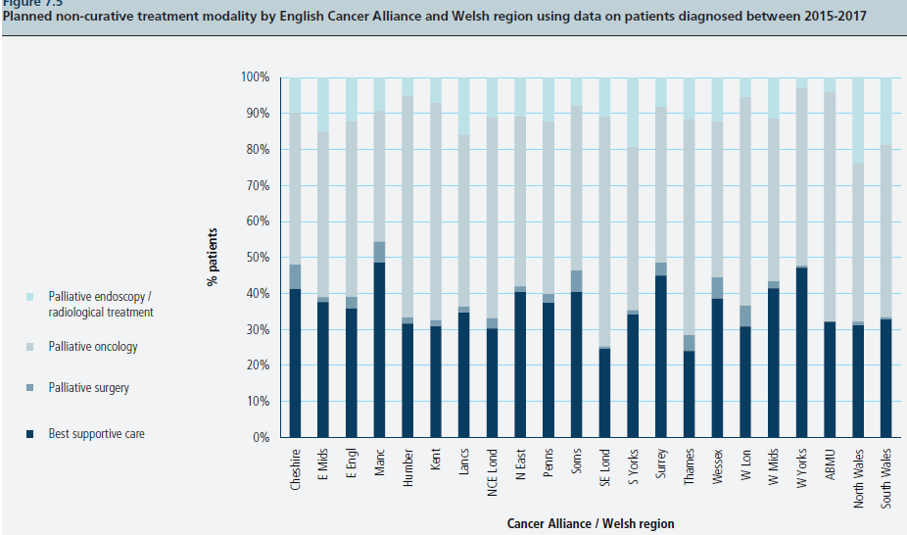

Slide 33
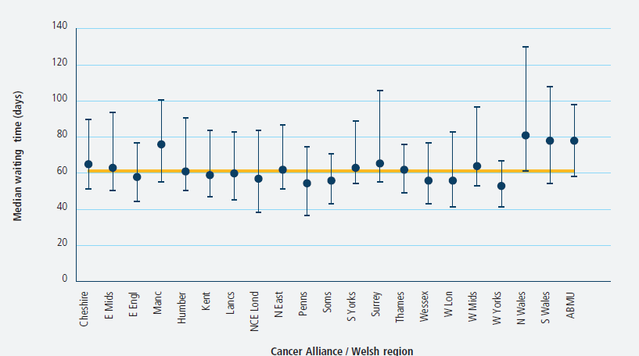

Slide 34
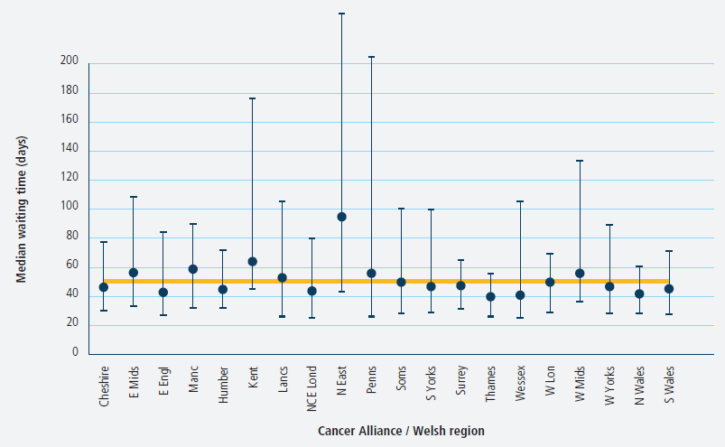

Slide 35
Palliative chemotherapy: triplet regimens
Guidelines recommend the use of triplet regimens (including a platinum-based agent, a fluoropyrimidine and an anthracycline) as a first line treatment option
There was regional variation in the use of triplet regimens, especially among patients aged 80 years and over

Slide 36

For further details: www.nogca.org.uk

