Slide 1
Identifying differences in the experiences of care between patients diagnosed with metastatic cancer of known and unknown primaries
Dr Richard Wagland
Faculty of Health Sciences
University of Southampton
Notes:
Please use the dd month yyyy format for the date for example 11 January 2008. The main title can be one or two lines long.

Slide 2
Previous QoL/ psycho-social research
Lack of understanding of CUP amongst pts
High level of uncertainty and distress (anxiety/depression)
Greater number of investigations (‘chasing the primary’)
Problems with care continuity/accountability – MDT tennis
NICE Guidance (2010)
Taxonomy (MUO, pCUP, cCUP)
Recommendation for an MDT in each Trust
Notes:
Previous research suggested the need to compare experience of CUP with broad range of patients with a known primary
Hereditary nature

Slide 3
Matched CPES frequency analysis compared CUP vs. non-CUP Methods
CPES (2013) data (n=4,535 identified as CUP patients).
Samples matched on 5 variables: (sex; age group; admission type; tumour type; time since tx start).
CUP patients who began tx in the past year, (n=1496)
χ2 tests associations: CUP vs non-CUP and each item
A ‘small’ or greater effect was classified as meaningful Cramer’s V >0.1 (df=1) or >0.07 (df=2)

Slide 5
Matched samples

Slide 6
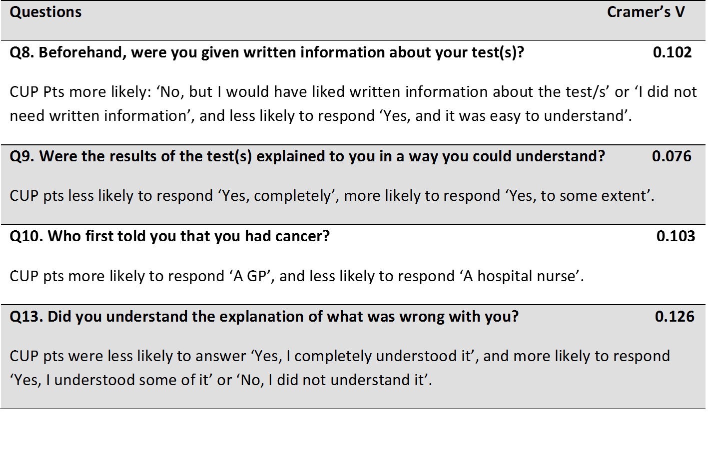
Results I

Slide 7
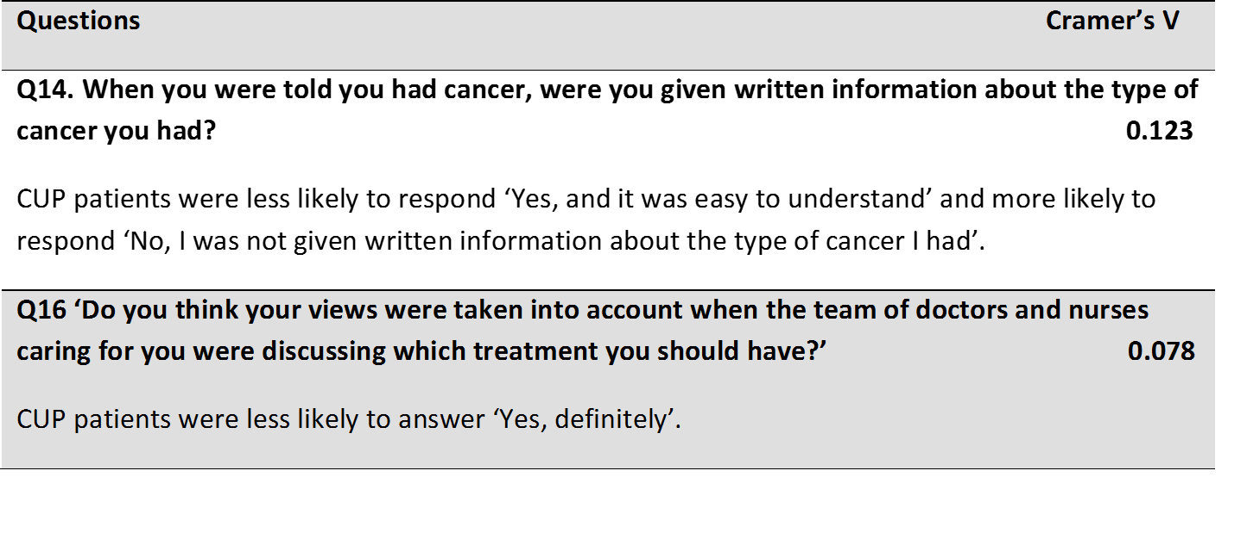
Results II

Slide 8
Results III

Slide 9
Sample limitations
Findings suggest experience CUP & non-CUP similar, except for 9 areas
Reflects findings from previous research
But, CUP sample not rep profile:
12m survival: 62% (sample) vs. 16% (NCRAS)
ICD-C80: 11% (sample) vs. 49% (NCRAS)
Thus,
CUP sample – more positive experience than expected

Slide 10
Further issues
Survey completed several months post-diagnosis/tx
ICD-10 codes do not differentiate CUP Taxonomy (MUO, pCUP and cCUP)
CPES sample = Trust admin data records: possible errors:
Errors in ICD coding of Pts (coded by admin staff)
Multiple ICD codes recorded within medical notes
Pt status not updated if primary found (multi MDTS)
Pt perception of disease/ Dr ‘best-guess – impact on CPES responses

Slide 11
Conclusion
First large scale comparison CUP Vs. non-CUP experience
Specific areas for targeted psychoeducational interventions
Greater uncertainty re: understanding diagnosis
Less prepared for diagnostic investigations
But, signif limitations found with CPES CUP sample data
Need for prospective, observational cohort studies for more complete understanding of the issues faced by CUP pts.
Difficulties re: ethics/ identifying non-frail cCUP pts

Slide 12
Acknowledgements
Allison Drosdowsky, MacCallum Cancer Institute, Melbourne, Australia
Prof. Alison Richardson, University of Southampton, UK
Dr John Symons, Cancer of Unknown Primary Foundation
Linda Mileshkin, Peter MacCallum Cancer Institute, Melbourne, Australia
Dr Mike Bracher, University of Southampton, UK
Prof. Penny Schofield, Swinburne University of Technology Melbourne, Australia

Slide 13
Reference
Boyland L, Davis C. Patients' experiences of carcinoma of unknown primary site: dealing with uncertainty. Palliat Med 2008;22:177–83.
Richardson A, Wagland R, Foster R, et al. Uncertainty and anxiety in the cancer of unknown primary patient journey: a multiperspective qualitative study. BMJ Support Palliat Care 2015;5:366–72.
Hyphantis T, Papadimitriou I, Petrakis D, et al. Psychiatric manifestations, personality traits and health-related quality of life in cancer of unknown primary site. Psychooncology 2013;22:2009–15.
Karapetis CS, Guccione L, Tattersall MH, et al. Perceptions of cancer of unknown primary site: a national survey of Australian medical oncologists. Intern Med J 2017;47:408–14.

