Slide 1
Lung Cancer Diagnosis and Management 2019 NICE Guidance
Doug West
Thoracic Surgeon, University Hospitals Bristol
Vice Chair, NICE Lung Cancer Guideline Update Committee 2019

Slide 2
Who are NICE?
Founded 1999
Public body within Department of Health
Guidance covers England and Wales
“Improving health and social care through evidence-based guidance”
Considers safety, clinical and cost effectiveness (as QALYs/ICERs*). QALY threshold c£20,000-30,000/QALY
*Incremental cost effectiveness ratio

Slide 3
Types of NICE guidance
Clinical Guidelines
Technology Appraisals (TAs)
Interventional Procedures Guidance
Quality standards
Language: “consider” vs. “offer”

Slide 4
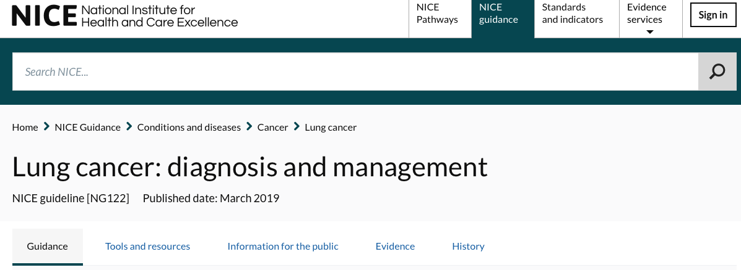
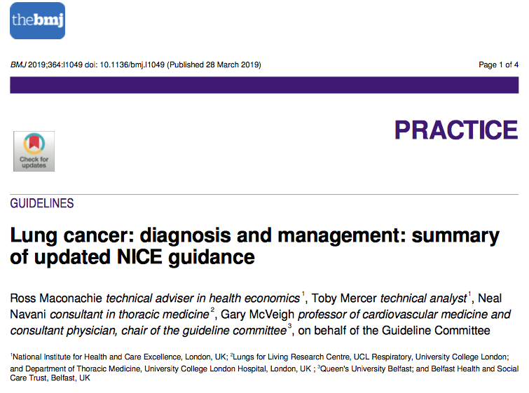
2019 NICE lung cancer update

Slide 5
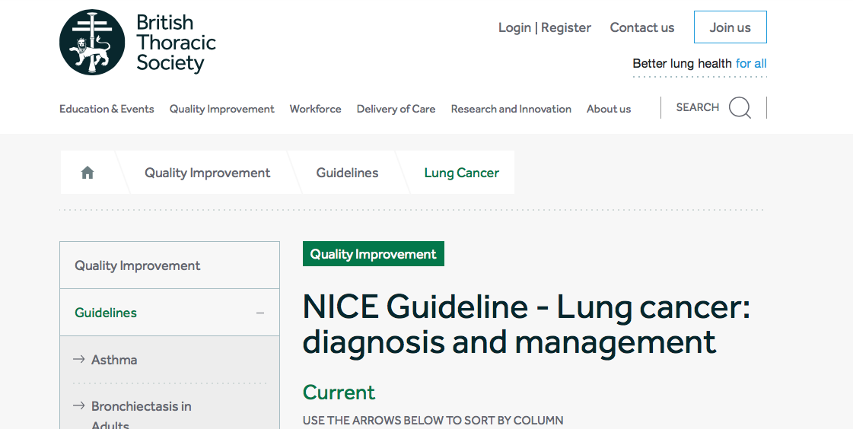
BTS/SCTS guidance now superceded

Slide 6
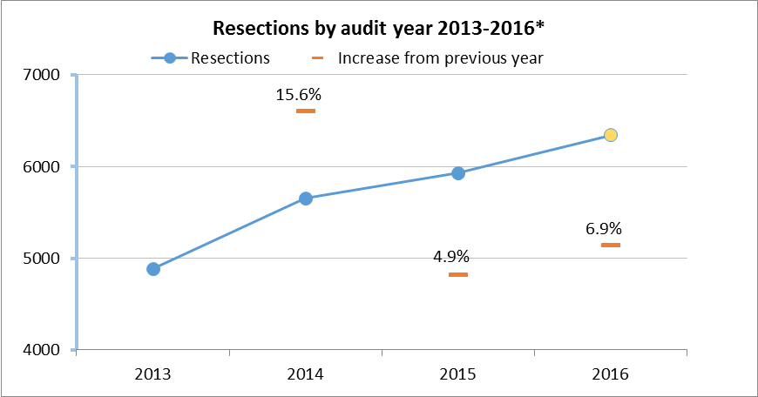
Lung cancer surgery
Significant and continuing rise in activity
Improved peri-operative care and falling mortality likely to increase further
TBC; screening and stage migration

Slide 7
Tobacco addiction
Stop smoking interventions and services
1.4.1
Inform people that smoking increases the risk of pulmonary complications after lung cancer surgery. [2011]
1.4.2
Advise people to stop smoking as soon as the diagnosis of lung cancer is suspected and tell them why this is important. [2011]
1.4.3
Offer nicotine replacement therapy and other therapies to help people to stop smoking in line with the NICE guideline on stop smoking interventions and services and the NICE technology appraisal guidance on varenicline for smoking cessation. [2011]
1.4.4
Do not postpone surgery for lung cancer to allow people to stop smoking. [2011]

Slide 8
Diagnosis
CT chest and upper abdo for all
FDG CT-PET if radical therapy contemplated
May be role for MRI in superior sulcus (Pancoast) tumours

Slide 9
New 2019: Brain imaging
Workup for radical therapy
Stage I
No imaging after PET-CT
Stage II
Brain CT
Stage III
Brain MRI

Slide 10
Brain imaging- why?
Already included in co-registration CT for PET
Undiagnosed (clinically and radiologically) brain metastases
Risk of futile radical therapy / unnecessary reduction in HRQoL
Risk of occult mets. increases with stage

Slide 11
Brain imaging- why?
Already included in co-registration CT for PET
Undiagnosed (clinically and radiologically) brain metastases
Risk of futile radical therapy / unnecessary reduction in HRQoL
Risk of occult mets. increases with stage
Evidence review 1.5-21.4% of stage I-IIIA will have mets on MRI
Expectation: more brain imaging and therapy (SABR etc) for brain mets

Slide 12
Staging
Offer PET-CT (if not already done), followed by EBUS‑TBNA and/or EUS‑FNA, to people with suspected lung cancer who have enlarged intrathoracic lymph nodes (lymph nodes greater than or equal to 10 mm short axis on CT) and who could potentially have treatment with curative intent. [2019]
1.3.20
Evaluate PET-CT-positive or enlarged intrathoracic nodes using a systematic approach[3] with EBUS‑TBNA and/or EUS‑FNA if nodal status would affect the treatment plan. [2019]
1.3.21
Consider surgical mediastinal staging for people with a negative EBUS‑TBNA or EUS‑FNA if clinical suspicion of nodal malignancy is high and nodal status would affect their treatment plan. [2019]
Reducing role for bronchoscopy

Slide 13
Invasive node staging: move to EBUS
PET-CT
PET-CT+EBUS
PET-CT+ EBUS
Declining role for mediastinoscopy; role in PET-avid mediastinum
with negative EBUS but poor quality/uncertain

Slide 14
Declining role of mediastinoscopy
EBUS-TBNA / EUS first line for invasive mediastinal staging
Role in confirming EBUS results IF
“clinical staging of nodal malignancy is high”
AND
“nodal status would affect their treatment plan”

Slide 15
Fitness assessment before surgery
Perform spirometry and transfer factor (TLCO) in all people being considered for treatment with curative intent. [2011, amended 2019]
Offer people surgery if they have a forced expiratory volume in 1 second (FEV1) within normal limits and good exercise tolerance. [2011]
When considering surgery perform a functional segment count to predict postoperative lung function. [2011]
Offer people with predicted postoperative FEV1 or TLCO below 30% the option of treatment with curative intent if they accept the risks of dyspnoea and associated complications.
Consider cardiopulmonary exercise testing to measure oxygen uptake (VO2 max) and assess lung function in people with moderate to high risk of postoperative dyspnoea, using more than 15 ml/kg/minute as a cut-off for good function. [2011]

Slide 16
Which operation?
Lobectomy VATS or open
More extensive resection only if needed for R0 margins
“Hilar and mediastinal sampling or resection”

Slide 17
Unfit for lobectomy?
Either or
Sublobar excision (segment / wedge)
Radiotherapy (SABR)
*SABR- stereotactic ablative radiotherapy

Slide 18
Non surgical outcomes for radical treatment of early stage disease
1.4.27
For people with stage I–IIA (T1a–T2b, N0, M0) NSCLC who decline surgery or in whom any surgery is contraindicated, offer SABR. If SABR is contraindicated, offer either conventional or hyperfractionated radiotherapy. [2019]
1.4.28
For eligible people with stage IIIA NSCLC who cannot tolerate or who decline chemoradiotherapy (with or without surgery), consider radical radiotherapy (either conventional or hyperfractionated). [2019]
1.4.29
For eligible people with stage IIIB NSCLC who cannot tolerate or who decline chemoradiotherapy, consider radical radiotherapy (either conventional or hyperfractionated). [2019]

Slide 19
Multimodality therapy
Consider adjuvant chemotherapy in PS 0-1 pN1-2
Consider adjuvant chemo in PS 0-1, tumour diameter >4cm
Combination Cisplatin-based chemo
New guidance: operable IIIA N2
For people with operable stage IIIA–N2 NSCLC who can have surgery and are well enough for multimodality therapy, consider chemoradiotherapy with surgery. [2019]

Slide 20
Operable IIIA N2 continued
1.4.41
Discuss the benefits and risks with the person before starting chemoradiotherapy with surgery, including that:
chemoradiotherapy with surgery improves progression-free survival
chemoradiotherapy with surgery may improve overall survival. [2019]
1.4.42
For people with stage IIIA–N2 NSCLC who are having chemoradiotherapy and surgery, ensure that their surgery is scheduled for 3 to 5 weeks after the chemoradiotherapy. [2019]
1.4.43
Multidisciplinary teams that provide chemoradiotherapy with surgery should have expertise in the combined therapy and in all of the individual components. [2019]

Slide 21
Small cell lung cancer surgery
Consider surgery in T1-T2a N0 M0 SCLC
Offer Cisplatin based chemotherapy in M0
Offer twice daily radiotherapy in M0 PS 0-1
Mainstay of treatment is early chemotherapy and radiotherapy

Slide 22
SACT for Advanced Disease (M1)
Radically different in age of targeted and immunotherapy
Focus now on obtaining tissue sufficient for early genetics

Slide 25
Follow up after radical treatment
1.6.1
Offer all people with lung cancer an initial specialist follow-up appointment within 6 weeks of completing treatment to discuss ongoing care. Offer regular appointments after this, rather than relying on the person requesting appointments when they experience symptoms. [2011]
1.6.2
Offer protocol-driven follow-up led by a lung cancer clinical nurse specialist as an option for people with a life expectancy of more than 3 months. [2011]
1.6.3
Ensure that people know how to contact the lung cancer clinical nurse specialist involved in their care between their scheduled hospital visits. [2011]

Slide 26
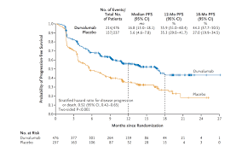
This guidance does not contain any…
Screening (pre NELSON)
VATS vs. open lung resection (waiting for VIOLET)
Palliation of pleural effusion (outside scope)
Mesothelioma
Follow up not reviewed
PACIFIC trial (IO in irresectable III N2)

Slide 27
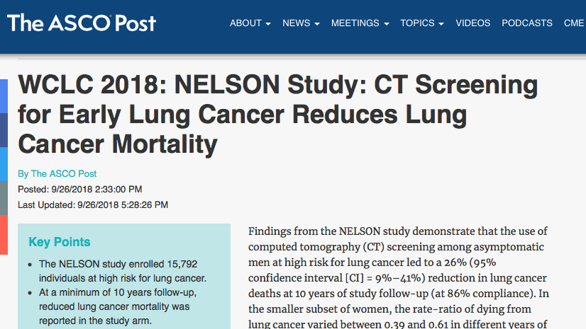
This guidance does not contain any…
Screening (pre NELSON)
VATS vs. open lung resection (waiting for VIOLET)
Palliation of pleural effusion (outside scope)
Mesothelioma
Follow up not reviewed
PACIFIC trial (IO in irresectable III N2)

Slide 28
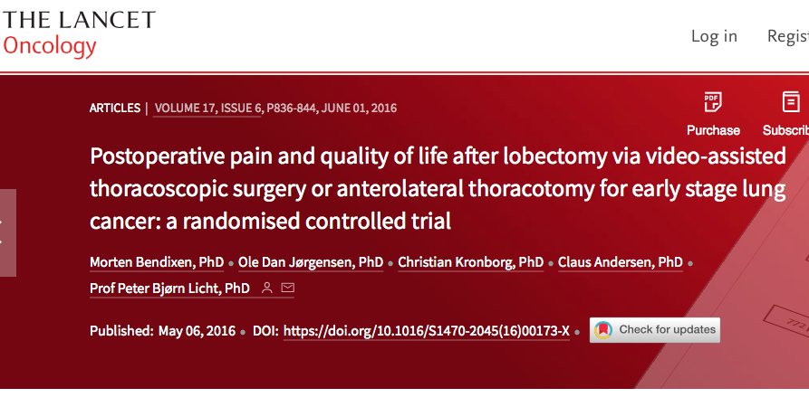
This guidance does not contain any…
Screening (pre NELSON)
VATS vs. open lung resection (waiting for VIOLET)
Palliation of pleural effusion (outside scope)
Mesothelioma
Follow up not reviewed
PACIFIC trial (IO in irresectable III N2)

Slide 29
Palliation of pleural effusion
Out of scope for 2019 guideline update
Other palliative treatments
1.5.7
Perform pleural aspiration or drainage in an attempt to relieve the symptoms of a pleural effusion. [2005]
1.5.8
Patients who benefit symptomatically from aspiration or drainage of fluid should be offered talc pleurodesis for longer-term benefit. [2005]
1.5.9
Consider non-drug interventions based on psychosocial support, breathing control and coping strategies for people with breathlessness. [2005]

Slide 30
Indwelling pleural catheters for malignant effusion; 2019 exceptional review
Why? Concerns from NHSE Clinical Expert Group and NICE guideline committee
10 new RCTs/systematic reviews
“no significant differences in outcomes including success rate and improvement of dyspnoea…One identified pleurodesis failure rate was higher in IPC compared with talc slurry pleurodesis…. mixed evidence concerning adverse event rate with IPC… several studies noted that IPC may be associated with a shorter length of hospital stay and fewer repeat pleural interventions.”

Slide 31
Recommendations for research: the known unknowns
(1) Role of immunotherapy after multimodality therapy including surgery
Why?

Slide 32
Recommendations for research: the known unknowns
PACIFIC
Bx proven unresectable stage 3 NSCLC
WHO 0-1
PD-L1 naïve
No progression after 2 cycles chemorads
Median PFS 16.8 vs. 5.6 months
PD-L1 status did not influence response

Slide 33
Recommendations for research: the known unknowns
(1) Role of immunotherapy after multimodality therapy including surgery
Why?
Significant PFS superiority for Durvalumab + chemoRT vs chemoRT alone in PACIFIC
Similar PFS (?OS) benefits may be possible in resectable stage IIIA pN2

Slide 34
Recommendations for research: the known unknowns
(2) SABR vs. surgery for early NSCLC

Slide 35
Thank you

