Slide 1
National Cancer Patient Experience (NCPES) Results 2017
Colorectal SSG January 2019

Slide 2
2017 NCPES
Any adult ( >16) with a cancer diagnosis and had an Inpatient or day case associated care episode during 01/04/17 – 30/06/17
Outsourced to Quality health pts sent postal questionnaires Oct’17
National response rate was 63% (2016 - 67%)
Results published end of September,2018 (previously published in July) 2018 surveys have been sent out for same time frame and 2019 CPES will include outpatient work for the first time
Results have not been published for Weston as 21 + responses are needed per question for results to be published
You can check any trust’s quantitative results at www.ncpes.co.uk
2017 | Trust responses | Colorectal responses
UHBristol | 755 | 59
North Bristol | 591 | 31
Glos / Chelt | 1182 | 53
Taunton | 544 | 67
Yeovil | 176 | 29
Weston | 197 | 7
Bath | 496 | 55

Slide 3
Overall, how would you rate your care (out of 10)?

Slide 4
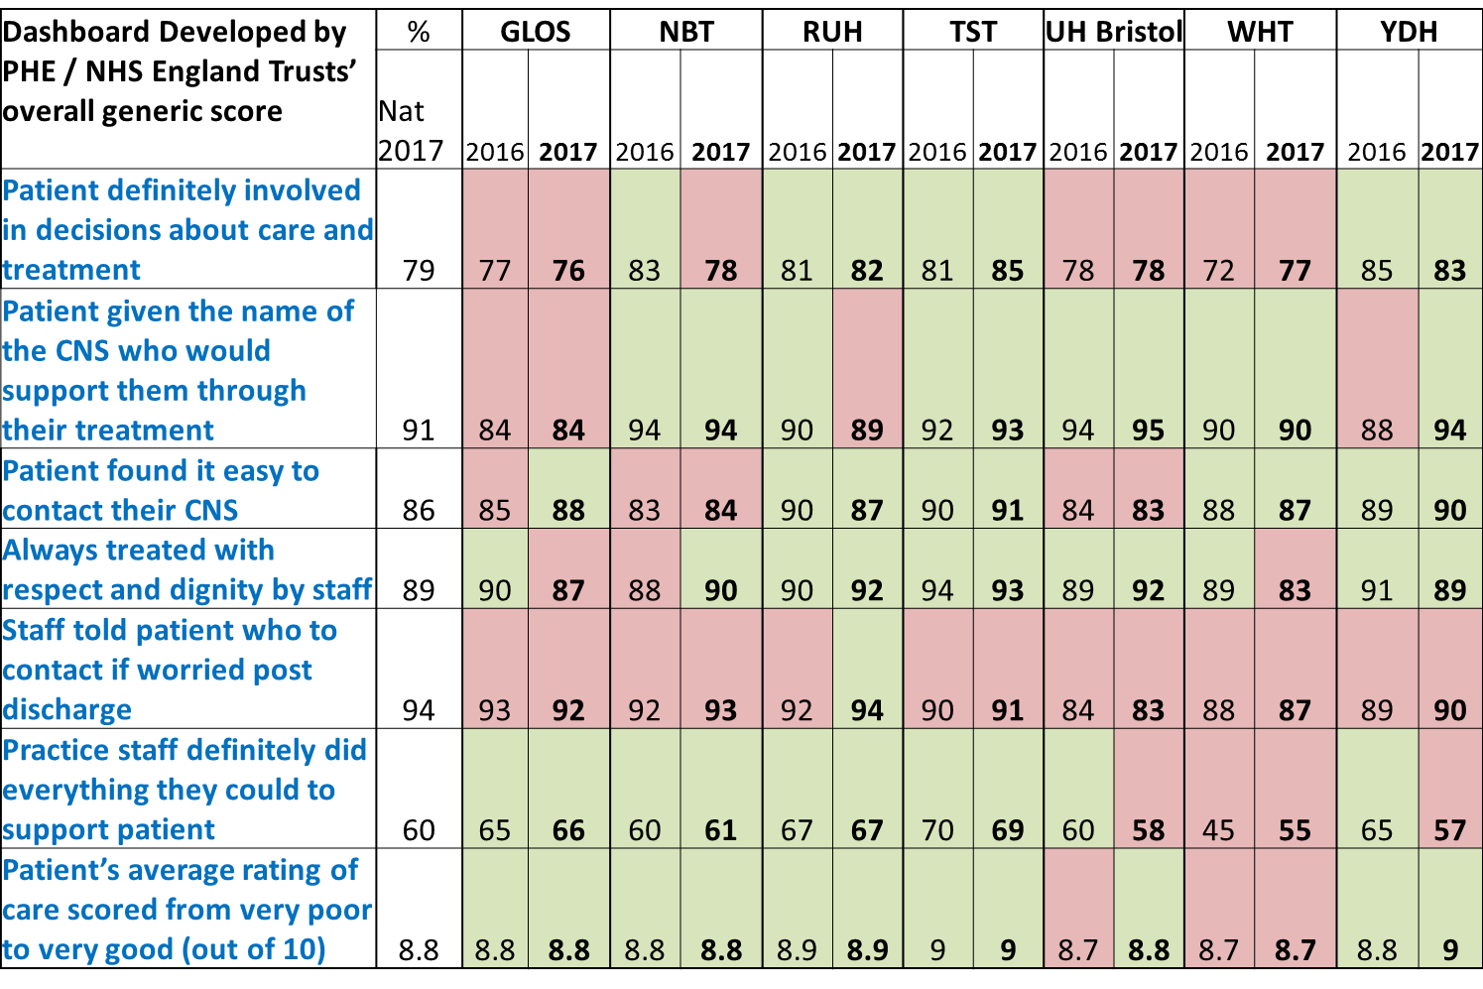
Any results less than the national average % are in red

Slide 5
Q5. Beforehand, did you have all the information you needed about your test?
Q5 and onwards hospital based

Slide 6
Q8. When you were first told that you had cancer, had you been told you could bring a family member or friend with you?

Slide 7
Q10. Did you understand the explanation of what was wrong with you?

Slide 8
Q12. Before your cancer treatment started, were your treatment options explained to you?

Slide 9
Q15. Before you started your treatment(s), were you also told about any side effects of the treatment that could affect you in the future rather than straight away?
LWBC link

Slide 10
Q16. Were you involved as much as you wanted to be in decisions about your care and treatment?

Slide 11
Q17. Were you given the name of a Clinical Nurse Specialist who would support you through your treatment?

Slide 12
Q18. How easy or difficult has it been to contact your clinical nurse specialist?

Slide 13
Q19. When you have had important questions to ask your Clinical Nurse Specialist, how often have you got answers you could understand?

Slide 14
Q20. Did hospital staff give you information about support or self-help groups for people with cancer?
LWBC link

Slide 15
Did hospital staff discuss with you or give you information about the impact cancer could have on your day to day activities (for example, your work life or education)?

Slide 16
Q48. Once you started your treatment, were you given enough information about whether your chemotherapy was working in a way you could understand?

Slide 17
Q55. Have you been given a care plan?

Slide 18
Q58. Since your diagnosis, has anyone discussed with you whether you would like to take part in cancer research?

Slide 19
Why CPES results are important
Since 2008 the National Cancer Survivorship Initiative (NSCI) in partnership with Macmillan and DoH have been looking at patient experience and they recommend five shifts in care:
1) Support people affected by cancer by greater focus on recovery, health and well-being after cancer treatment, 2) stratify how we follow up patients, 3) shift towards self-management and 4) shift towards personalised care planning and the last shift is
5) how patient experience should inform service provision and the recommendation is on a shift from emphasis on measuring clinical activity to emphasis on experience and outcomes ( PROMS)
Also outside our organisation these patient experience results are used in:
The external Quality Surveillance for our provision of quality cancer services (national cancer peer review),
good indicator/ matric in the NSHE transformational Living With and Beyond Cancer (LWBC) project and funding i.e. increase % care plans
CHKS accreditation for our chemotherapy services and discussed with the CQC inspectorate

