Slide 3
A good MDT
MDT working is considered the gold standard for cancer patient management bringing continuity of care and reducing variation in access to treatment – and ultimately improving outcomes for patients.
The number of patients to be discussed in MDT meetings has grown significantly, as has the complexity of patients; due to an ageing population and the growing number of treatment options available.
The way that MDT meetings are organised has not adapted to cope with this increased demand.
Clinical trials can be seen as the problem not the solution

Slide 4
MDT meeting

Slide 5
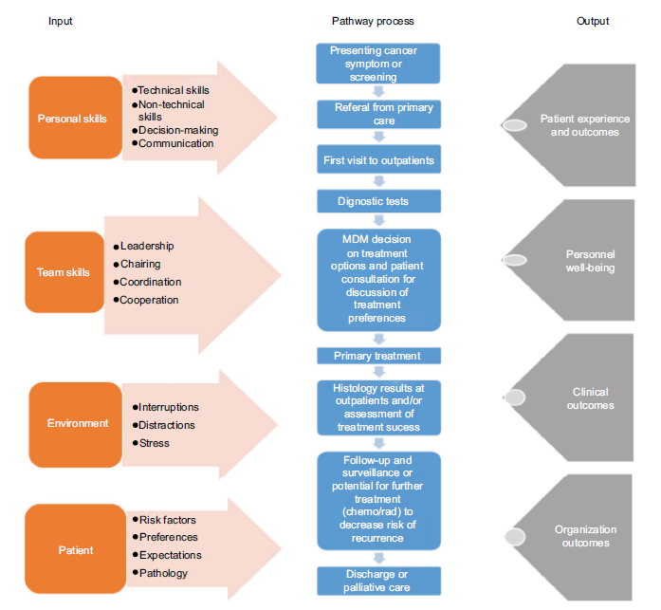

Slide 6
MDT and MDT meeting are integrated but distinct
It helps when the MDTs run out of time to get agreement of change
Next steps – easy wins
Streamline EUS referrals HPB
Protocolise OG pathway

Slide 7
MDT efficiency and effectiveness project colorectal cancer Bristol
The process is initiated by the referrer to the MDT
The referrer completes the demographics and retains responsibility for actioning outcomes
The referrer/endoscopist follows the pathway i.e. requests relevant initial investigations
Therafter the radiology and pathology proformas trigger outcome by the MDT co-ordinator who books relevant appointments

Slide 8
Colon cancer Endoscopy
Endoscopy Action
Histology No Fit for colonoscopy Yes Colonoscopy
No/uncertain Clinic review
Yes Radiology report

Slide 9
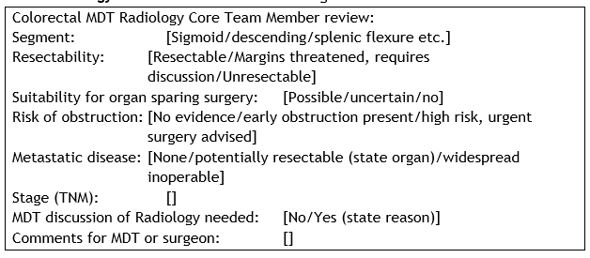
Radiology

Slide 10
Pathology

Slide 11
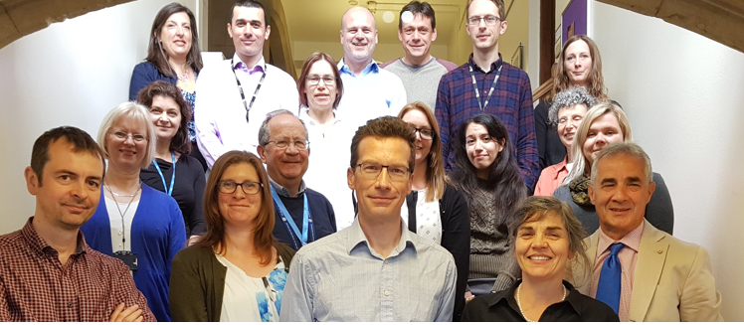
What has worked and not for us
Effective team working yes/no
Whole team buy in and ownership yes/no
Uptake of radiology template reporting yes/no
‘I like the way it is and see no reason to change’
‘I like concentrating on those cases that need discussion’

Slide 12
MDT Evaluation
4 sites only returned data
Three out of the four sites that introduced SoCs increased the time spent on discussion of cases, after they were introduced.
• Two out of four sites reduced number of patients discussed, with the other two sites increasing the number of patients discussed, one only marginally. The reason for this is unclear and may be due to variation in caseload and timing of introduction around Christmas.
• There were some marginal changes in the case mix of patients discussed before and after the introduction of Standards of Care, e.g. in prostate almost three quarters of patients not discussed had stage 1&2 disease. However, these findings should be interpreted as indicative only due to small sample size.
• From qualitative interviews, MDTs felt that introducing streamlining had reduced pressure on the MDTM creating a less stressful environment.

Slide 13
MDT Evaluation outcome
For staff who are involved in the streamlining process (usually the MDT coordinator as well as key clinical staff) there is an impact on their time, however for many staff involved in the main MDTM there is evidence of potential to save time.
• There is not a one-size-fits-all solution, and proposed models of streamlining may not be appropriate for all tumour sites. Variations relating to the characteristics of different tumour sites, existing guidelines, the size and approach taken by different MDTMs and hospitals all impact on the suitability of using Standards of Care for streamlining.
• Consultation on the proposals also highlighted the importance of, and need for, effective radiology and histopathology input into the MDMT as well as concerns relating to losing the educational element of the MDTM.
• Patient safety emerged as a key theme. A number of safety mechanisms were suggested in the interviews to ensure that patients who are not discussed receive safe and appropriate care.

Slide 14
Draft Alliance guidelines implementation
The Cancer Alliance should work with site-specific clinical leads to identify MDTs in which to begin work on developing and introducing Standards of Care.
□ Standards of Care should be developed and signed off by the relevant Cancer Alliance tumour pathway board, or equivalent, in collaboration with the clinical lead for that tumour site.
□ The Medical Director and lead cancer clinician at a Trust should sign off the Standards of Care before they are implemented at Trust level. This is to ensure clinical oversight and buy-in to facilitate practice change.
□ The MDTMs to which streamlining applies should be agreed at both Alliance and Trust level, and done in agreement with all those involved in the pathway.
□ A process for triage should be agreed at Trust level with approval from the Medical Director before Standards of Care are introduced, with roles and responsibilities set out for: referring clinicians, those involved in reviewing cases, and the MDT Chair. This may require consideration of job plans.
□ An approach to audit should be set out before streamlining begins, to ensure that all information is captured and scheduled for review at appropriate intervals, including consideration of how patient representatives can contribute to audits.

Slide 15
Developing predetermined SoC
The following steps must be completed for predetermined SoC to be signed off by the Cancer Alliance:
• Identify the point in a predetermined SoC where referral to the MDTM is required, and incorporate NHS England’s timed pathways for the diagnosis of patients, where applicable, to support the Faster Diagnosis Standard.
• Clear clinical parameters for the application of the predetermined SoC, e.g. histological sub-type, stage and grade of disease, and therefore a patient does not require full discussion at MDTM. They should also give consideration to situations where a predetermined SoC would not apply.
• The predetermined SoC identified must be based on national or international standards, guidelines and protocols, and best practice as determined by the tumour pathway board. The clinical guidelines used in generating the predetermined standards of care must be referenced

Slide 16
Implementing streamlining
All patients on a Cancer Alliance agreed predetermined Standard of Care must be listed at the full MDTM. No patient should be removed from oversight of the MDTM or responsibility of the MDTM.
• Patients listed “not for discussion” must have a completed minimum data set available (see section 7 below) which has been implemented as agreed by the tumour pathway board.
• If there are any queries on a patient or new information becomes available in advance of, at, or after the MDTM then the patient should be discussed at the MDTM; this could include physiological or psycho-social needs. Ability to refer the patient ‘for discussion’ is a safeguard for patient care.
• The MDTM should undertake a regular audit of patient cases not discussed in relation to the appropriateness of patients receiving a predetermined SoC and their outcome.
• Implementing streamlining may require changes to processes across clinical, administrative, and management roles. It is important to engage all staff to raise awareness and collaborate to help the work to embed effectively.

Slide 17
Minimum core data requirements:
The following information must be accounted for in order to list a patient not for discussion at the MDTM:
• Diagnosis date (specify mode of diagnosis)
• Stage (specify investigations)
• Performance status
• Histopathological and/or cytological diagnosis;
• Co-morbidities;
• Availability of, and suitability for, clinical trial/s;
• Relevant genomic/genetic testing;
• Patient preference (if known) and/or any special circumstances have been taken into consideration
• MDTM recommendation and treatment pathway;
• Any additional tumour-specific tests needed to inform diagnosis

Slide 18
For a patient to be assigned for brief or no discussion at the MDT meeting
They have been seen by a core MDT member consultant or clinical nurse specialist (CNS)
• The minimum core data requirements have been met
• The pathology has been reported by designated persons for that tumour type
• Images have been reported by designated persons for that tumour type
• All other tests relevant to the decision-making have been completed (e.g. genomics)
• Patient preference stated (if known) and any special circumstances have been taken into consideration. Patients should be referred to the MDTM for discussion where preference contradicts a SoC pathway.
• The predetermined SoC has been reviewed by an appropriate person or triage group, there is clarity that it is appropriate, and all of the above have been fulfilled.

Slide 19
Audit
MDTMs should review a sample of patient data quarterly, covering both patients on predetermined Standards of Care, and those referred for discussion at the MDTM. This will not replace pre-existing arrangements for annual operational meetings for MDTMs. Process and outcomes of the audit should be documented.
The streamlining of MDTMs will obviate the need for some audit. However initially, it may be necessary to institute more regular audit of MDTM processes to allow real time assessment of the implementation of the MDTM streamlining.
8.1.2 Topics for inclusion in audit
Audit meetings should cover both clinical and operational functioning of the streamlining MDT Meeting. Topics for inclusion are outlined in the Annex.

Slide 20
What next
To attempt to painlessly move the process forwards
The SOC is the easy bit
How to make MDT meetings more effective but not increase bureaucracy and avoid a different triage process ie a second MDT

