Slide 1


Slide 2
A good MDT
MDT working is considered the gold standard for cancer patient management bringing continuity of care and reducing variation in access to treatment – and ultimately improving outcomes for patients.
The number of patients to be discussed in MDT meetings has grown significantly, as has the complexity of patients; due to an ageing population and the growing number of treatment options available.
The way that MDT meetings are organised has not adapted to cope with this increased demand.

Slide 3
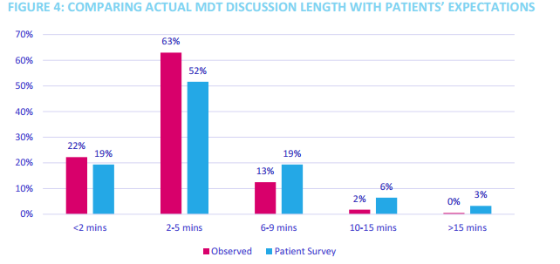
Time pressures

Slide 4
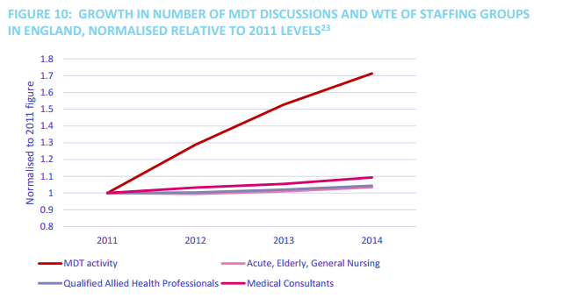
Time pressures

Slide 5
Quality and relevance of a MDT meeting within a multi-disciplinary team
The quality of decision making has been shown to drop dramatically after discussion of 20 patient/after 1 hour
Introduction of a 10 minute break in the MDT has been shown to bring balance to the quality of decision making and reduce the overall time of the meeting.
Streamlining MDTs should work around the needs of radiology and pathology colleagues
The key to streamlining is teamwork
Teamwork in MDTs can be measured, assessed and improved, and there 3 validated tools that can be used for this purpose
Training is required to use the tools to assess MDT performance.

Slide 6
Whats happening
NHS England had a pilot period
Locally
  Colorectal cancer
  Skin cancer
  Urology
  Sarcoma
  Pathology
  Common theme is
  Triage

Slide 7
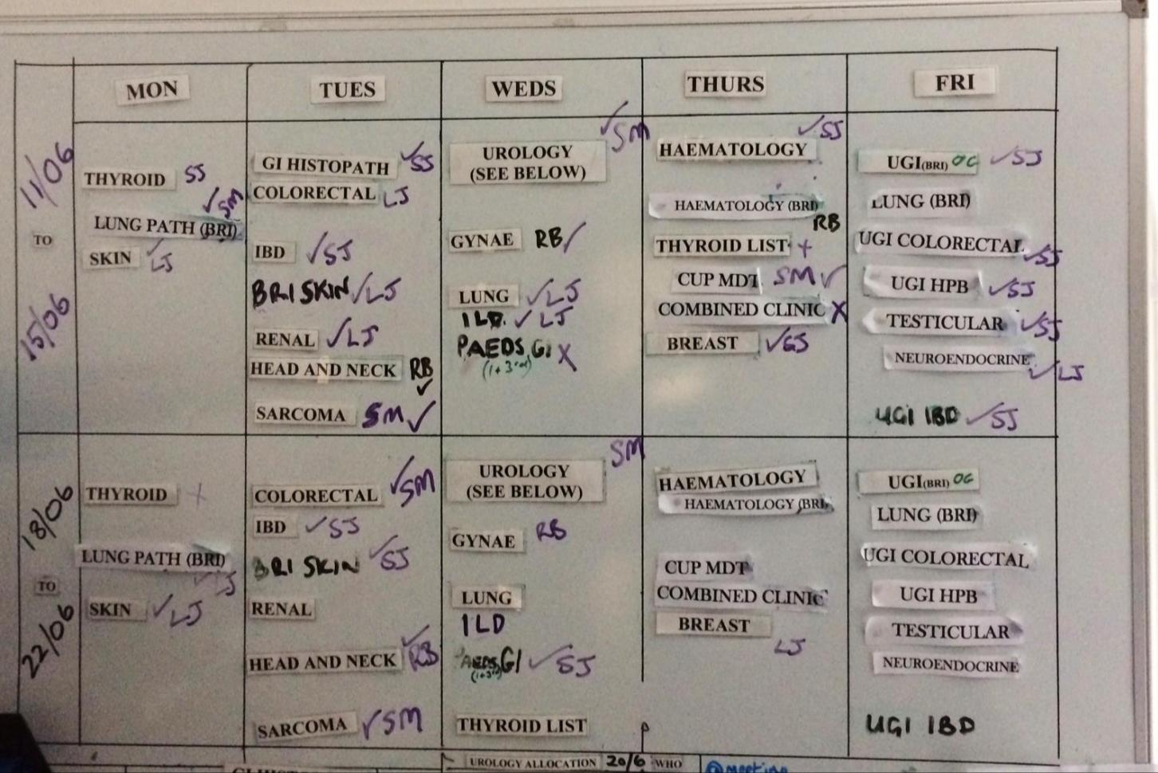

Slide 8
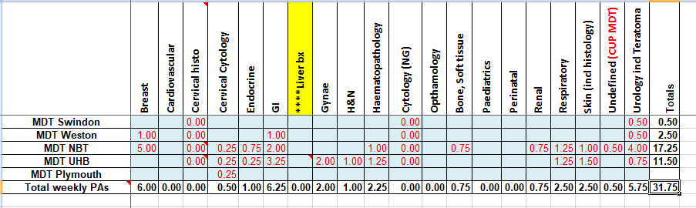
MDT workload

Slide 9
How can we make the MDTM better?
Triage cases
  Standardised treatment pathways
  Pre-MDT for clinicians
Improve TAT for pathology will decrease chasing
Realistic TATs
In-line MDT review for pathology

Slide 10
Does pathology review add value?
Introduction of double reporting all cancers
Specialist reporting
High proportion of cases the clinical information provided at MDTM does not change the diagnosis
Why do we review?

Slide 11
Path A
Reads slides
REPORT
MDT REVIEW
Path B Double reports
Audit pulls slides and prints report
Path A,B or C Reviews slides and report
Treatment can commence
Treatment can commence
MDT REVIEW
REPORT
Path A
Reads slides
Path B Double reports + checks report + adds line MDT review agrees
Audit prints report ONLY
Path A,B or C Reviews report ONLY

Slide 12
Draft Alliance guidelines implementation
Develop and agree standards of care
Agree an audit programme

Slide 13
Implementing streamlining
All patients on a Cancer Alliance agreed predetermined Standard of Care must be listed at the full MDTM. No patient should be removed from oversight of the MDTM or responsibility of the MDTM.
• Patients listed “not for discussion” must have a completed minimum data set available (see section 7 below) which has been implemented as agreed by the tumour pathway board.
• If there are any queries on a patient or new information becomes available in advance of, at, or after the MDTM then the patient should be discussed at the MDTM; this could include physiological or psycho-social needs. Ability to refer the patient ‘for discussion’ is a safeguard for patient care.
• Implementing streamlining may require changes to processes across clinical, administrative, and management roles. It is important to engage all staff to raise awareness and collaborate to help the work to embed effectively.

Slide 14
Minimum core data requirements:
The following information must be accounted for in order to list a patient not for discussion at the MDTM:
Diagnosis date (specify mode of diagnosis)
Stage (specify investigations)
Performance status
Histopathological and/or cytological diagnosis;
Co-morbidities;
Availability of, and suitability for, clinical trial/s;
Relevant genomic/genetic testing;
Patient preference (if known) and/or any special circumstances have been taken into consideration
MDTM recommendation and treatment pathway;
Any additional tumour-specific tests needed to inform diagnosis

Slide 15
For a patient to be assigned for brief or no discussion at the MDT meeting
They have been seen by a core MDT member consultant or clinical nurse specialist (CNS)
The minimum core data requirements have been met
The pathology has been reported by designated persons for that tumour type
Images have been reported by designated persons for that tumour type
All other tests relevant to the decision-making have been completed (e.g. genomics)
Patient preference stated (if known) and any special circumstances have been taken into consideration. Patients should be referred to the MDTM for discussion where preference contradicts a SoC pathway.
The predetermined SoC has been reviewed by an appropriate person or triage group, there is clarity that it is appropriate, and all of the above have been fulfilled.

Slide 16
MDT efficiency and effectiveness project colorectal cancer Bristol
The process is initiated by the referrer to the MDT
The referrer completes the demographics and retains responsibility for actioning outcomes
The referrer/endoscopist follows the pathway i.e. requests relevant initial investigations
Therafter the radiology and pathology proformas trigger outcome by the MDT co-ordinator who books relevant appointments

Slide 17
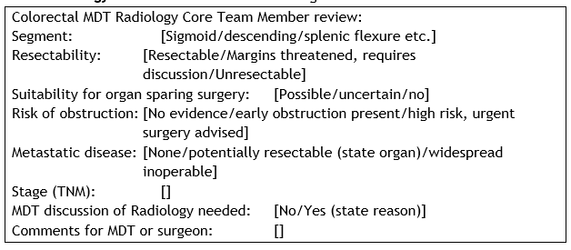
Radiology

Slide 18
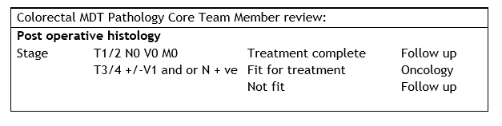
Pathology

Slide 19
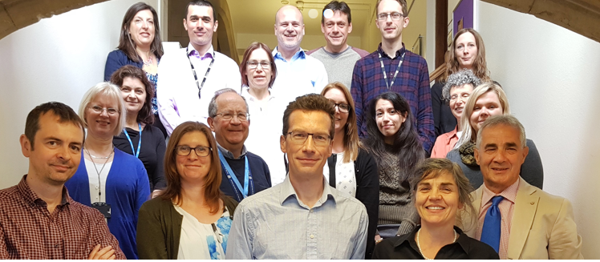
What has worked and not for us
Effective team working yes/no
Whole team buy in and ownership yes/no
Uptake of radiology template reporting yes/no
‘I like the way it is and see no reason to change’
‘I like concentrating on those cases that need discussion’

Slide 20
What next
To attempt to painlessly move the process forwards
The SOC is the easy bit- you have it
The challenge: How to make MDT meetings more effective but not increase bureaucracy and avoid a different triage process ie a second MDT
I have agreement from the alliance to support job plan changes to facilitate this programme

