Slide 1
Evaluating and improving MDTMs: a case study
North Bristol Trust Breast Cancer Multi-Disciplinary Team
Dr Alexandra Valencia, MDT Lead
Helen Dunderdale, SWAG Clinical Advisory Group Manager
Dr Tayana Soukup, Implementation and Improvement Scientist

Slide 2
Plan for this session
Background
Methods
Conclusions

Slide 3
Background

Slide 4
Multidisciplinary team (MDT) working is seen as the ‘gold standard’ in many countries
Care of cancer patients has become more complex due to the increasing numbers of diagnostic tests, treatments, and increased patient empowerment in decision-making
When MDTs do not work together effectively care can be sub-optimal; recommendations can be clinically inappropriate, or not acceptable to patients, resulting in delays to treatment, distress for patients and frustration for healthcare professionals
Effective MDT decision-making requires consideration of comprehensive patient-centred information at the point of decision-making
https://www.ncbi.nlm.nih.gov/pmc/articles/PMC5783021/

Slide 5
Assessing and improving MDT working is important
Increased performance
variability exists
https://www.ncbi.nlm.nih.gov/pubmed/30382292
Patient safety
“Teamwork as mechanism for enhancing patients safety” (IoM)
Cost-effectiveness
£822K/year; prep time £100mil/year
https://www.bmj.com/rapid-response/2011/11/02/cost-mdt

Slide 6
Methods

Slide 7
Study setting
1x team: Breast Cancer MDT from Bristol
Trained assessor
3x meetings: baseline assessments between July and August 2019
1x team feedback session

Slide 8
Team Audit and Feedback [Identify, Assess, Feedback, Improve]
1. IDENTIFY a problem / issue
Performance in MDMs
2. ASSESS:
Team’s baseline performance against evidence and recommendations, or previous phase
3. FEEDBACK: Feed back results to the team, and introduce QI intervention
4. IMPROVE:
Implement QI intervention
5. REPEAT
the cycle
(steps 2 to 4)
Benchmark performance against: 2 1. team’s baseline performance 2. recommendations 3. evidence

Slide 9
Team Audit and Feedback [Identify, Assess, Feedback, Improve]
1. IDENTIFY a problem / issue
Performance in MDMs
2. ASSESS:
Team’s baseline performance against evidence and recommendations, or previous phase
3. FEEDBACK: Feed back results to the team, and introduce QI intervention
4. IMPROVE:
Implement QI intervention
5. REPEAT
the cycle
(steps 2 to 4)
EVIDENCE-BASED:
Non-punitive and actionable feedback provided to professionals to allow them to assess and adjust their performance is effective in improving practice and supporting quality and safety in healthcare settings.
Flottorp et al., 2010; Michie et al., 2005; Ivers et al., 2012

Slide 10
“We can only be sure to improve what we can actually measure”
Professor A Darzi
High Quality Care for All
Department of Health (UK) 2008

Slide 11
Tools for MDT assessment
Instrument/Tool | What it measures
1. MDT-MODe | Team decision-making process
2. MDT-ORAS | Team functioning as expressed in national UK guidance (18 components)
3. TEAM | Core functions of the team and their team meetings, based on the components defined in “the characteristics of effective MDT
4. MDT-MOT | Team attendance, leadership/chairing of the MDM, teamwork and culture
5. MDT-FIT | Encompasses validated components of MDT-MOT and TEAM, allows self-assessment of team working, combined with expert feedback from facilitator, and sharing of the outcome with the team as part of a team-reflective discussion
6. ATLAS* | Leadership and chairing skills
7. MeDiC** | Gauges complexity of cases for MDT discussion (streamlining workload)
https://www.ncbi.nlm.nih.gov/pubmed/29403284

Slide 12
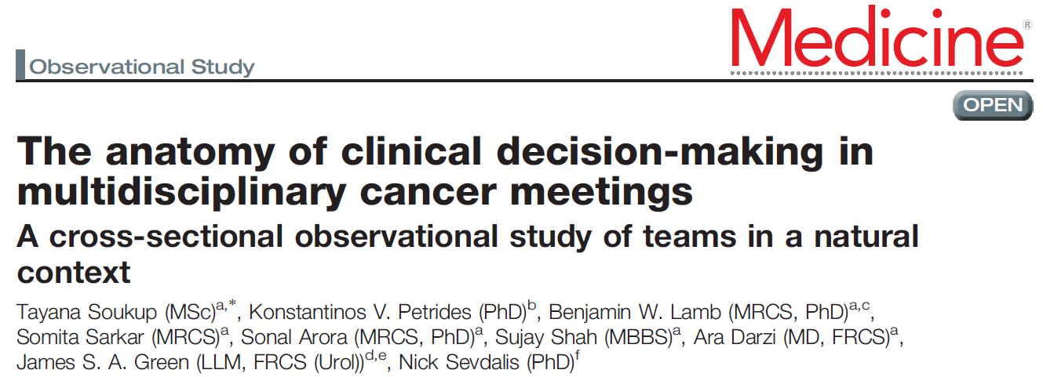
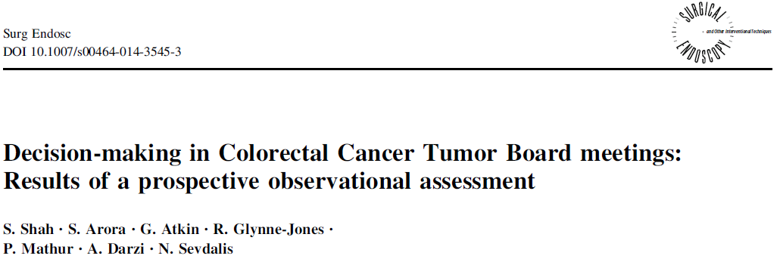
The most widely used MDT tool across different cancers, teams and countries….
Across various cancer:
Urology
Colorectal
Upper GI
Head & Neck
Breast
Lung
Gynaecological
Used by clinical and non-clinical researchers
Notes:
12

Slide 13
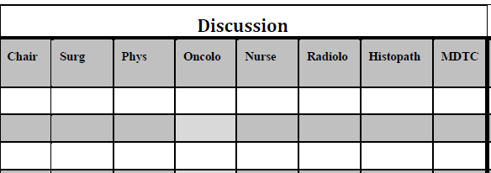
https://www.ncbi.nlm.nih.gov/pubmed/21610266
1. Quality of
information
2. Quality of
contributions
3. Decision made is recorded as yes, no, or deferred to next MDT

Slide 14
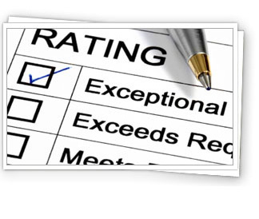
MDT-MODe Rating Scale
5-point scale
Anchors vary slightly
1 | 2 | 3 | 4 | 5
Poor, inadequate, no information, absent contribution |  | Average, with some vagueness or inconsistencies |  | Good, comprehensive information & fluid contribution
COMPROMISED Decision-Making ENHANCED

Slide 15
MDT-MODe Rating Scale (CONT.)
Scored as N/A when:
a one stop clinic case is benign and no further action contributions from the oncologists and nurses are not applicable as they won’t have been in clinic
a new radiology or one stop clinic case is malignant contributions from the nursing team are not applicable as the nurses are not present in the one stop clinic or radiology clinics

Slide 16
Results

Slide 17
Preliminary findings
299 patients discussed over 3 meetings
95, 103 and 101, respectively
2min av. discussion time per patient
Range: 20sec to 7min
37 cases deferred for another meeting
Data analysis in progress!

Slide 18
Discussion

Slide 19
Examples of practice…
15min meeting break occurred in the observed MDT after discussion of 48 cases in the first meeting, and 56 cases in the next two meetings
Thoughts from Helen:
As discussed in the first meeting of SWAG Cancer Clinical Leads, the prolonged length of meetings has been proven to reduce quality of decision making, particularly after the first hour, or discussion of 20 patients. The addition of a 10 minute break at this point has been shown to balance the quality of decision making and reduce the length of the overall meeting
https://bmjopen.bmj.com/content/9/5/e027303

Slide 20
Examples of practice cont.
Meeting room is configured in a U-shape which allows participants to see and hear each other clearly
Case discussions are ordered according to the patient pathway, which allows oncologists to attend a specific slot in the meeting
Role of Chair, Pathologist and Radiologist is rotated half way through the meeting
Surgeon who knows the patient introduces the case history
Research nurse facilitates discussion of relevant research trials
MDT outcome is relayed directly to the MDT Coordinator, typed immediately into the Somerset Cancer Register, and checked for accuracy by the relevant attendees

Slide 21
For consideration
Are some professional groups under-represented when they shouldn’t be? Could Chairing help with this?
Are certain types of information under-represented when it would be useful?
Could pathology provide a cut-off date for listing cases to report results from surgical samples?
Could some of the benign cases be removed if planning time is scheduled?
Could attendance be reduced further for particular sections of the meeting?

Slide 22
Thank you for listening. What do you think?

