Slide 1
Breast Multidisciplinary Team Meetings
Oncology Survey

Slide 2
Your Role What is your current role?
Clinical Oncologist
Medical Oncologist
Other

Slide 3
Diagnosis Should all patients undergoing needle biopsy or open surgical diagnostic biopsy be formally discussed at a MDTM ?
Yes
No
Not Certain

Slide 4
Diagnosis Does an Oncologist need to be present for that discussion ?
Yes
No
Not Certain

Slide 5
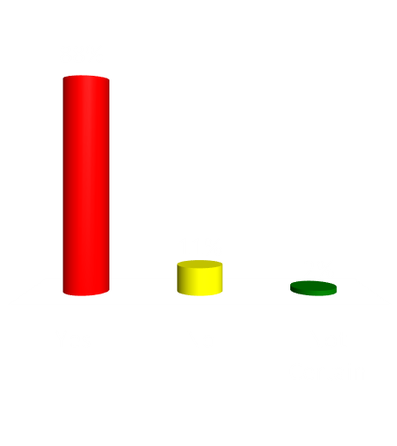
New Breast Cancer Diagnoses Should all newly diagnosed breast cancer cases be formally discussed at a MDTM before commencement of treatment ?
Yes
No
Not Certain

Slide 6
New Breast Cancer Diagnoses Does an Oncologist need to be present at a MDTM to discuss ALL newly diagnosed breast cancer cases before the commencement of treatment ?
Yes
No
Not Certain

Slide 7
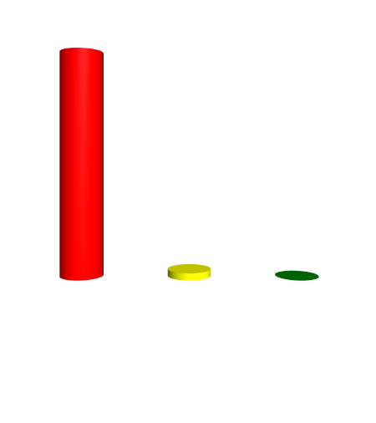
New Breast Cancer Diagnoses Does an Oncologist need to be present at a MDTM to discuss newly diagnosed breast cancer cases where neoadjuvant treatment is being considered as an option ?
Yes
No
Not Certain

Slide 8
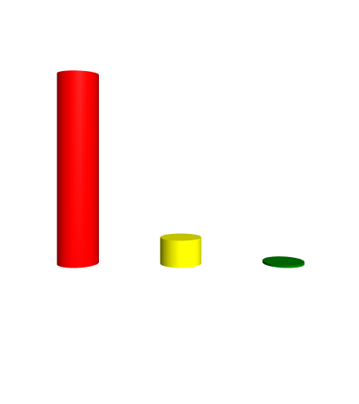
Post Op Should all breast cancer cases undergoing surgery be formally discussed at a MDTM following surgery ?
Yes
No
Not Certain

Slide 9
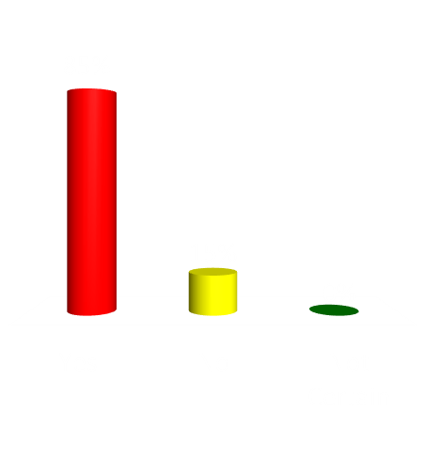
Post Op Does an Oncologist need to be present for that discussion ?
Yes
No
Not Certain

Slide 10
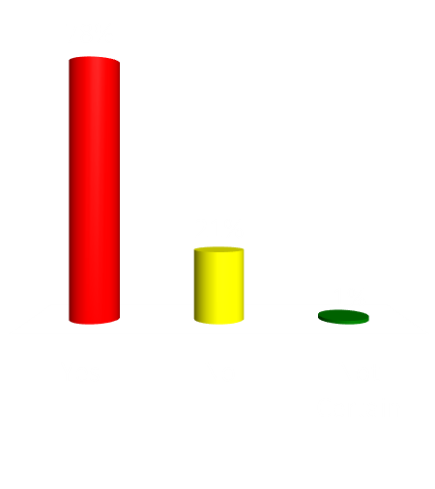
Breast Cancer Recurrence Should all breast cancer cases of recurrent breast cancer be formally discussed at a MDTM ?
Yes
No
Not Certain

Slide 11
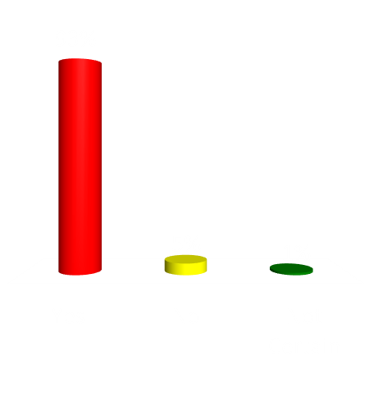
Breast Cancer Recurrence Does an Oncologist need to be present for that discussion ?
Yes
No
Not Certain

Slide 12
MDTM Transformation Would you be in favour of a reformed MDM system where only a small number of selected cases are formally discussed at a MDTM ? The majority of cases being placed on pre-agreed, recognised treatment algorithms / pathways
Yes
No
Not Certain

Slide 13
Have your say - MDTM Toolkit
Please contribute your ideas to improve
MDTM efficiency and if applicable give
examples of changes made to your Breast
MDTMs that may have already made them
more efficient
Please email your views / examples to:
mdtmtoolkit@gmail.com

