Slide 1
South West Lung Pathway Transformation
SWAG Cancer Alliance Role
Henry Steer
Lung Cancer clinical lead , SWAG

Slide 2
South West Lung Pathway Transformation
SWAG Cancer Alliance Role
Whilst STPs / ICSs are responsible for ensuring that the cancer services provided to their populations are of the highest standard……
Cancer Alliances provide clinical, operational and transformational leadership by bringing together their constituent commissioners and providers, on behalf of their STPs/ICSs to ensure system-wide oversight and transformation of cancer services and outcomes

Slide 3
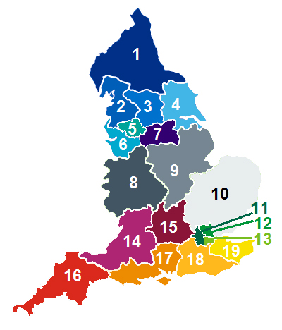
Cancer Alliance priorities 2018/19
Each Cancer Alliance brings together the key organisations in an area to coordinate cancer care and to plan for and lead delivery of improved outcomes for patients locally. This year Alliances are working to:
Support delivery of all eight waiting time standards for cancer, including the 62 day referral-to-treatment cancer standard.
Progress towards the 2020/21 ambition for 62% of cancer patients to be diagnosed at stage 1 or 2, and reduce the proportion of cancers diagnosed following an emergency admission.
Implement the nationally agreed rapid assessment and diagnostic pathways for lung, prostate and colorectal cancers, ensuring that patients get timely access to the latest diagnosis and treatment.

Slide 4
South West Lung Pathway Transformation
Planning Guidance Deliverable 1 - Sustainable Operational Performance – 2m
Priority | Planning Guidance deliverable
Cancer waiting times standards | Delivery of all eight cancer waiting times standards - increase capacity;
 | Delivery of all eight cancer waiting times standards - encourage effective, cross-organisational working
 | Delivery of all eight cancer waiting times standards - broker agreements between providers to balance supply and demand more effectively across the system
Time to diagnosis | All Trusts to be collecting the faster diagnosis standard mandatory data items starting from 1st April 2019
 | Demonstrable improvement in number of lung cancer patients diagnosed in 28 days
 | Demonstrable improvement in numbers of prostate cancer patients diagnosed in 28 days
 | Demonstrable improvement in numbers of colorectal cancer patients diagnosed in 28 days

Slide 5
Cancer Alliance Funding Allocation
£217,200 to achieve a demonstrable improvement in the number of lung cancer patients diagnosed in 28 days
Opportunity
Turnaround times for CT scans (request to report)
requesting of the ‘package of tests’ for potentially curative patients.
Thus the following methodology is proposed for spending these funds:
Eligibility
Providers who currently do not have CT scans completed and reported by day 7 of the 62 day pathway (based on median from quarter 3 2018/19)
Providers sending patients for curative treatment without all relevant tests being reported (PET scan, full pulmonary function tests, cardiopulmonary exercise testing and echocardiogram)
Allocation
Funds then split between eligible providers proportionally based on numbers of lung two week wait referrals at the provider
Financial Governance
Providers would have to prove by end of 2019/20 financial year that they had made permanent sustainable changes that enabled CT scans to be reported by day 7 of the 62 day pathway (median) and that 90% patients were being sent for curative treatment with relevant tests completed.

Slide 6
SW CA Lung Cancer Pathway Transformation Work Programme 2019/20 - SW CA Lung Cancer Pathway Delivery Group
Best practice resourcing
Reduce delays to diagnostics
Support MDT effectiveness improvements*
Optimise workforce skills mix*
Increase resection rates
Reduce delays to treatment
*Lung pathway work part of Cancer Alliance wide workstream

Slide 7
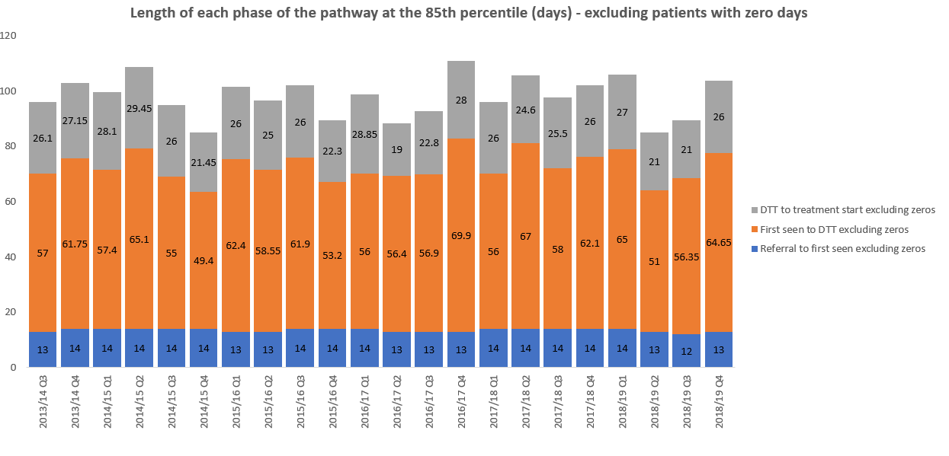
Lung Pathway (referral to treatment) - SWAG

Slide 8
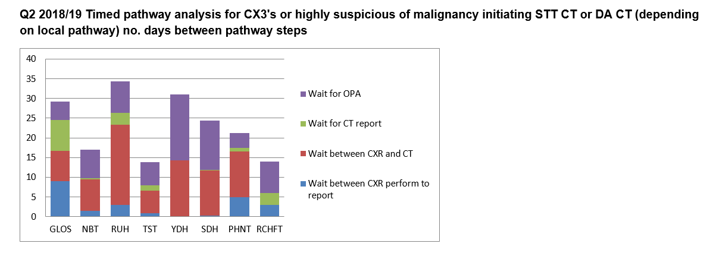

Slide 9
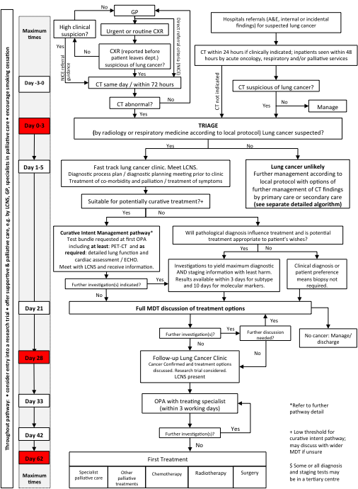
NOLCP - SWAG site visits

Slide 10
Provider: |  | Yeovil District Hospital NHS FT |  | Salisbury District Hospital NHS FT |  | RUH Bath |  | Gloucestershire Hospitals NHS FT |  | Taunton and Somerset NHS FT |  | UHB NHS FT
Pathway Milestone | Target of timed Milestone | Pathway step compliance (is this the next step / in place) | Provider baseline timed milestone | Pathway step compliance (is this the next step / in place) | Provider baseline timed milestone | Pathway step compliance (is this the next step / in place) | Provider baseline timed milestone | Pathway step compliance (is this the next step / in place) | Provider baseline timed milestone | Pathway step compliance (is this the next step / in place) | Provider baseline timed milestone | Pathway step compliance (is this the next step / in place) | Provider baseline timed milestone
Direct access to urgent or routine CXR from primary care | Day -3 to 0 | yes |  | yes |  | yes |  | yes | n/a | yes |  | yes
CXR reporting |  | within 24 hours |  | within 24 hours |  | within 24 hours |  | within 24 hours | n/a | within 24 hours |  | within 24 hours
Action on abnormal result secondary care responsibility |  | yes |  | yes |  | yes |  | yes | n/a | yes |  | yes
Escalation from CXR to CT (same day/within 72 hours) – ‘straight-to-CT’ arrangement in place as described in NOLCP implementation guide. |  | Yes 1-3 days | within 72 hours | yes- local solution |  | yes | same day |  |  | Yes
Direct access to CT (same day/ within 72 hours) – Arrangements can be put in place with primary care for patients with normal CXR but when clinical symptoms and risk factors continue to cause concern. Timeframes should be the same as for those with abnormal CT. |  |  |  | within 72 hours |  | same day |  |  |  | within 72 hours |  | within 72 hours
Triage by radiologist or lung physician | Day 0 to 3 | lung physician |  | lung physician |  | lung physician |  | lung physician |  | radiologist |  | lung physician
Local protocol developed to facilitate streamlined triage process |  | no |  |  |  | no | Pathway in place for streamlined triage but no agreed protocol | yes | No - due to delays in previous steps. | yes |  | yes
If lung cancer can be ruled out there is no need to see patient in a cancer clinic. |  | yes |  | yes |  | yes | Timeframe achieved in some cases but not all | yes |  | yes |  | no
Direct biopsy option – for when initial triage suggests cancer but patient unlikely to be suitable for curative treatment, |  | no |  | no | no | no | Not currently being explored | no | No - currently not offered due to radiology constraints. Some patients go directly from triage to EBUS. | no |  | no | N/A
Local protocol for direct biopsy option. |  | no |  | no | no | no | Not currently being explored | no |  | no |  | no
Fast track lung cancer clinic | Day 1 to 6 | yes |  | yes |  | yes | Timeframe achieved in some cases but not all | no |  | yes |  | yes
Meet Lung CNS in lung cancer clinic |  | yes |  | yes |  | yes |  | no |  | yes |  | yes
Diagnostic process plan, diagnostic planning meeting prior to clinic, treatment of co-morbidity and palliation/ treatment of symptoms). |  | yes |  | no |  | no |  | yes |  | yes |  | yes
Curative Intent Management pathway - test bundle requested at first outpatient appointment including at least PET-CT spirometry, with lung function and cardiac assessment/ ECHO as required. | Day 14 | yes |  | no |  | no | Where appropriate and available test bundle is requested | no |  | yes |  | no
MDT and discussion of treatment options (It is envisaged that when the new guidance on multidisciplinary team meetings is published in summer 2018, there will be a recommendation that some patients on clear and agreed cancer pathways may be discussed more briefly either at the beginning, or end, of the MDT). | Day 21 | yes | Timeframe of MDT 21-35 days | yes | Timeframe of MDT 21-35 days | yes | Timeframe achieved in some cases but not all |  |  | yes | Timeframe of MDT 21-35 days | yes | Timeframe of MDT 21-35 days
Local arrangement / networking to reduce PET-CT delays at this stage. |  | yes |  |  |  | yes |  |  |  | yes |  | yes
Follow up in Lung Cancer Clinic: cancer confirmed and treatment options discussed, or if no cancer diagnosis then manage/discharge (this should be at earliest opportunity e.g. by day 1-6 stage if CT excludes cancer). | Day 28 |  |  |  |  | yes | Timeframe achieved in some cases but not all |  |  | yes |  | yes
Any further investigations following MDT will have been completed by day 28. |  |  |  |  |  | no | Timeframe achieved in some cases but not all |  |  | yes |  | Yes (excl. staging med, which is outwith this timescale in the NOLCP)

Slide 11
Patient Information
RUH – most patients get leaflet from GP or Xray dept
All other trusts – PIL exist but minimal uptake
Reporting Tool
Most trusts CX3 only (everything else uncoded)
Gloucestershire created new CX2 code – low concern for cancer but CT correlation required, eg ?fat pad, ?vascular hilum etc – direct recall for urgent but non 2ww CT
CXR report goes to
GP plus one or more of cancer lead / cancer inbox / MDT / LCNS / fast track office
2ww trigger CX3 report requests 2ww from GP all providers

Slide 12
Who orders CT
Radiology – GHNHSFT, Taunton, UHB – automatic trigger
Respiratory – RUH (Cons), NBT (LCNS),
GP – Salisbury (3x CCGs)
CXR to CT times
NBT, Yeovil <72 hr
Others up to 7 days
CT reporting
Same day UHB, Salisbury
Others variable, often triaging/seeing pt with unreported scans

Slide 13
Triage
Glouc, RUH, Salisbury – consultant triage of 2ww, usually pre CT
NBT – LCNS triage 2ww and book CT + requests OPA
UHB – No triage but OPA triggered directly after CT (same day)
Taunton – 2ww vetted on receipt and CT then reviewed at twice weekly MDT
D/C from pathway post CT
Taunton – Only see pt with Ca on CT. Approx 75% 2ww referrals not seen in 2ww. Only need approx 6 2ww slots per week
Salisbury/Glouc/Yeovil – some (<20%) d/c without 2ww appt

Slide 14
Diagnostic MDT?
Only Taunton – diagnostic Mon, Treatment Thurs
UHB – All pt seen with CT hot reported by thoracic radiologist
Glouc/RUH – informal radiology support for triage by phone/email
Diagnostic bundles
RUH recently introduced
Others No / In progress

Slide 15
Navigators
RUH most advanced service – 2 Navigators.
Key – embedded within resp, work closely with LCNS/Ca lead
Proactive ++
Pick up CX3 reports, arrange CT requests, book and chase all Ix, book OPA, daily pathway review of all patients with LCNS, maintain tracking spreadsheet
Glouc – 1x Navigator, role to be redefined and readvertised
NBT – LCNS perform role
UHB/Taunton – admin support worker / resp secretary
Clinics
2ww capacity issues in Gloucester – changing structure/capacity in July
Otherwise most trusts able to see within 72 hours of CT.
Same day CT/clinic/RFTs BRI
US guided Neck FNA in clinic – Glouc

Slide 16
Diagnostics
CT bx – variable problems, with waits up to 14 days at times
EBUS – local in Glouc/NBT/UHB/RUH – waits <7 days
In set up Taunton/Salisbury
Thoracoscopy – UHB/RUH/Glouc/NBT/Taunton
IN set up – Salisbury
Pathology
Generally around a week for histo plus subtyping
Molecular testing
A problem – generally up to 10-14 day turnaround
All reflex test except Taunton – requested at MDT

Slide 17
Other initiatives
Pathway review meetings
RUH – daily review of all pt on pathway between Navigator/LCNS
UHB – pathway review meeting Wed
Consultant telephone triage
Glouc – selected patients phoned during triage and then seen with results of PET/RFTs etc on day 7-14 – dependent on CT done and referral information provided by GP.
Pt feedback positive (listening event Nov 18)
Haemoptysis with normal CXR pathway, Taunton
Triggers 2ww non contrast CT and then reviewed at diagnostic MDT. If not Ca then not seen.
Audit shows no cancers found in this group in 3 years
RUH ‘LIFT’ clinic
Planned fast track clinic/investigation day within 48 hr of CT
Radiographer CXR reporting
2 in training - Yeovil

Slide 18
Clinical Lead Visit Summary
Query | Consensus | Variation | Plans | Strengths / Challenges | Other
CXR-CT
Patient information Leaflets (PIL) | Developed for the pathway, accessible to GP's, Radiology re-affirmation | GP handout PIL, YDH and RUH confident |  |  | Possibly pathway process response v evidence of activity
Reporting tool | CX3 | RUH (CX1,2,3) GHFT (CX3 access pathway, CX2+ urgent CT - 3 weeks no 2WW) | GHFT audit CX2+ | YDH Radiographer training CXR
Reporting times | <=72 hours | Flagged to Hot report
CX3 report to | GP | Respiratory clinician, cancer services, LCNS, Respiratory secretary, radiology bookers |  | *LCNS capacity / recruitment *dedicated email box
Who orders CT |  | Respiratory Consultant, LCNS, Radiologist |  | *automated radiology dept process *YDH dedicated CT slots demand often exceeds capacity
CXR to CT wait | approx 7 days |  | 72 hours target | *YDH reduced wait times from 8.4-1.2 over 6 months* GHFT agreement with radiology teams *UHB ring fenced slots | Q2 project evaluation report challenges to data and increased CT scanners on line by Q1 2019/20
CT reporting wait | less than 7 days | UHB and TST ring fenced slots for CT or for reporting <3 days |  | Variation between 1-7 days at single providers where no ring fenced capacity
2ww | All CX3’s trigger request to GP for 2ww referral

Slide 19
Clinical Lead Visit Summary
Query | Consensus | Variation | Plans | Strengths / Challenges | Other
Triage
Who | Respiratory consultant / LCNS
When | On receipt 2ww | TST diagnostic MDT |  | majority pre CT
Proportion D/C following normal CT without OPA | Minimal | TST 75% |  | CT delays prevent triage post CT
Post triage diagnostic planning | Diagnostic planning at OPA | GHFT radically treatable cancer fit patient diagnostic planning call from Respiratory Consultant well received by patients |  | PET/RFTs/ECHO etc on day 0 and see pt with results on day 10-14 (OPA)
Diagnostic Bundles | If decision made for radical treatment booking PET / RFT's /ECHO etc likely at OPA or pa | *RUH adapted Manchester algorithms | Ambitions |  | UHB hold pathway meeting 1/week

Slide 20
Clinical Lead Visit Summary
Query | Consensus | Variation | Plans | Strengths / Challenges | Other
Navigator
Yes / No | In place or in progress | TST no current plans to fund
Role | Tracking | Booking Ix and OPA's
Clinical / Non clinical |  | NBT and YDH plans LCNS
Radiology
Thoraccic radiologists | Engaged |  |  | *GHFT scarcity, * lack of resiliance elsewhere
Clinics
Dedicated cancer clinics | In place or planned 2019 |  |  | LCNS results clinics
Capacity | Sub optimal - adhoc additional
Neck biopsy | No | GHFT in place, RUH considering
Same day testing | No | UHB OPA (CT and RFTs)

Slide 21
Clinical Lead Visit Summary
Query | Consensus | Variation | Plans | Strengths / Challenges | Other
MDT's
Separate diagnostic | No | TST in place 20/hour includes nodules and all 2ww CT's |  | GHFT dynamic radiology support for diagnostic planning
No's patients discussed | 15-35 over 1-2 hours
Diagnostics - Radiology
CT Bx | Yes 1-14 days | RUH upt to 21 days
PET CT | 7-14 days | ring fenced capacity agreements |  | electronic referral delayed
EBUS | In House for majority <1/52 | TST and YDH (RD&E or UHB) | TST go live pre October 2019
Thoracoscopy | In house for majority <1/52
Diagnostics - Pathology
Lung Pathologist | single
Turnaround | <1/52
Reflex testing |  | Not across all providers |  | UHB and NBT reflex pathology testing
Molecular testing | <14 days | UCL or Birmingham

Slide 22
MDT Streamlining (Draft) Guidance
Outcomes of streamlining patient discussions at MDTM:
Spending more time discussing patients with complex clinical or other issues. Patients will be stratified by either:
patient on a predetermined SoC (no discussion), or;
patient requires discussion for any given reason.
Patient stratified by their consultant in advance of MDTM
All patients accounted for
Definition of Predetermined Standard of Care (SoC)
A clinical intervention for a stage of disease or clinical scenario which is recognised by NICE or NHS England or a national or international professional group.
There may be 2 or more recognised SoCs for a stage of disease or clinical scenario.
A SoC includes a ‘watch and wait’ policy.
SoCs are chosen or drawn up by tumour site specialist MDTs with the alliance Tumour Pathway Board, must be referenced, signed off by the Cancer Alliance and apply across the geography of a Cancer Alliance.
SWAG CA ask is for each lung cancer MDT to describe their Standards of Care; with a view to sharing and discussing at future Clinical Advisory Group – Steve Falk is leading on this work stream and will define ask

Slide 23
NLCA organisational survey 2019
Portal now open for submissions. The deadline for submissions is Wednesday 19 June.
2019 NLCA Collaborating with the Getting it Right First Time (GIRFT) Lung cancer work programme.
Getting It Right First Time is a national programme designed to improve the quality of care within the NHS by reducing unwarranted variations.
By tackling variations in the way services are delivered across the NHS, and by sharing best practice between trusts, GIRFT identifies changes that will help improve care and patient outcomes, as well as delivering efficiencies such as the reduction of unnecessary procedures and cost savings. Importantly, GIRFT is led by frontline clinicians who are expert in the areas they are reviewing. This means the data that underpins the GIRFT methodology is being reviewed by people who understand those disciplines and manage those services on a daily basis. The GIRFT team visit every trust carrying out the specialties they are reviewing, investigating the data with their peers and discussing the individual challenges they face.

