Slide 1
Feedback from visit to Wythenshawe Hospital
Dr Vidan Masani
Lung SSG – November 2018

Slide 2
Wythenshawe Hospital
Tertiary Centre
  Surgery
  EBUS
  LAT (?)
On site thoracic surgery
Large team already in place

Slide 3
RAPID program
R apid
A ccess to
P ulmonary
I nvestigation
D ays

Slide 4
Background
Health Foundation grant
New lung cancer building
    RAPID hub
    Radiologist office with a reporting station
    Clinic rooms
    Recovery ward
    Bronch/EBUS suites

Slide 5
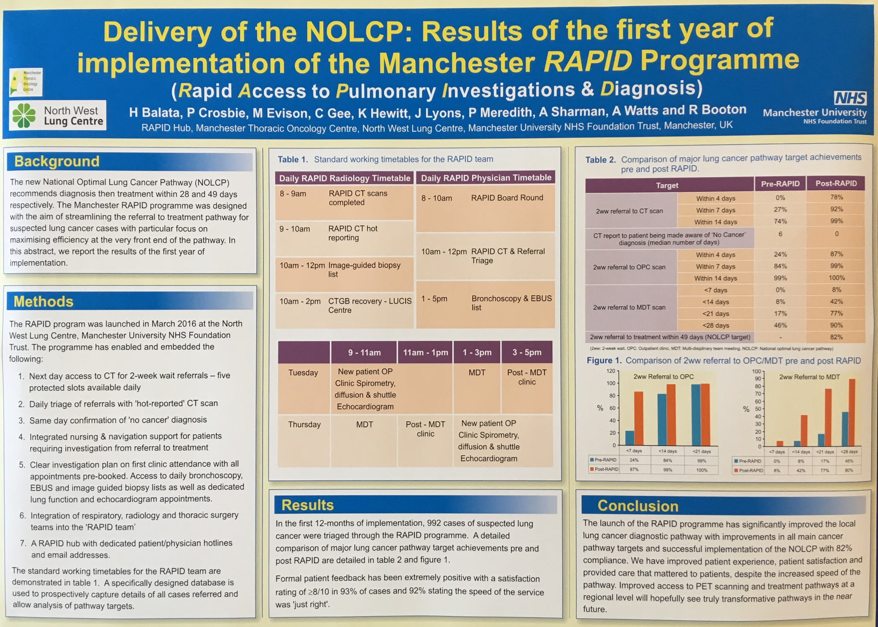

Slide 6
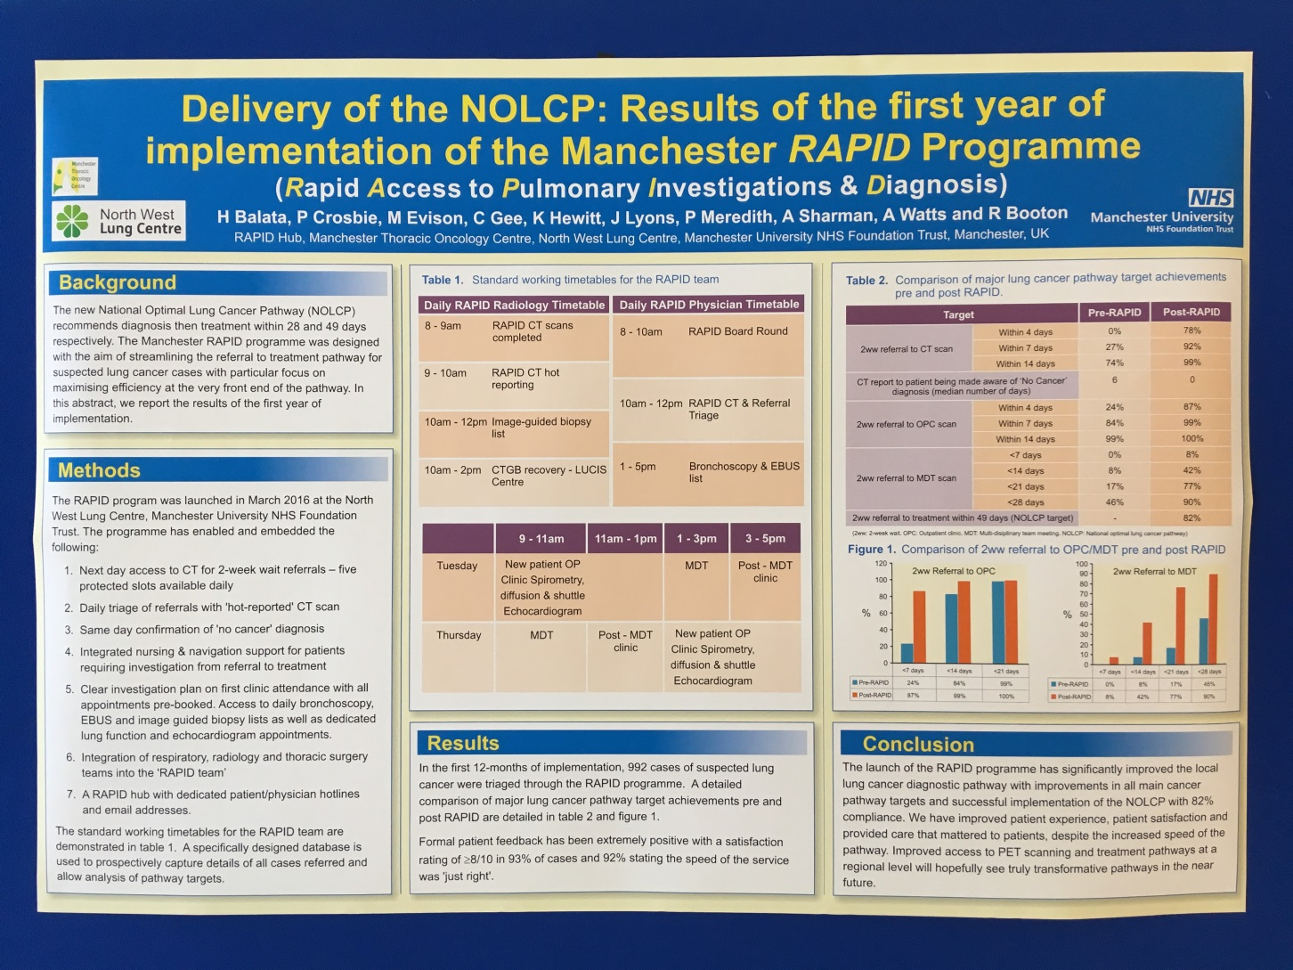

Slide 8
Big team!
7 WTE nurses
5.5 WTE band 3 HCAs
12 WTE administrative staff
3/4 lung cancer consultants
1 lung cancer radiologist
Also includes thoracic surgical team

Slide 9
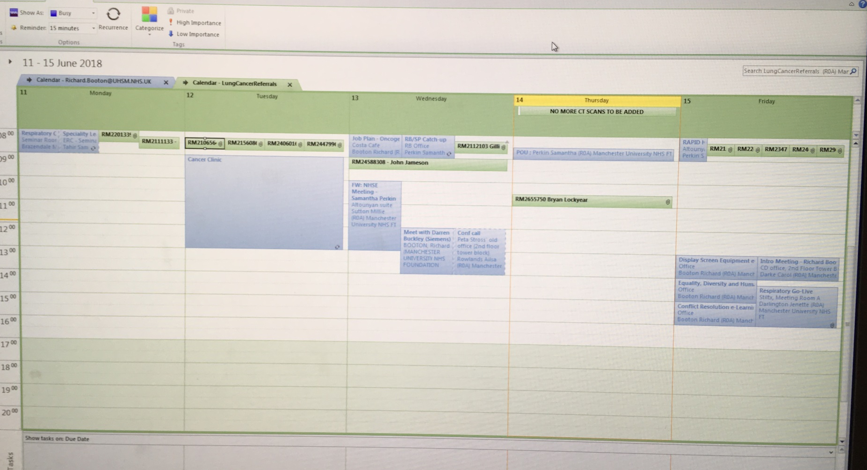

Slide 10
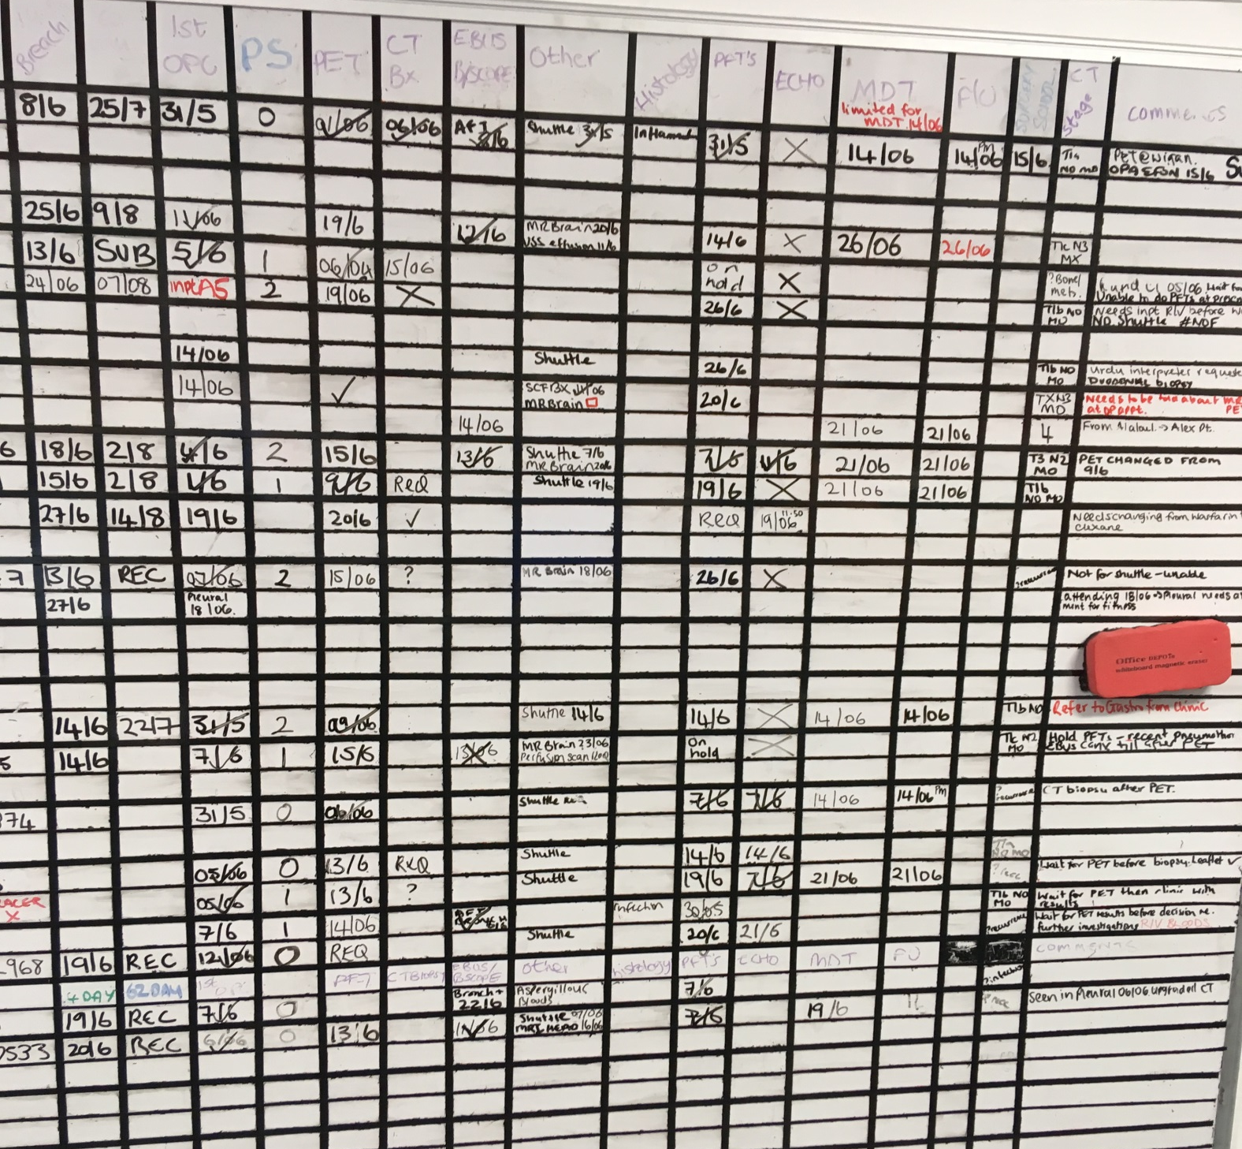

Slide 11
Key components
Team ethos
Coding
Finance
Part Radiology led
Part Nurse led

Slide 12
What could we do?
Extract the best parts which are applicable to our own local pathway
Foster team approach
Savvy with costings
NOLCP = 49 days
Don’t think no, think how

