Slide 1
Living Well With and Beyond Cancer
Catherine Neck

Slide 2
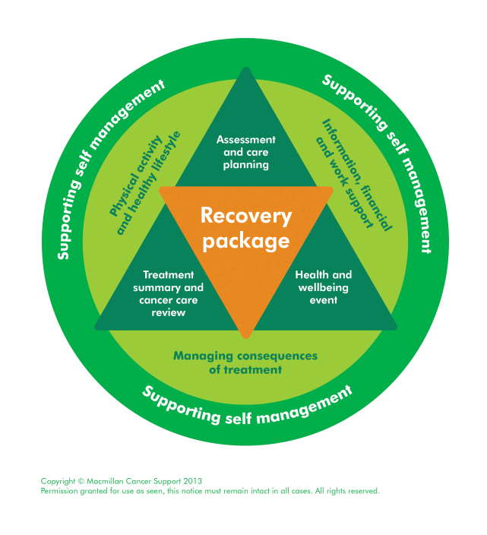
LWWBC
Recovery Package (Personalised Care and Support)
Holistic Needs Assessments
Health and Wellbeing Events
Treatment Summaries
Cancer Care Reviews
Risk stratification / pathway redesign
Cancer Support Workers
Rehabilitation
Community based Macmillan Rehab and Support Team
Macmillan Rehabilitation / Therapy Support Service in UHBristol
Prehabilitation
Penny Brohn UK- Treatment Support Clinic / Courses (Wellbeing support during and after cancer treatment)

Slide 3
Current projects
Significant Macmillan funding of LWWBC projects previously
Current Cancer Transformation Fund project – funded by NHS England, for 2 years, finishing March 2020
Awaiting sustainable funding commissioning decision

Slide 4
Holistic Needs Assessments
HNA (eHNA)
Structured assessment of holistic needs / concerns and care plan
Within 31 days of diagnosis & end of treatment
Electronic / paper / face to face or telephone
Clinical Nurse Specialists / Cancer Support Workers
Electronic Care plan to GPs / link to Treatment Summaries

Slide 5
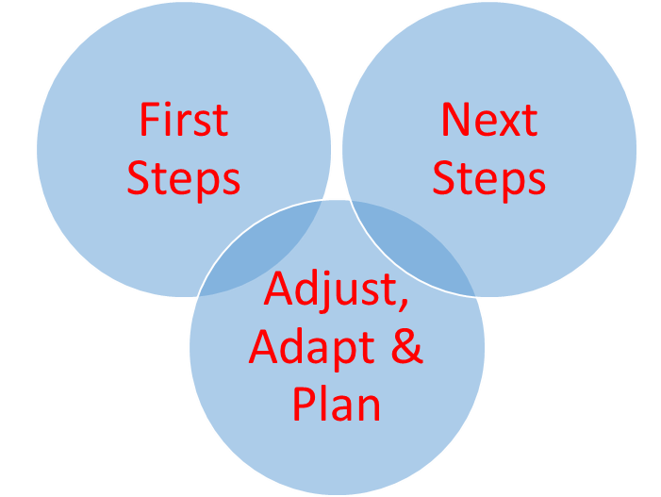
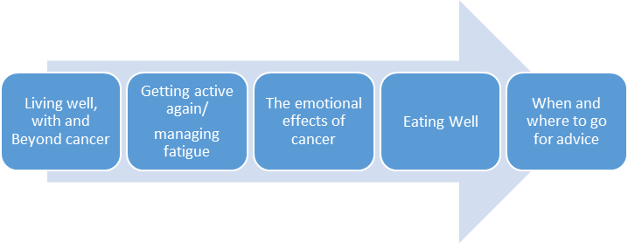
Health and Wellbeing Events
Information / education events for patients
First steps –
For people with a recent cancer diagnosis
Next Steps –
For people at the end of cancer treatment
Adjust, Adapt and Plan –
For people living with uncertainty and
a prognosis of ~ 6-36 months

Slide 7
Physio session, getting active again

Slide 8
Information
and refreshments

Slide 9
Break time – market stall information gathering, meeting other patients, CNSs, AHPs

Slide 10
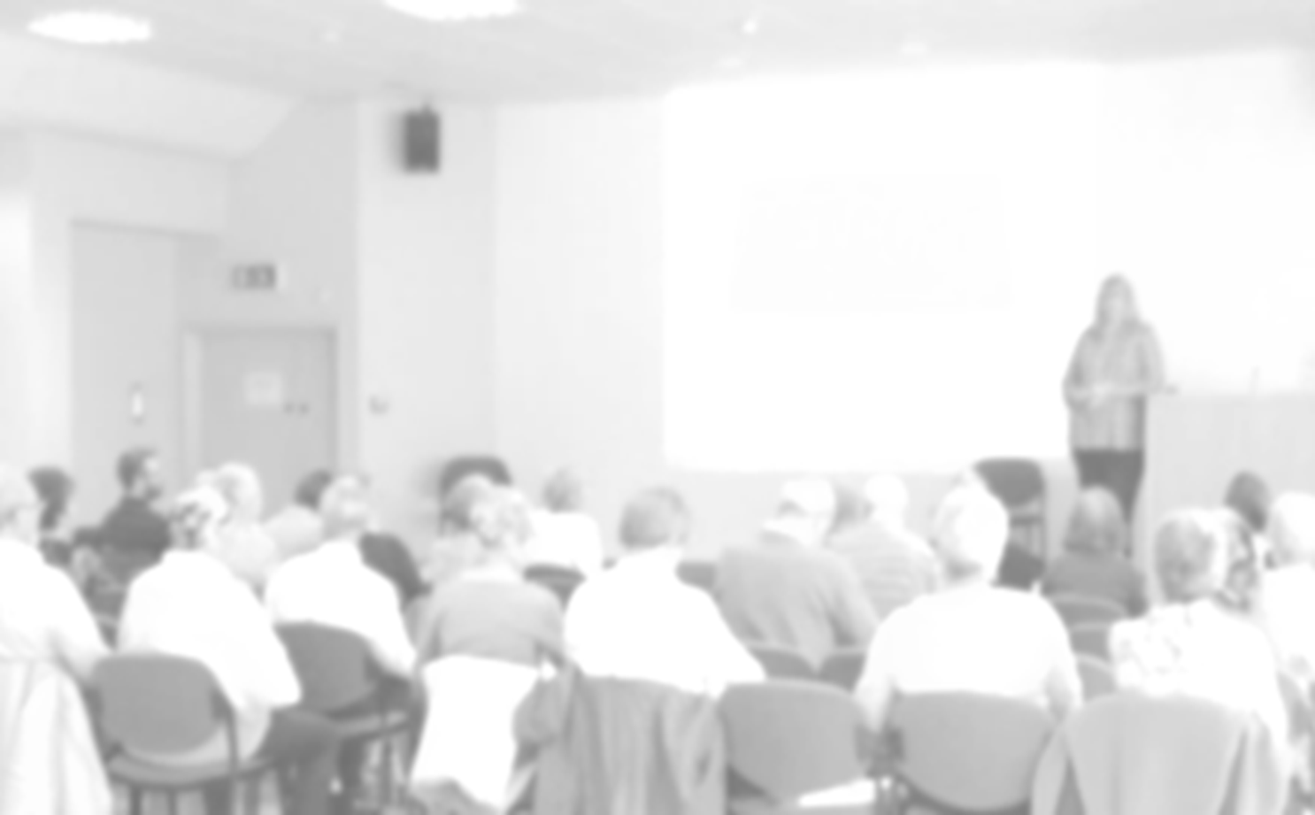
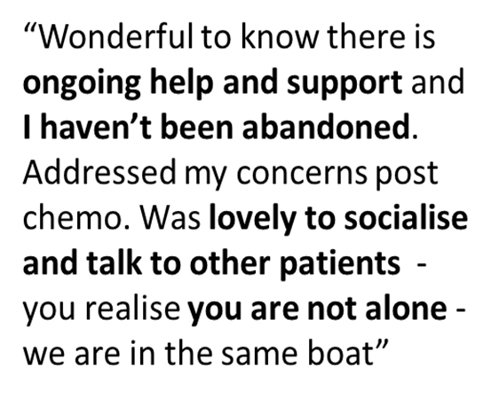

Slide 11
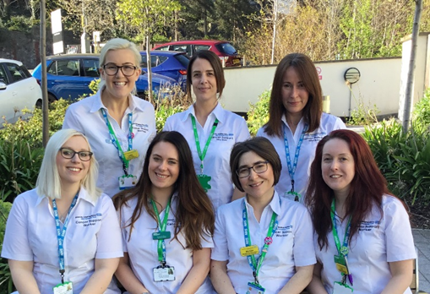
Cancer Support Workers
Evolving role – B4, working alongside Clinical Nurse Specialist teams, trained to provide information and support to people with cancer
Clinical Nurse Specialists make electronic referrals to Cancer Support Workers
1:1 referral for support & signposting / following HNA
Recovery package:
Holistic Needs Assessments
Health and Wellbeing Events
Support CNS teams with information
packs / leaflets
Awareness / health promotion campaigns

Slide 12
Cancer Support Worker – UGI Case study
50 year old lady with 3 children, diagnosed with palliative Upper GI cancer. Palliative chemo cancelled due to further progression.
Financial / emotional and practical concerns identified:
CAB referral
Macmillan grant – £450
Nicola Corry - £320 to pay for a school trip for their 10 year old daughter
British Gas Fund - £3500 towards the cost of a new boiler.
St Monica’s - £110 per month for 6 months and £450 for stair lift fitted & 3 month rental.
Blue Badge
Regular inpatients visits – listening ear.
Liaised with CNS team about issues and concerns
Family support for husband/ daughter
Headwear – took to Cancer Information and Support Centre headwear shop
£60 from ‘Friends of BHOC’ for taxis

